Slide 1

The Facility for Antiproton and Ion Research in Europe

Slide 2
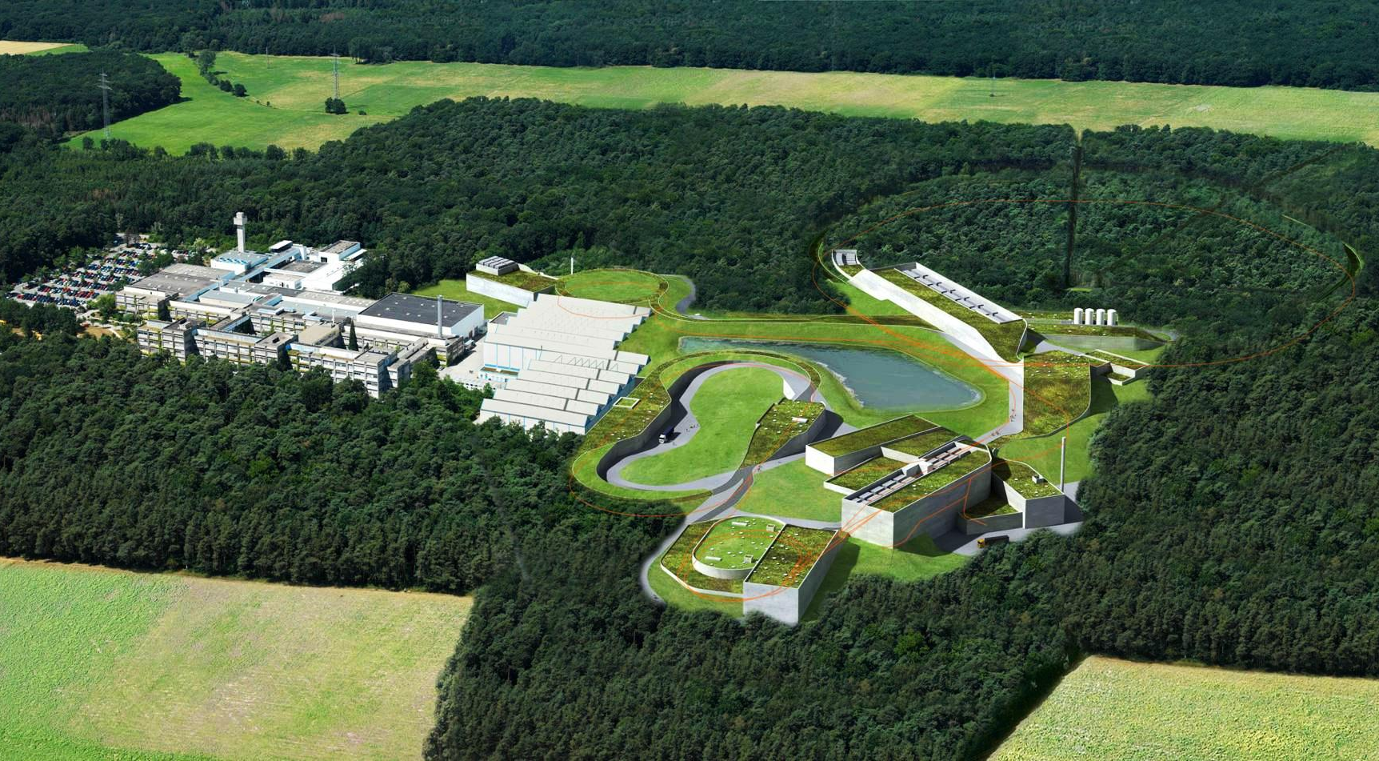
FAIR @ Darmstadt

Slide 3
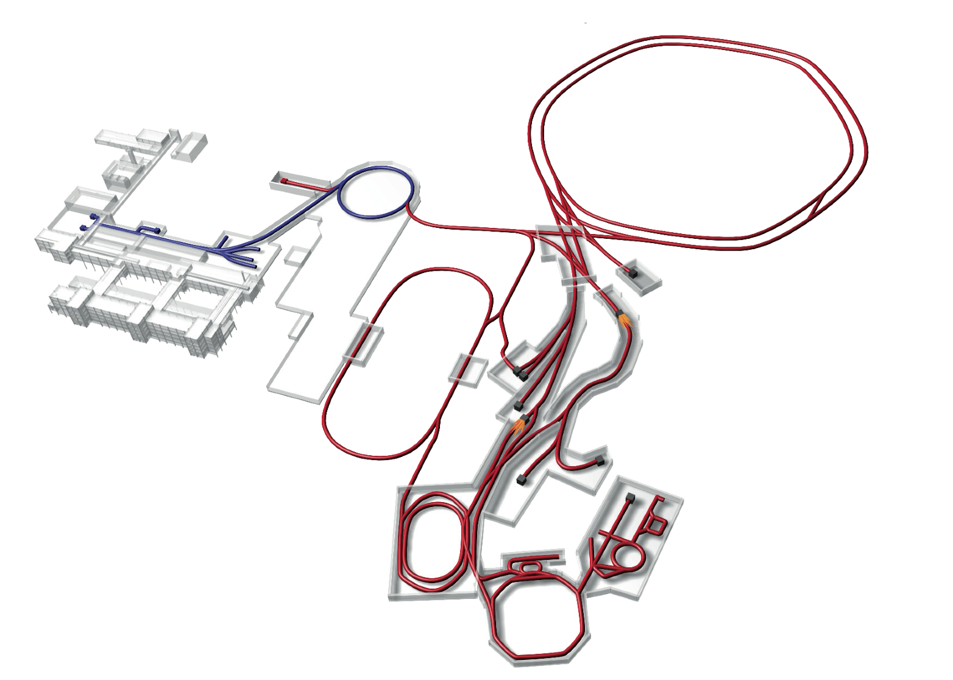
Facility for Antiproton & Ion Research
Nuclear Structure & Astrophysics
(Rare-isotope beams)
Hadron Physics
(Stored and cooled
14 GeV/c anti-protons)
p-Linac
SIS18
SIS100/300
UNILAC
QCD-Phase Diagram
(HI beams 2 to 45 GeV/u)
HESR
Rare-Isotope
Production Target
Fundamental Symmetries
& Ultra-High EM Fields
(Antiprotons & highly stripped ions)
Anti-Proton
Production Target
Dense Bulk Plasmas
(Ion-beam bunch compression
& petawatt-laser)
CR &
RESR
Cryring
Materials Science & Radiation Biology
(Ion & antiproton beams)
NESR
100 m
Accelerator Physics

Slide 4
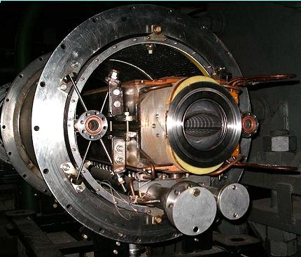
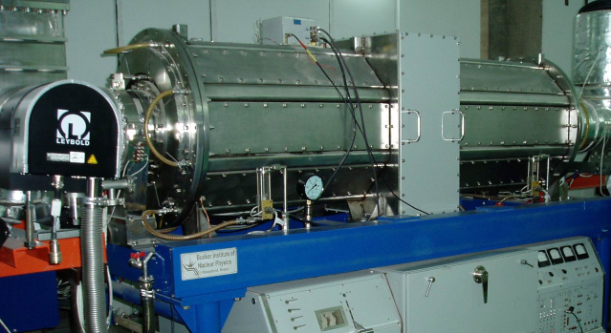
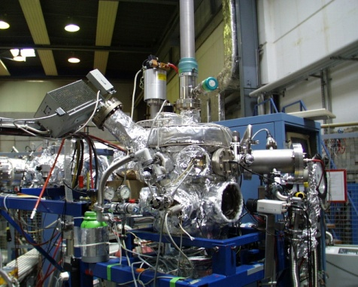
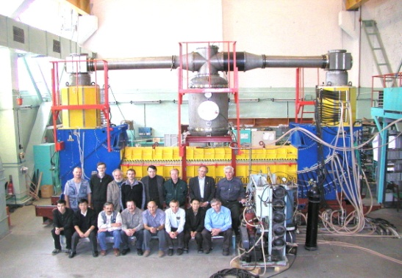
Accelerator Challenges
Compact & cost effective accelerators
Fast cycling superconducting magnets
dB/dt ~ 4T/s
Fast acceleration
High gradient, variable frequency
Ferrite & MA loaded cavities
XHV @ high beam intensities
Extremely high vacuum ~10⁻¹³ mbar
Precision beams
Electron & stochastic cooling

Slide 5
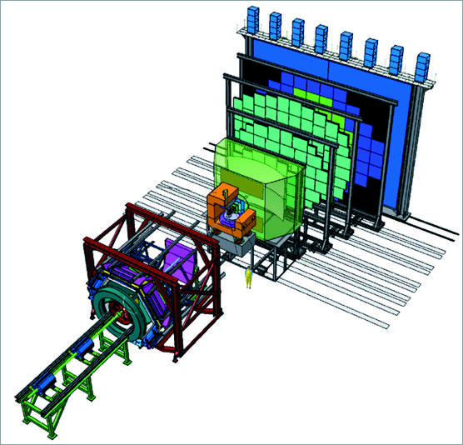
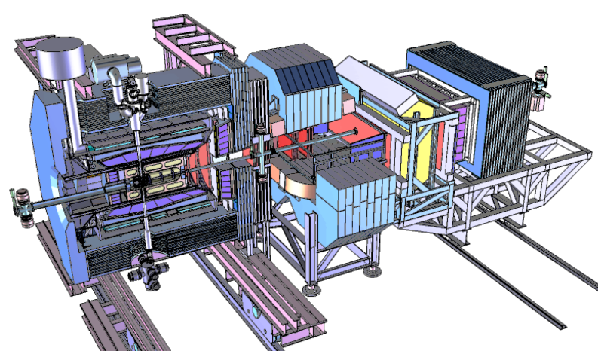
FAIR Experiments
CBM
APPA
Super-FRS
PANDA
NuSTAR

Slide 6
Brain Twister I
No free quarks observed. They are confined in pairs or triplets in strongly interacting particles (hadrons).
Proton (p)
938 MeV/c²
Neutron (n)
939 MeV/c²
π-
140 MeV/c²
u
d
u
d
u
d
u
d
Baryons
Mesons

Slide 7
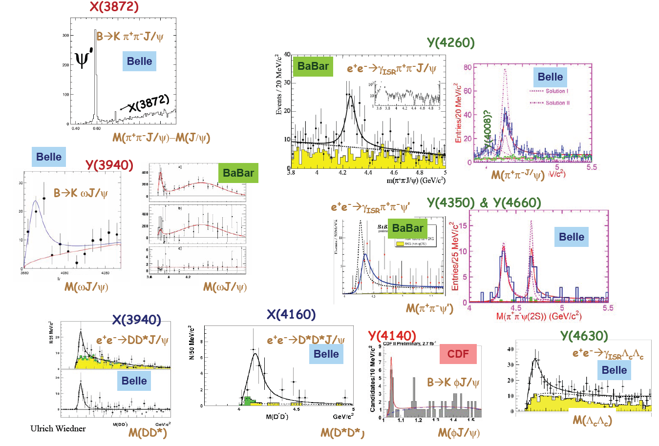
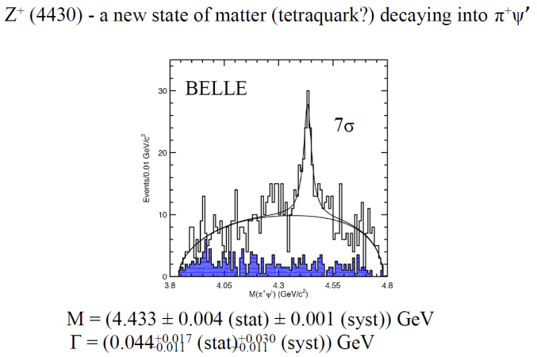
Narrow Hadronic States
PANDA @ FAIR

Slide 8
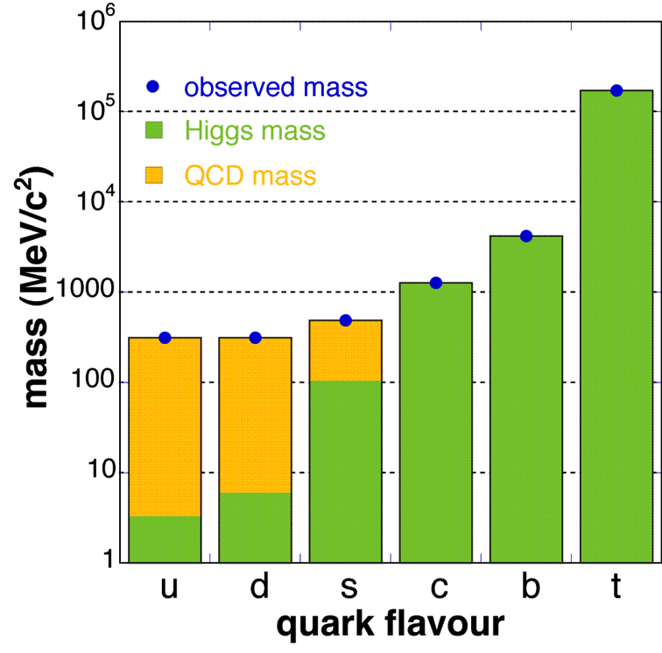
Brain Twister II
Normal (heavy) matter consists of pointlike, nearly massless quarks.
99% of the mass of the visible universe is, strictly speaking, energy!

Slide 9
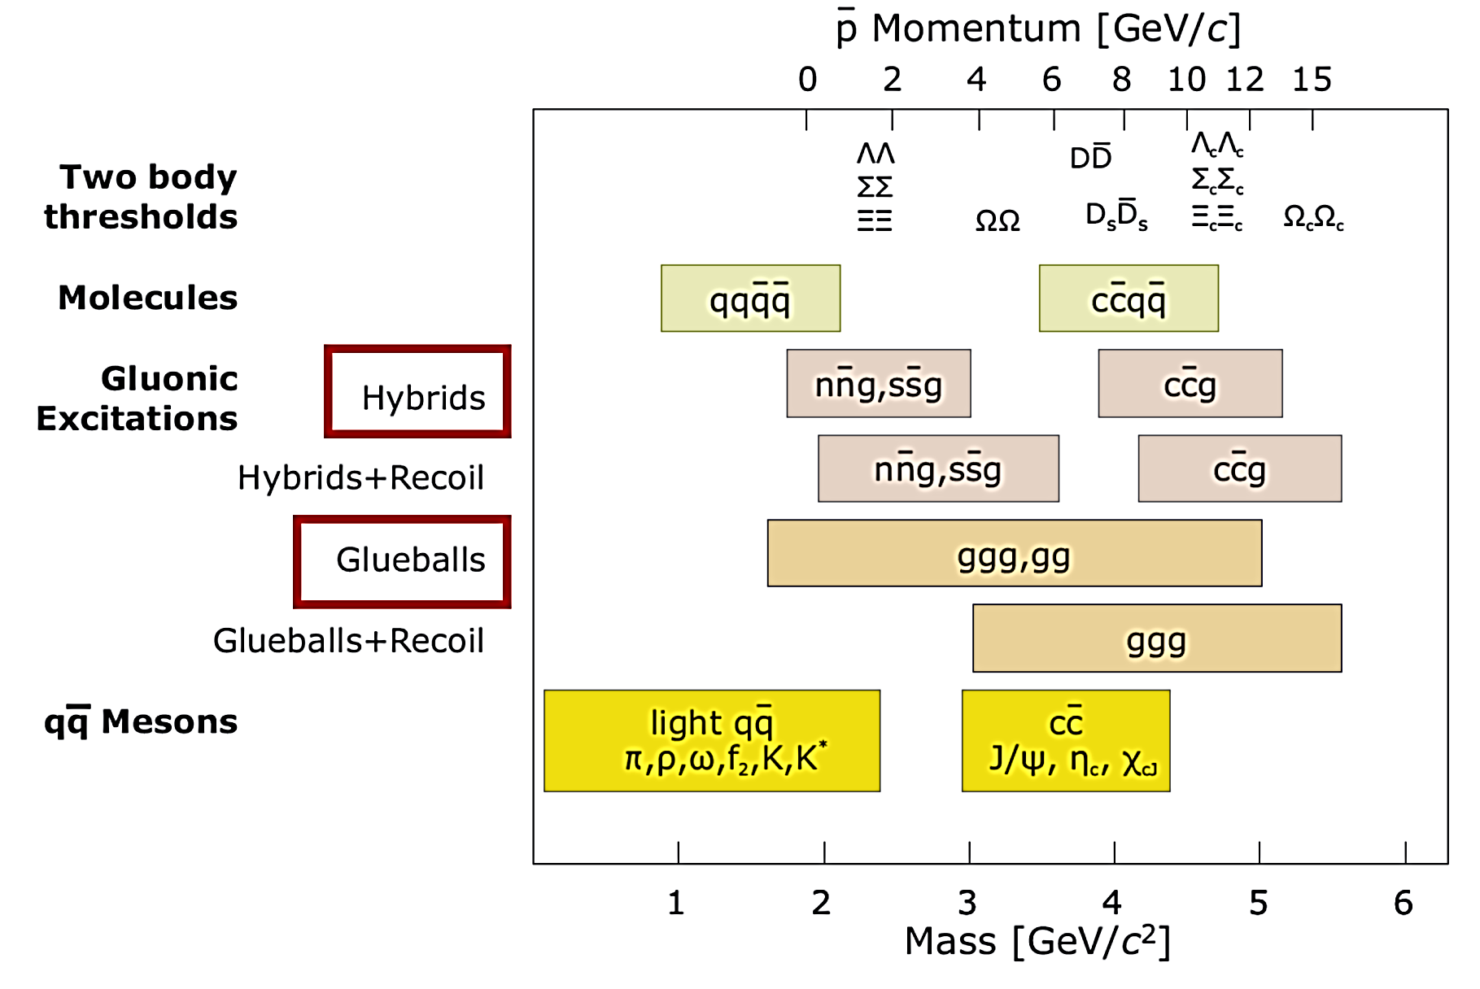
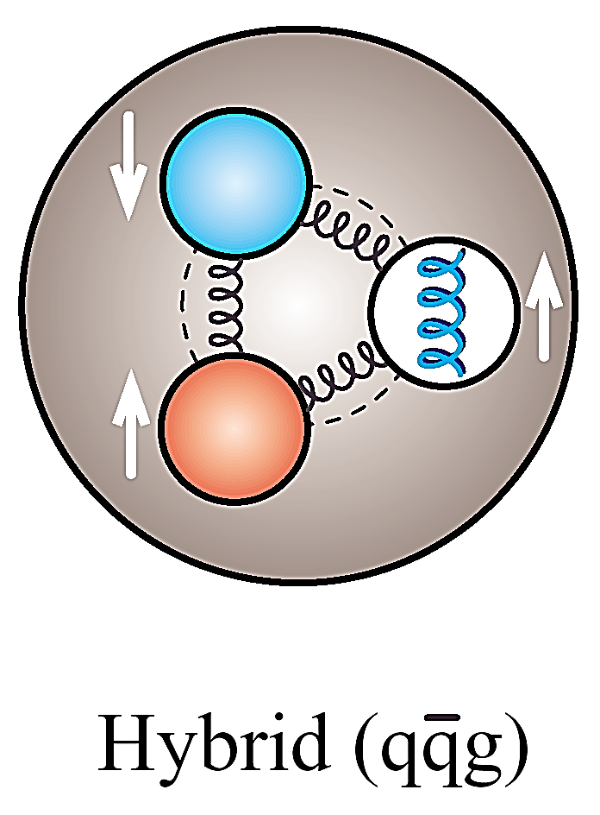
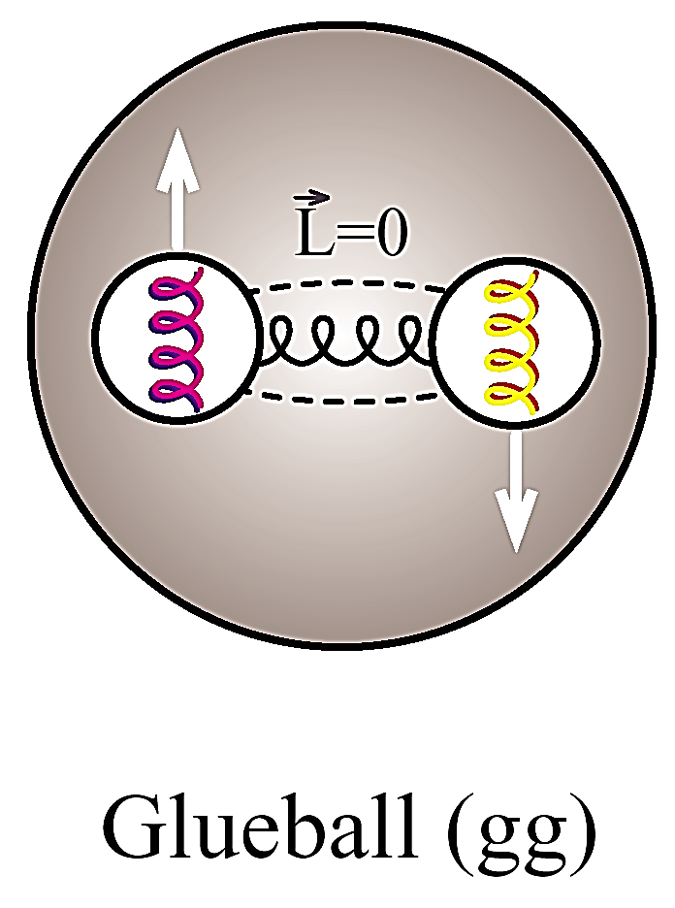
Anti-Proton Annihilation @ DA
PANDA

Slide 10
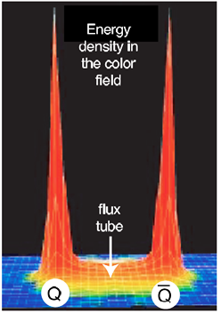
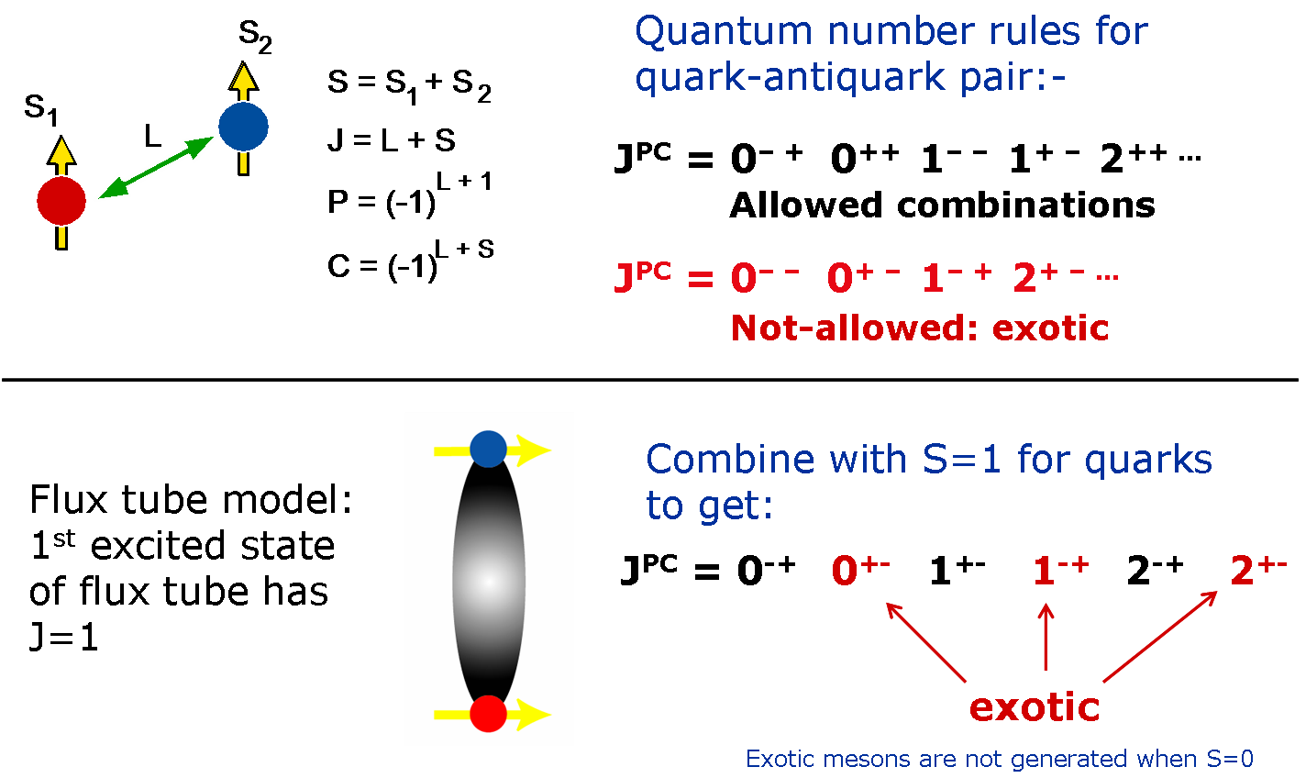
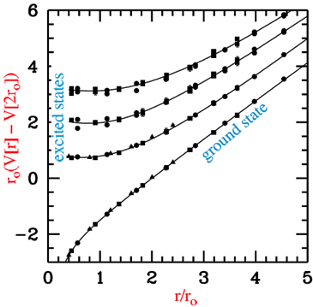
Gluonic excitations

Slide 11
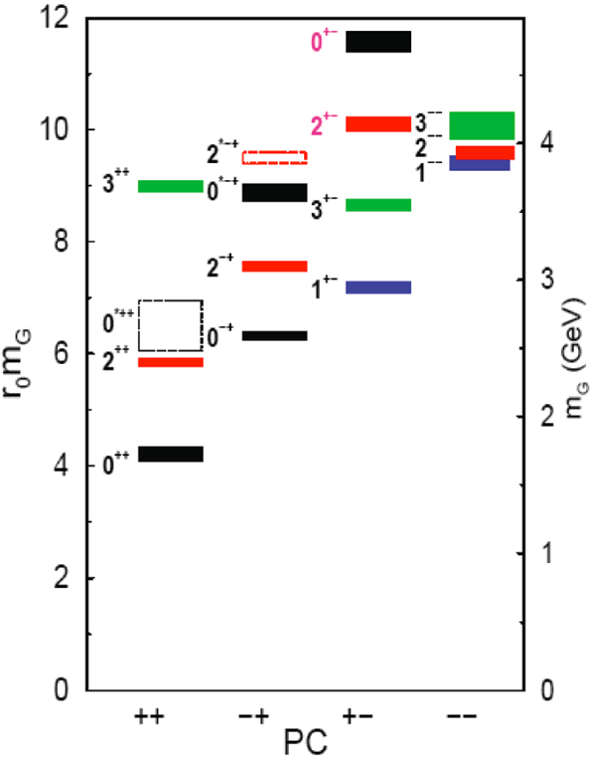
Search for Heavy Glueballs
“Charmed” glueballs
  flavour blind decays
    charmed final states!
  only a few charmed mesons around 3 - 4 MeV/c²
    less mixing!
Exotic glueballs (oddballs), no mixing!
  m(2⁺⁻) = 4140(50)(200) MeV
  m(0⁺⁻) = 4740(70)(230) MeV
  decay modes φφ, φη, J/ψη, J/ψφ
  Narrow widths predicted
Morningstar & Peardon, PRD60(1999)34509
Morningstar & Peardon, PRD56(1997)4043

Slide 12
PANDA & CBM: Hadrons in Nuclei
Partial restoration of chiral symmetry in nuclear matter
  Light current quarks sensitive to quark condensate
Charmonium states
  Sensitive to gluon condensate
  Significant mass shifts expected for χ_{c}, ψ’, ψ(3770): 40, 100, 140 MeV/c² resp.
D mesons: the QCD analogue of an H-atom
  Chiral symmetry to be studied on a single light quark
  Theoretical calculations disagree in size and sign of mass shift (50 MeV/c² attractive vs. 160 MeV/c² repulsive)
Vacuum
Nuclear
medium
π⁻
π
25 MeV
π⁺
K⁺
K
100 MeV
K⁻
D
D⁻
50 MeV
D⁺
Hayaski, PLB 487 (2000) 96
Morath, Lee, Weise, priv. Comm.

Slide 13
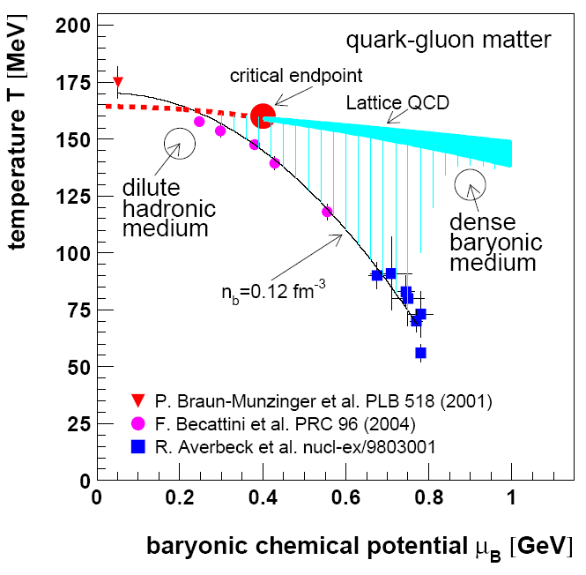
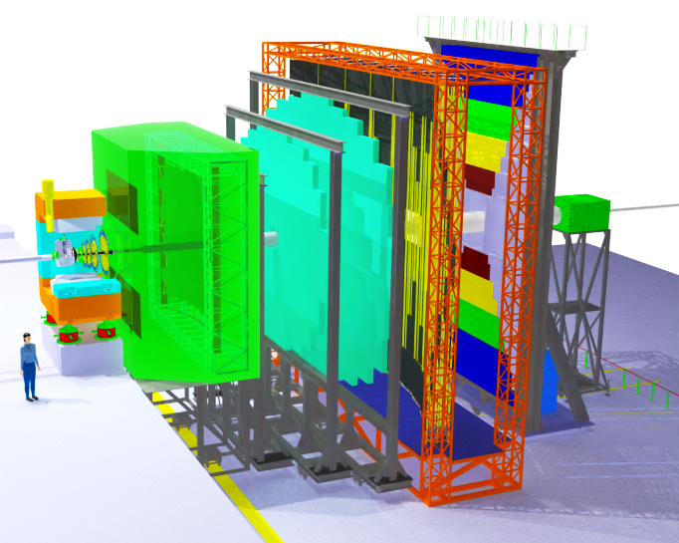
Compressed Baryonic Matter
SIS100/300
CBM @ FAIR

Slide 14
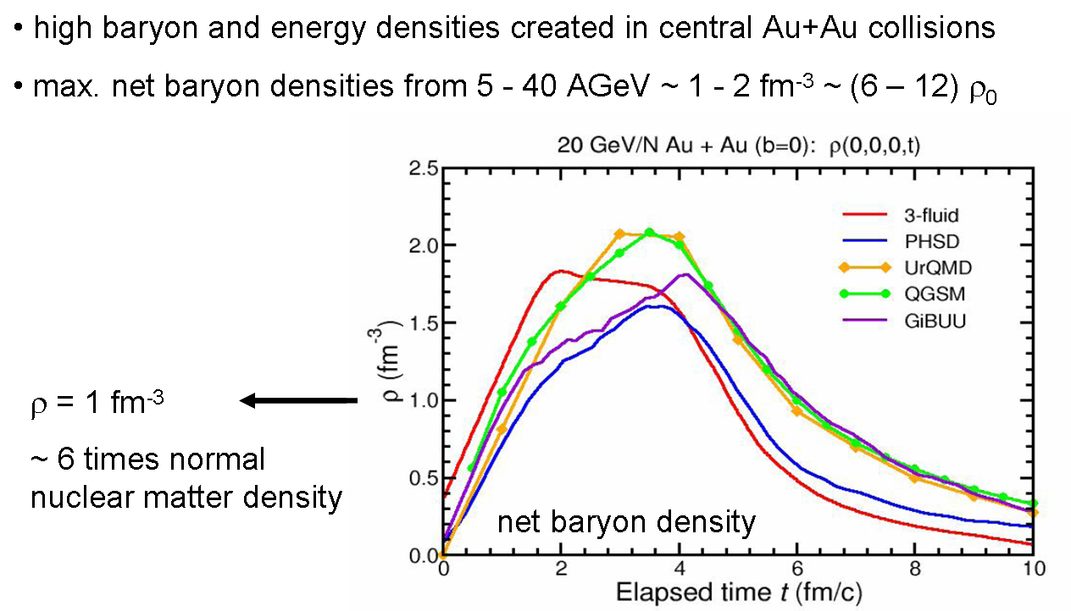
High Baryon Density @ CBM

Slide 15
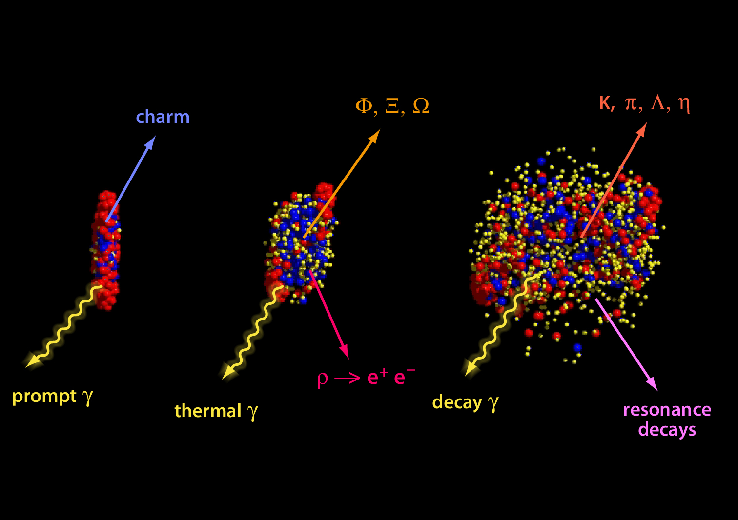
Probes of Dense Phase
No data so far → FAIR Range

Slide 16
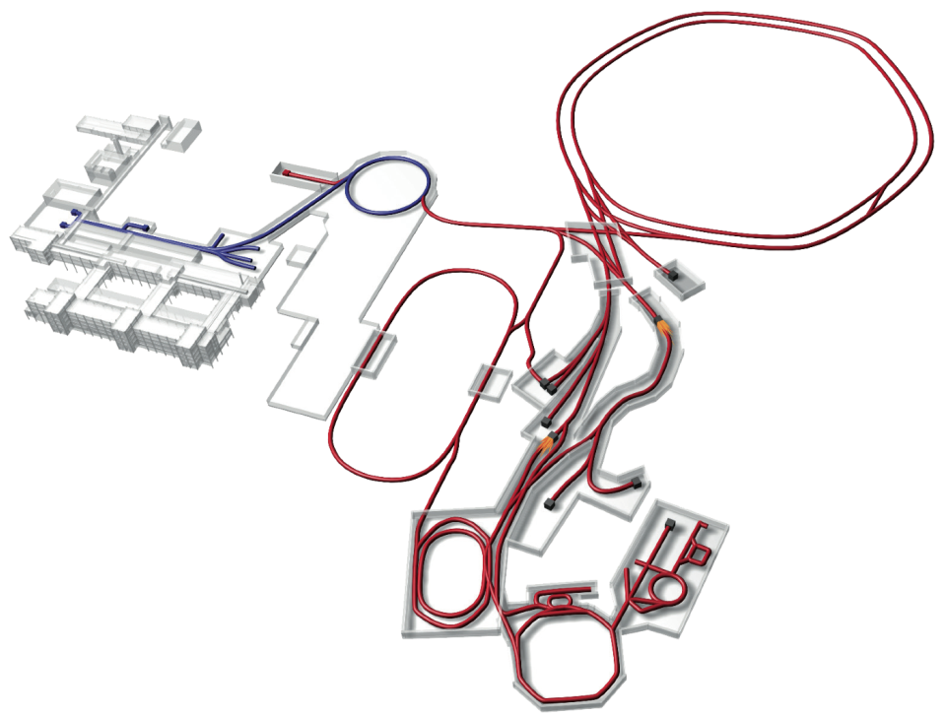
NuSTAR
Primary HI Beams:
⁴⁰Ar¹⁸⁺ 2x10¹²/s @ 1 – 2 GeV/u
²³⁸U^{28+:} 5x10¹¹/s @ 1 – 2 GeV/u
⁴⁰Ar¹⁸⁺ 2x10¹⁰/s @ 1 – 45 GeV/u
²³⁸U^{92+:} 1x10¹⁰/s @ 1 – 35 GeV/u
100 x 1000 times current intensity
Super-FRS
NuSTAR
Secondary Beams:
Broad range of radioactive ion beams ≤ 2 GeV/u
RI- Intensities up to 10 000 over present

Slide 17
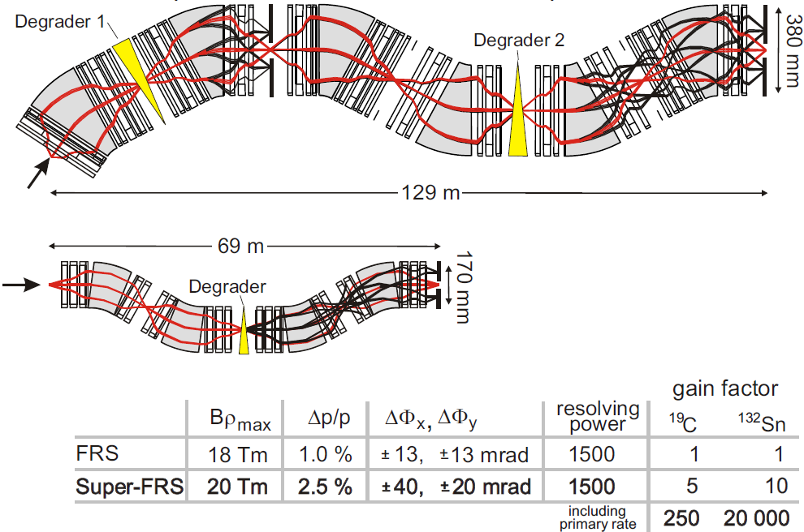
GSI FRS → FAIR Super-FRS
Super-FRS
FRS
1000 7500

Slide 18
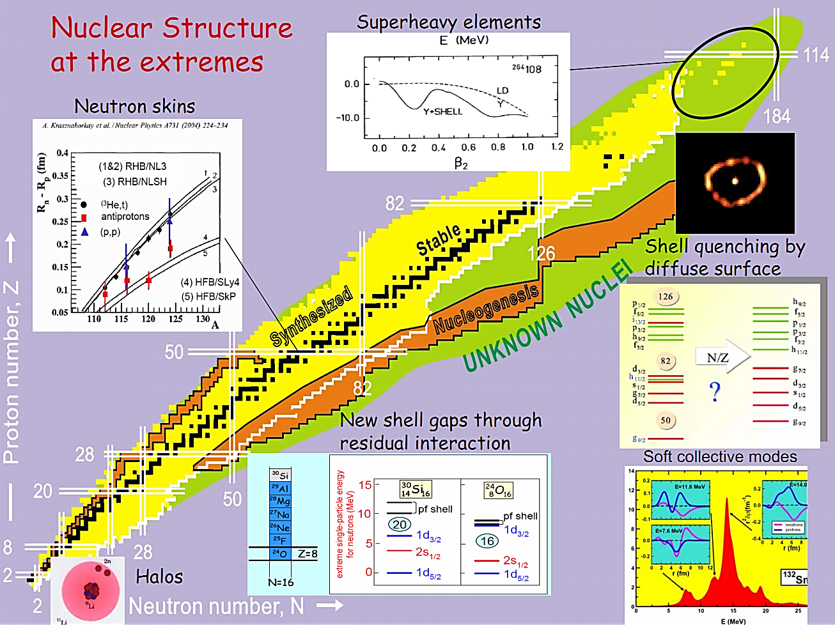
NuSTAR

Slide 19
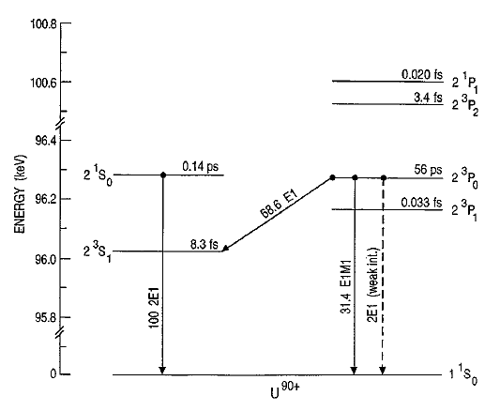
APPA: Parity-Violation
Energy levels of He-like uranium
γ
e
e
N
N
2E1 (PNC)
Ζ
e
e
N
N
Mixing coefficient for states with opposite parities:
To “compete” with spontaneous decay channels one needs to induce a two-photon PNC transition by polarised light with intensity 10²⁰ W/cm²
Select case
with small splitting!
Notes:
19

Slide 20
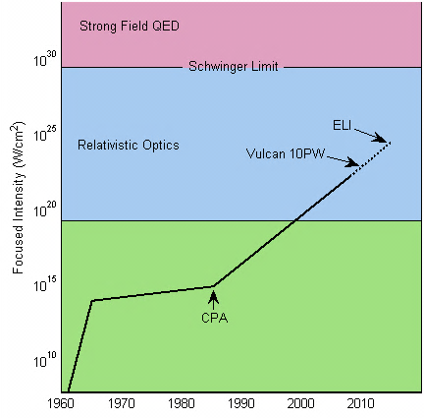
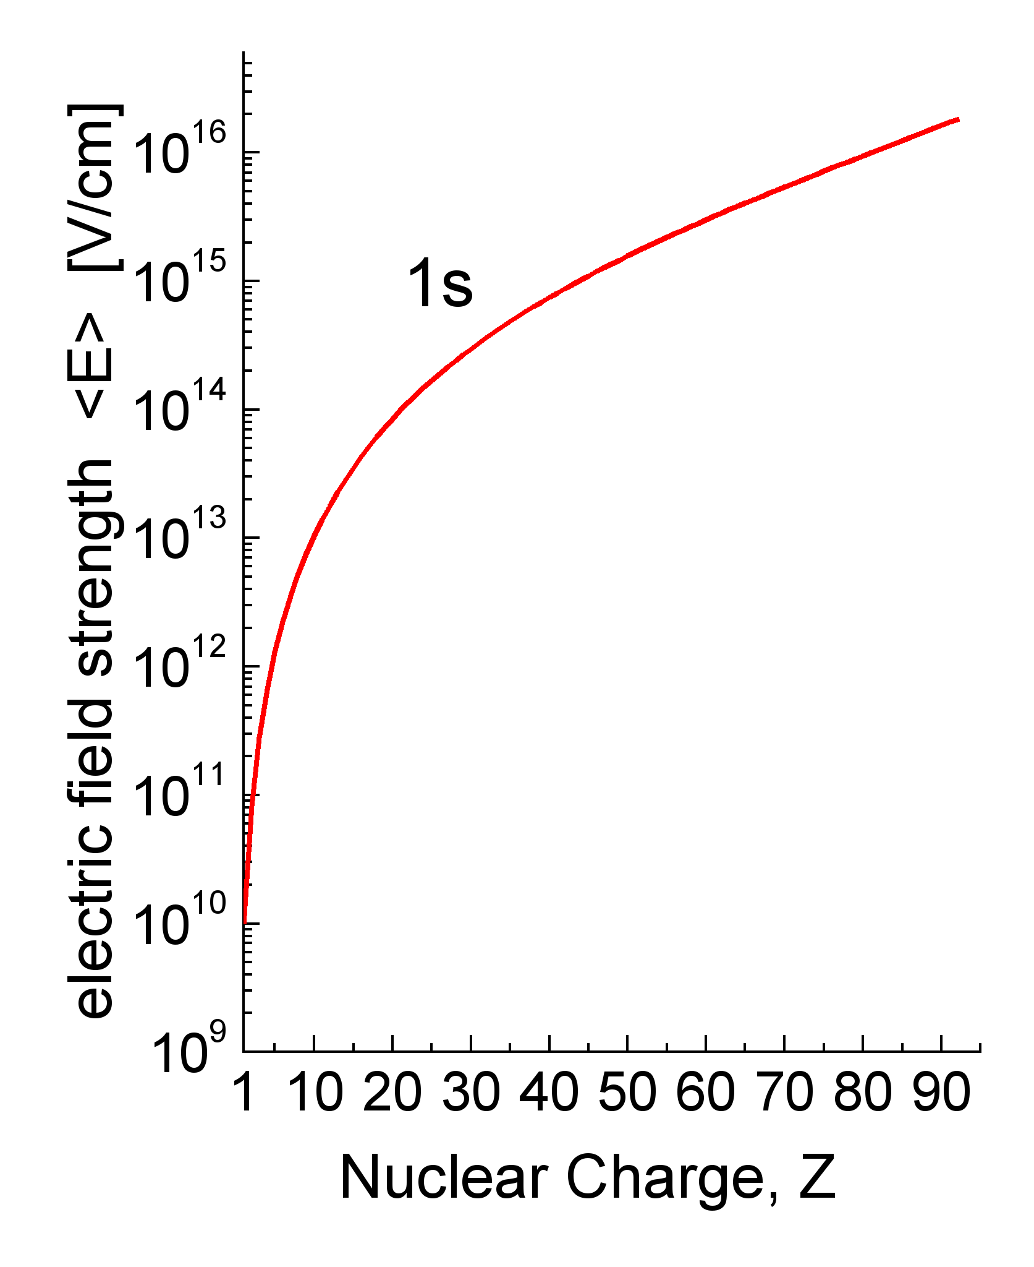
Large EM Fields
Lasers
Heavy ions
Equivalent to
I ≥ 10²⁸ W/cm²
(adapted from Mourou, Tajima, Bulanov, RMP 78, 2006)
Sub-fs pulses
Large EM fields, zs pulses
Notes:
20

Slide 21
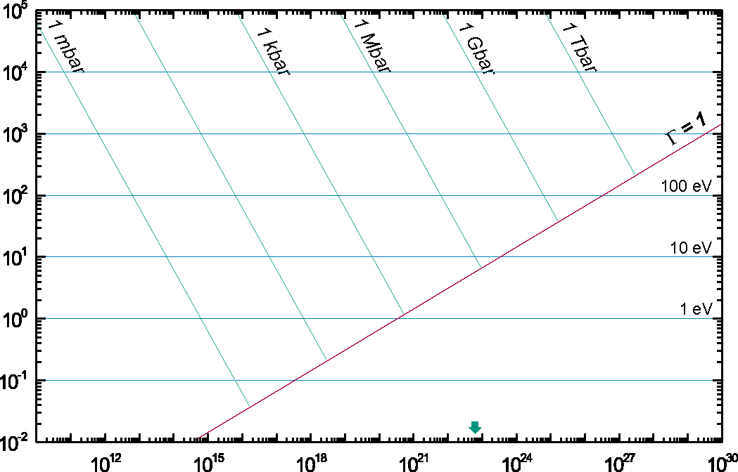
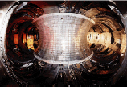
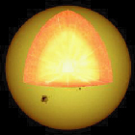
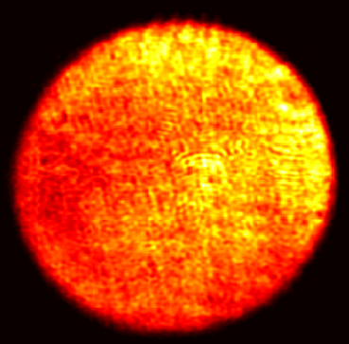
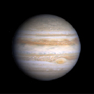
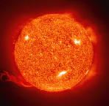
Plasmas
Magnetic Fusion
Inertial
Fusion
Energy
Temperature [eV]
XFEL
Sun Core
PHELIX
SIS
100
Laser
Heating
FLASH
Ideal plasmas
Ion Beam
Heating
Strongly coupled
plasmas
SIS 18
Jupiter
Sun Surface
solid state
density
Particles / cm⁻³
Notes:
21

Slide 22
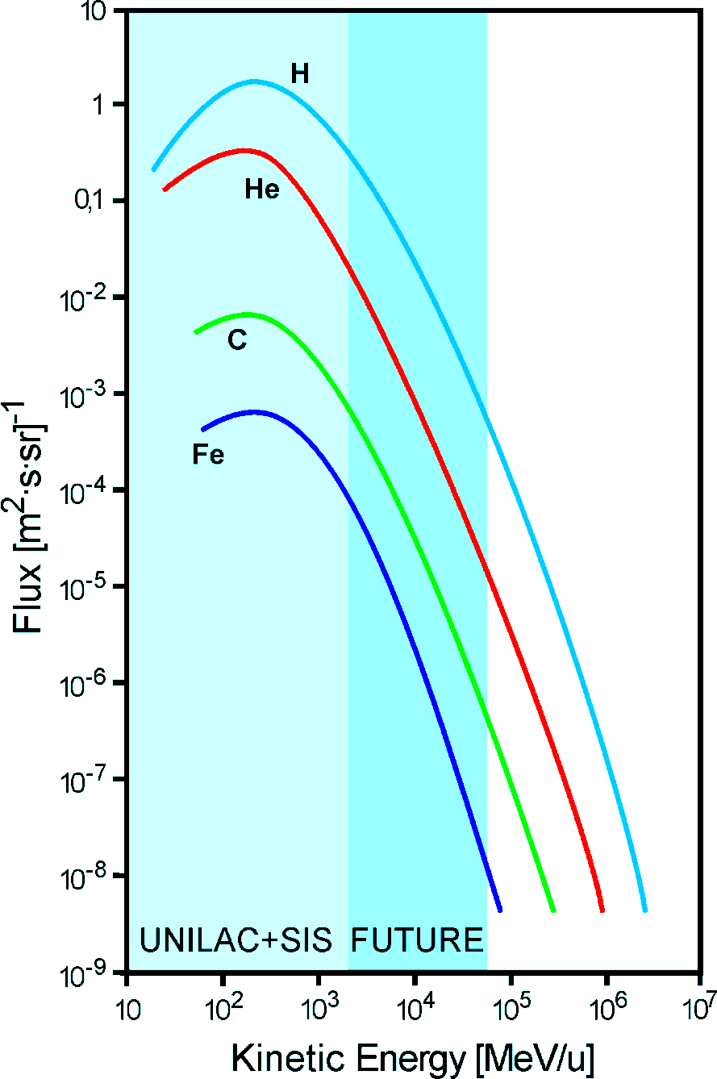
ESA @ GSI & FAIR
Durante & Cucinotta, Nature Rev. Cancer (2008)
Notes:
definition of GCR? I added the next foil which is from Dieter, I think this is easier for quickly catching the idea
Later you use 'atomic number' instead of 'charge number' ! the terms should be consistent

Slide 23
Staging
Start Version Phase A (SIS100) |  |  |  |  |  | Phase B (SIS300)
Modularised Start Version
Module 0 | Module 1 | Module 2 | Module 3 | Module 4 | Module 5
SIS100 | Exp. halls CBM & APPA | Super-FRS NuSTAR | Antiproton Facility PANDA & options NuSTAR | LEB, NESR, FLAIR NuSTAR & APPA | RESR PANDA, NuSTAR & APPA
2017/18

Slide 24
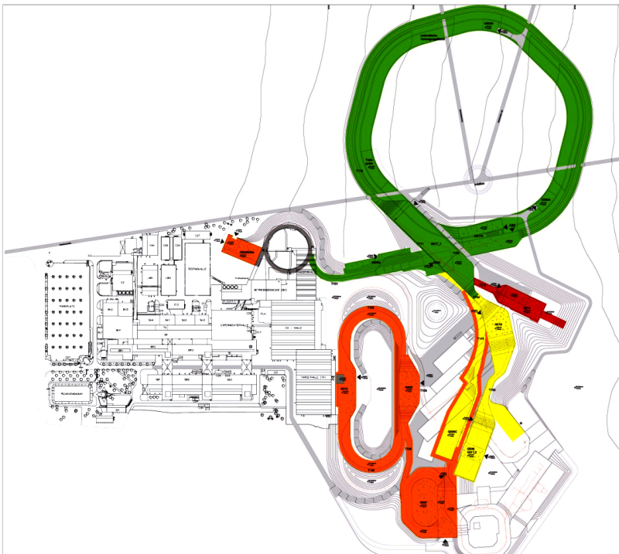
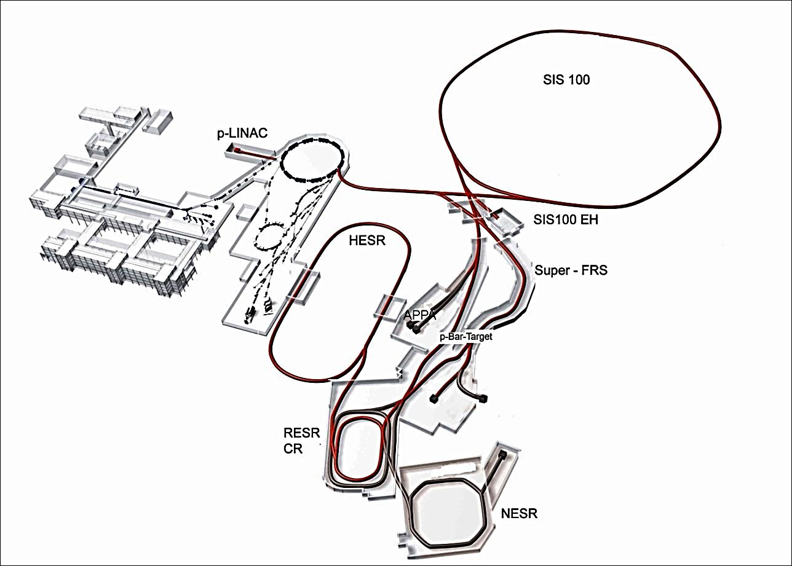
Modularised Start Version
M0
M3
M1
CBM/HADES
M3
M2
APPA
Experiments
M1: APPA
M1: CBM/HADES
M2: NuSTAR
M3: PANDA
PANDA
NuSTAR

Slide 25
Costs MSV
Accelerators and personnel (including Super-FRS) | 502 M€
Civil construction (excluding site related costs) | 400 M€
FAIR contribution to experimental end stations * | 78 M€
FAIR GmbH personnel & running until 2018 (>8 years) | 47 M€
Grand Total MSV, Modules 0 - 3 | 1027 M€
in 2005 €
(inflation escalation until 2018: ca. +50%)
* Total experimental end stations (excluding Super-FRS): ca. 210 M€ (2005) = 315 M€ (2018)

Slide 26
Funding Modules 0-3
Contracting Party | Contribution (in 2005 M€)
Finland | 5.00
France | 27.00
Germany | 705.00
India | 36.00
Poland | 23.74
Romania | 11.87
Russia | 178.05
Slovenia | 12.00
Sweden | 10.00
Total | 1.008,66
All numbers in 2005 €
(escalation until 2018 ca. +50%)
Spain expected to join soon (with 11.87 M€)
China and the UK are potential Associate FAIR Members and will contribute to the experiments (6.6 M€)

Slide 27
Timelines
2011
2012
2013
2014
2015
2016
2017
2018
2019
6
7
8
9
10
11
12
6
Submission building permits
Site preparation
Civil construction contracts
Building of accelerator & detector components
Completion of civil construction work
Installation & commissioning of accelerators and detectors
Data taking
7
8
9
10
11
12

Slide 28
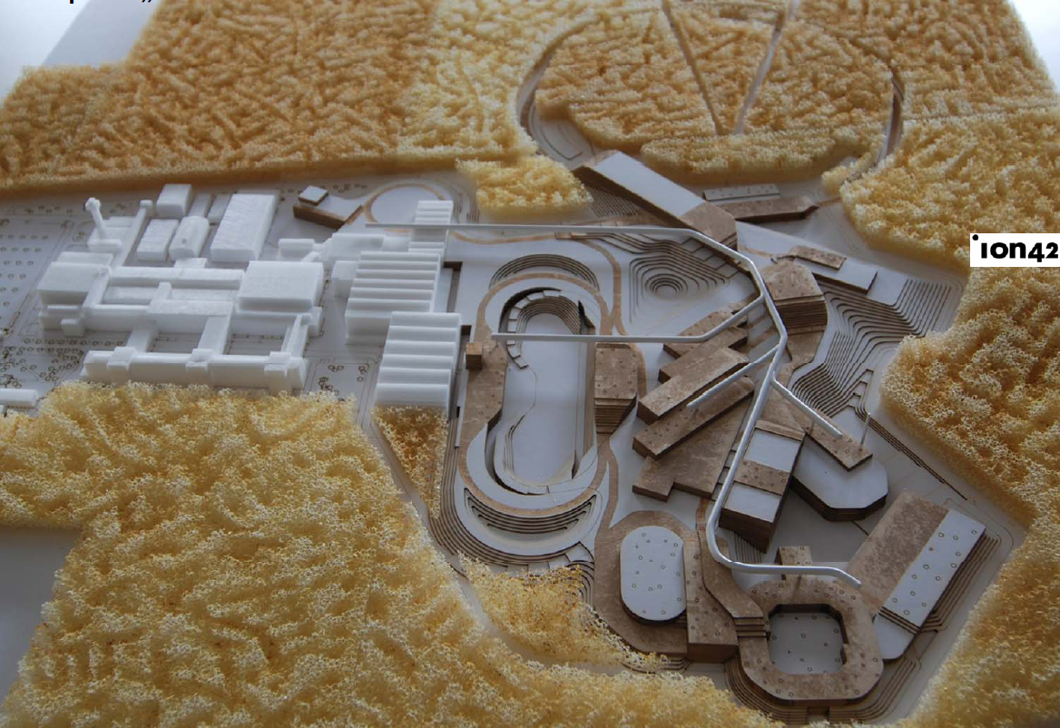
Civil Construction

Slide 29
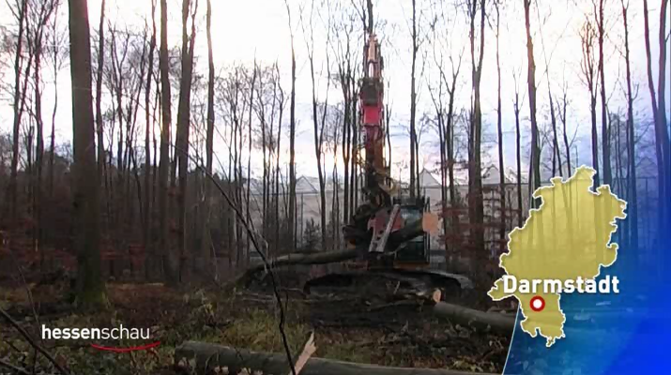
Start Clearing 6/12/2011

Slide 30
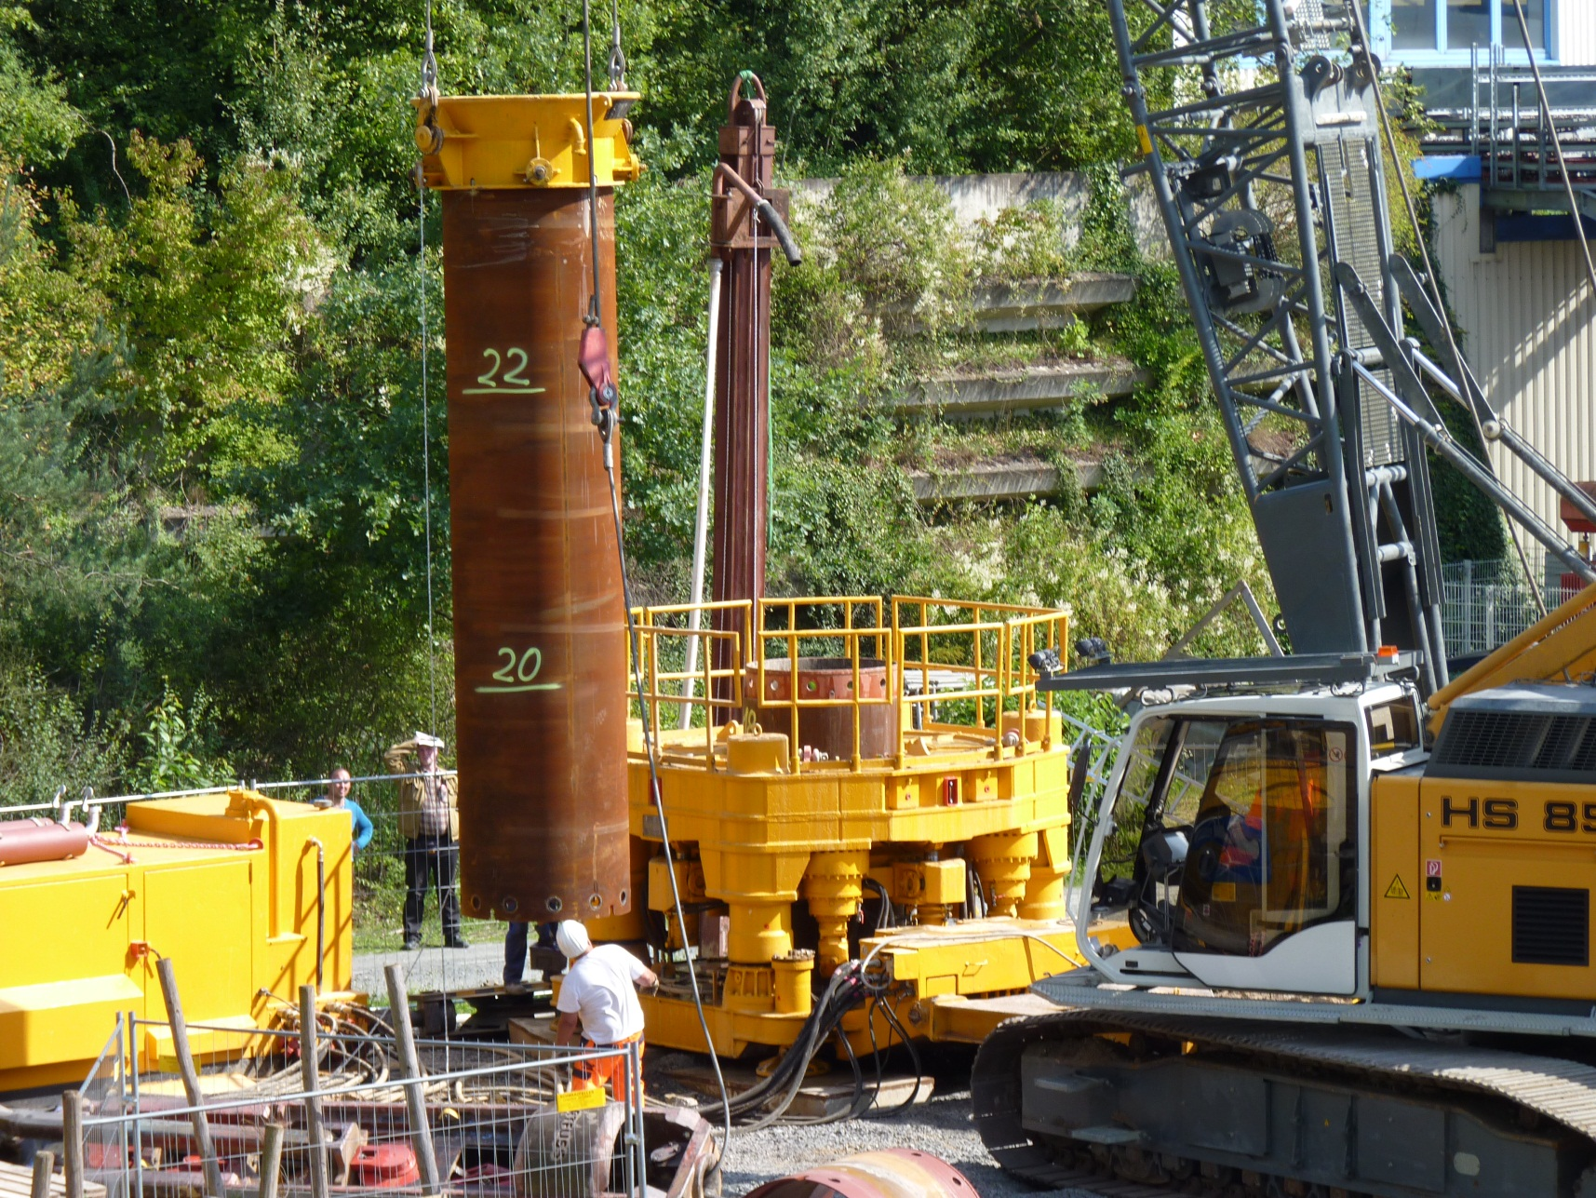
Test Drilling 31/8/2011

Slide 31
Thank you very much

