Slide 1


Recent results and future plans
for AMADEUS
11th International Workshop on Meson Production,
Properties and Interaction
Krakow, Poland
10-15 June, 2010
Johann Zmeskal,
for the AMADEUS collaboration
Stefan Meyer Institute for subatomic Physics
Vienna, Austria
MESON 2010, Krakow

Slide 2
Outline
Introduction, motivation
AMADEUS programme
KLOE data analysed by AMADEUS
AMADEUS - design studies and prototypes
Summary
MESON 2010 JZ

Slide 3
AMADEUS
Eine kleine Nachtmusik
Antikaon
Matter
At
DAΦNE:
Experiments with
Unraveling
Spectroscopy
MESON 2010 JZ

Slide 4
AMADEUS at DAΦNE 2
100 Scientists from about 25 Institutes
of 13 Countries
Letter of Indent
Study of deeply bound kaonic nuclear states
at DAΦNE2
March 2006
MESON 2010 JZ

Slide 5
Introduction
Investigations of antikaon-mediated bound nuclear
systems were done, are ongoing or planned at
several facilities - KEK, LNF, GSI, J-PARC, CERN-AD
Next-generation experiments should be exclusive,
i.e. require the measurement of formation and decay
AMADEUS @ DAΦNE2 aims to perform exclusive
measurements
- stopped K⁻ in low-density gas targets
- unique features available at DAΦNE2
- measurement of all decay particles, charged and
neutral, using the KLOE detector
MESON 2010 JZ

Slide 6
Motivation
→ proof or disproof the existence of
antikaon-mediated bound nuclear systems
Study of the antikaon - nucleon/nucleus dynamic at low
energy
  information on the modification of the kaon mass
and on N interaction in a nuclear medium,
  study of the restoration of chiral symmetry
    hadron mass problem
Λ(1405)
low-energy antikaon scattering
MESON 2010 JZ

Slide 7
AMADEUS programme
search and study of the
kaonic dibaryon states: ppK⁻
produced in a ³He gas target
search and study of the
kaonic 3-baryon states: ppnK⁻ and pnnK⁻
produced in a ⁴He gas target
in addition, we plan to extend these studies
systematically over a broad range of nuclear
targets, like Li, B and Be
MESON 2010 JZ

Slide 8
Amadeus programme, cont.
low-energy charged kaon cross section on p, d,
He-3 and He-4, for K⁻ momentum lower than
100 MeV/c
the K⁻ nuclear interactions in helium (poorly
known, based on one paper from 1970 …)
resonance states as Λ(1405) or Σ(1385) will be
studied and in addition their behaviour in a
nuclear medium
MESON 2010 JZ

Slide 9
Tri-baryon systems with S=-1
formation process:
K⁻ + ⁴He → ppnK⁻ + n
possible decay channels:
ppnK⁻ → Λ + d
→ Λ + p + n
→ Σ ⁻ + p + p
→ Σ ⁰ + d
→ Σ ⁰ + p + n
→ p + π⁻
n + π⁰
⁻ → n + π⁻
⁰ → Λ + γ
MESON 2010 JZ

Slide 10
Tri-baryon systems with S=-1
K⁻ + ⁴He -> n + (ppnK⁻)
Σ⁻pp
Σ⁰pn
Λpn
Λd
nπ⁻
Λγ
pπ⁻ (~64%)
pπ⁻
pπ⁻
nπ⁰ (~36%)
nπ⁰
nπ⁰
n(~500 MeV/c)
2p,n,π⁻
n(~500 MeV/c)
2p,n,γ,π⁻
1p,2n,π⁰,γ
n(~500 MeV/c)
2p,n,π⁻
1p,2n,π⁰
n(~500 MeV/c)
p,d,π⁻
n,d,π⁰
MESON 2010 JZ

Slide 11
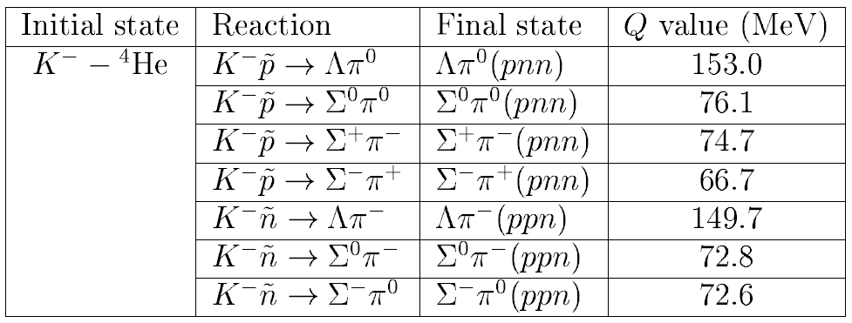
Hyperon production
K⁻N →Yπ
MESON 2010 JZ

Slide 12
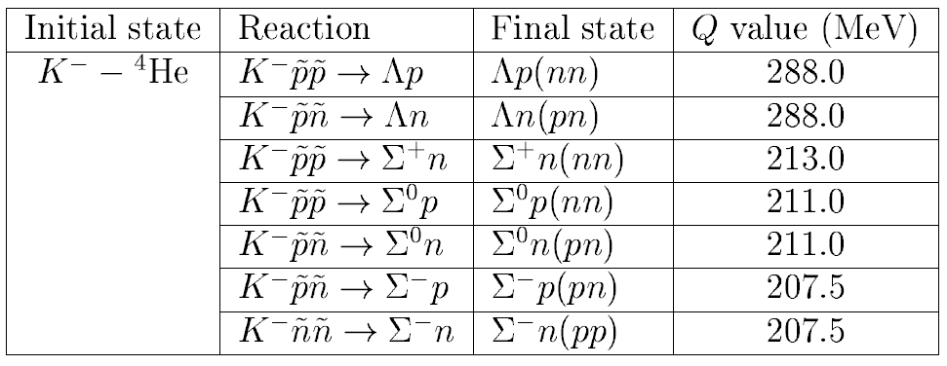
Non-mesonic absorption
K⁻NN→ YN
MESON 2010 JZ

Slide 13
DAΦNE
electron – positron collider
collision energy tuned
to the Φ resonance
at 1.02 GeV c.m.
MESON 2010 JZ

Slide 14
DAΦNE 2 for AMADEUS
The main features of DAΦNE 2 are:
- low-momentum (127 MeV/c) charged kaons
~ 1200/s at L_{int} ≈ 10³³ cm⁻²s⁻¹
- low momentum spread ( < 0.1%)
- K-pair production in back-to-back topology
- hadronic background intrinsically low
(different for extracted beams)
MESON 2010 JZ

Slide 15
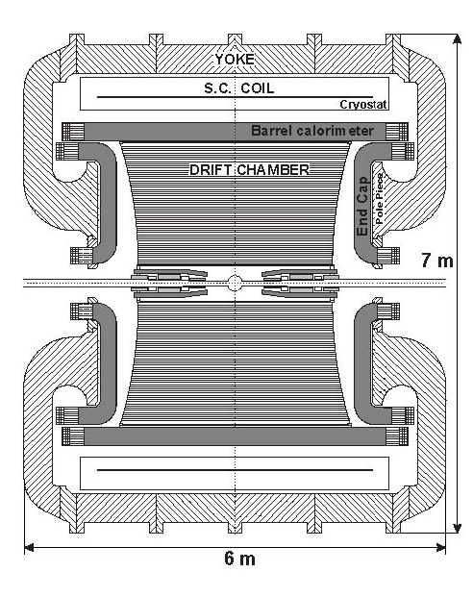
AMADEUS first results
Schematic
side view of
the KLOE detector
K⁻
e⁺
e⁻
The KLOE Drift
Chamber is mainly
filled with ⁴He
(+ 10% isobutane )
K⁺
MESON 2010 JZ

Slide 16
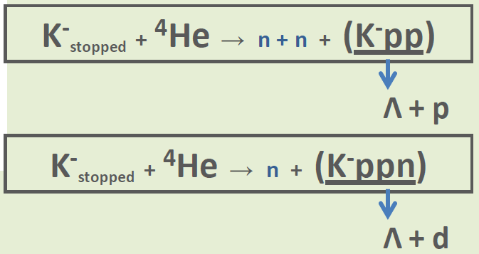
Hadronic interactions of K⁻ in KLOE
From MC simulation:
0.1 % K⁻ are stopping in the DC volume
This would lead to about hundred of possible kaonic
clusters produced in the 2 fb⁻¹ of KLOE data:
Total amount of KLOE data
analyzed, up to an integrated
luminosity of ~1,1 fb⁻¹ → Oton Vázquez Doce
MESON 2010 JZ

Slide 17
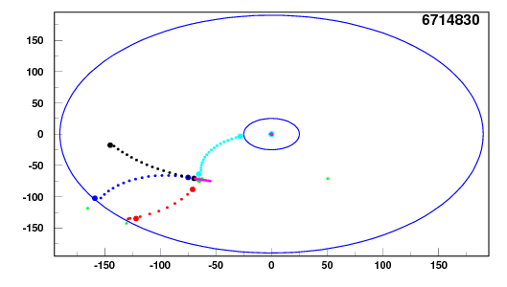
Hadronic interactions of K⁻ in KLOE
• Strategy: Search for hadronic interactions with an
Λ(1115) involved
• Λ → p + π⁻ (64% BR) vertex made by KLOE
reconstruction routine
• Construct a vertex with Λ + an extra particle
Topology of analysed events:
EMC
y[cm]
CDC
other
K⁻
pion
proton
x[cm]
MESON 2010 JZ

Slide 18
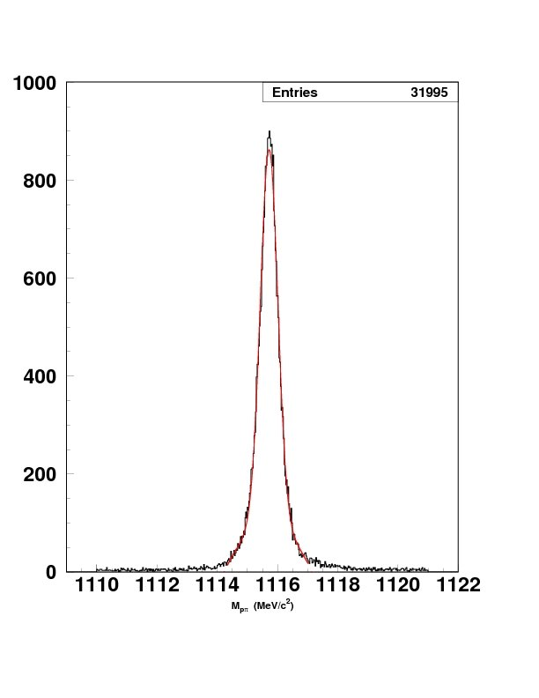
Λ reconstruction
σ = 0. 289 ± 0.003 MeV/c²
Λ → p + π⁻
dedicated event selection to avoid
eloss in the DC wall
(1.1 fb⁻¹)
KLOE:
M_{inv} = 1115,723 ± 0. 003 stat (MeV/c²)
PDG: M_{Λ} = 1115,683 ± 0.006 stat ± 0.006 syst (MeV/c²)
systematics dependent of momentum calibration,
evaluated by 2-body decay of K ± :
K± → μ±ν
K± → π±π⁰
M_{inv} pπ (MeV/c2)
MESON 2010 JZ

Slide 19
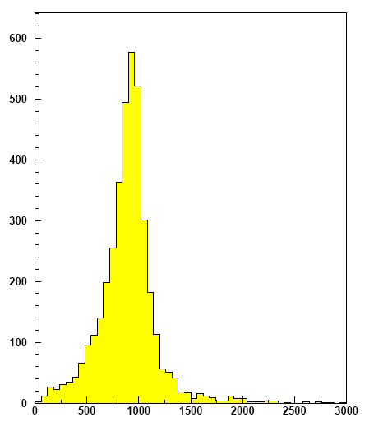
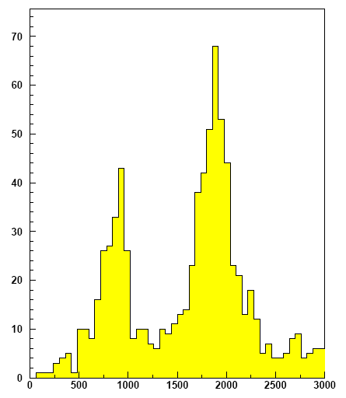
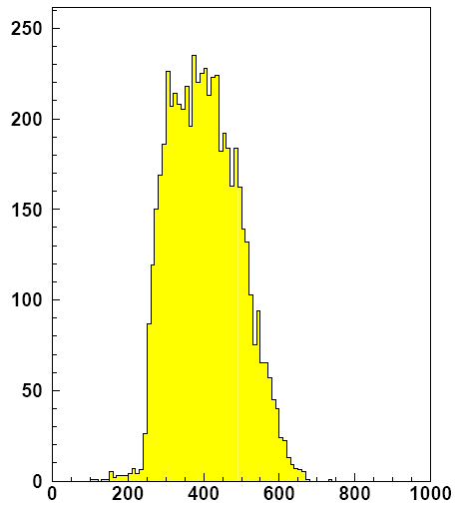
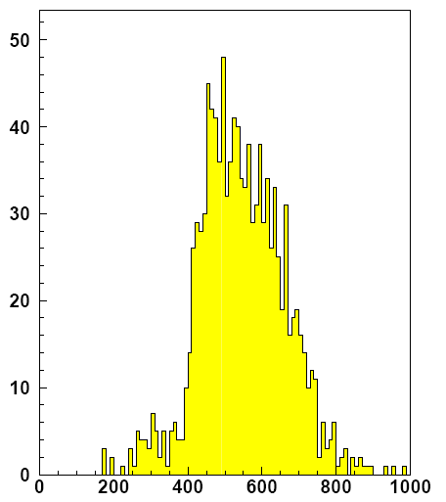
Selection of protons and deuterons
Proton/deuteron candidates are required to have an associated cluster in the EMC and its mass is measured by time of flight.
PROTONS
selected by dE/dx
DEUTERONS
selected by
dE/dx
M_{proton} (MeV/c²)
M_{deuteron} (MeV/c²)
P_{proton} (MeV/c)
P_{deuteron} (MeV/c)
MESON 2010 JZ

Slide 20
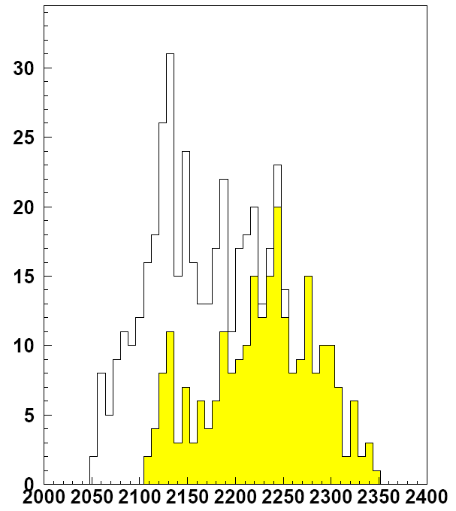
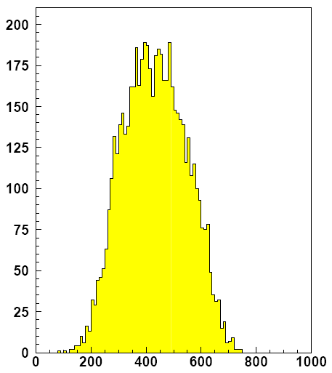
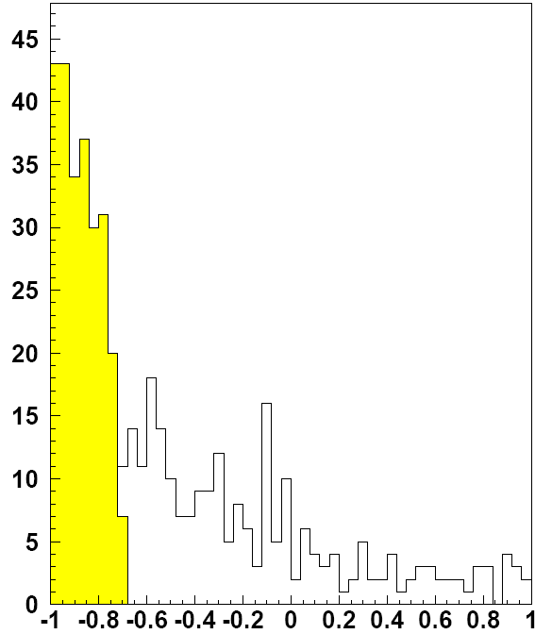
Invariant mass analysis of Λp
K⁻_{stopped} + ⁴He → n + n + (K⁻pp)
Momentum for
Lambda and proton:
total events 482
back to back 247
2M_{p}+M_{π-}
2M_{p}+M_{K}
P_{Λ} (MeV/c)
Preliminary
M_{inv} Λp (MeV/c²)
Total Yield = 0.03%
btb Yield = 0.02%
(per stopped K⁻)
cos θ (Λp)
P_{p} (MeV/c)
MESON 2010 JZ

Slide 21
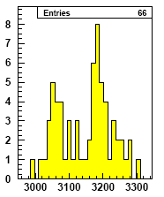
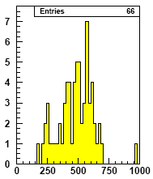
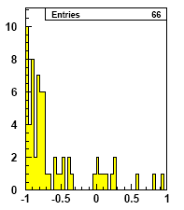
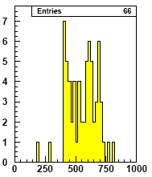
Λ - d
K⁻_{stopped} + ⁴He → n + (K⁻ppn)
Λ + d
Momentum of lambda and deuteron:
M_{d}+ M_{p}+ M_{π-}
M_{d} + M_{p}+ M_{K}
M_{inv} Λd (MeV/c²)
P_{Λ} (MeV/c)
Cos θ (Λd)
P_{d} (MeV/c)
MESON 2010 JZ

Slide 22


Neutron search
K⁻_{stopped} + ⁴He → n + (K⁻ppn)
π
p
Λ + d
d
Λ
  => Outgoing neutrons 400-600 MeV/c
KLOE has an experimentally proved capability for neutron detection (KLOnE)
p + π⁻
n
EMC
MESON 2010 JZ

Slide 23
Invariant mass of (Σπ)⁰
Search for Λ(1405)/Λ(1420)
  strongly related with the
  deeply bound kaonic
  states prediction
  lack of experimental data
π
EMC
p
γ
Λ
Σ⁰
γ
γ
π⁰
EMC
MESON 2010 JZ

Slide 24
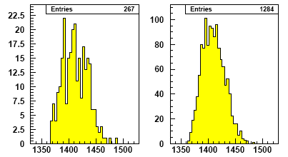
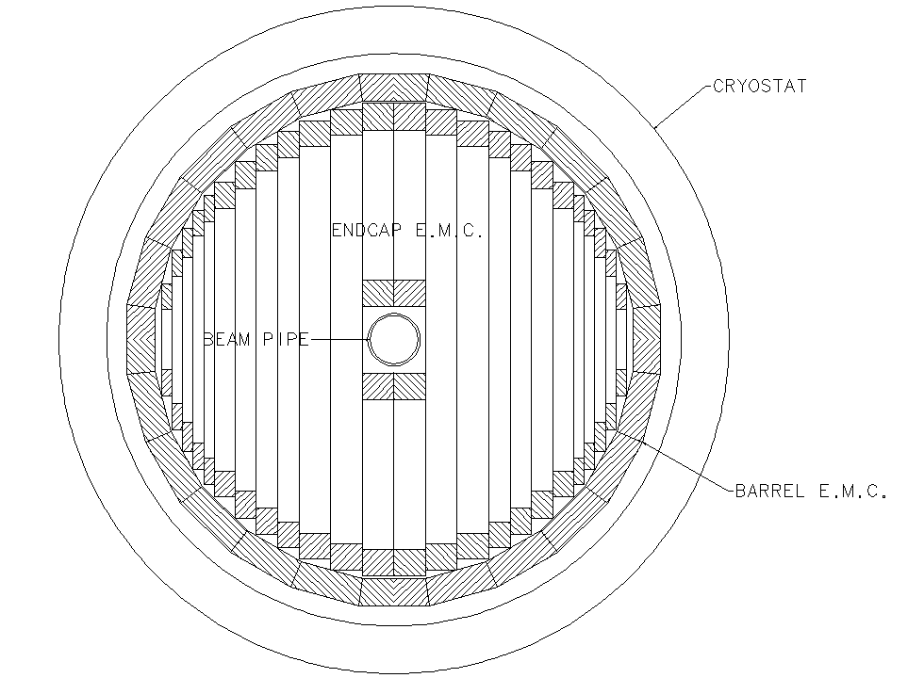
Invariant mass spectra of (Σπ)⁰
approach to Λ(1405)
Events in the
DC volume
DC wall
M_{inv}Σ⁰π⁰ (MeV/c²)
MESON 2010 JZ

Slide 25
Further analysis and future goals
Study background from Σ -> Λγ miss-identification
Increase “acceptance” by removing EMC (mass by TOF)
cut
Study Σ⁺π^{-,} Σ⁻π⁺ events
Increase the statistics to the whole 2004-2005 KLOE
data set (x2)
Analyze KLOE 2 data !!!
MESON 2010 JZ

Slide 26
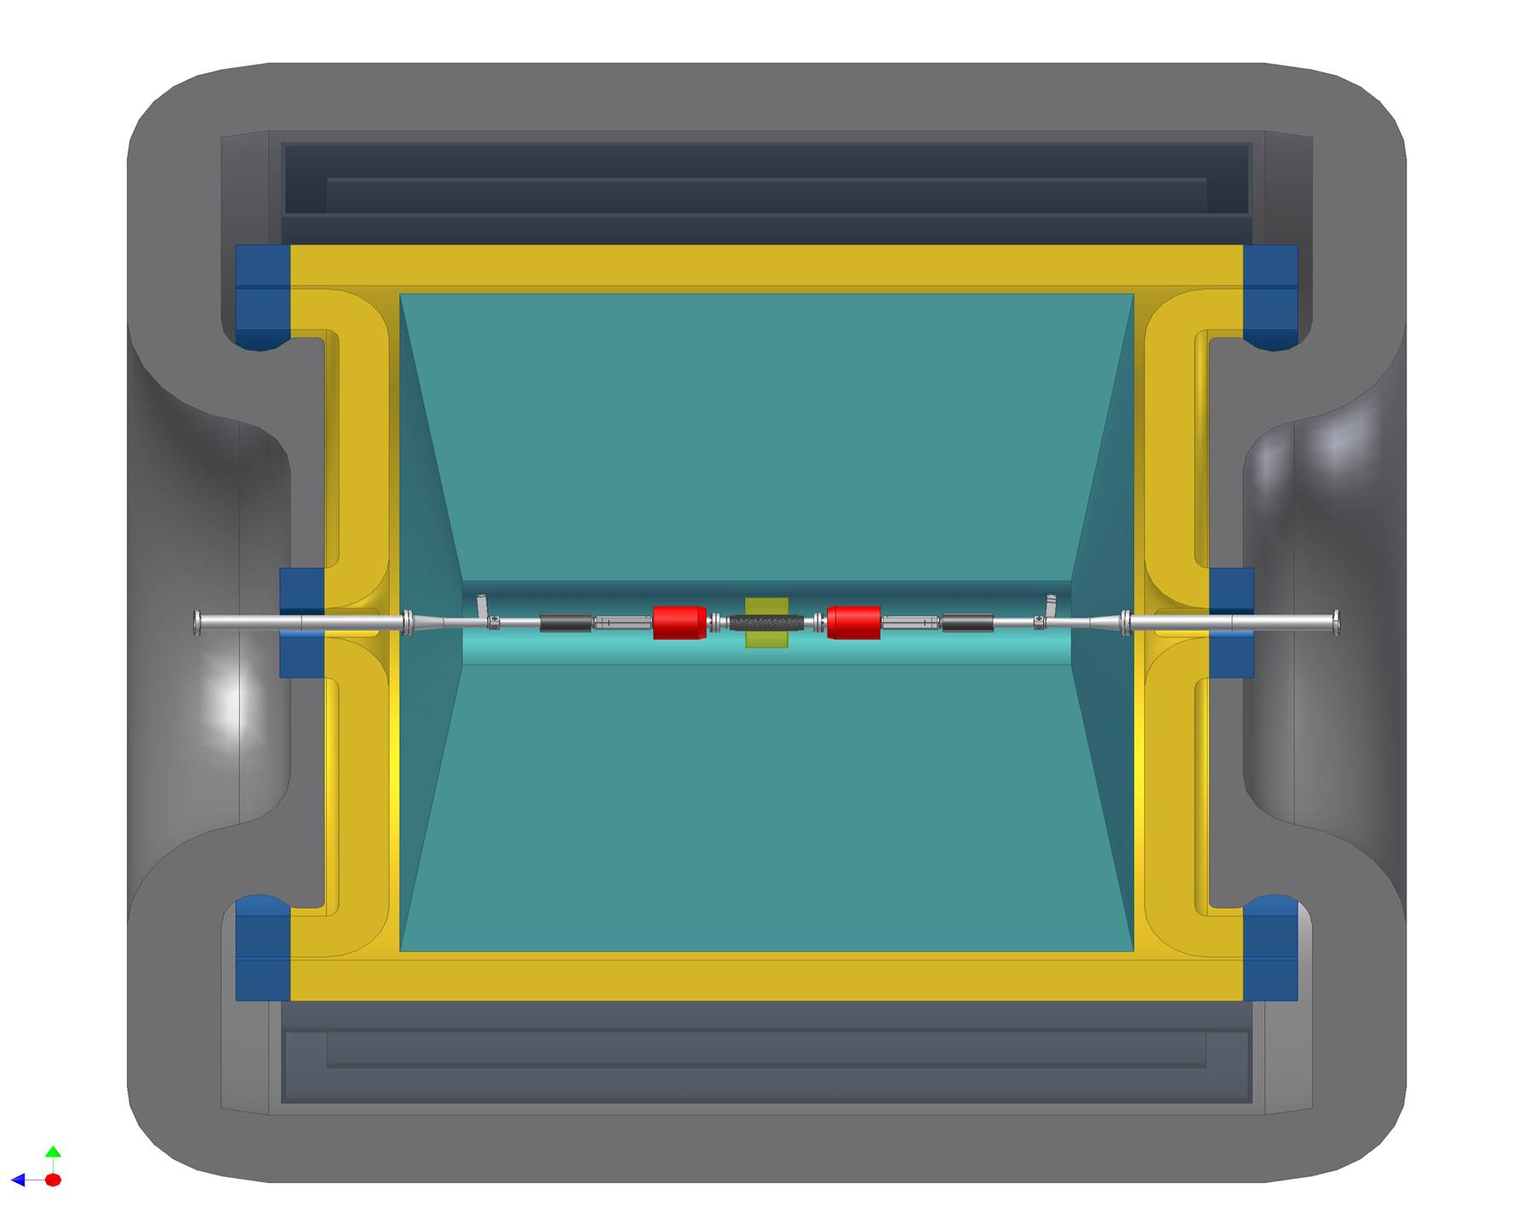
AMADEUS @ KLOE
EMC
7 m
Drift Chamber
MESON 2010 JZ

Slide 27
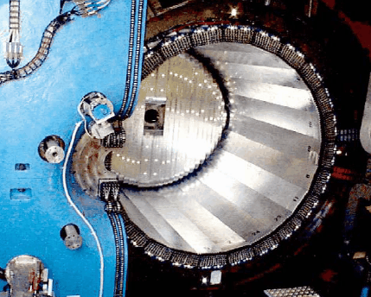
KLOE electromagnetic calorimeter
MESON 2010 JZ

Slide 28
Reconstructed K_{s} mass
K_{s} →πºπº,
with πº→γγ
Photon energy resolution
σ(E)/E = 5.7%xE(GeV)^{-1/2}
time resolution
Δt/t = 54 [ps]xE(GeV)^{-1/2}
MESON 2010 JZ

Slide 29
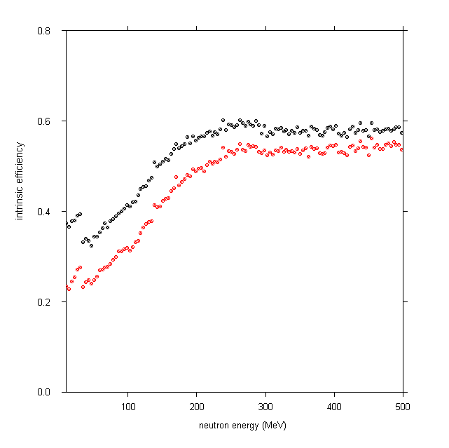
Neutron detection efficiency
MC simulation, confirmed with
measurements at TSL (Uppsala)
intrinsic efficiency
Threshold at 1 MeV
Threshold at 3 MeV
neutron energy [MeV]
MESON 2010 JZ

Slide 30
AMADEUS @ KLOE
EMC
AMADEUS setup
7 m
Drift Chamber
MESON 2010 JZ

Slide 31
AMADEUS setup I
Gas target cell:
T = 10 K
P = 1.0 bar
Rin = 5 cm
Rout = 15 cm
L = 20 cm
half-cylindrical cryogenic
target cell
1st inner-layer of
scintillating fibre
fiber size: 1x1mm²
three outer-layers
of scintillating fibre
fiber size: 1x1mm²
2nd inner-layer of
scintillating fibre
fiber size: 1x1mm²
MESON 2010 JZ

Slide 32
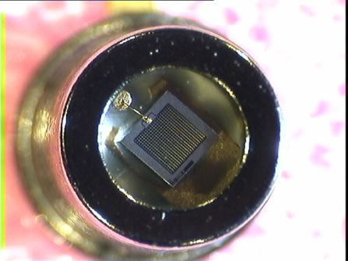
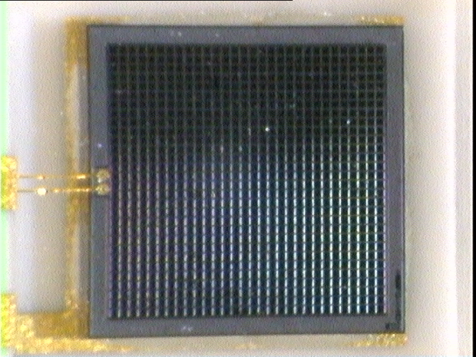
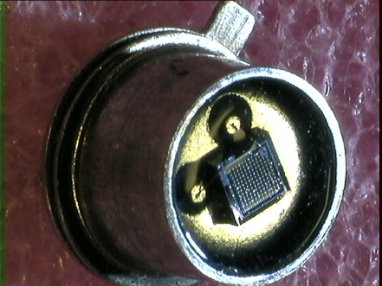
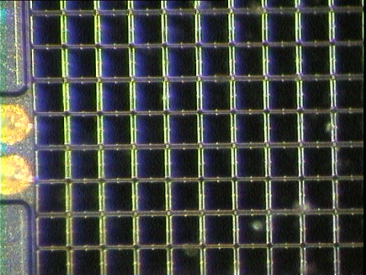
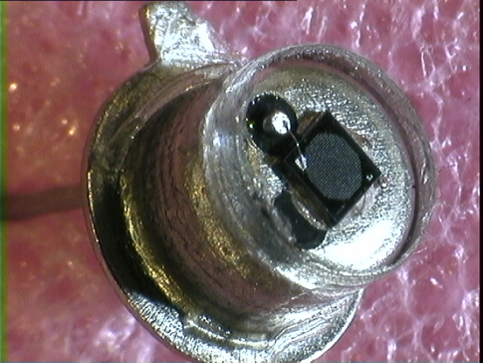
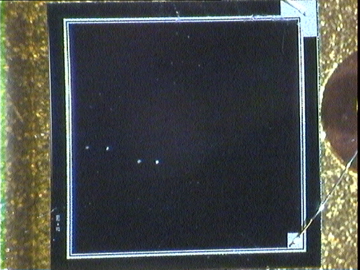
R&D: Test of different SiPMs
Various SiPMs were tested:
Hamamatsu: 1mm², 3 mm²
Photonique: 1 mm²
Dubna: 1 mm², 3 mm²
Zecotek: 1 mm², 3 mm²
Different characteristics :
Number of cells (linearity)
Fill factor
Q.E.
Noise, dark current
MESON 2010 JZ

Slide 33
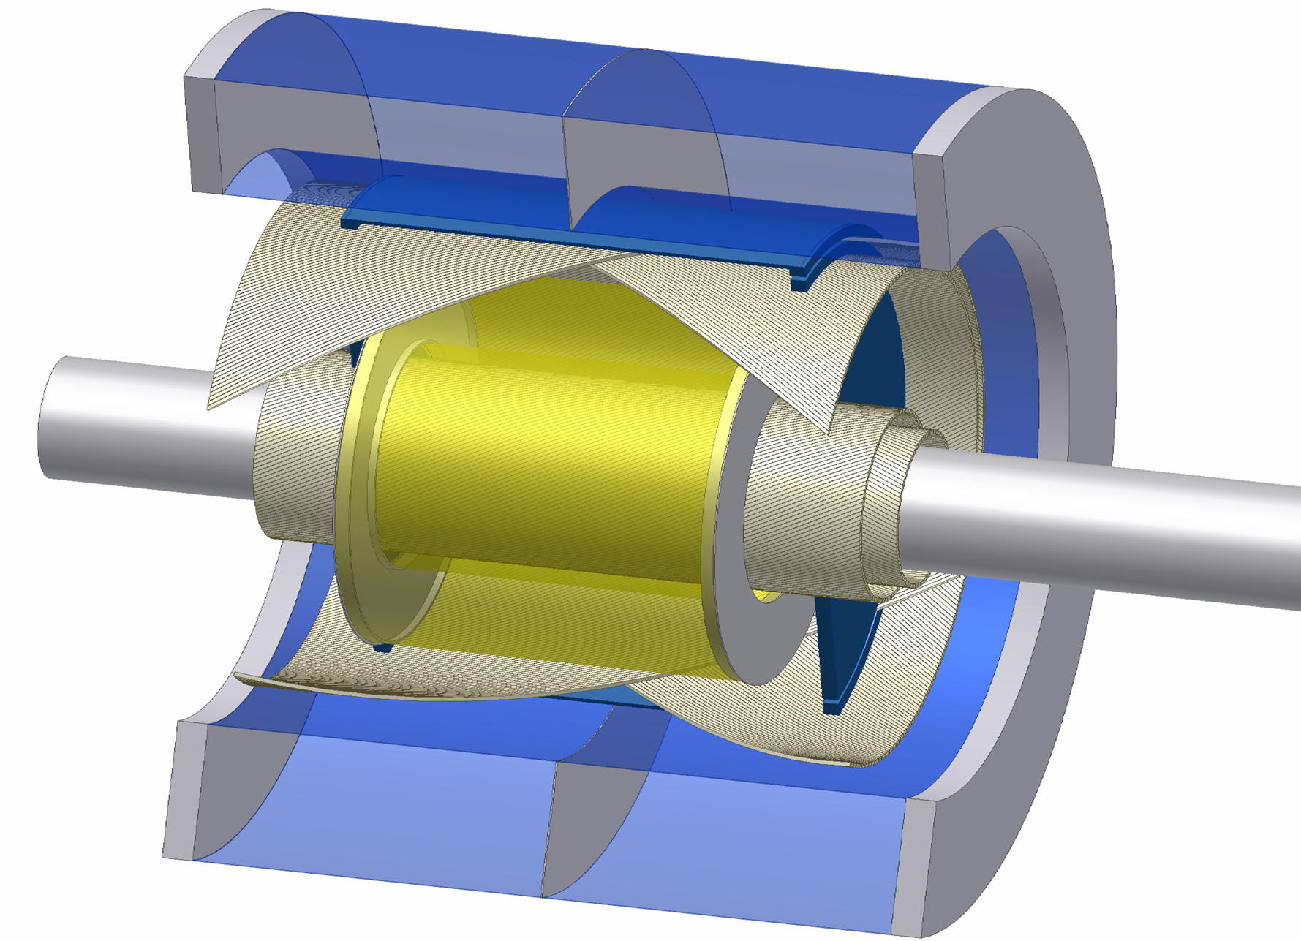
AMADEUS setup II
Tracking device:
TPC-GEM or
3-4 C-GEMs
Kaon trigger:
Scint. fibers
with SiPMs
Target system:
cylindrical
cryogenic cell
or active target
0.5 m
MESON 2010 JZ

Slide 34
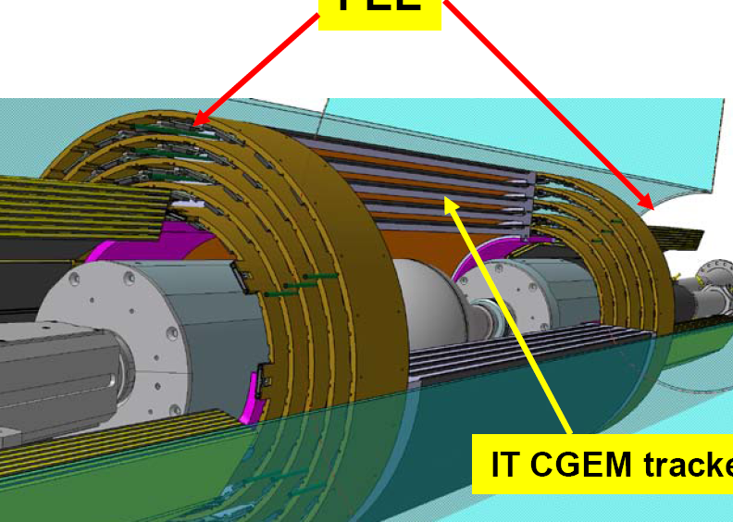
R&D: Cylindrical GEM
Cylindrical
GEMs
FEE
inner tracker
MESON 2010 JZ

Slide 35
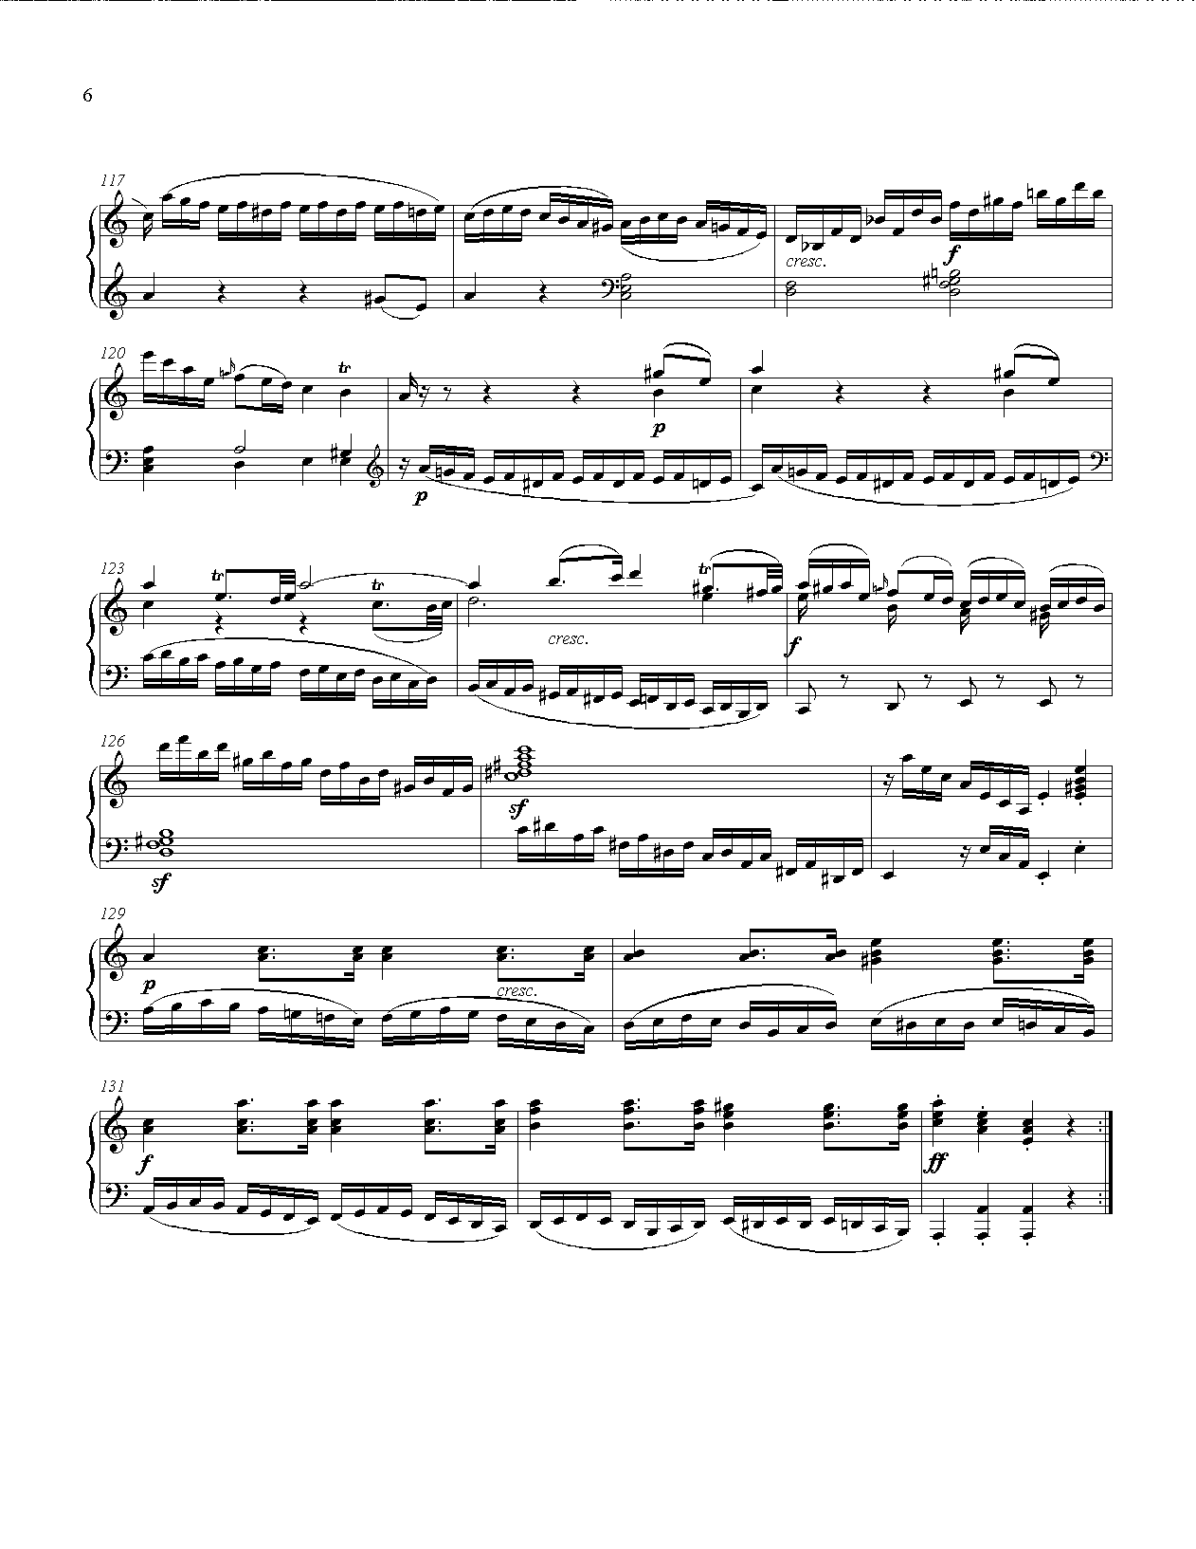
Summary
The performed analysis reconstructing Λ(1115) has
showning excellent capabilities of KLOE to study
KN interactions at low energy.
The capacity to analyze Λp, Λd, Σπ, in a broad
kinematic range with high acceptance was shown,
a key ingredient for the success of AMADEUS.
The R& D and design of the AMADEUS apparatus
is ongoing and well under control.
Thank you
MESON 2010 JZ

Slide 36
MESON 2010 JZ

Slide 37
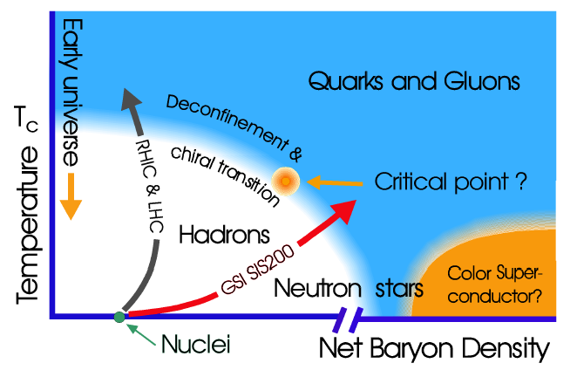
Exploring dense nuclear states
MESON 2010 JZ

