Slide 1
Status and plans of E17 experiment at J-PARC
Barbara Katharina Wünschek
on behalf of the J-PARC E17 collaboration
Stefan-Meyer-Institute for subatomic physics
Austrian Academy of Sciences

Slide 2
Overview
Idea of E17 experiment
Experimental Setup
Silicon Drift Detectors
Systematic Studies
Outlook

Slide 3
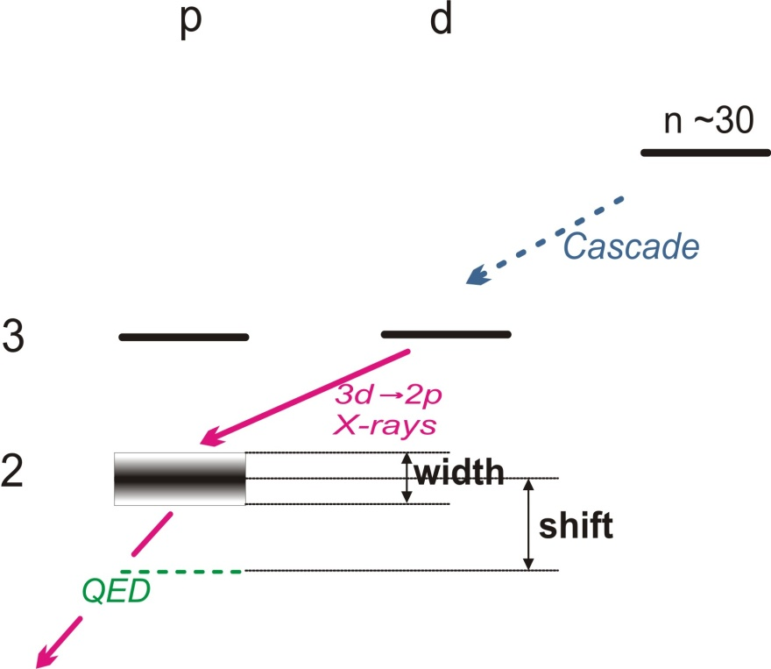
Idea of E17
Kaonic Helium
n ≈ 30
strong interaction:
width Γ
shift ε = E^{meas} – E^{calc,QED}
K⁻ - ³He: 3d → 2p X-ray transition
K⁻
e⁻
p
n
p

Slide 4
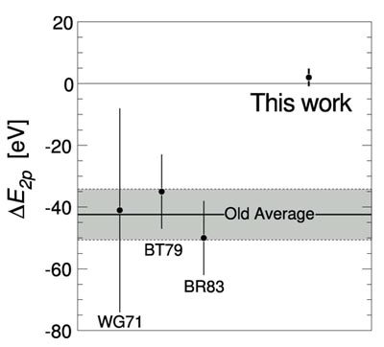
Idea of E17
Kaonic Helium Puzzle
Most theories predict: ε ≈ 0 eV for K⁴He
Averaged measured values:
ε ≈ -43 ± 8 eV Γ≈ 55 ± 34 eV
(measured between 1971 and 1983)
Solved in 2005 with E570
experiment at KEK with ⁴He:
ε ≈ 2 ± 2(stat.) ± 2(sys.) eV,
Confirmed: SIDDHARTA, LNF, Italy in 2009
(Bazzi M. et al., Phys.Lett.B, 681, 2009)
S. Okada et al., Phys.Lett. B 653, 387

Slide 5
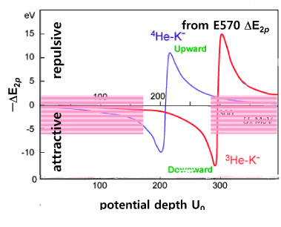
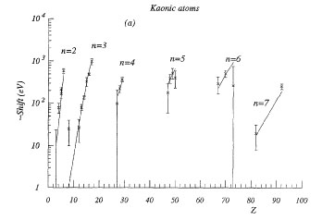
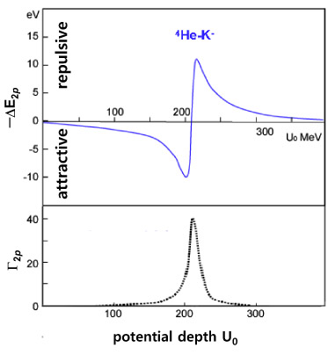
Idea of E17
Theories
ε ≈ -0.2eV (Batty, 1997, optical potential model)
‏ε ≈ -1.5eV (Akaishi, 2002, optical potential model)
Akaishi, 2005, coupled channel model:
allows shift ε > |5eV|
Deep potential if non-zero
³He and ⁴He: possible large shifts
⁴He: E570 and SIDDHARTA
excluded for ⁴He
Not solved for ³He
Our goal: precision of 2eV
C.J. Batty, Phys. Rep. 287 (1997)

Slide 6
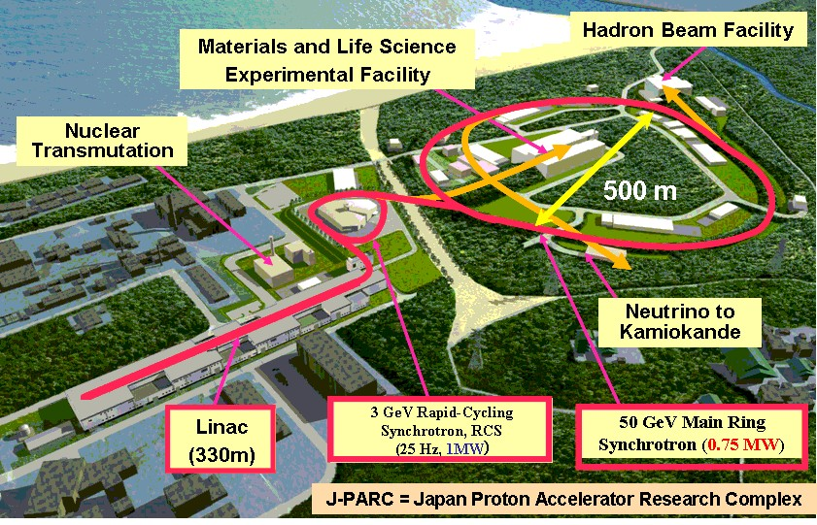
Idea of E17
E17 experiment at J-PARC
Case for ³He not solved yet: Large shift? Isospin dependence?
No data on ³He
Measuring 3d → 2p of K³He
First experiment at J-PARC Hadron Beam Facility
Notes:
Slow extraction: at 50GeV, kompliziert weil stabilität über langen zeitraum aufrecht erhalten ist schwierig – knallt gegen die Wand – Aktivierung – Strahlenschutz – derzeit nur kleine Intensität von etwa 5kW. Fast extraction: Kamiokande

Slide 7
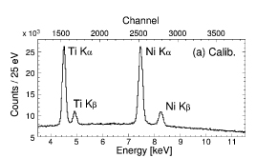
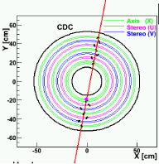
Experimental setup
Successful Setup of E570
In-beam calibration:
fiducial volume cut
K³He @ 6.2keV
E570 data
Incoming Kaon and tracking of secondary charged particles
via Drift Chamber
S. Okada et al., Phys.Lett. B 653, 387
Silicon Drift Detectors (SDDs)
Notes:
Tracking ein Vorteil, dass viel BG wegfällt (strahl größer, mehr Halo,…), wenn man nur die in He gestoppten rausnimmt

Slide 8
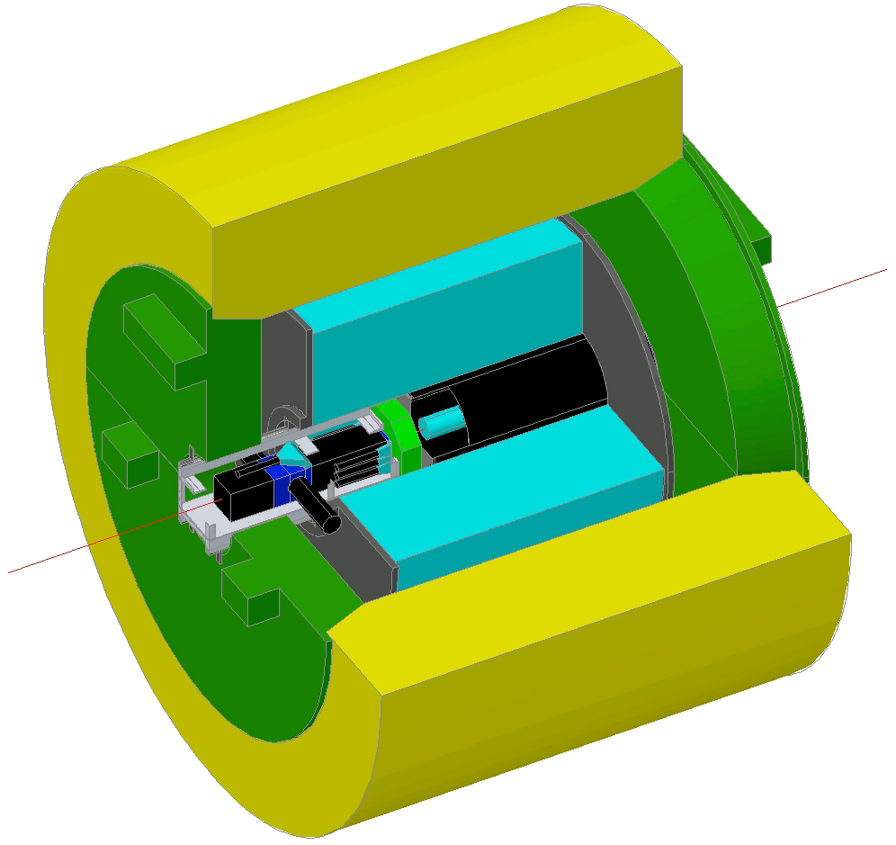
Setup
Technical Background
0.7GeV/c K⁻
K⁻ stopped in helium target
K⁻/π⁻ separation
Lucite Cherencov Counter for detection (separation)
Liquid ³He @ ~1.3K, cooled with ⁴He
8 SDDs, operated at 130K, with their
Preamplifiers inside vacuum
Notes:
Separator ist Wienfilter, LC ist einfach nur elektronisches rausfiltern

Slide 9
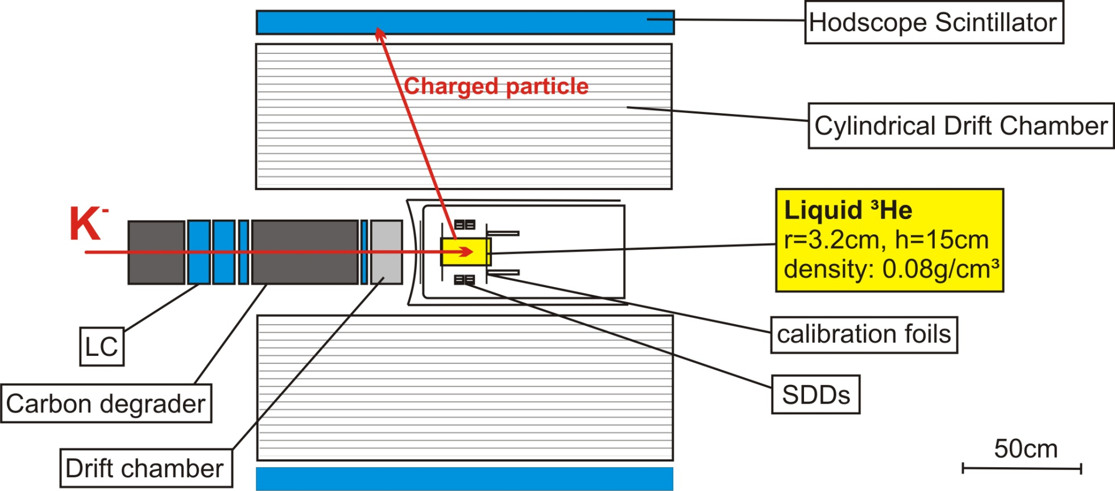
Setup
Cylindrical Detector System:
Cooling system works properly
Detector system works properly
Beamtuning in progress
Notes:
Erwähne pion-cali! Kaontracker sind mehrere (gerade-1pkt-def-gehtnich), für fid volume cut, geladene particles 2. track (pion, p,…), hidscope is szinti, wenn er spricht, dann wird track zurückverfolgt. 4 FOILS!!

Slide 10
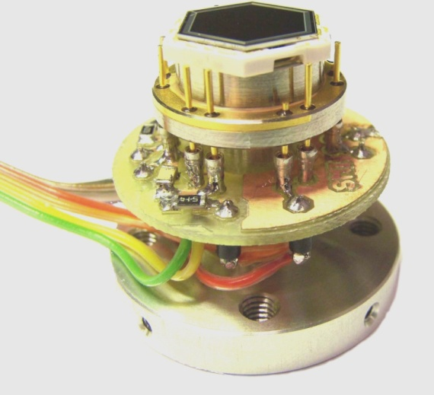
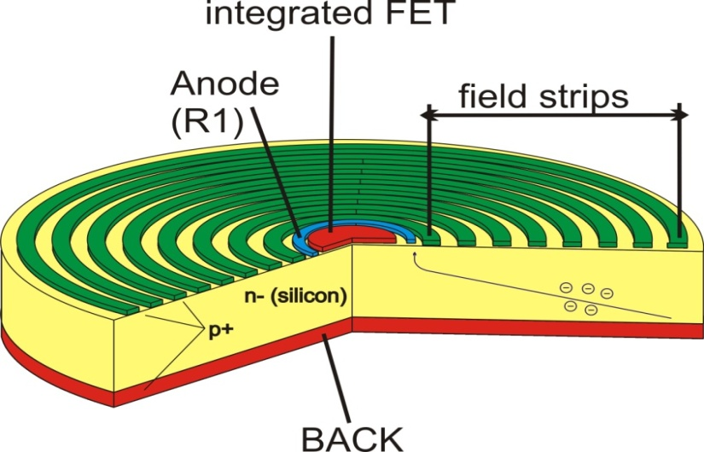
Silicon Drift Detectors
Basic principle of SDDs
Thickness: ~500µm, 1cm² area
Good energy and time resolution (~140eV @ 5.9keV, <1µs
Work from ~245K to ~ 100K
Thin active layer, small anode area, large active area
Low-energetic X-rays at high rates
Precision of 2eV
SDD Vitus
Reset Type
KETEK

Slide 11
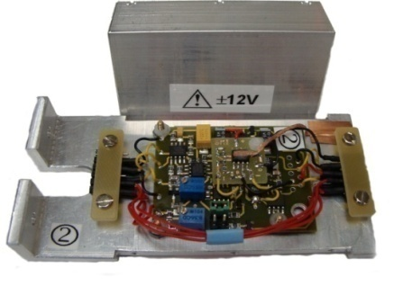
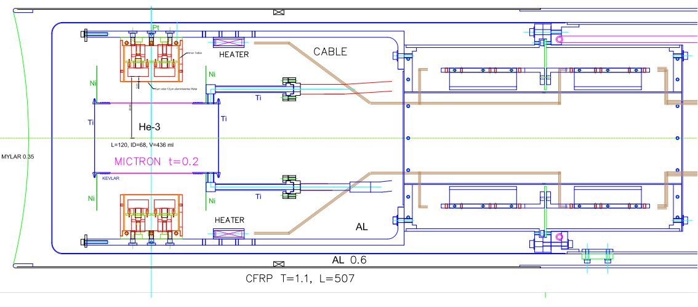
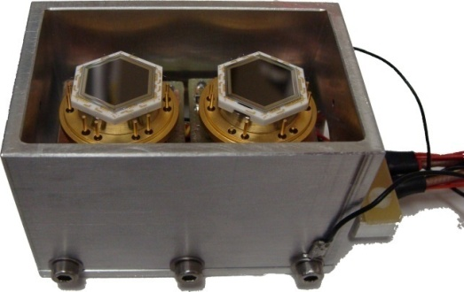
Silicon Drift Detectors
Usage in experiment
Notes:
Herausforderung für sdds & preamp in vakuum wegen platz (alles in cds) – neue probleme unter diesen bed – wir haben gelöst, he target net zu stark aufgheizt

Slide 12
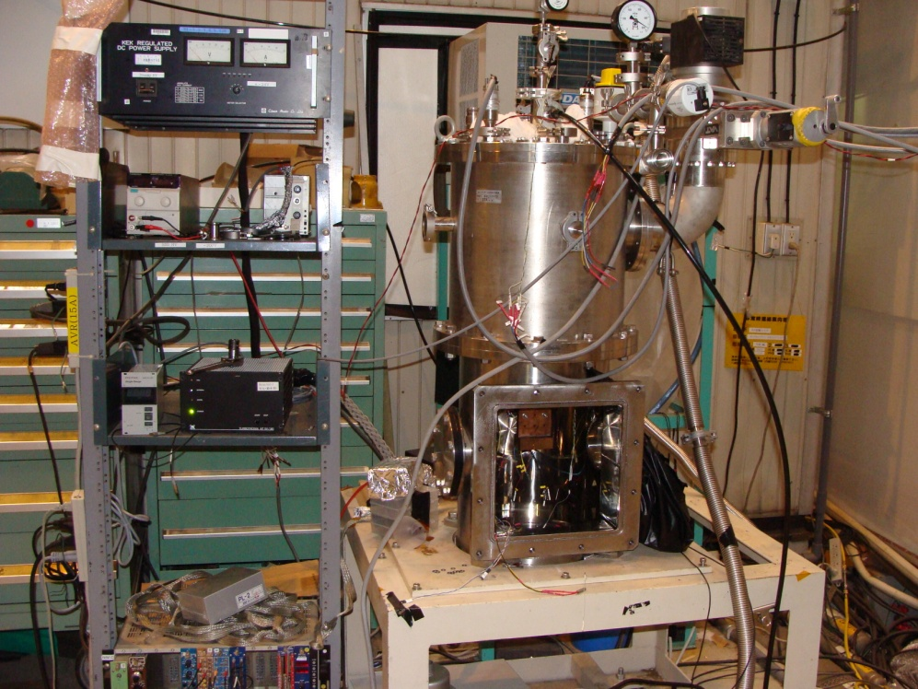
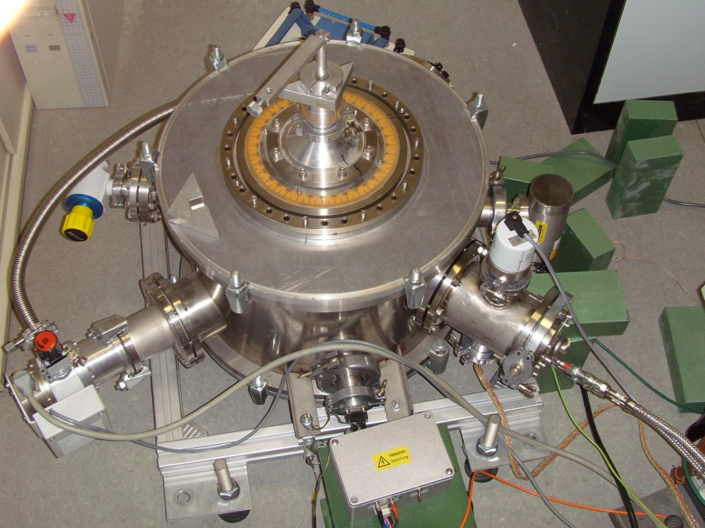
Systematic tests
Test Setups
JAPAN (KEK)
Systematic tests with
All 8 SDDs
VIENNA
Preparation of devices and housings
Check general functionality

Slide 13
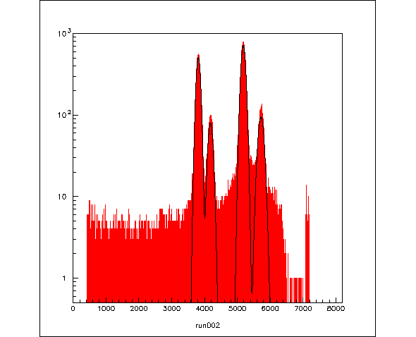
Systematic tests
Procedure and Results
⁵⁵Fe
Functionality Check with
⁵⁵Fe (K_{a} @ 5.9keV)
X-ray tube / Sr-source with
several foils
General functionality of all 8 SDDs and their preamps was confirmed
Temperature dependence
on time- and energy resolution
Stability tests under way
Optimum conditions (voltages, shieldings,…) for SDD and preamp at T^{SDD} ~130K and T^{amp} ~280K were found
Cu
Notes:
Genauigkeit von 2eV erreichbar durch: gute detektor-responsefunktion-kenntnisse, stabilität, kurven form genau kennen – haben gelernt bei e570 & siddharta

Slide 14
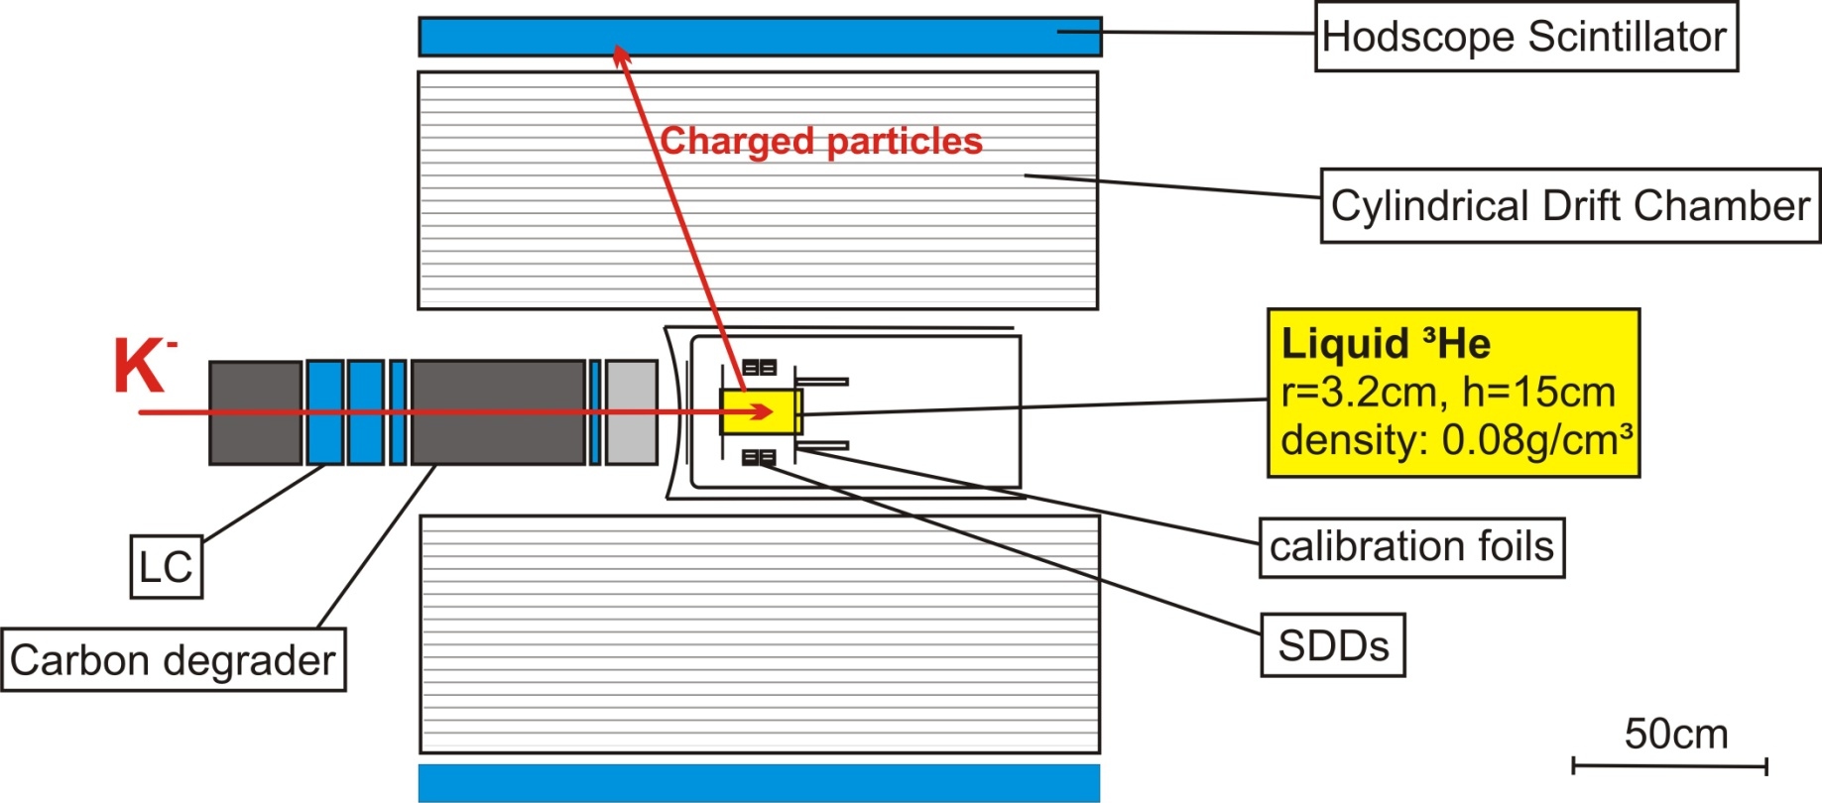
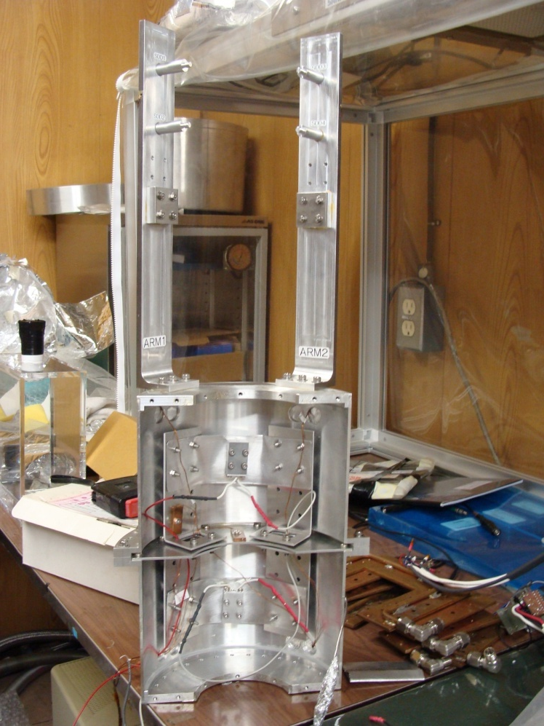
Final Setup
Target chamber with SDDs
Functionality confirmed,
Optimum found:
140eV @ 5.9keV
Notes:
Erkläre wo sdd und preamps sitzen

Slide 15
Outlook
Construction and systematic studies almost finished
Move to J-PARC with final setup in July
Detectors work with desired precision
Experiment will be performed at the hadron facility, beamline K1.8BR
First test run in autumn 2010
Spring 2011 experiment

Slide 16
J-PARC E17 Collaboration
H. Bhang¹, M. Cargnelli², S. Choi¹, C. Curceanu³, O. V. Doce³,
S. Enomoto⁴, H. Fujioka⁵, Y. Fujiwar^{a6}, C. Guaraldo³,
T. Hashimoto⁶, R. S. Hayano⁶, T. Hiraiwa⁵, M. Iio⁷, S. Ishimoto⁸,
T. Ishiwatari², K. Itahashi⁷, M. Iwasaki^{7,9}, H.Kou⁹, P. Kienle^{2,10},
J. Marton², Y. Matsuda⁶, H. Noumi⁴, H. Ohnishi⁷, S. Okada³,
H. Outa⁷, F. Sakuma⁷, M. Sato⁶, M. Sekimoto⁸, H. Shi⁶, D. Sirghi³,
F. Sirgh^{i3}, T. Suzuki⁶, K. Tanida¹, H. Tatsuno⁶, M. Tokuda⁹,
D. Tomono⁷, A. Toyoda⁸, K. Tsukada⁷, A. R. Vidal³, E. Widmann²,
B. Wunschek², T. Yamazaki^{6, 7}, J. Zmeskal²
SNU¹, SMI², LNF³, RCNP⁴, Kyoto Univ^{.5}, Univ. of Tokyo⁶,
RIKEN7, KEK/J-PARC⁸, Tokyo Tech⁹, Tech. Munich Univ.¹⁰

