Slide 1
Three-nucleon interaction dynamics studied via the deuteron-proton breakup
Elżbieta Stephan
Institute of Physics, University of Silesia

Slide 2





Studies of the ¹H(d,pp)n Breakup
University of Silesia, Katowice, Poland
PhD theses: A. Micherdzińska, A. Biegun
Jagiellonian University, Kraków, Poland
PhD theses: R.Sworst, I. Ciepał
KVI, Groningen, The Netherlands
Institute of Nuclear Physics PAN, Kraków, Poland
Forschungszentrum Juelich, Germany

Slide 3
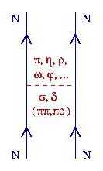
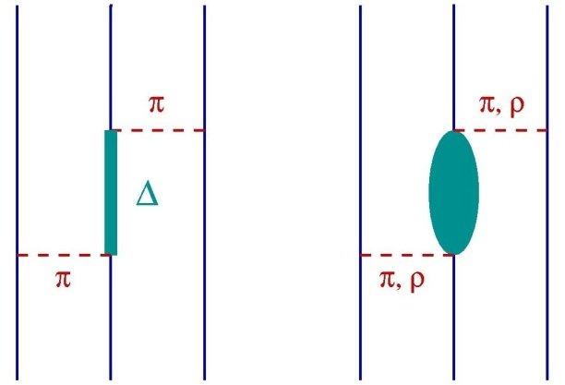
¹H(d,pp)n Measurement at 130 MeV
Motivation
Faddeev framework provides exact treatment for the 3N system
Various approaches to construct the interaction (2N and 3N):
  Realistic potentials + phenomenological 3NF models
  Chiral Perturbation Theory
  Coupled-Channels formalism with explicit Δ

Slide 4
¹H(d,pp)n Measurement at 130 MeV
Motivation
Three-nucleon system is the simplest non-trivial environment to test predictions of the NN and 3N potential models
Elastic scattering data demonstrate both success and problems of modern calculations
Very few breakup data at medium energies (earlier PSI experiments provided only 14 kinematical configurations)
In order to reach meaningful conclusions about the interaction models needed experimental coverage of large phase space regions

Slide 5
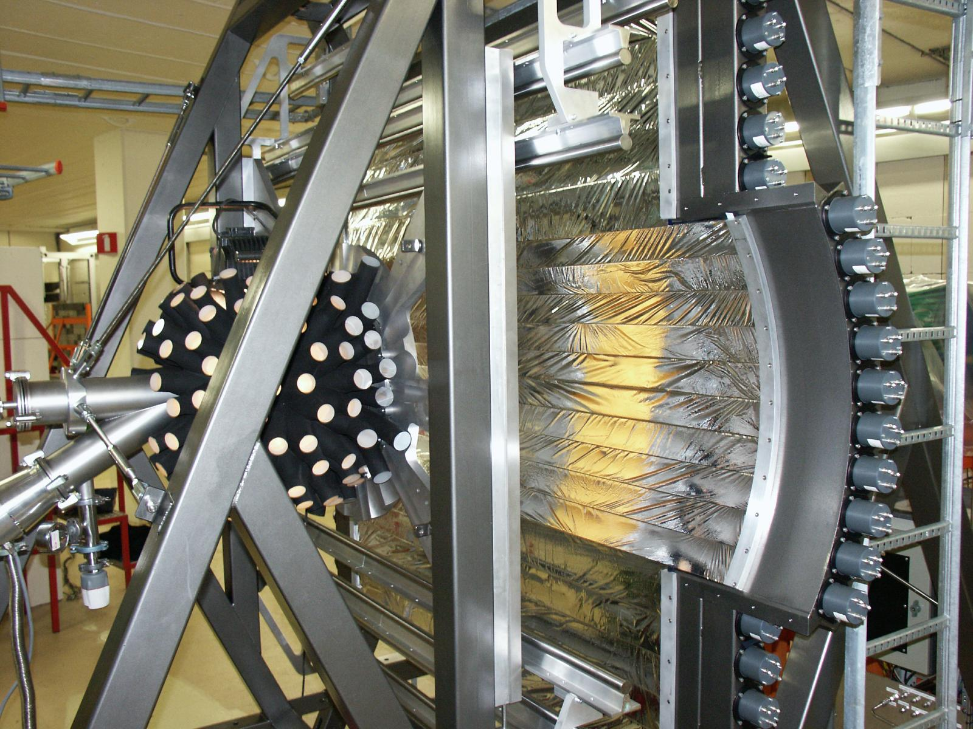
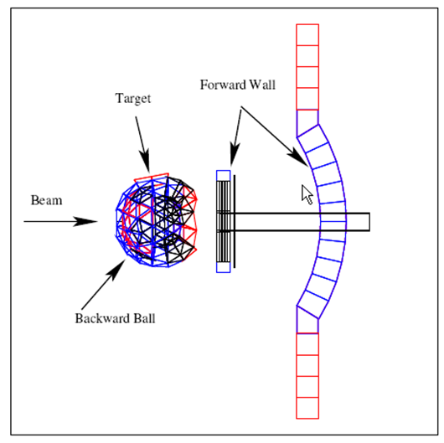
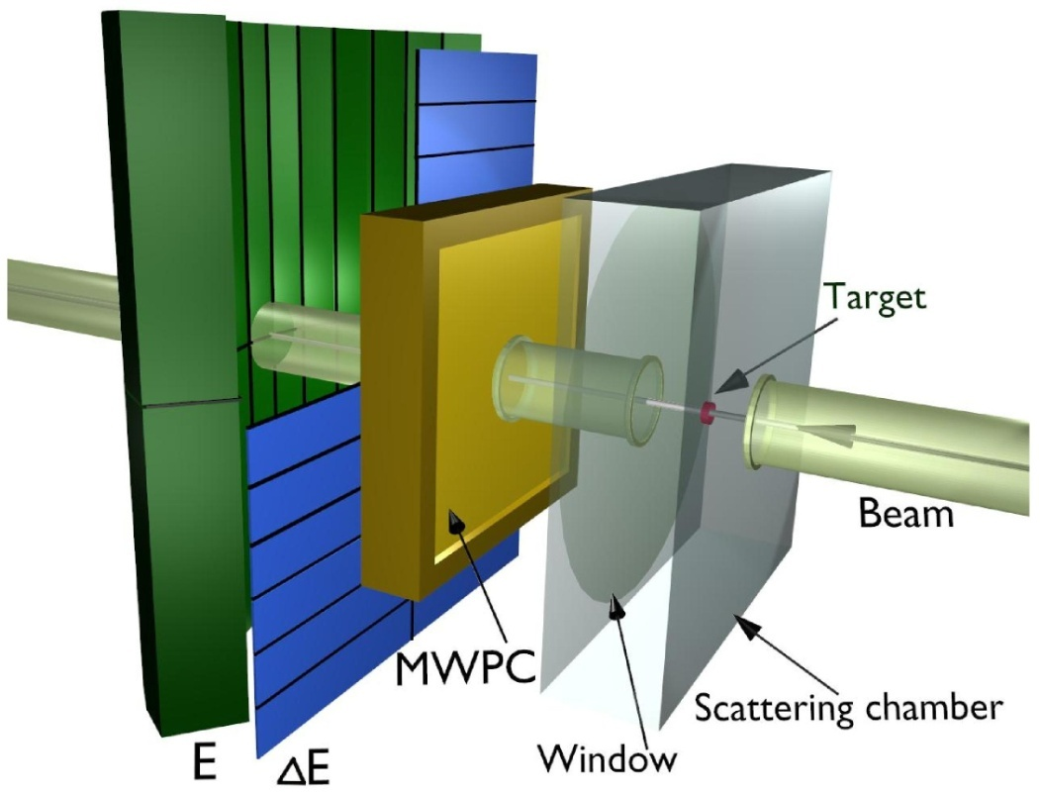
¹H(d,pp)n Measurements at 130 and 100 MeV
Detection systems at KVI
SALAD
BINA
140 ΔE-E telescopes
3 plane MWPC
angular acceptance:
θ = (12º, 38º), φ = (0º, 360º)
Wall - very similar to SALAD
Ball - system of phoswitch detectors
angular acceptance: nearly 4π

Slide 6
¹H(d,pp)n Measurement at 130 MeV
Cross Section Results – Summary
Nearly 1800 cross section data points
  θ₁, θ₂ = 15º – 30º; grid 5º ; Δθ = ±1º
  an additional set for θ₁, θ₂ = 13º
  φ₁₂ = 40º – 180º; grid 10º-20º ; Δφ = ±5º
  S [MeV] = 40 – 160; grid 4; ΔS = ±2
  Statistical accuracy 0.01 – 0.05
  Data very clean – accidentals below 2%
  Systematic errors – 3% – 5%
Global comparisons with theory (χ² test for all points, χ² = f(φ₁₂), χ² = f(E_{rel}), tests of normalization)

Slide 7
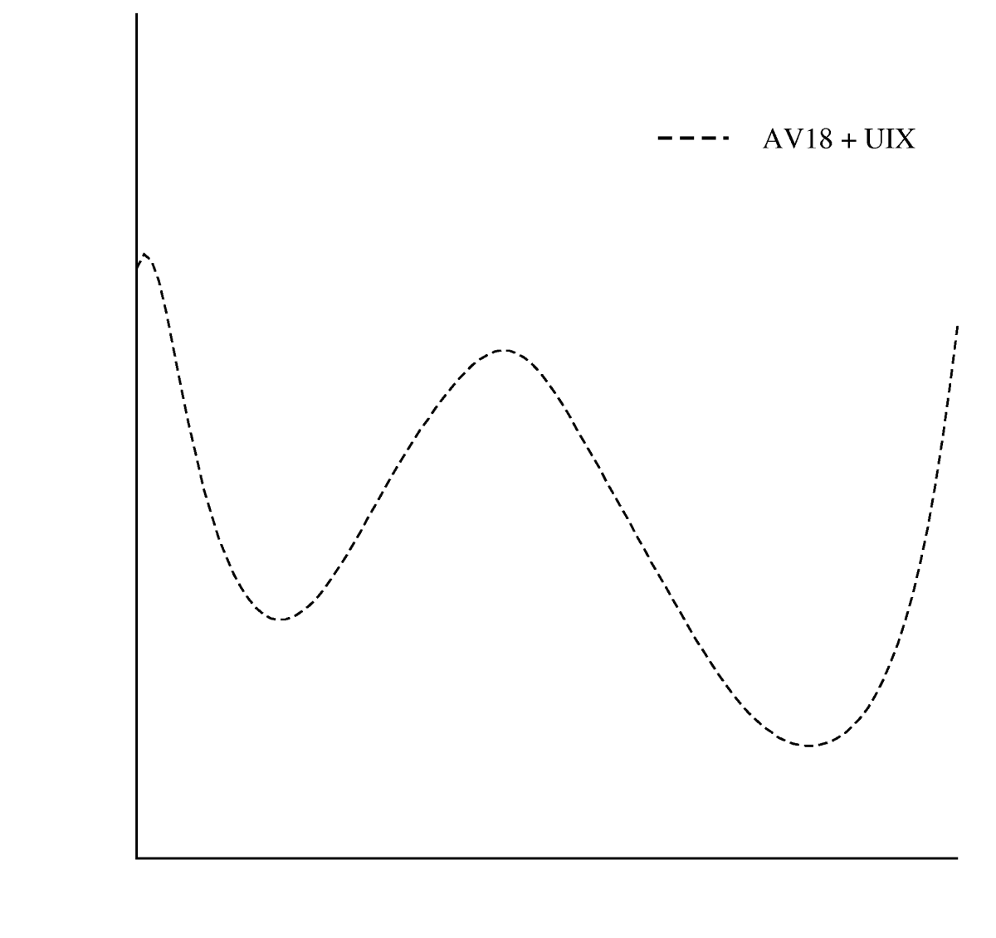
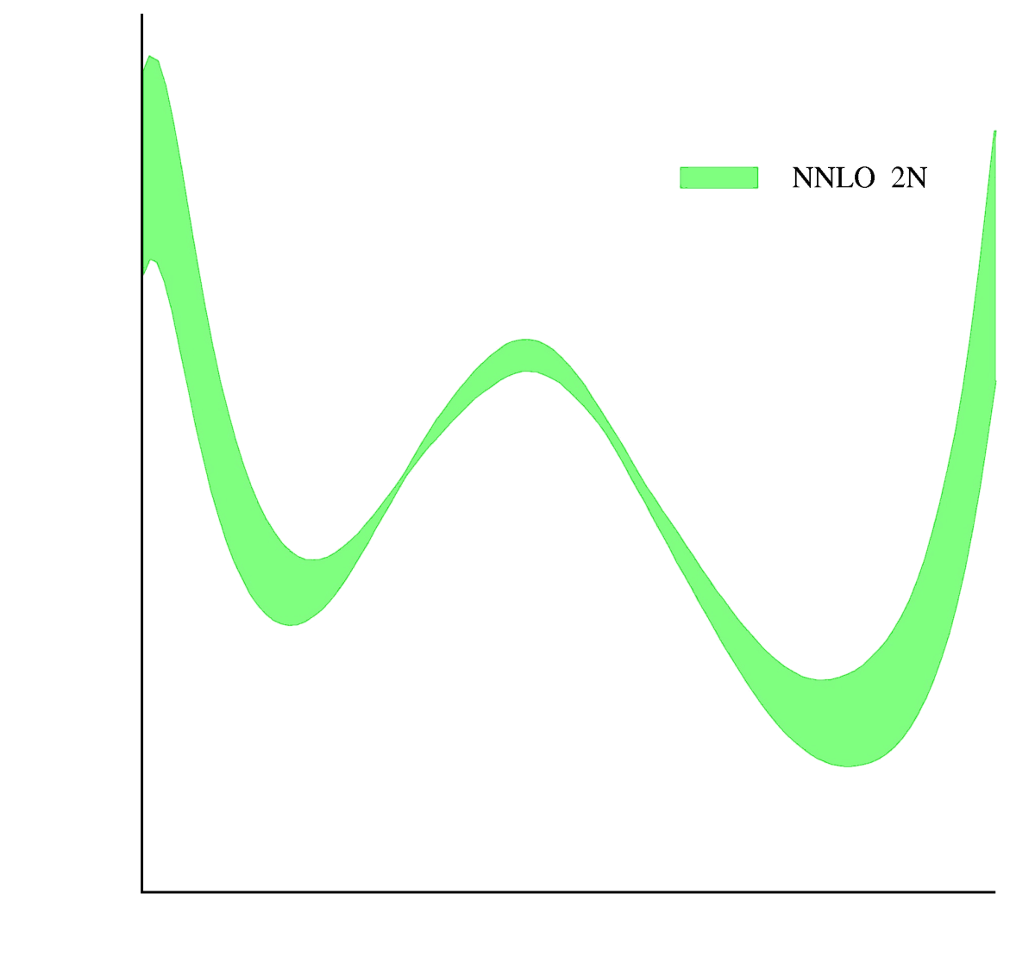
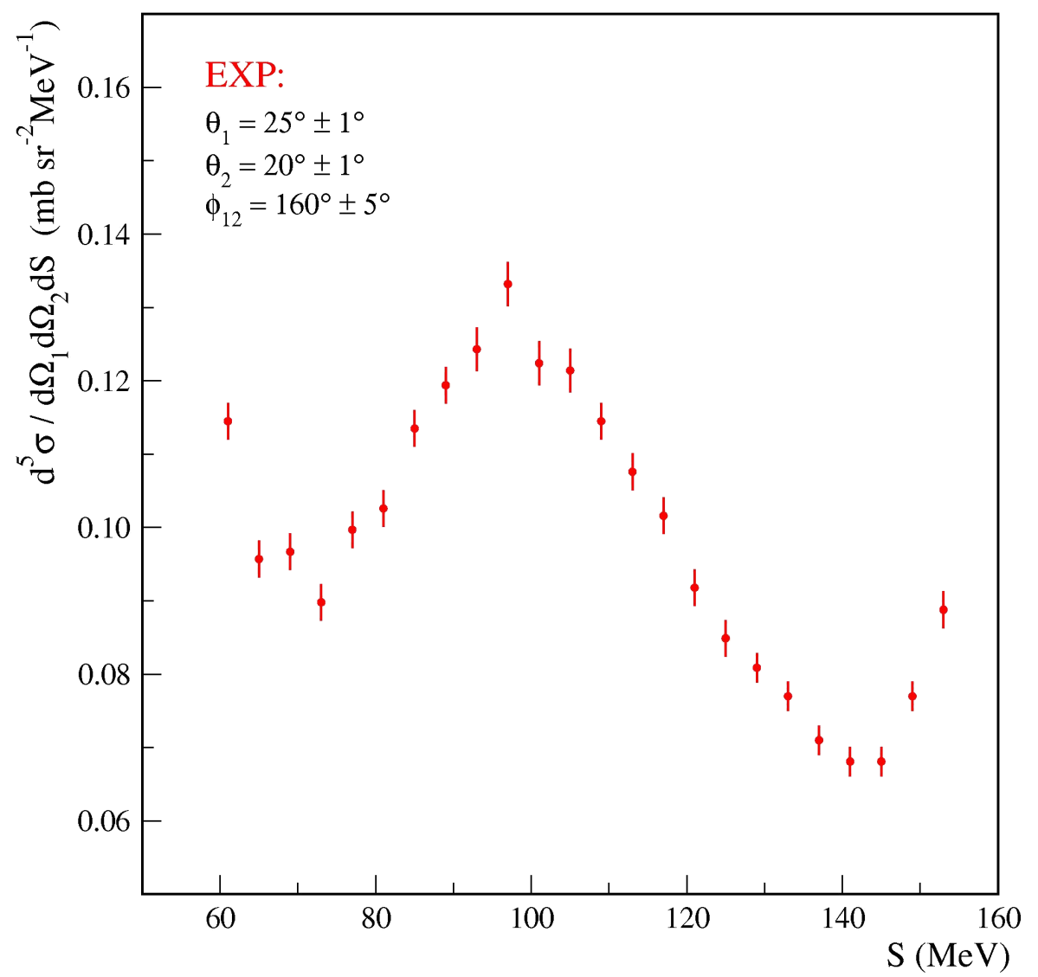
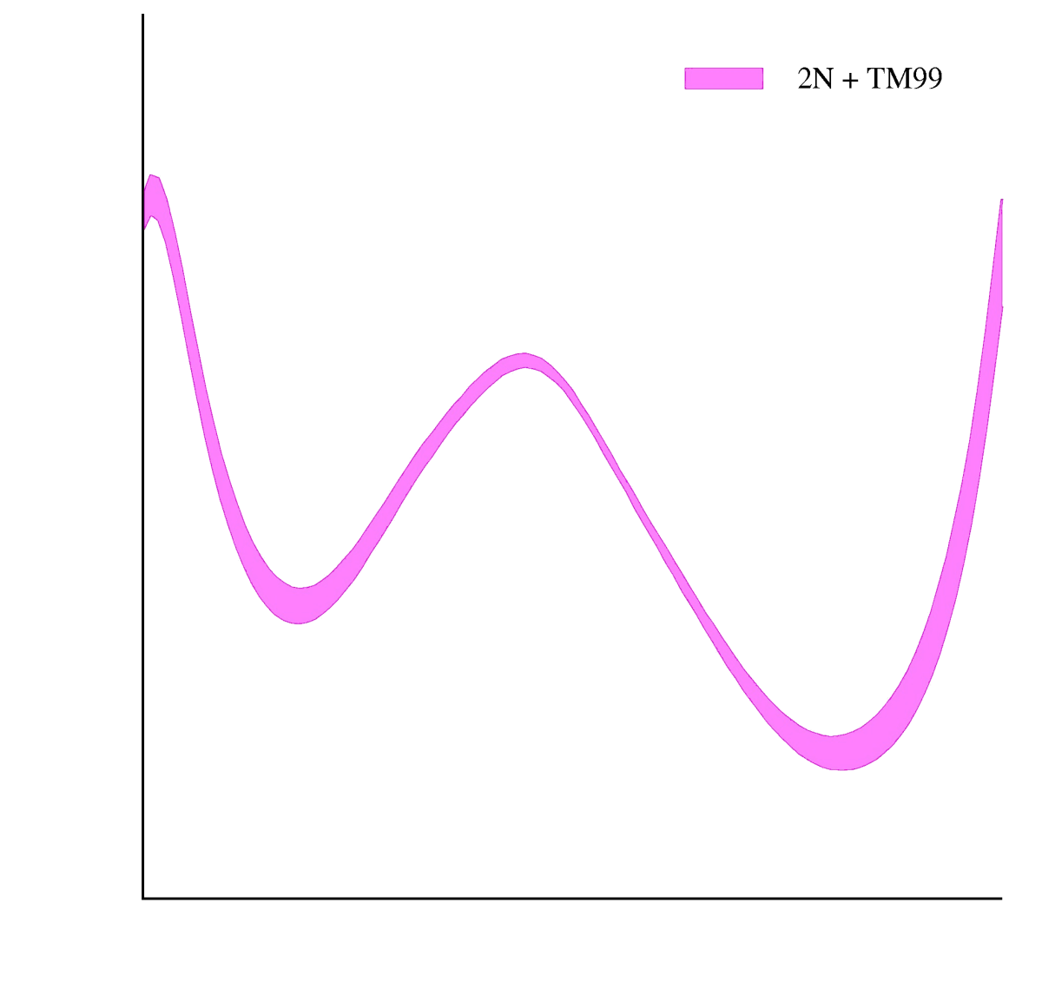
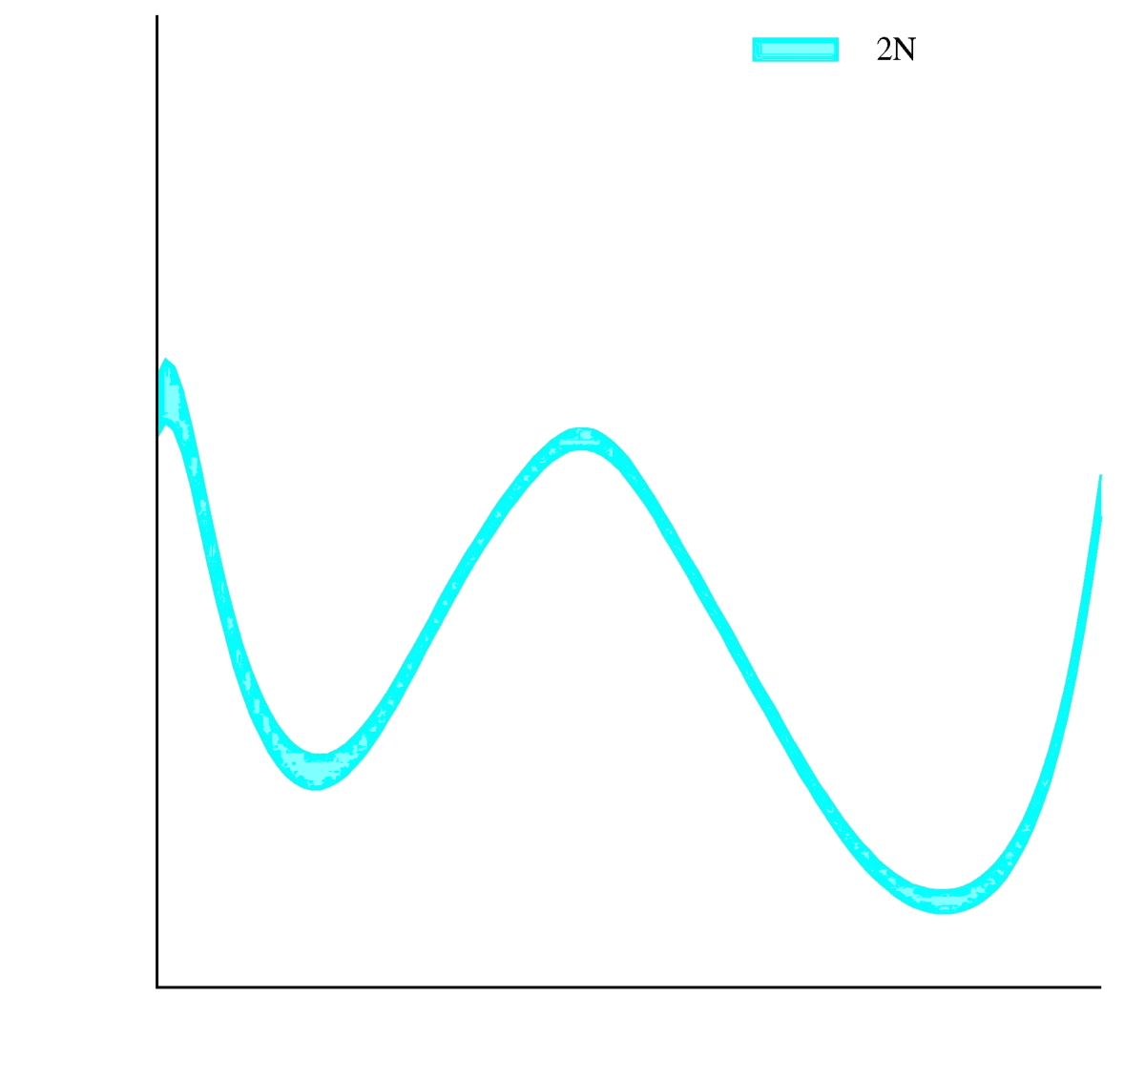
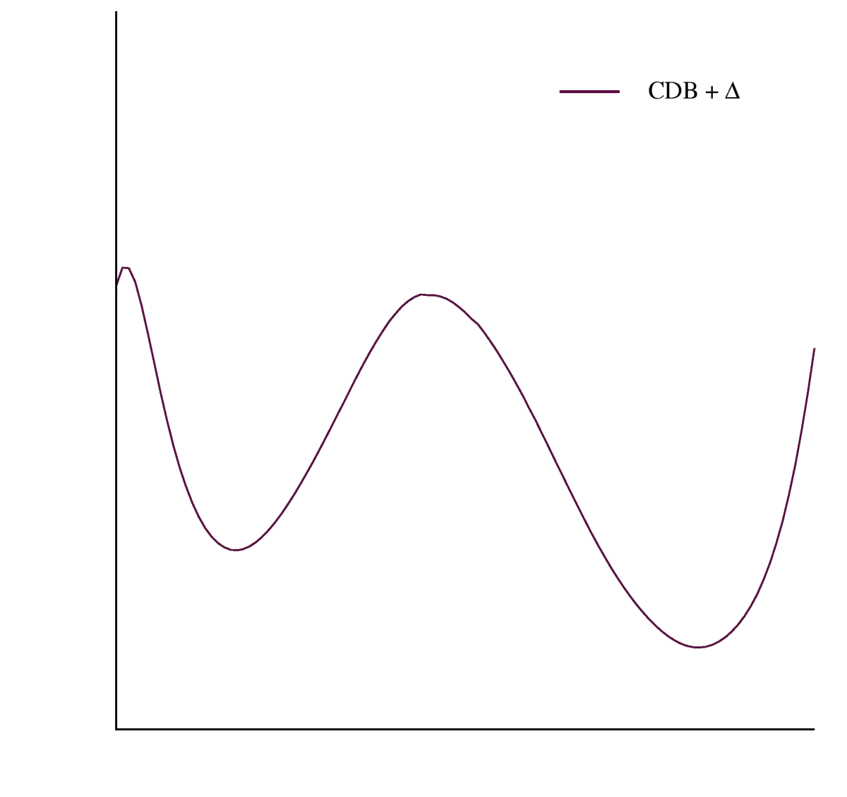
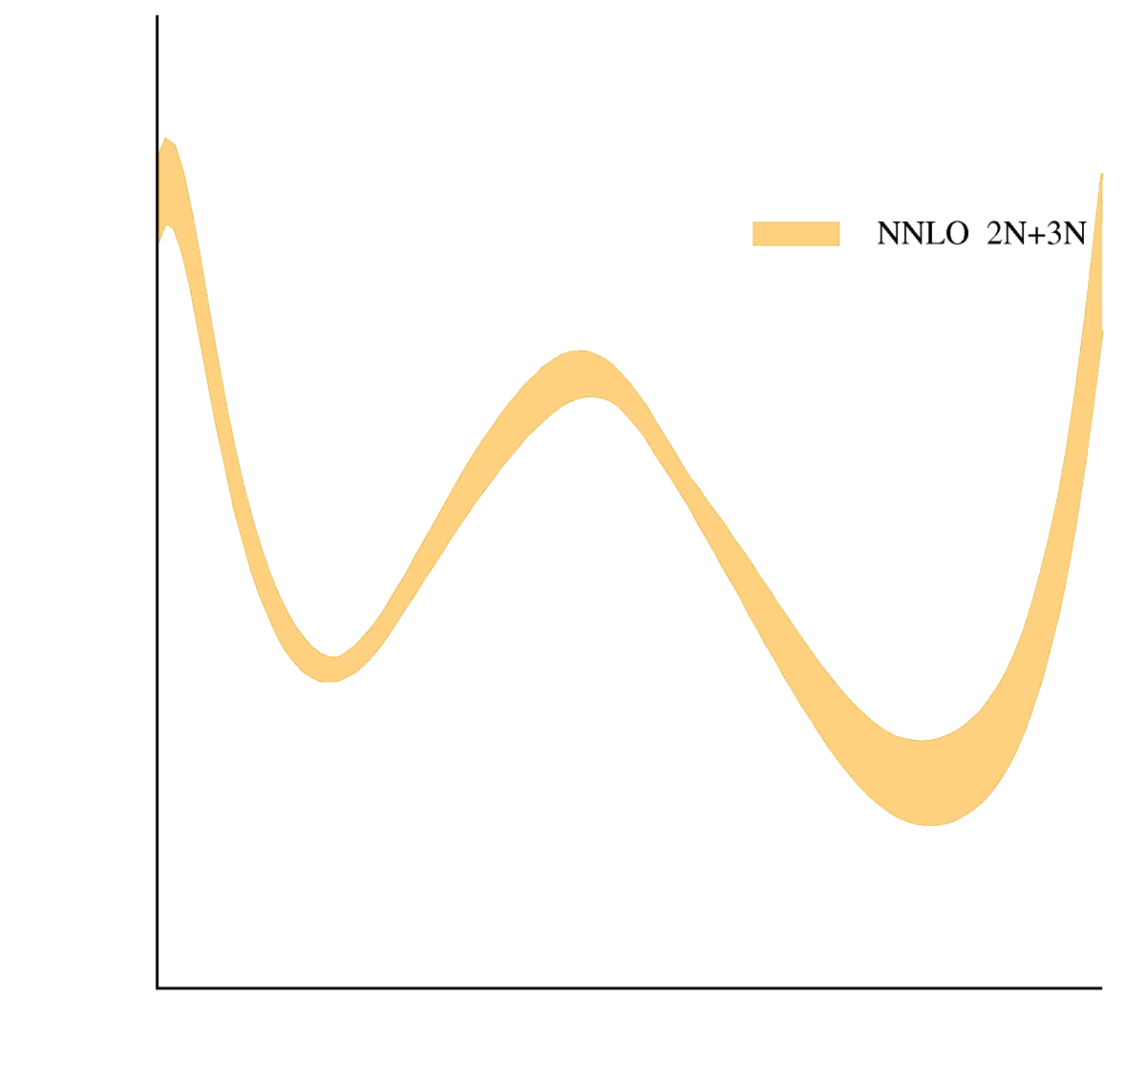
¹H(d,pp)n Measurement at 130 MeV
Cross Section Results – Example
Coupled channels calculations
CD Bonn (modif.) + Δ
EFT/ChPT calculations
NNLO – 2N only
NNLO – 2N + 3 N
Faddeev calculations
Realistic NN potentials: (CD Bonn, NijmI, NijmII, Av18)
3NF model: TM99, UIX

Slide 8
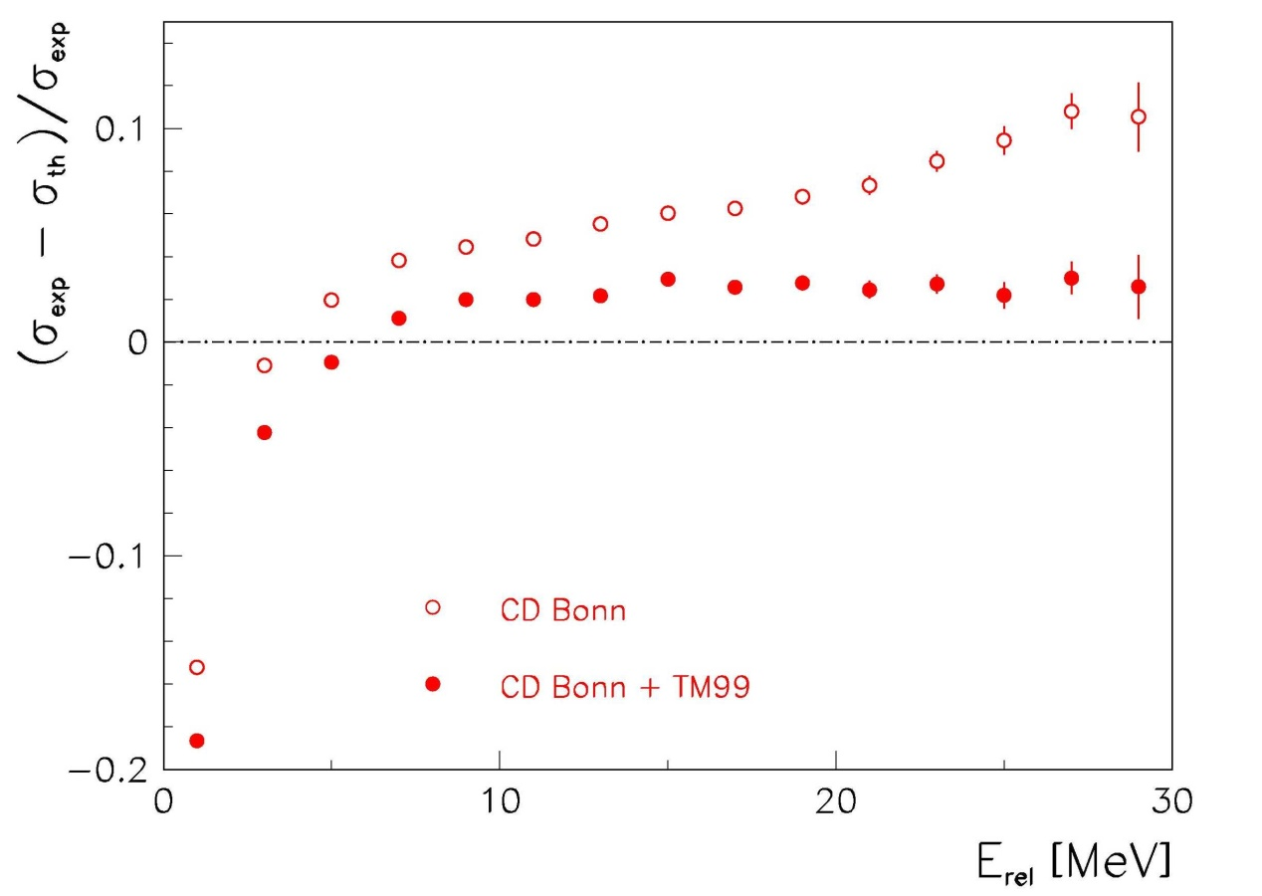
¹H(d,pp)n Measurement at 130 MeV
Cross Section Results – Exploring Phase Space
Relative χ² as a fun-ction of the relative azimuthal angle φ₁₂ between the two proton trajectories
For large E_{rel} 3NF’s improve description of the data when combined with the NN potentials
In general:
Including 3NF’s reduces global χ² by about 30%
[Phys. Rev. C 72 (2005) 044006]

Slide 9
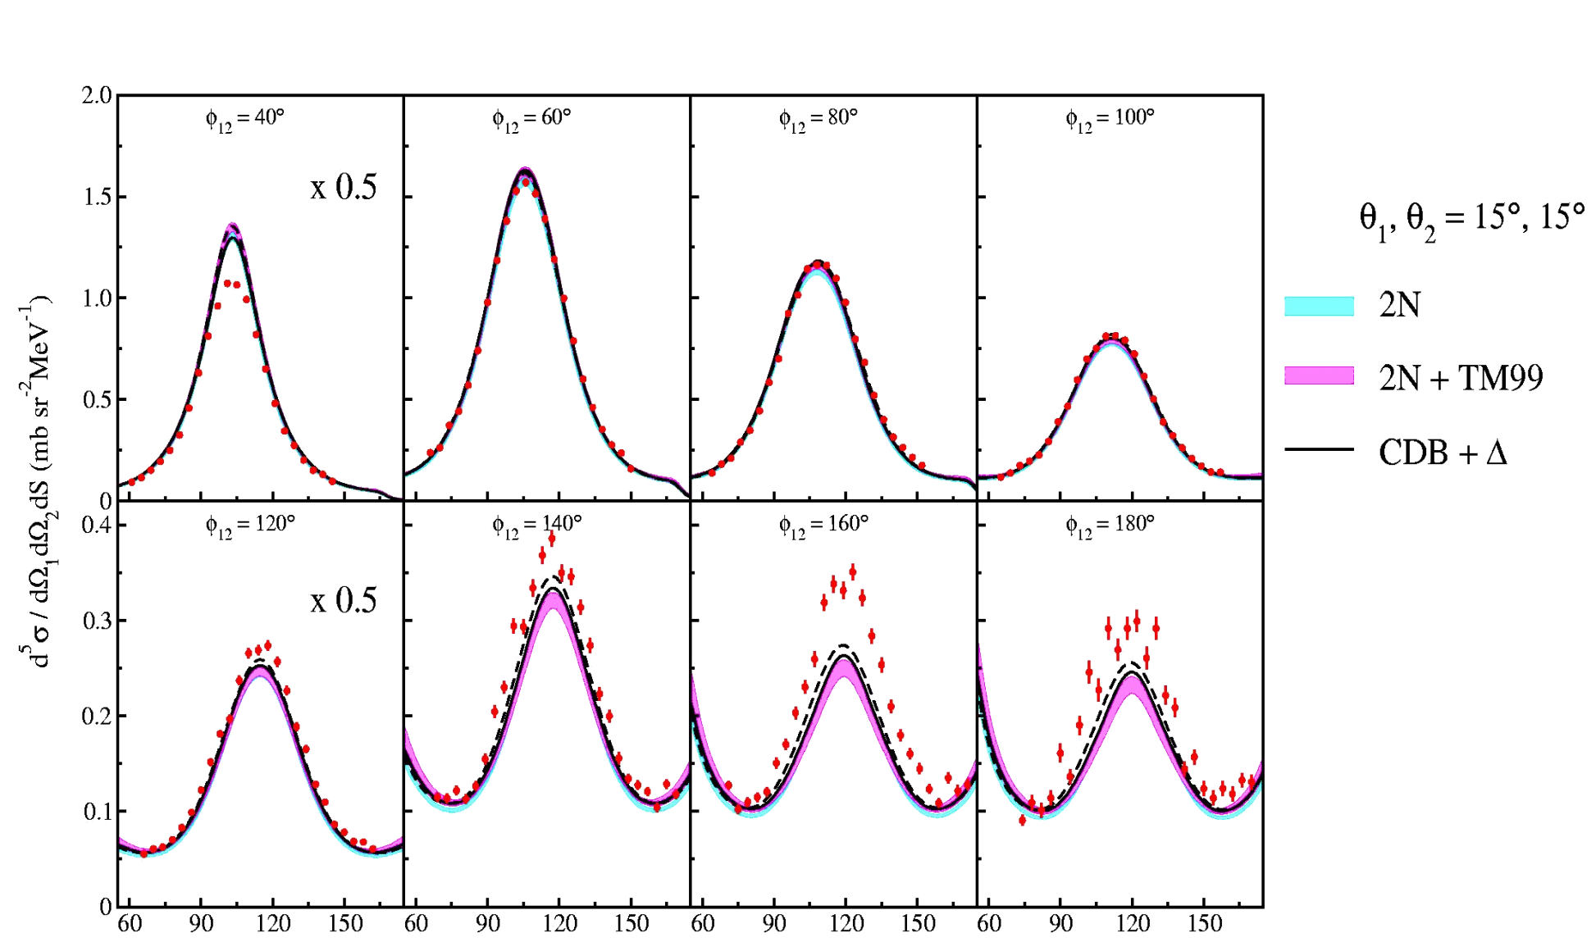
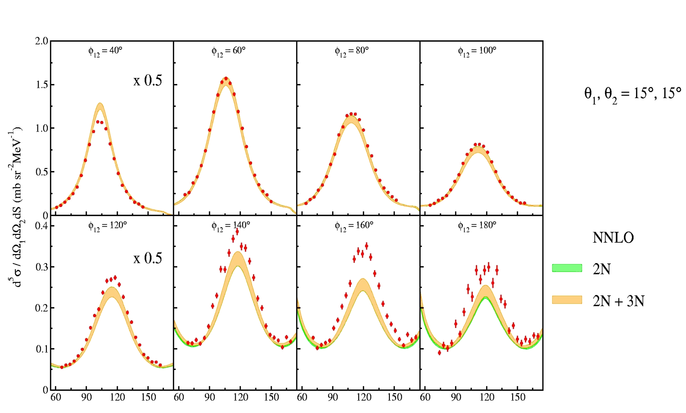
¹H(d,pp)n Measurement at 130 MeV
Cross Section Results – Discrepancies

Slide 10
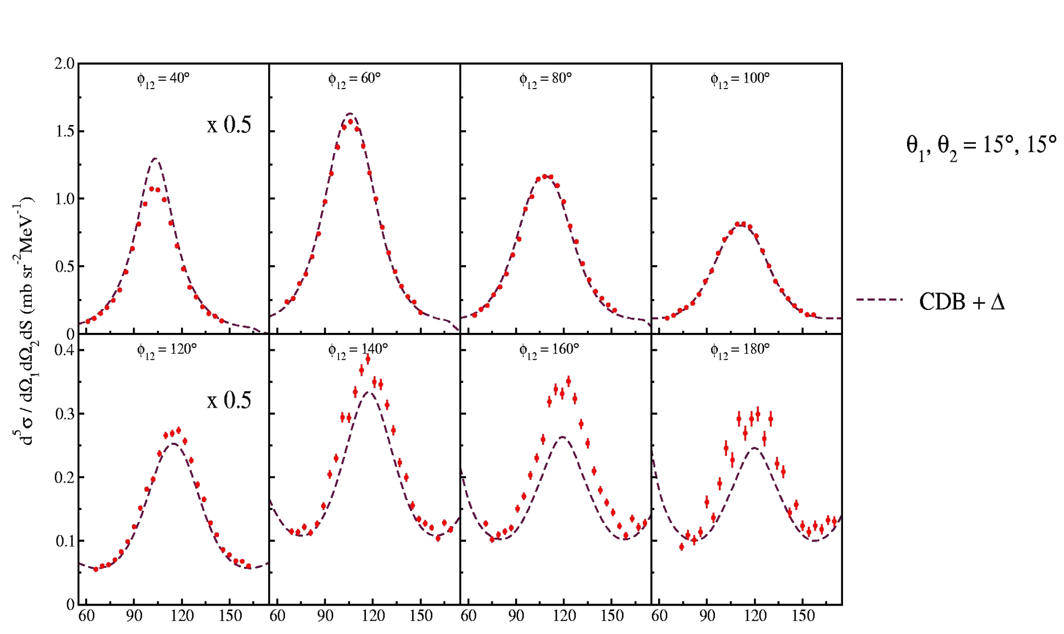
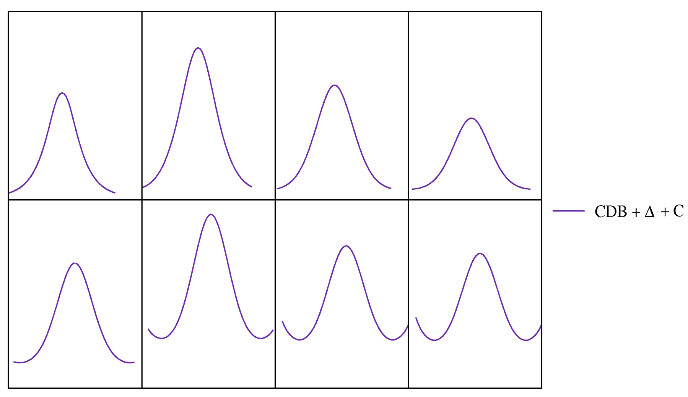
¹H(d,pp)n Measurement at 130 MeV
Cross Section Results – Discrepancies Cured
Coupled Channel
calculations
Coupled Channel
calculations with
Coulomb effects
Predictions with Coulomb reproduce data much better !

Slide 11
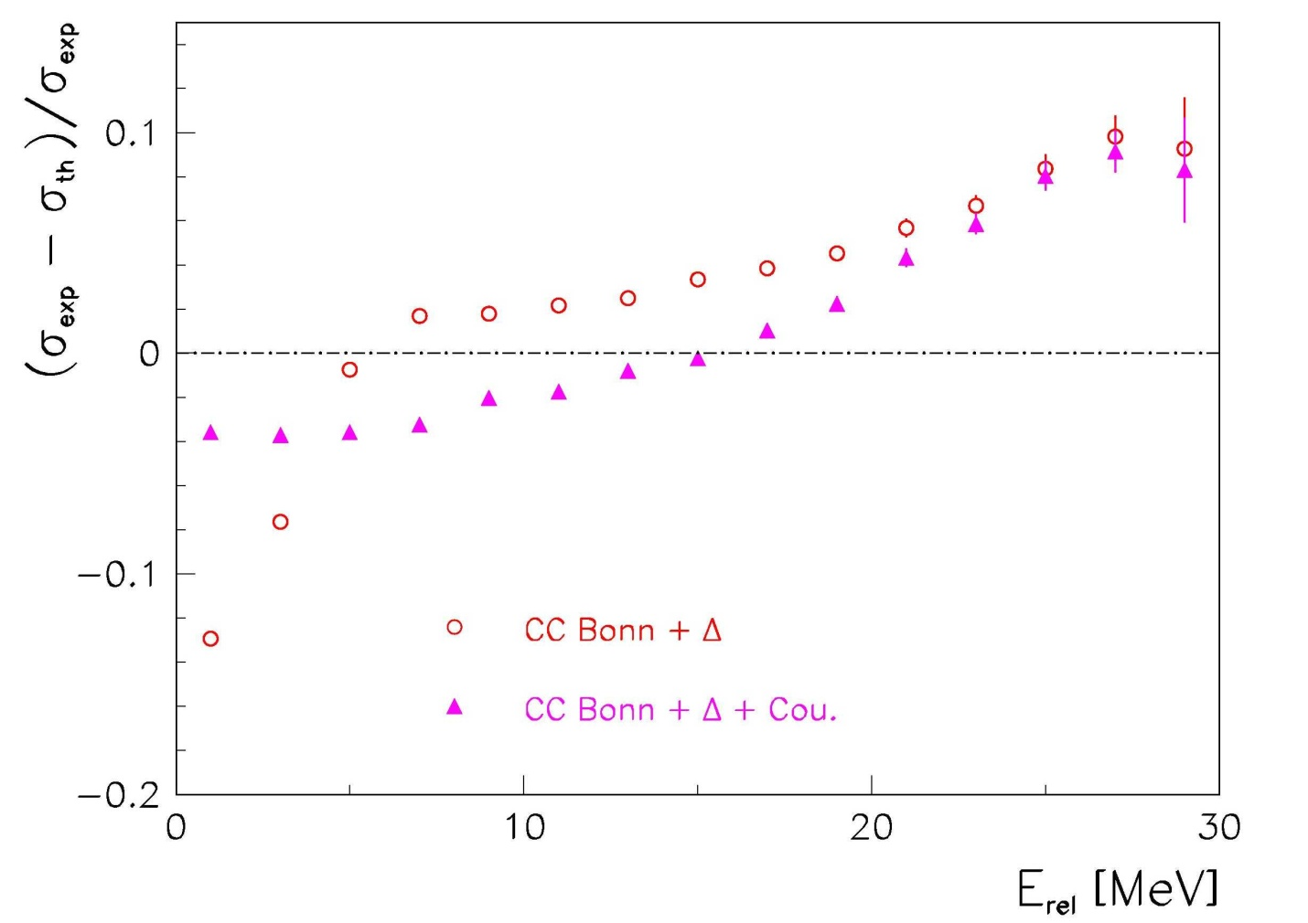
¹H(d,pp)n Measurement at 130 MeV
Discrepancies at low E_{rel} cured
Coupled Channel
calculations

Slide 12
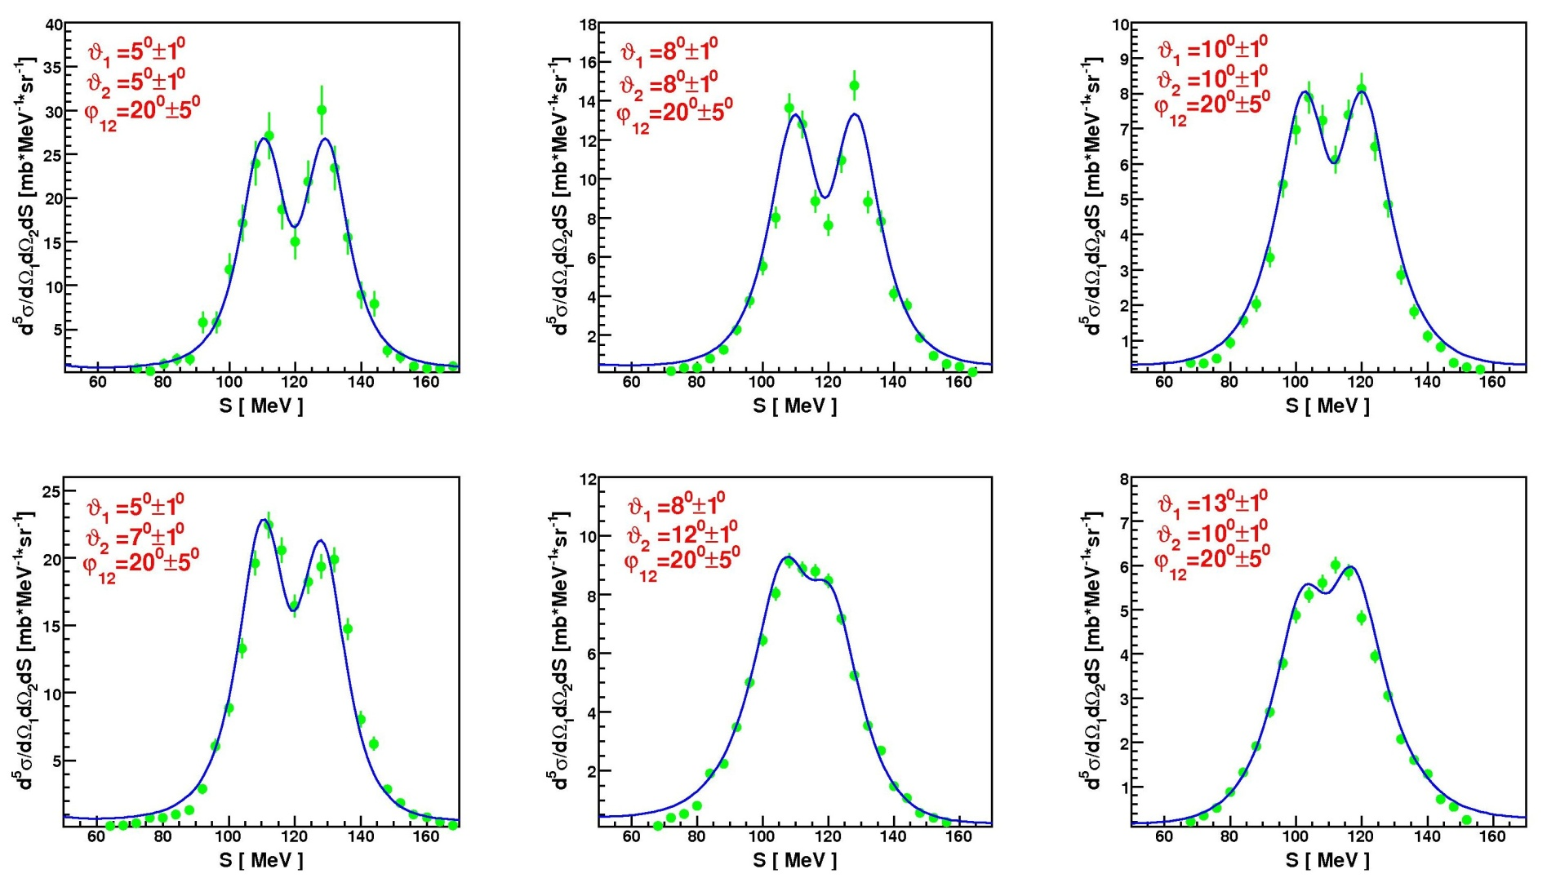
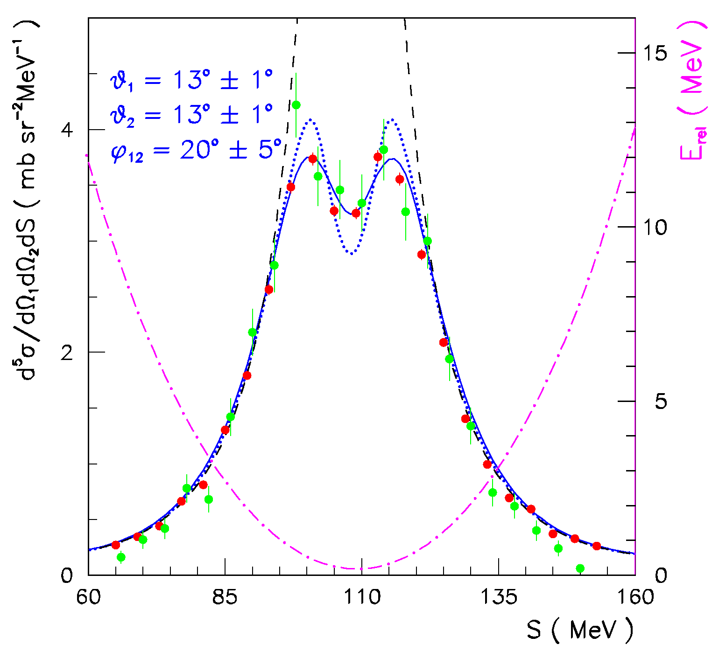
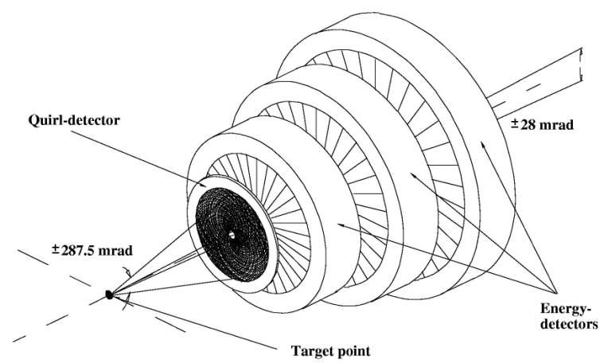
¹H(d,pp)n Measurement at 130 MeV
Coulomb effects – dedicated experiment
GeWall@COSY
P R E L I M I N A R Y
E_{d} = 130 MeV
Very forward-angle region
θ = 5º - 15º
Comparison
● KVI ; ● FZJ
Averaging important !

Slide 13
¹H(d,pp)n Measurement at 130 MeV
Vector and Tensor Analyzing Powers
A few times more additional data points (supplementing cross sections)
Potentially stronger sensitivity to small ingredients (sums of interfering amplitudes)
Small Coulomb effects - it can be easier to trace 3NF
7 states: |  | Δ P_{z} | Δ P_{zz}
 |  | _{0.008} | _{0.05}
P_{z}^{max} | P_{zz}^{max} | P_{z} | P_{zz}
+1/3 | -1 | 0.265 | -0.73
+2/3 | 0 | 0.480 | -0.08
-2/3 | 0 | -0.469 | 0.06
0 | +1 | -0.058 | 0.52
0 | -2 | 0.009 | -1.37
+1/3 | +1 | 0.219 | 0.61
0 | 0

Slide 14
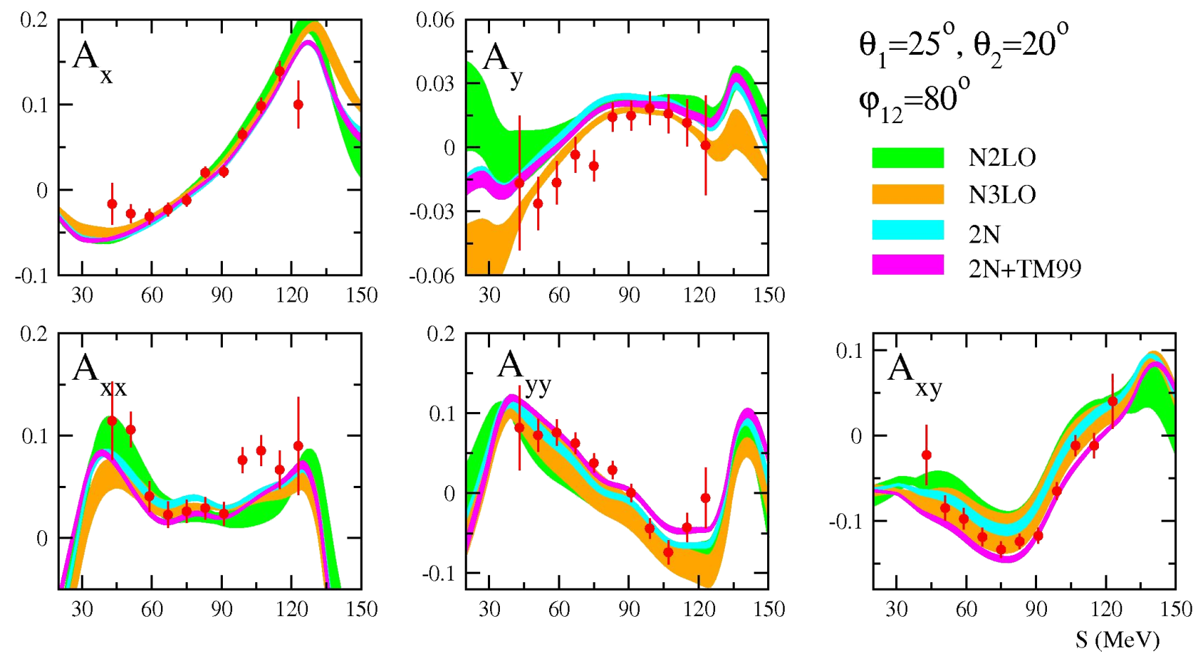
¹H(d,pp)n Measurement at 130 MeV
Analyzing Power Results – Summary
Vector (A_{x}, A_{y}) and tensor analyzing powers (A_{xx}, A_{yy}, A_{xy}) determined in the large part of the phase space
Nearly 800 data points per observable
  θ₁, θ₂ = 15º – 30º; grid 5º ; Δθ = ±2º
  φ₁₂ = 40º – 180º; grid 20º ; Δφ = ±10º
  S [MeV] = 40 – 160; grid 4; ΔS = ±4
  Statistical accuracy 0.01 – 0.05
  Systematic errors – analysis under way
Global comparisons with theory (χ² test)

Slide 15
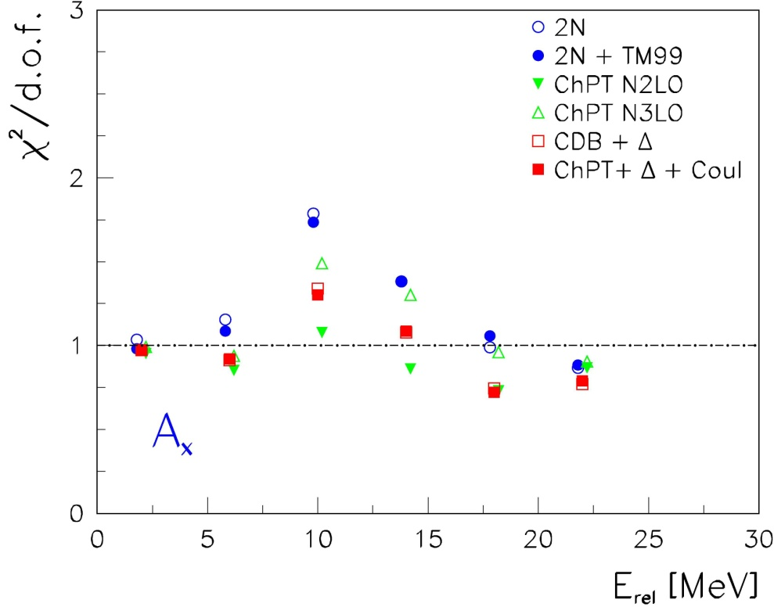
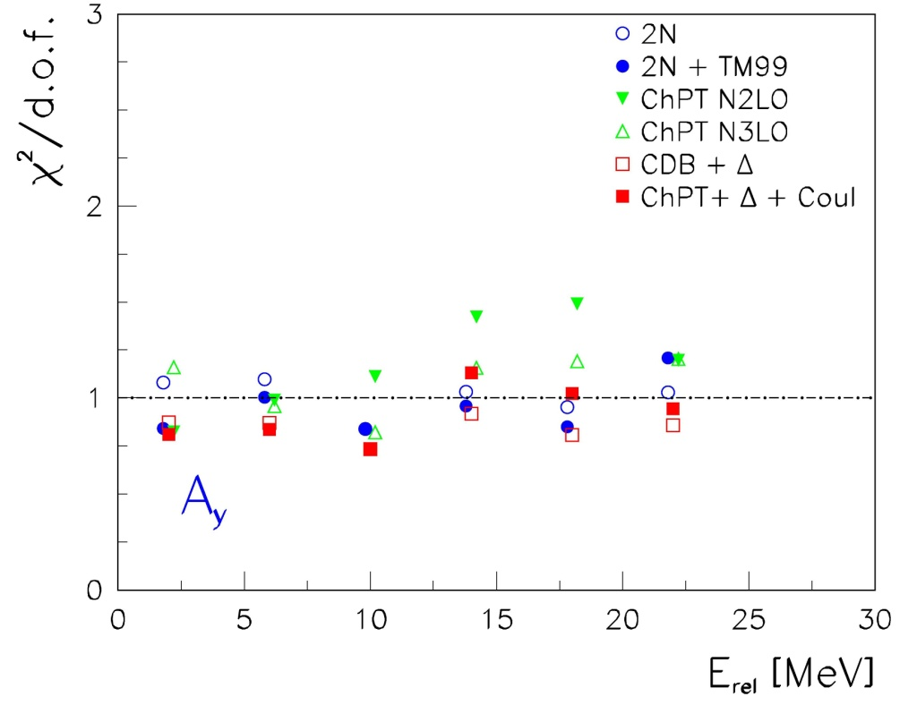
¹H(d,pp)n Measurement at 130 MeV
Vector Analyzing Power Results

Slide 16
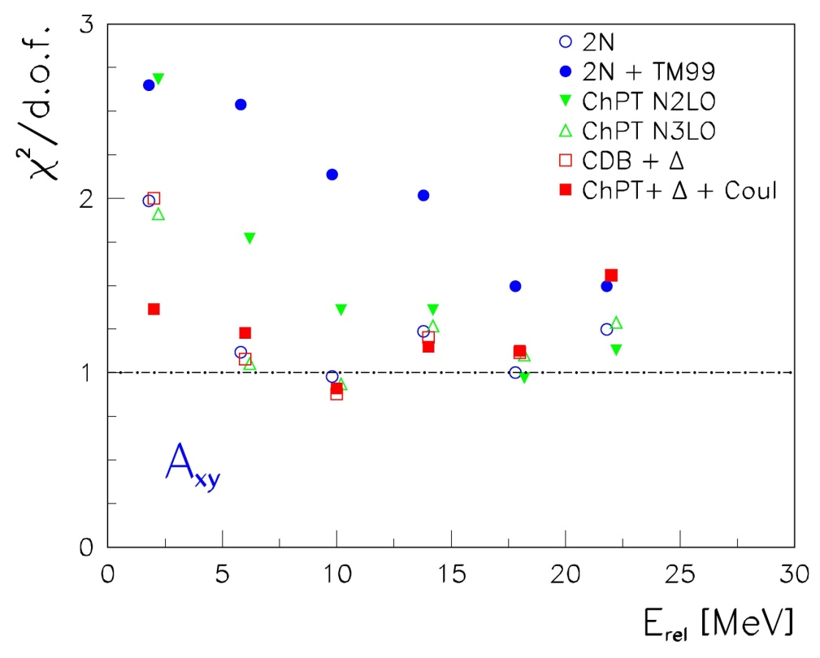
¹H(d,pp)n Measurement at 130 MeV
Tensor Analyzing Power Results
Problem with TM99!

Slide 17
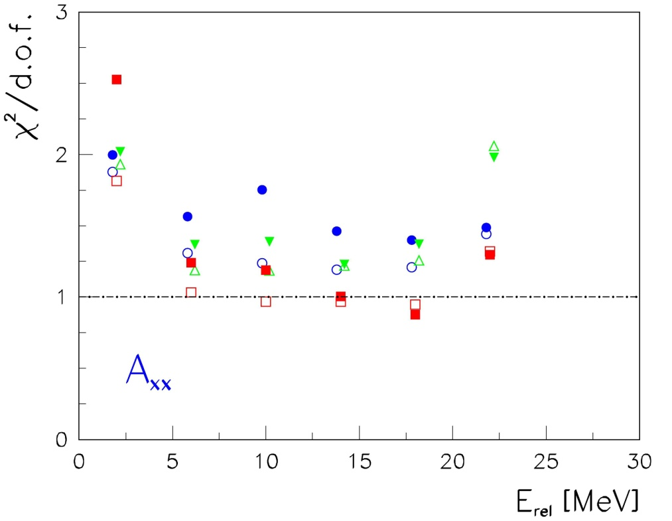
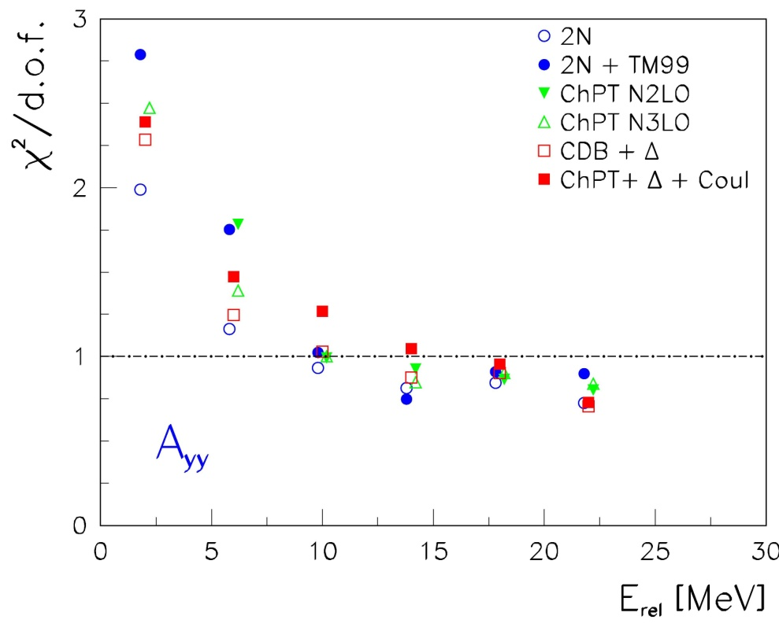
¹H(d,pp)n Measurement at 130 MeV
Tensor Analyzing Power Results
problem at low energies of relative motion of pp pair

Slide 18
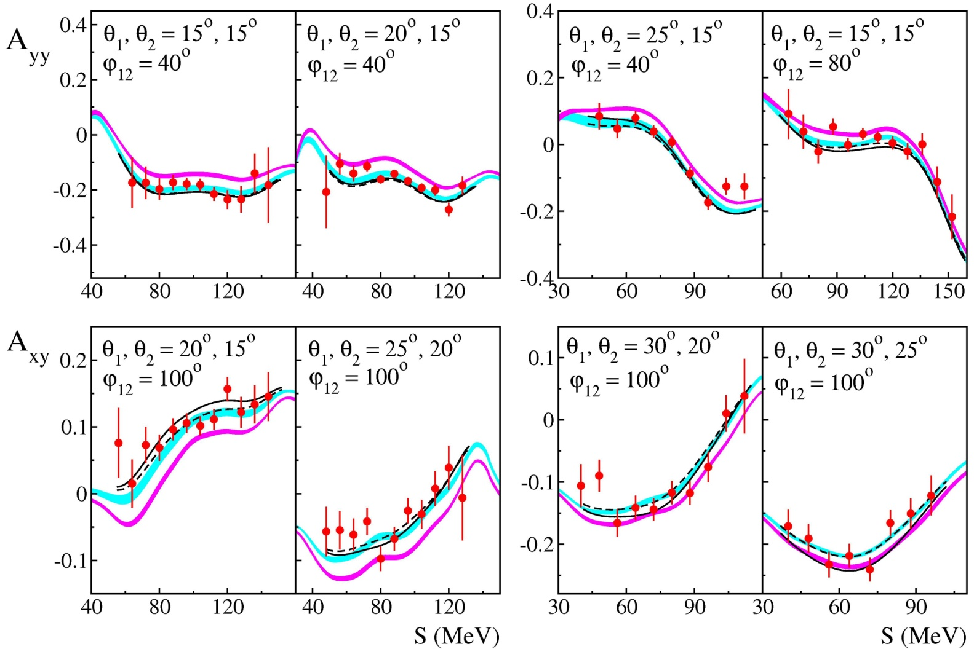
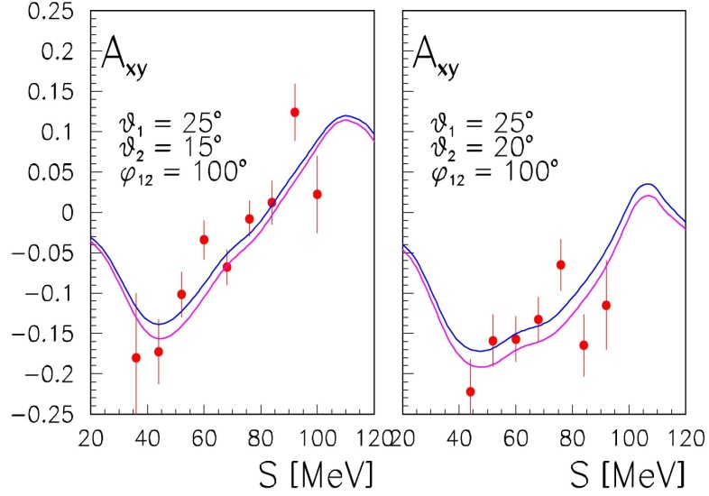
Tensor Analyzing Power Results configurations with predicted strong 3NF effects
100 MeV

Slide 19
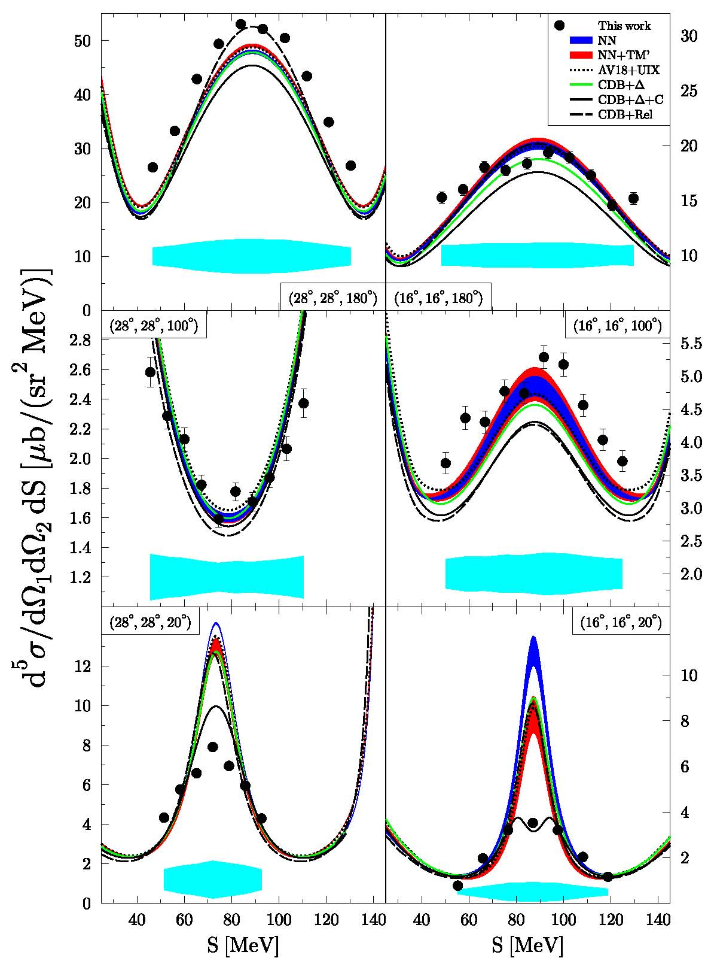
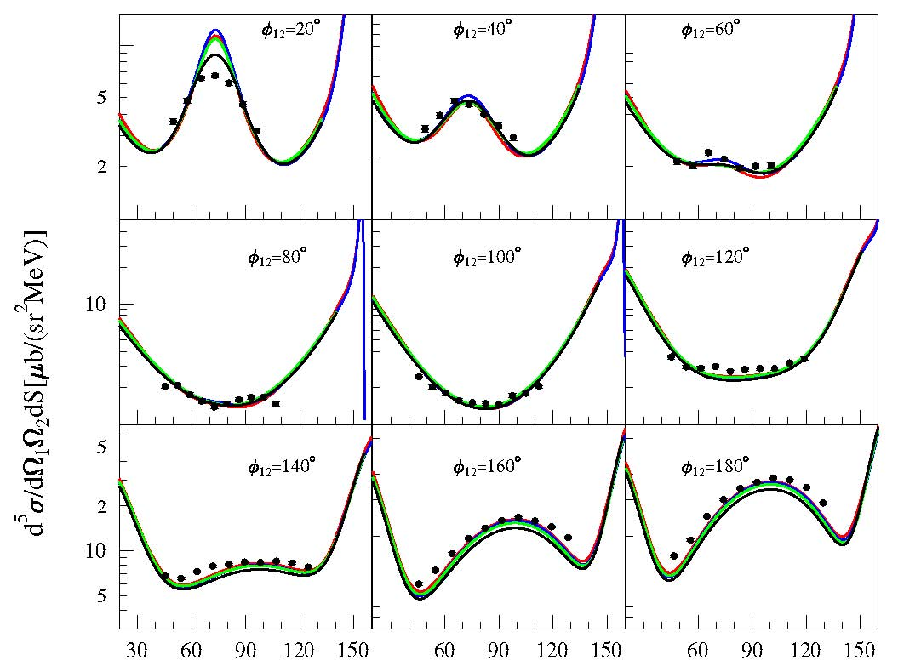
Measurements of ²H(p,pp)n with BINA
Cross sections
E_{p} = 135 MeV
θ = 14º - 30º
Relativistic
effects !
M. Eslami-Kalantari et al.
θ₁=28º, θ₂=24º

Slide 20
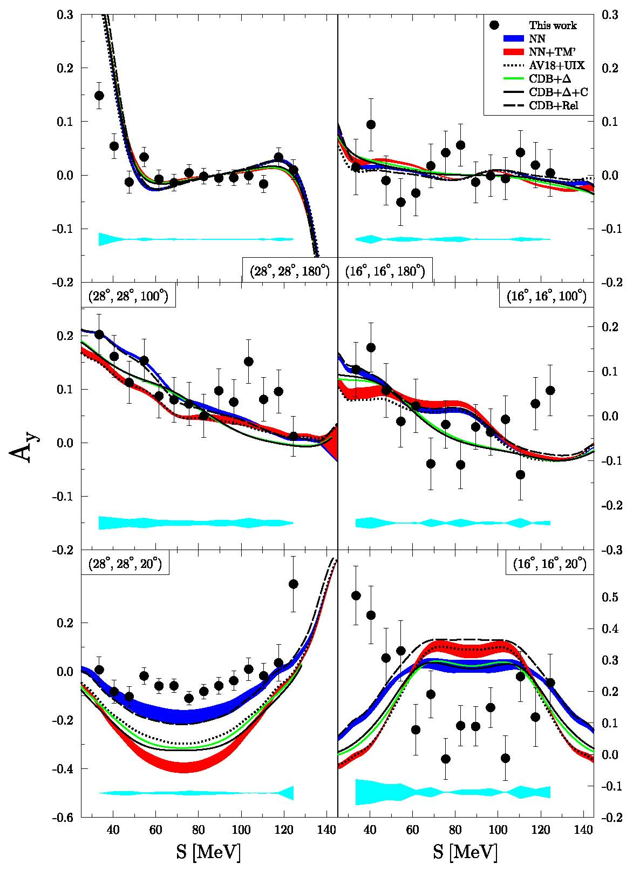
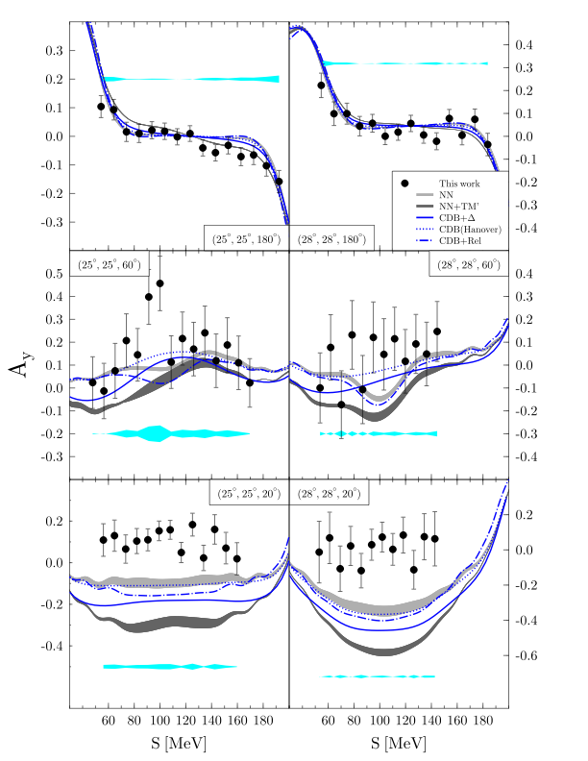
Measurements of ²H(p,pp)n with BINA
Vector (proton) analyzing powers
135 MeV, M. Eslami-Kalantari et al.
190 MeV, H. Mardanpour et al.
P
P

Slide 21
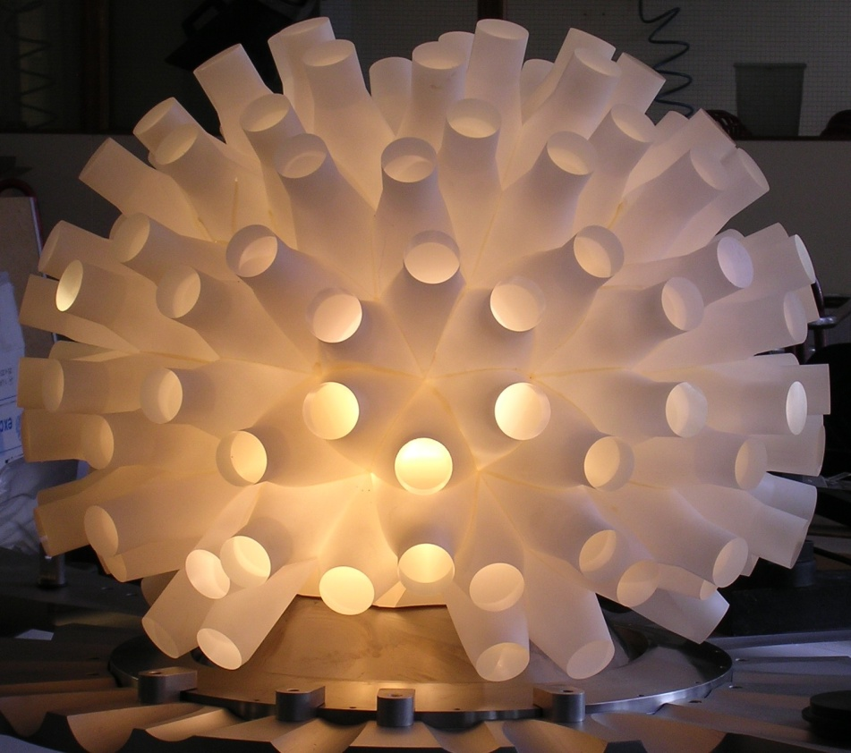
Investigations of 3N continuum
Summary
Rich set of high precision cross sections and analyzing powers data:
  Data at E_{d} = 130 MeV (SALAD) supplemented with results for forward proton angles (GeWall@COSY)
  Complete set for E_{d} = 100 MeV (BINA)
  Measurements for pd systems at 190 and 135 MeV (BINA)
Developments in theoretical calculations for 3N system
  3N force, Coulomb interaction, relativistic effects, higher order in ChPT …

Slide 22
Conclusions:
Significant 3NF effects observed in dp breakup cross section at 130 MeV
For this observable, found large influence of Coulomb force, especially at low energy of relative motion of two protons
Vector (deuteron) analyzing powers at 130 and 100 MeV reveal very low sensitivity to 3NF and Coulomb interaction
Tensor analyzing powers:
  at 130 MeV sensitive to 3NF, but...current models of 3NF do not provide precise description of A_{xy} – problems with spin
  part of 3NF?
  at 100 MeV much less sensitive to 3NF
Relativistic effects confirmed in pd breakup cross section at 190 and 135 MeV
Strong 3NF effects predicted in pd breakup vector analyzing powers at 190 and 135 MeV - not confirmed by the data

Slide 23
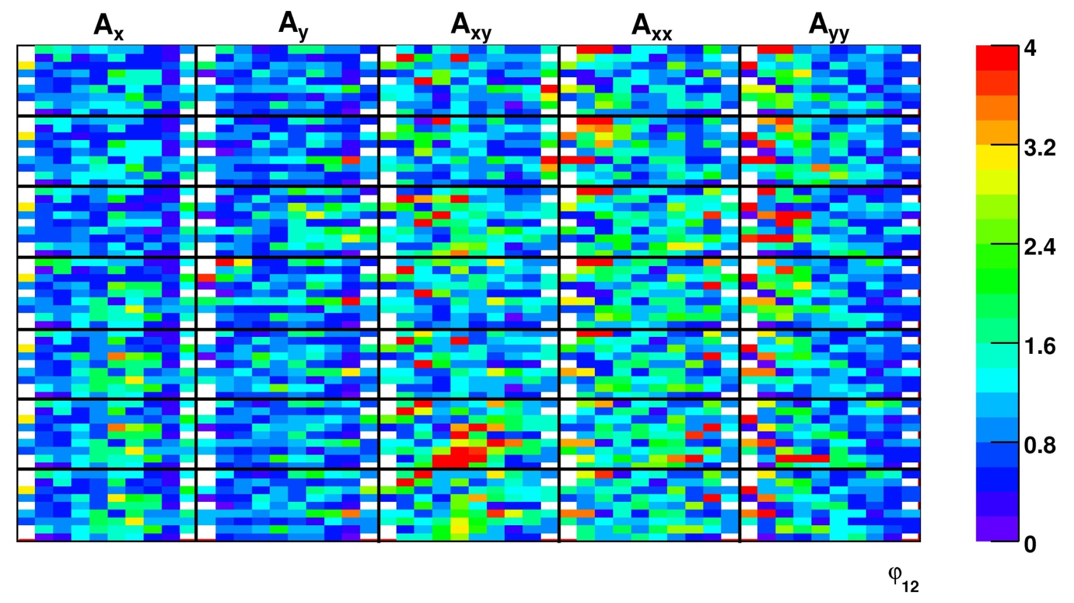
Thank you for your attention!

Slide 24
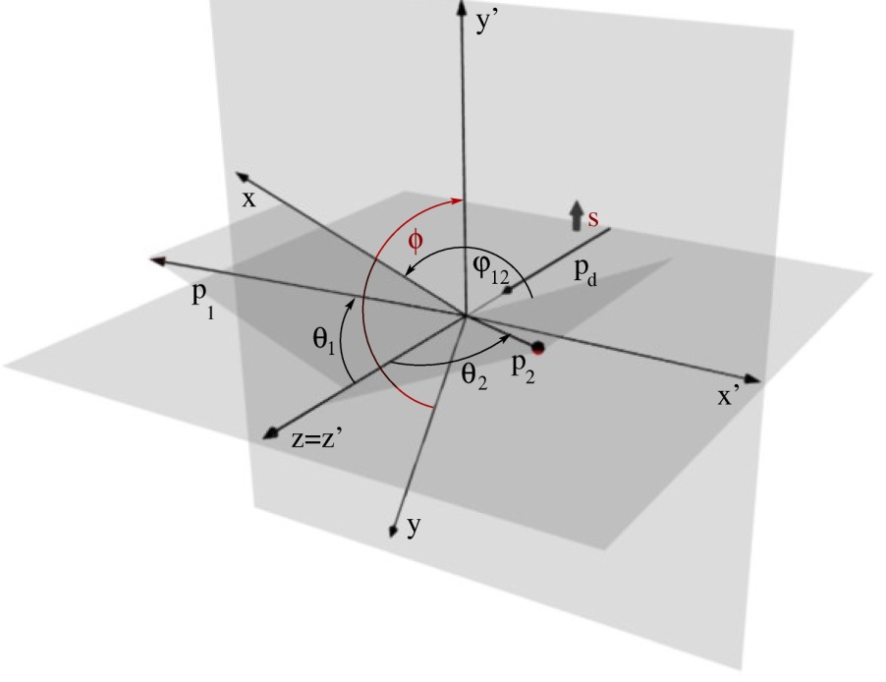
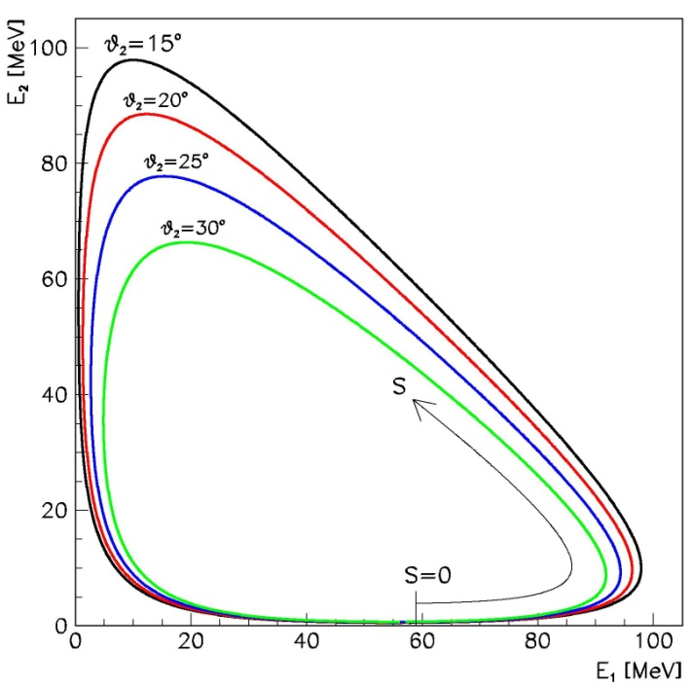
Kinematics of breakup reaction
Three nukleons in final state - 9 variables
Conservation of energy and momentum– 4 equations
Five independent kinematical variables
  Exclusive experiment – measurement of ≥ 5 parameters
  Inclusive experiment – measurement of ≤ 4 parameters
Arc-length S
¹H(d,pp)n
protons:
θ₁,φ₁,E₁
θ₂,φ₂,E₂

Slide 25
¹H(d,pp)n Measurement at 130 MeV
Analyzing Power Results - comparison to theories
CDB+Δ
CDB+Δ+
Coul
ChPT N2LO
ChPT
N3LO
2N
2N+TM99
AV18+UiX

Slide 26
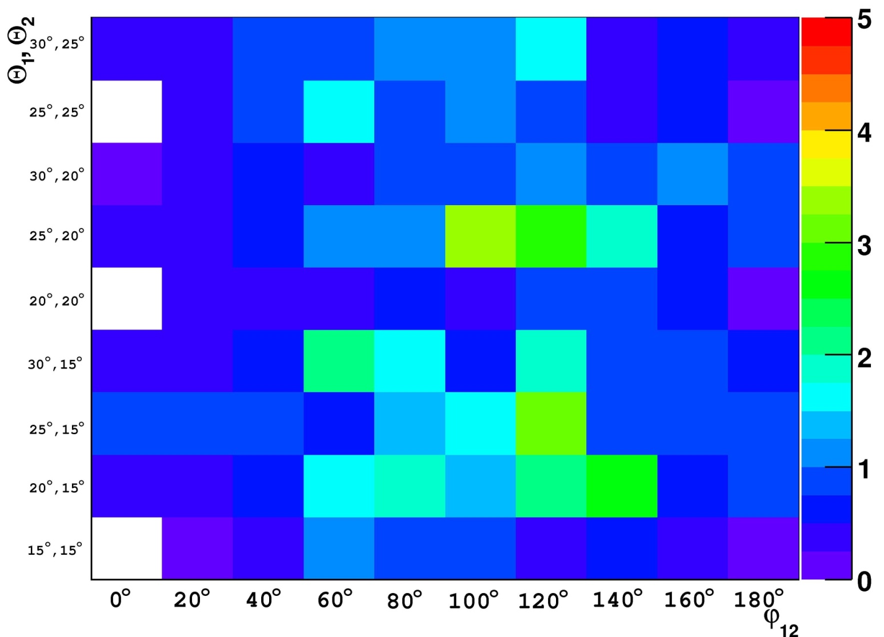
¹H(d,pp)n Measurement at 130 MeV
Analyzing Power Results - comparison to theories

Slide 27
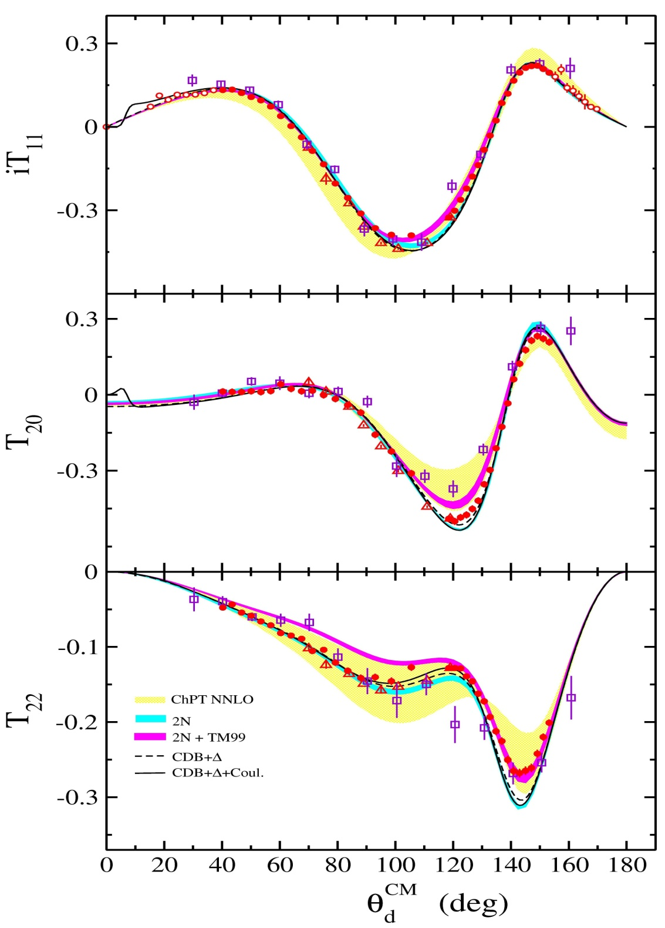
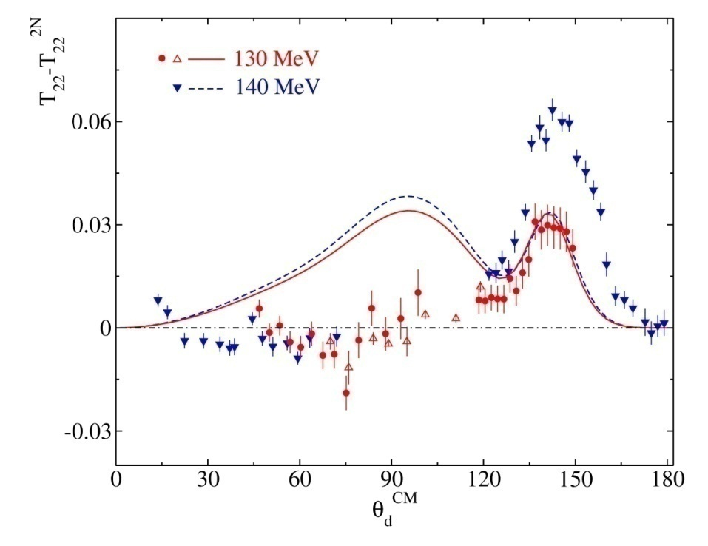
Analyzing powers of elastic scattering
K. Sekiguchi, Phys. Rev. C 70, 014001 (2004)
¹H(d,d)p
¹H(d,dp)
E. Stephan et al.,
Phys. Rev. C 76, 057001 (2007)
GeWall @ COSY
H. Mardanpour et al.,
Eur. Phys. J. 31, 383 (2007)
H. Witała et al.,
Few-Body Systems 15, 67-85 (1993)

Slide 28
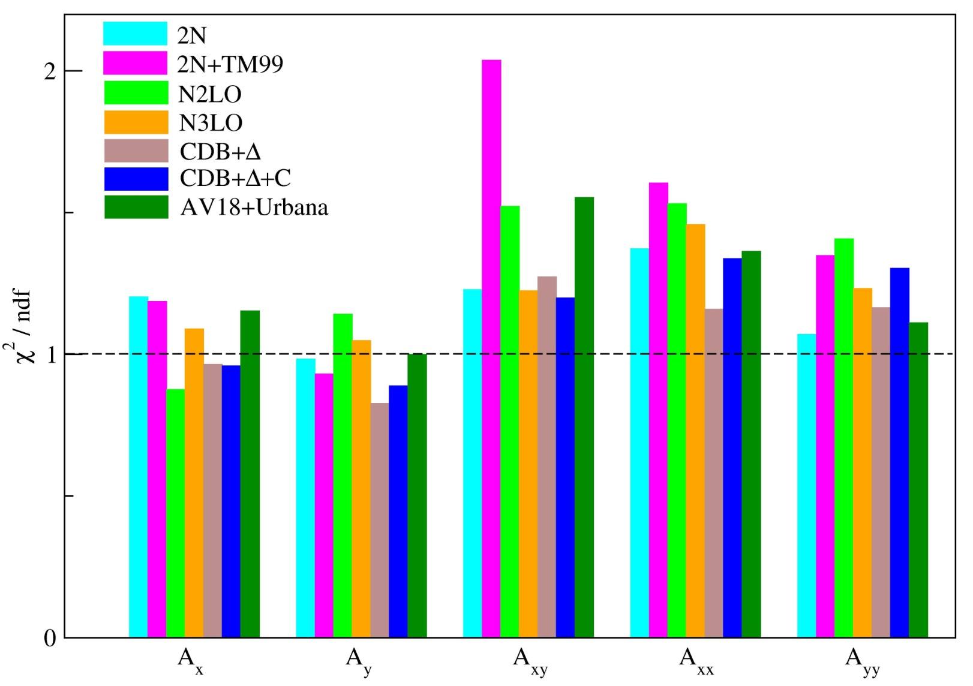
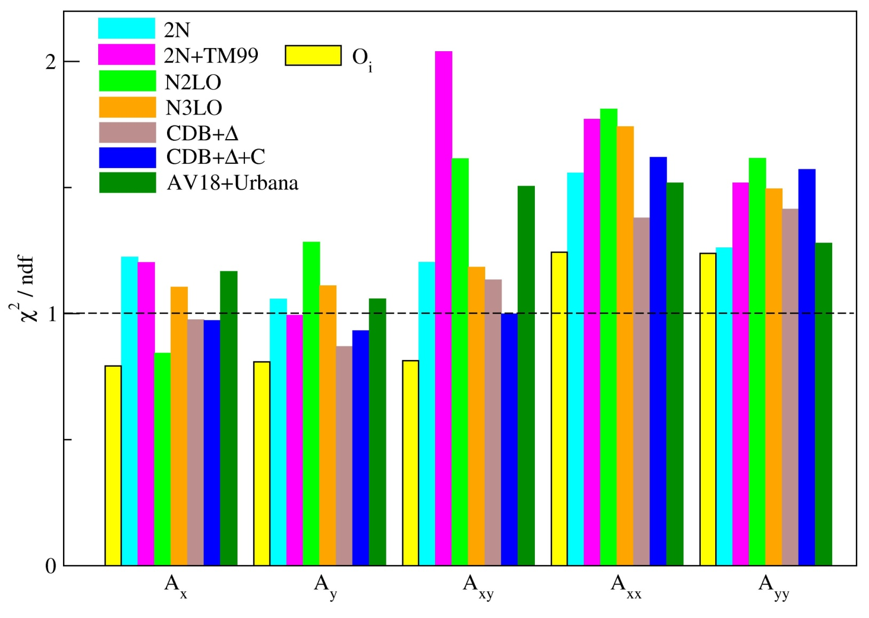
l=1 for "even"
l=0 for "odd"

Slide 29
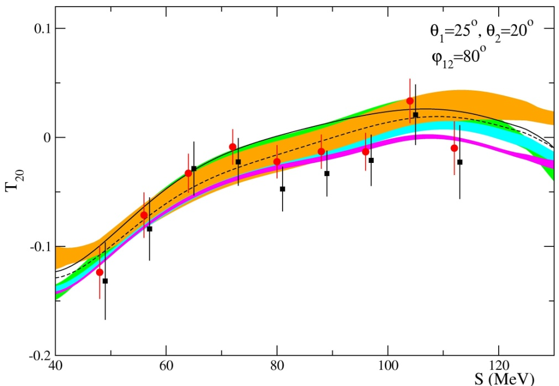
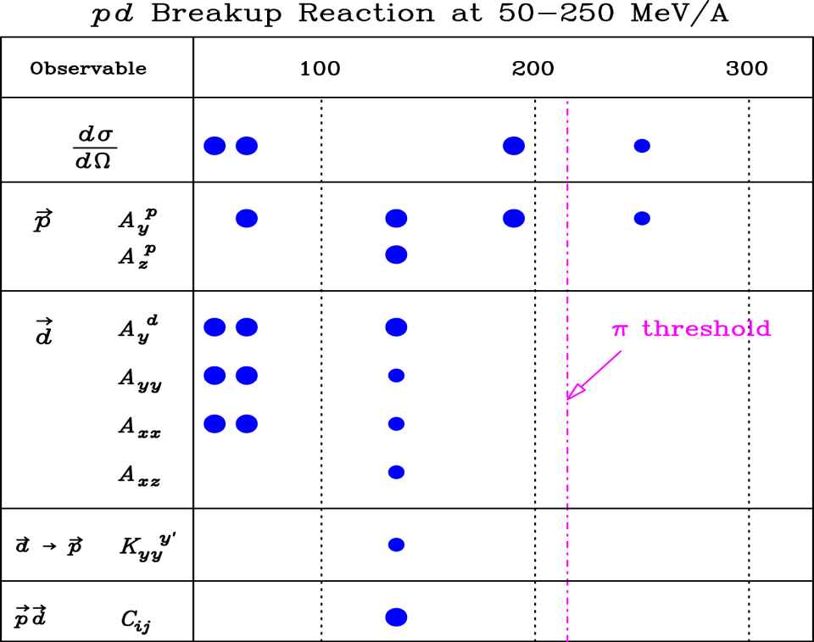

Slide 30
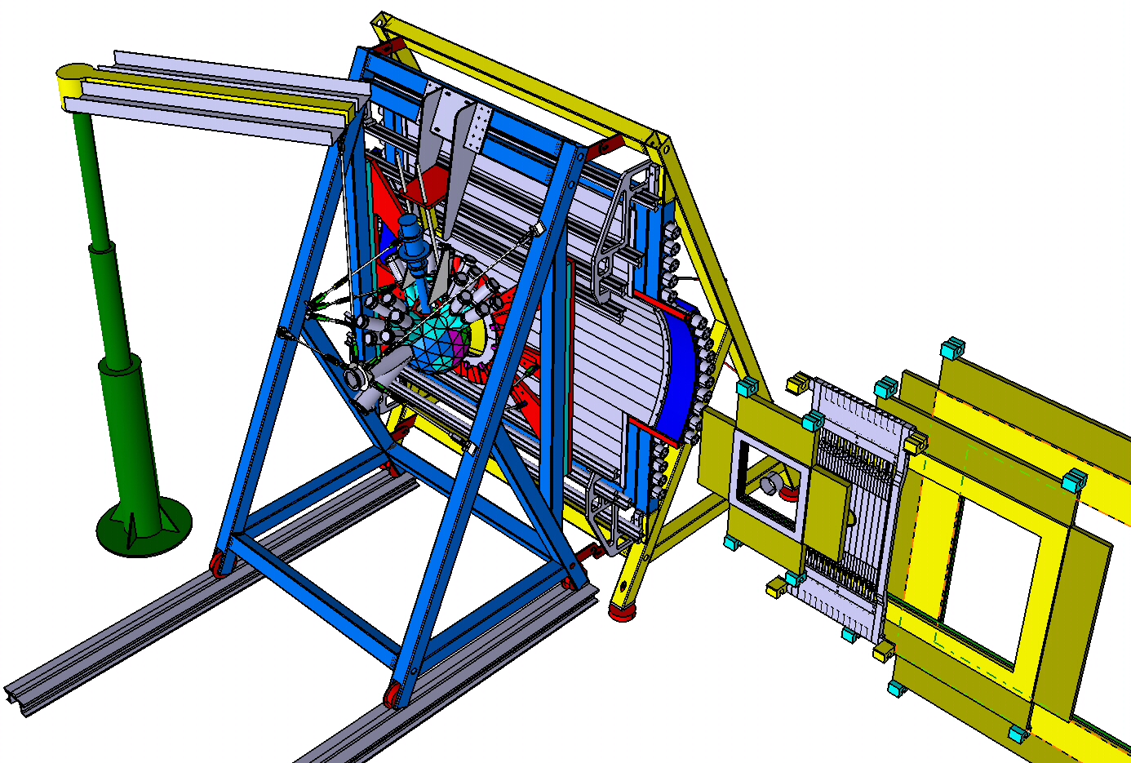
BINA detection system at KVI
BINA Detector
Phoswich Ball
ΔE Wall
Stopping (E) Wall
MWPC

Slide 31
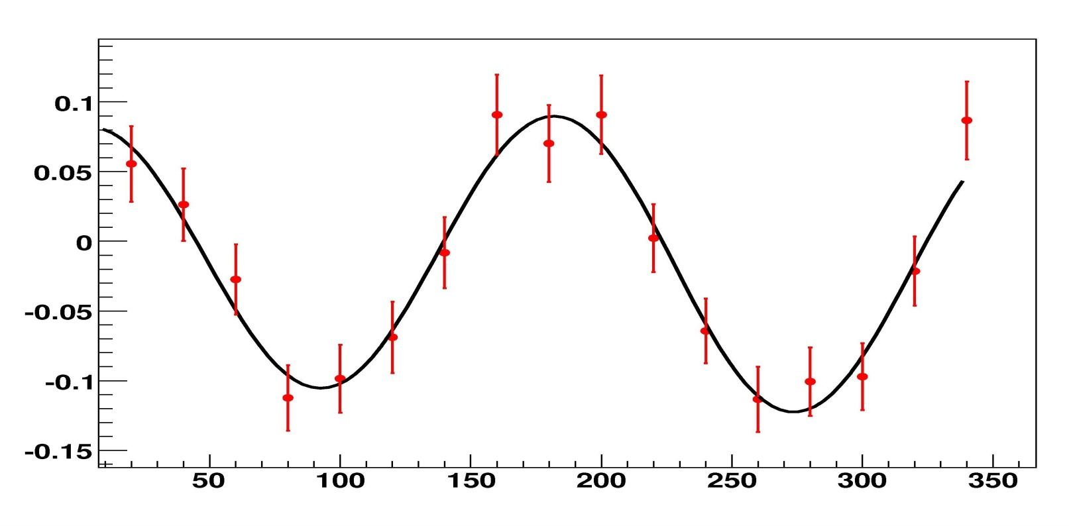
ϕ₁

Slide 32
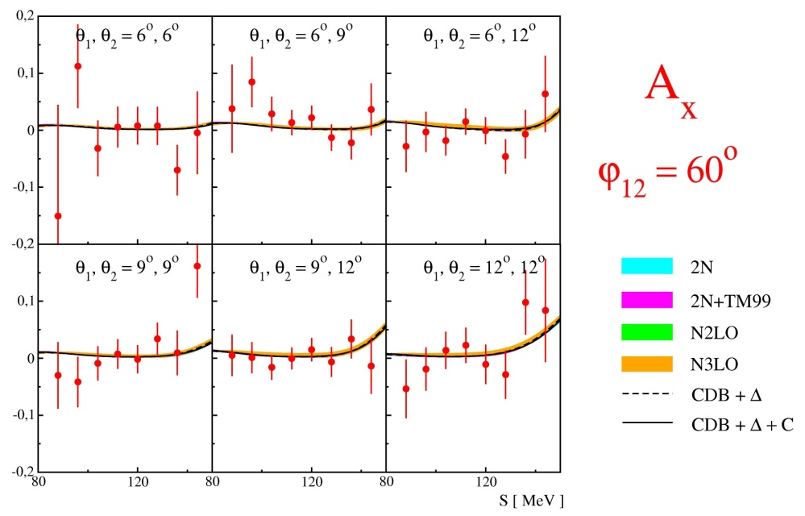
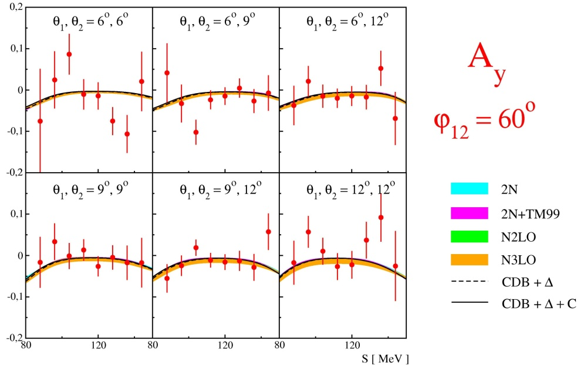
Wektorowe zdolności analizujące
Pomiary przy pomocy GeWall - przykłady

Slide 33
