Slide 1
NN & NY interactions at small energies
Hartmut Machner, FZ Jülich and Univ. Duisburg-Essen
Frank Hinterberger, Univ. Bonn
Regina Siudak, PAN Krakow
for the HIRES & GEM collaborations
Why is this important?
NN interactions ←→ Nuclear potential, nuclear structure
NY interactions ←→ Hypernuclear potential, hypernuclear structure
1
Notes:
1

Slide 2
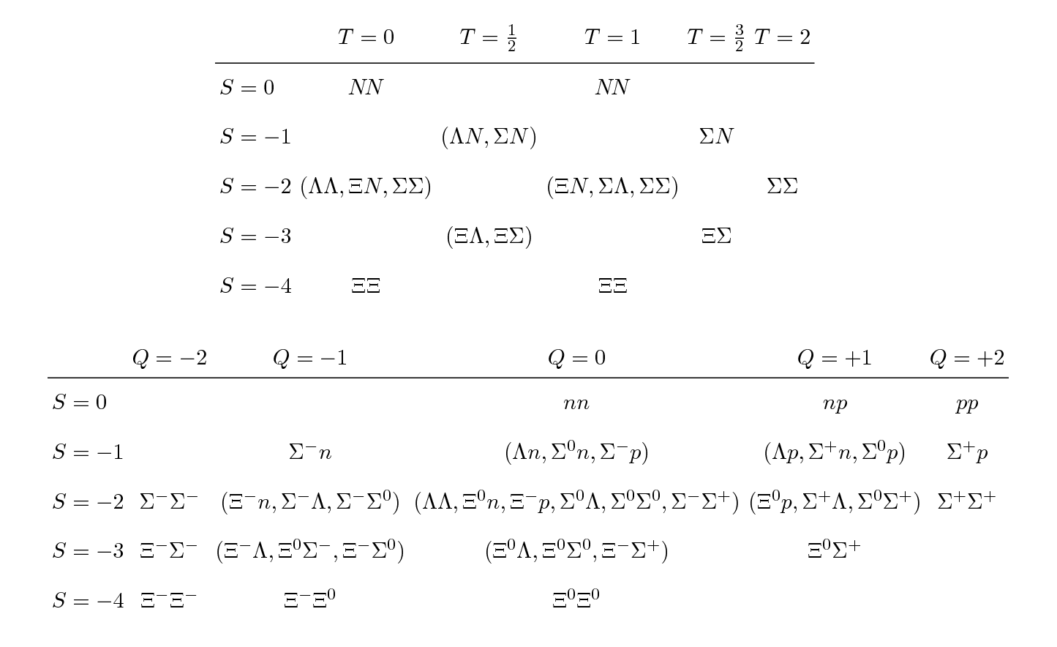
All possible interactions

Slide 3
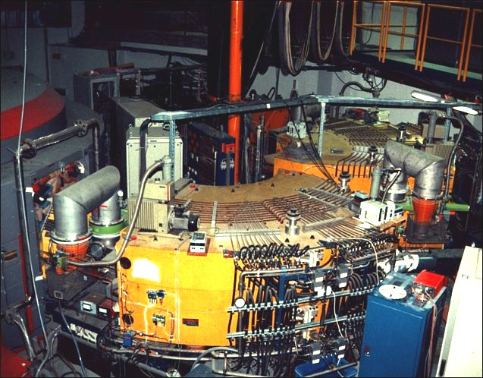
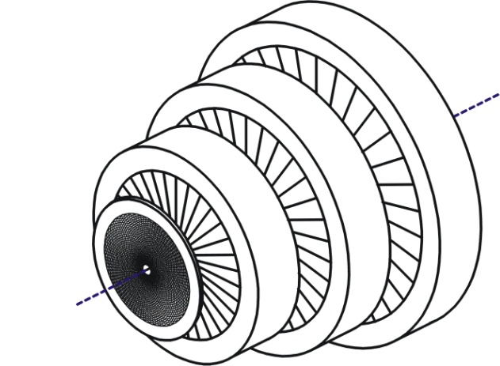
Detectors: Big Karl +
Ge-Wall
focussing spectrometer (Ω = 10 msr)
high resolution Δp/p < 5×10⁻⁵
combined with detectors close to target:
multi-layer Germanium detector GEM
Germanium
detector

Slide 4
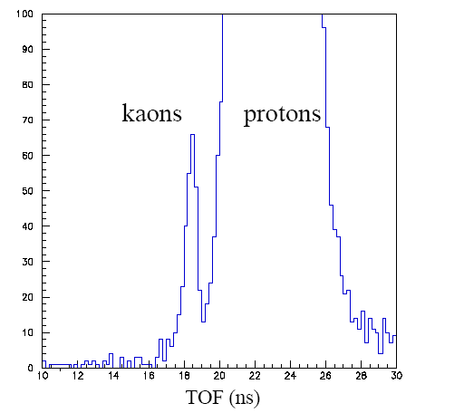
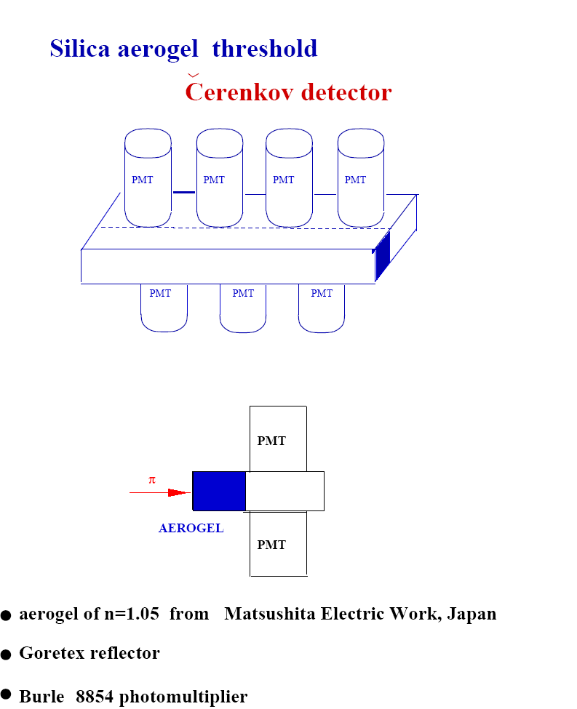
Particle identification
NIM A 596 (08)311

Slide 5
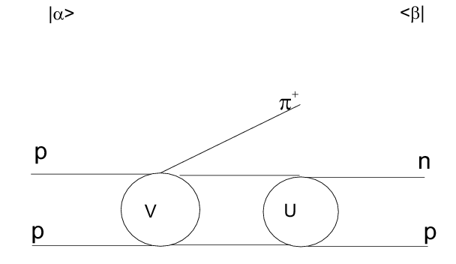
Problem
Often the target or the beam is not available or even impossible. Way out: three body final states with fsi (Watson+Migdal theory):
factorisation:
with
leads to

Slide 6
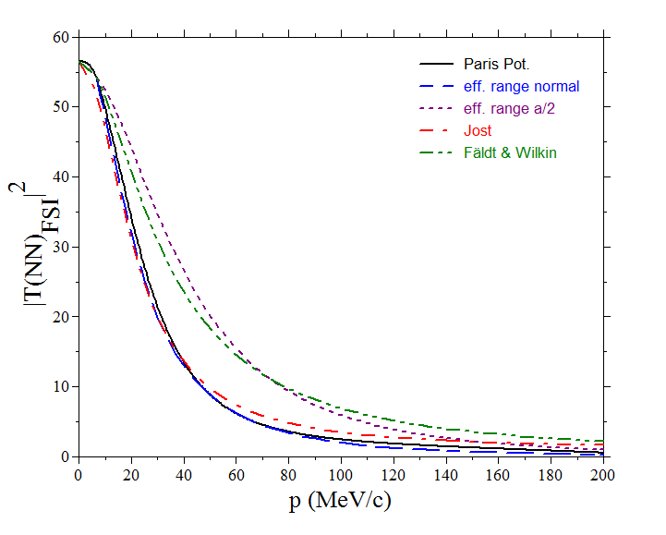
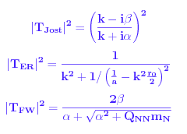
FSI approaches
A lot of studies made use of a Gauss potential. However the Bargman potential is the potential which has the effective range expansion as exact solution: a, r → α, β. α defines the pole position (positive ↔ bound, negative ↔ unbound).

Slide 7
The pp-case
Elastic pp scattering, Coulomb force seems to be well under controle: a_{pp}=-7.83 fm
However: an IUCF group
Claimed „…the data require a_{pp}=-1.5 fm.“ They questioned the validity of the factorization.
Experiment at GEM, differential and total cross sections.
PRC 65(02)0641001

Slide 8
Modell
FSI with Gamow factor, to account for Coulomb repulsion
PRC 65(02)0641001

Slide 9
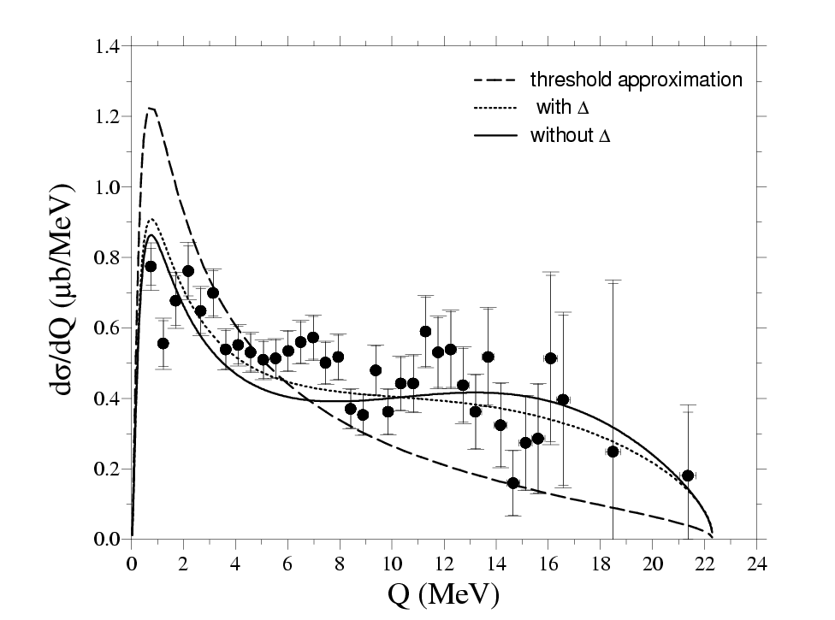
Projection of Dalitz plot

Slide 10
pp→ppπ⁰
FIT Ss, Pp (Ps from polarisation experiments)
blue: no Δ resonance
red: with Δ resonance, usual fsi
black: with Δ but fsi with half the usual pp scattering length
No need for a change of the scattering length!

Slide 11
Connection bound-continuum
Fäldt & Wilkin derived a formula ( for small k)
From this follows, that from a the cross section of a known pole (bound or quasi bound) the continuum cross section is given [N(d)→N(pn)_{t}→ξN(pn)_{s}].
The fsi is large for excitation energies Q of only a few MeV.
type | pro | contra
single arm | absolute normalization of the triplet fraction | contamination from deuteron
double arm | no contamination from deuteron | no absolute normalization
best: an experiment avoiding the con’s. → high resolution single arm

Slide 12
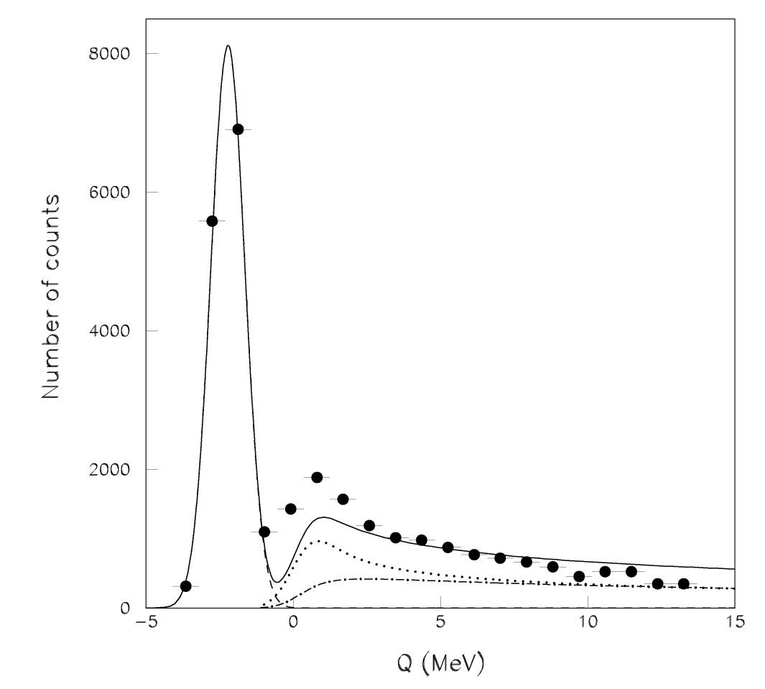
Old analysis
singlet
d+p→p+(pn)
triplet
T_{d}=1600 MeV

Slide 13
Recent data Celsius
Uppsala
PLB 446(99)179

Slide 14
GEM data
p=1642.5 MeV/c
PLB 610(05)31

Slide 15
Singlet FSI absolute

Slide 16
Triplet FSI absolute

Slide 17
Full spectrum
singlet fraction | Ref.
0.40±0.05 | Boudard et al.
< 0.10 | Betsch et al.
<0.10 | Uzikov & Wilkin
< 0.10 | Abaev et al.
< 0.003 | this work
Why is there no singlet state?
The isospin related reaction to the singlet state is pp→ppπ⁰
first high resolution measurement allowing to study the threshold region of the d break up
fixed cross section for the unbound triplet state
the upper limit for the singlet break up contribution was reduced by a factor of 3
the ratio for unbound to bound state is < (1.9±0.5) ×10⁻³

Slide 18
Data vs Fäldt Wilkin
Why?
Tensor force?
PRC 79(09)061001(R)

Slide 19
3 body calculation with tensor force
Relativistic phase space
Reid soft core
Also necessity to normalize

Slide 20
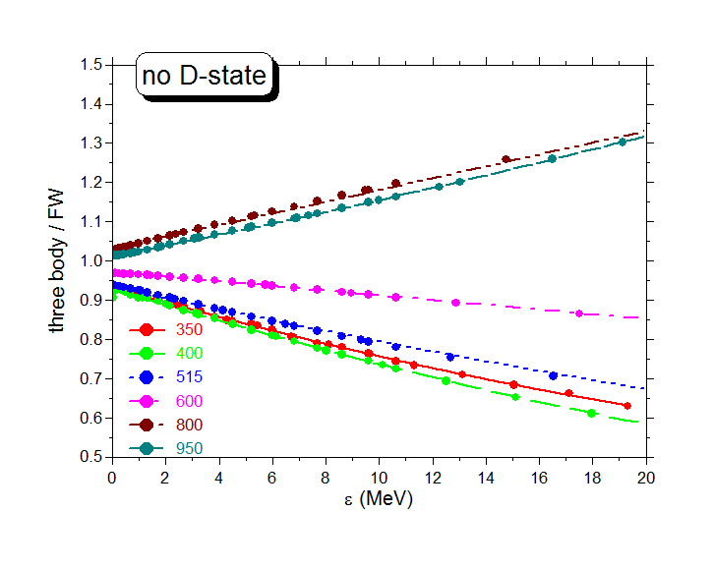
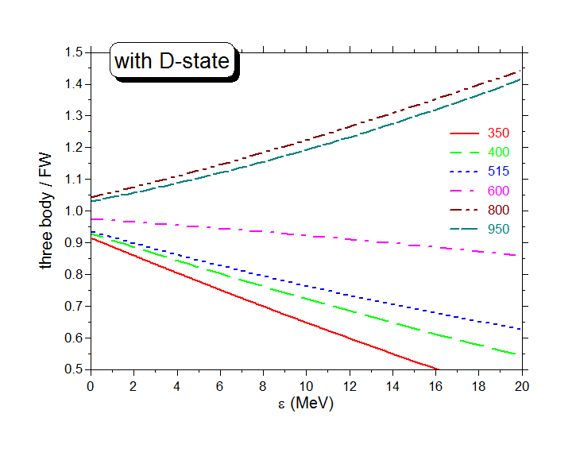
It‘s not the tensor force!
What is it then? Long ranging force!

Slide 21
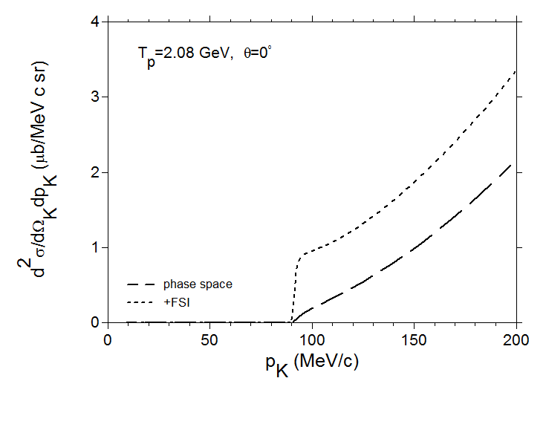
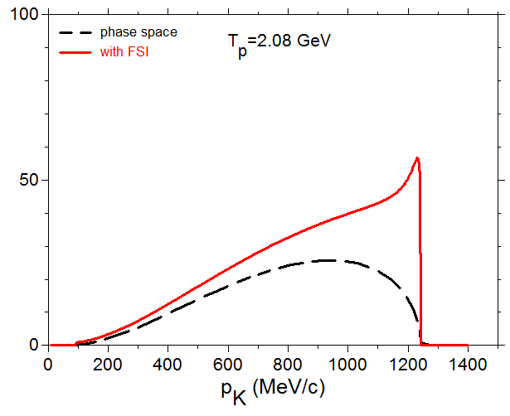
pp→K⁺Λp: why the forward Kaons under zero degree?
Kaons being forward emitted in the
cm system
Kaons being backward emitted in the
cm system
FSI as deduced from the present experiment

Slide 22
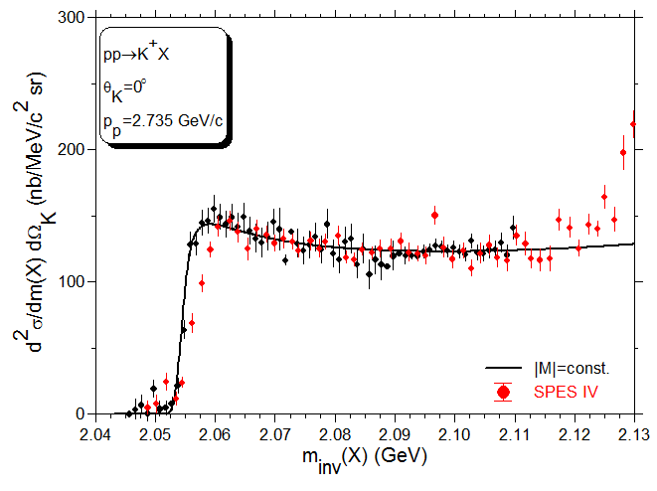
Hyperon production
P_{beam} =2735 MeV/c and 2081.2 MeV/c
PLB 687(10)31

Slide 23
Three inputs
2
1
K⁻d2π⁻Λp: (Tai Ho Tan, PRL 23(69)695
a_{t} =−2.0 ±0.5 fm and r_{t} = 3.0±1.0 fm
3

Slide 24
Results from 6 parameter fit

Slide 25
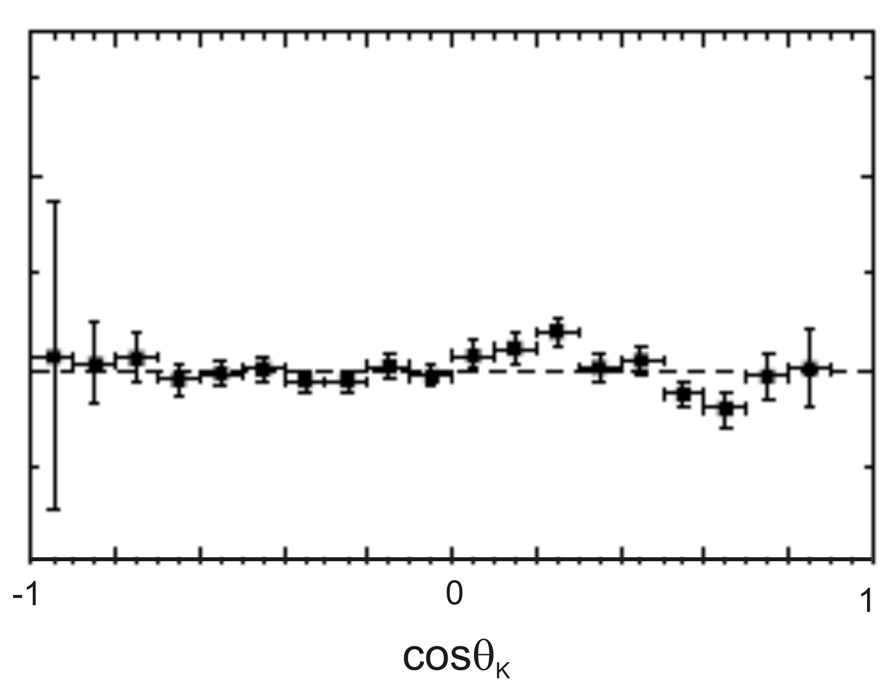


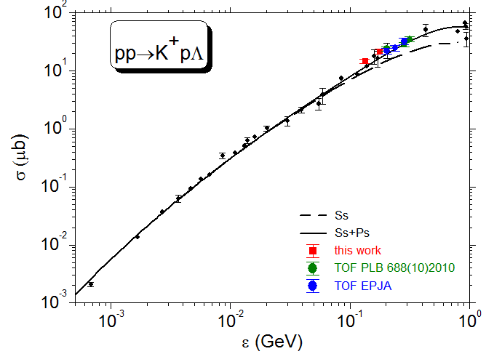
Total cross sections
Almost isotropic Kaon angular distribution → *4π

Slide 26
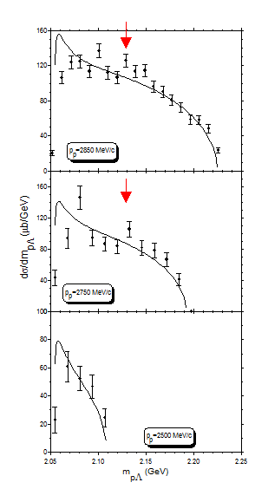
Comparison with
exclusive data
Data: COSY TOF
No fit: input: total cross section given plus FSI

Slide 27
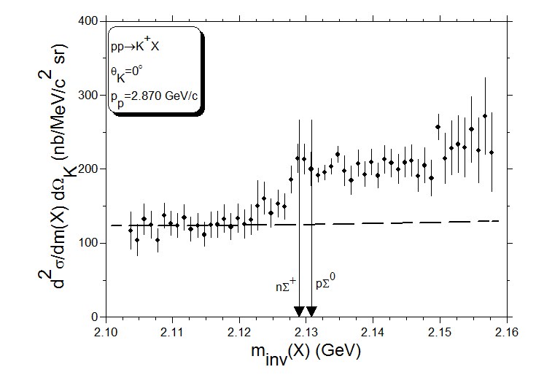
Data at higher beam momentum

Slide 28
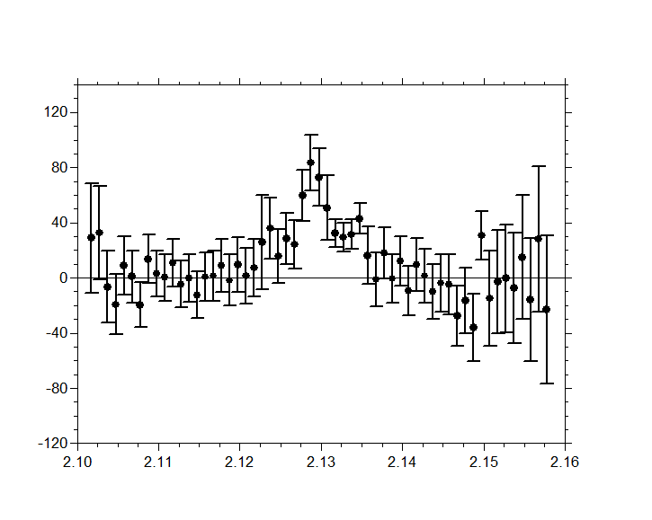
cusp in pΛ
due to tensor
force?

Slide 29
Summary
We have measured pp→π⁰pp (full Dalitz plot)
Data and total cross sections can be discribed with standard parameters of pp FSI
We have measured pp→π⁺np with very high missing mass resolution (ΔMM/MM=5*10⁻⁵)
FW theorem discribes the shape of the continuum but fails to give the absolute height
The tensor force is not the origin for that, but long ranged forces
We have measured pp→Κ⁰Λp at two beam momenta.
FSI parameters could be deduced as well as total cross sections.
We see an enhancement at and below the ΣN thresholds.
Notes:
29

Slide 30
Summary cont.
What this structure?
- two step process with kinematic matching? No, too large width
- a cusp? (Nijmegen group: in ³S₁ channel, Haidenbauer)
- a resonance in Λp→Λp, shoulder from Σ⁺n→Λp (Dalitz: fourth sheet pole) ?
- bound state is excluded (no second sheet pole)
np and Λp seem to have opposite behavior in FSI:
np almost only spin triplet, bound state exists
Λp almost only spin singlet, no bound state exists

