Slide 1
Meson Physics at JLab
Now and at 12 GeV
L. Cardman
Jefferson Lab and University of Virginia
MESON 2010

Slide 2
Outline
What is JLab today, and how will that change with the 12 GeV Upgrade
Examples from the physics program relevant to Meson Physics
  Meson spectroscopy / hybrids
  Nucleon spectroscopy via meson decay channels
  Meson form factors
  Mesons as a probe of strongly interacting matter and mesons in medium
  Hypernuclear physics
  Symmetry tests in nuclear physics w/ mesons, ….
Other Physics Motivating the 12 GeV Upgrade

Slide 3
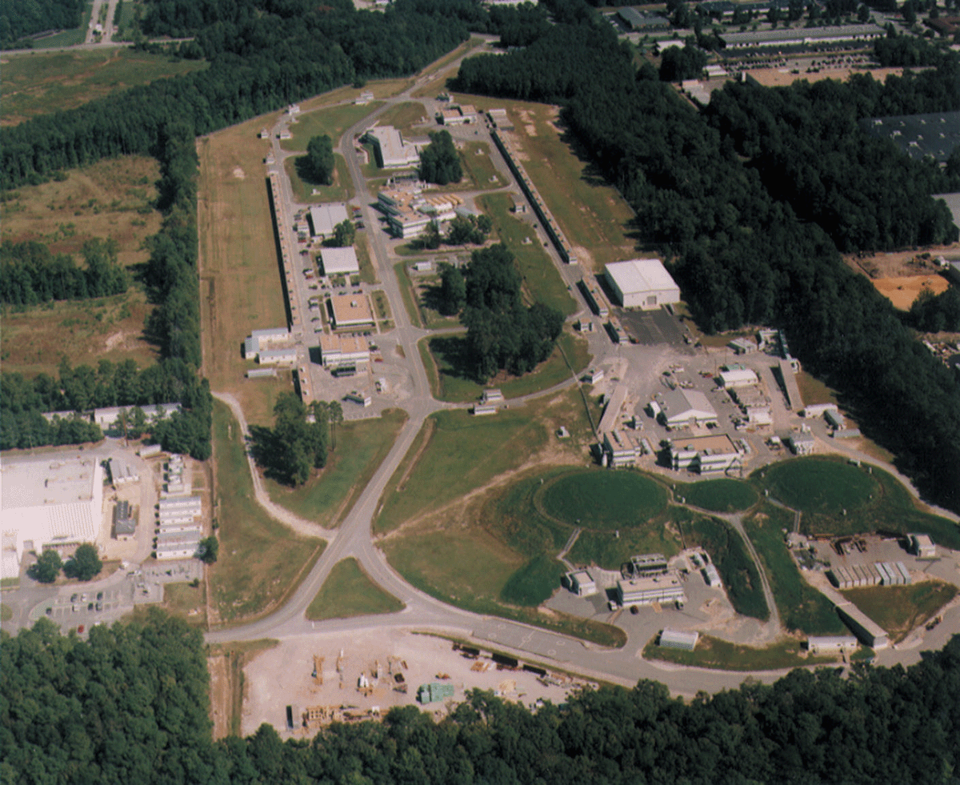
Arc
Linac
Linac
Arc
3 End Stations

Slide 4
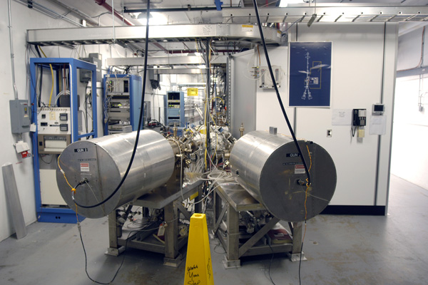
Arc
Linac
Linac
Arc
3 End Stations
The JLab Polarized Electron Source

Slide 5
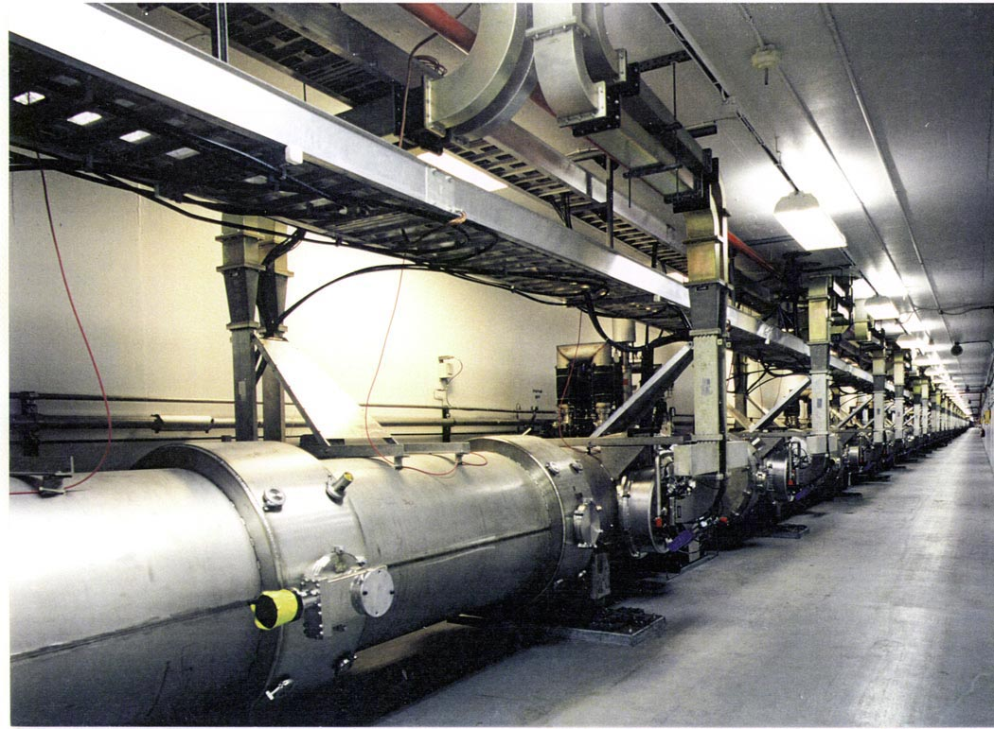
Arc
Linac
Linac
Arc
3 End Stations

Slide 6
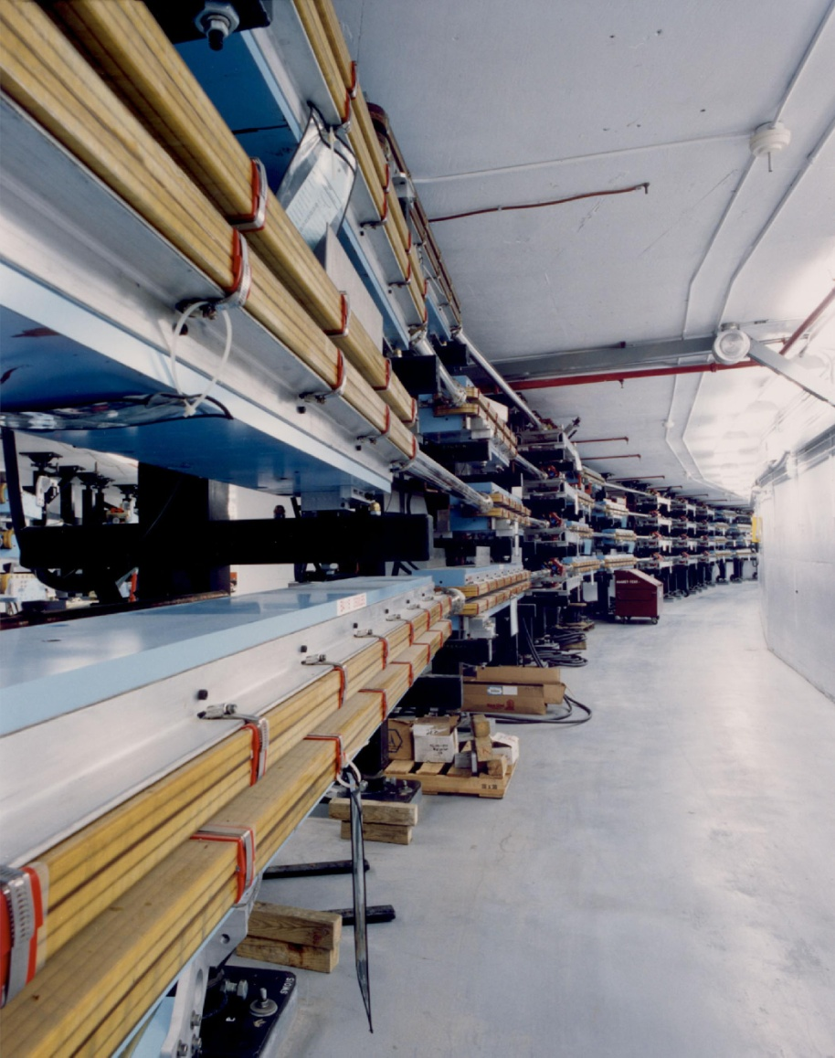
Arc
Linac
Linac
Arc
3 End Stations

Slide 7
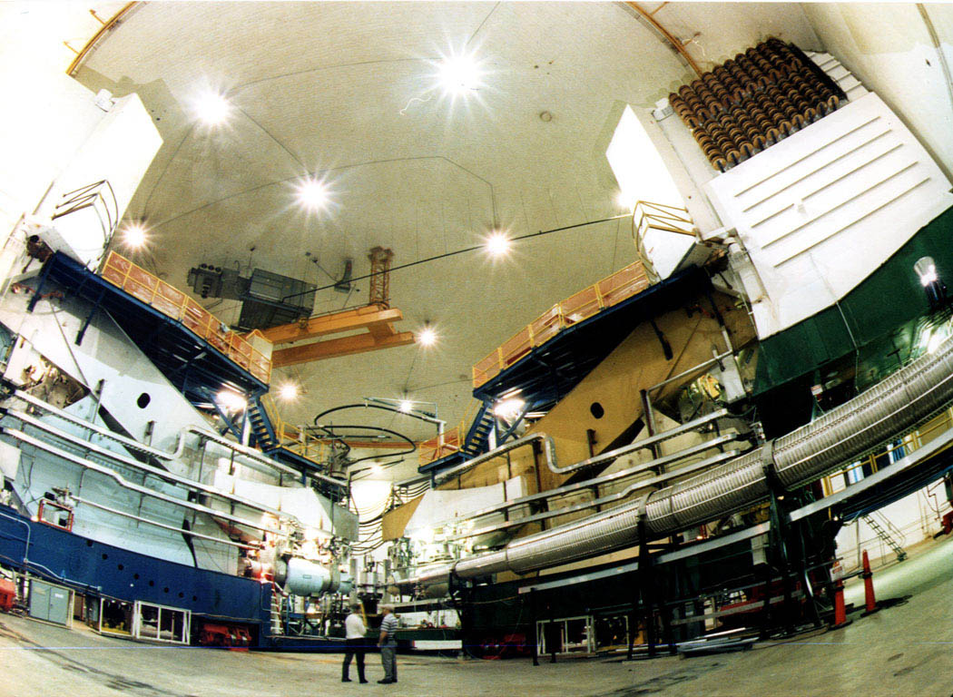
Hall A: Two High Resolution (10⁻⁴) Spectrometers

Slide 8
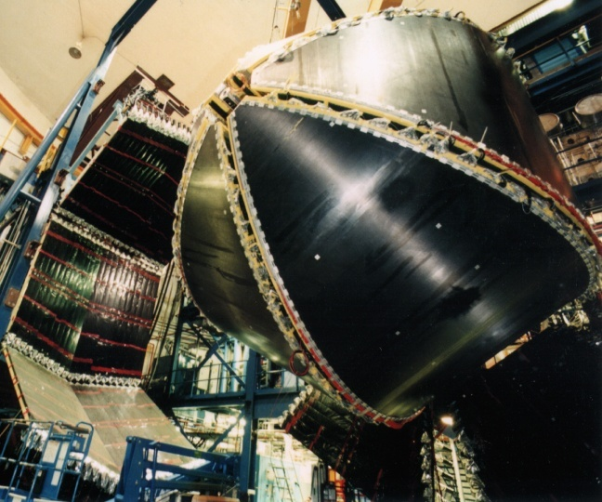
Hall B: The CEBAF Large Acceptance Spectrometer (CLAS)

Slide 9
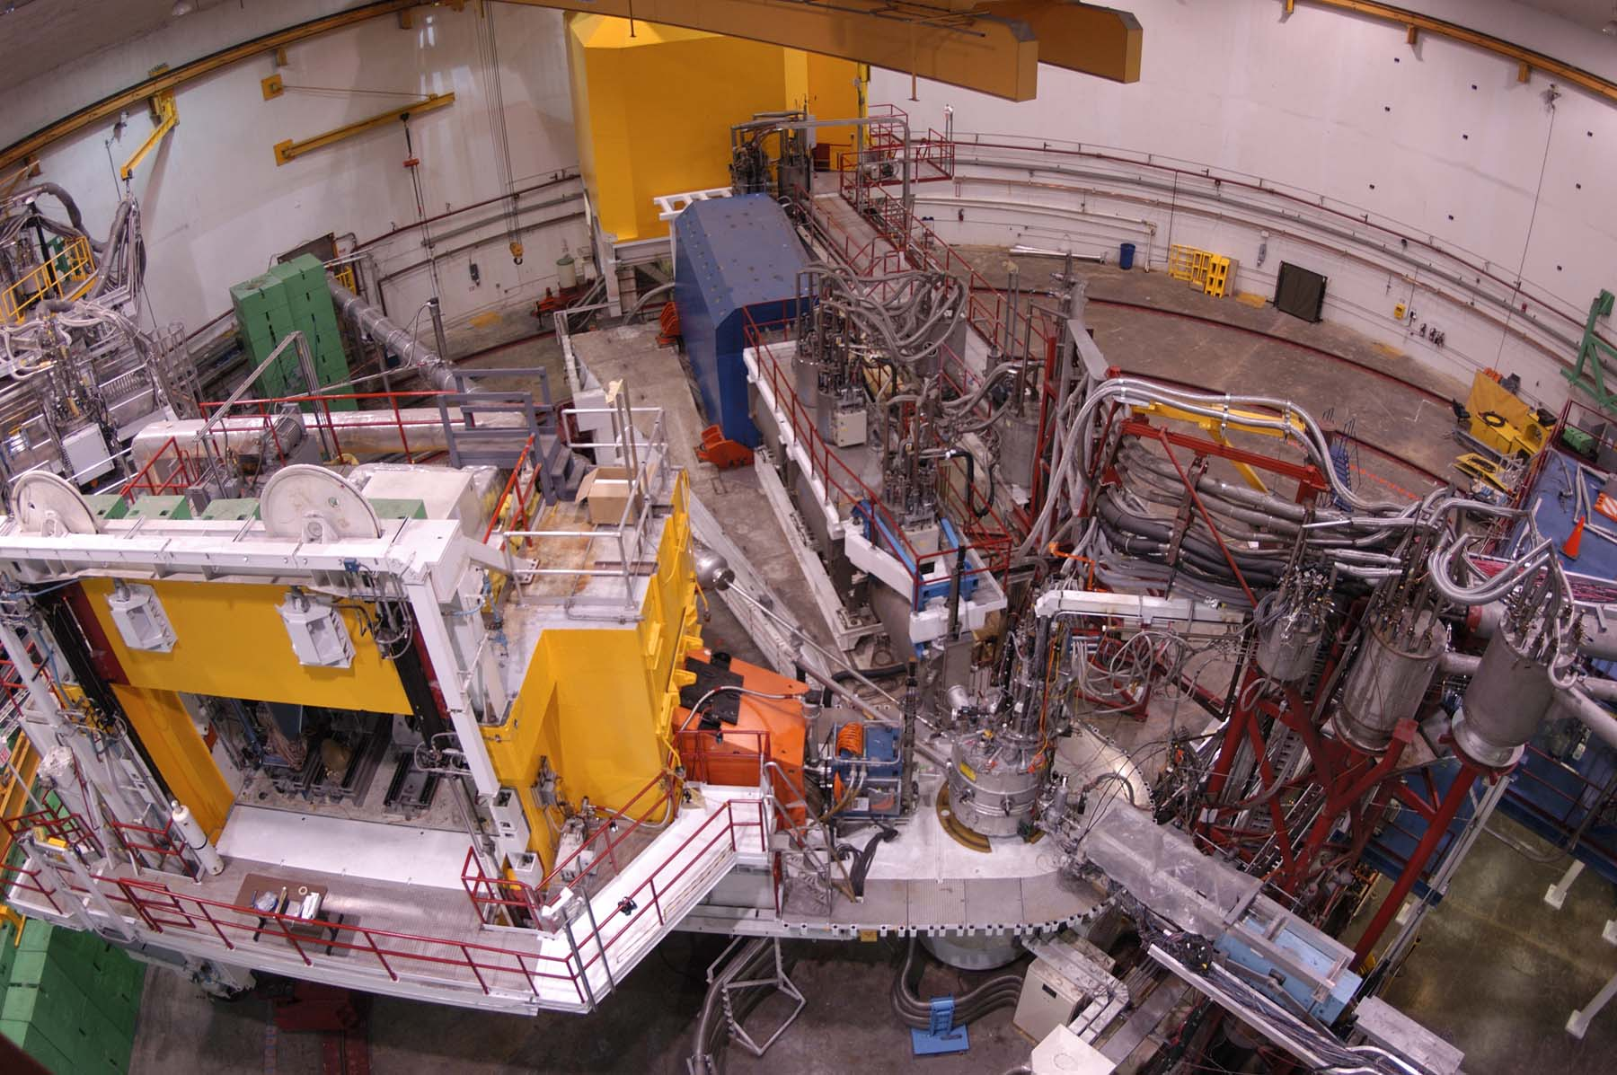
Hall C: A High Momentum and a Broad Range Spectrometer
Setup Space for Unique Experiments

Slide 10








12 GeV to Hall D
12
6 GeV CEBAF
11
Upgrade magnets and power supplies
CHL-2
Two 0.6 GeV linacs
1.1
Enhanced capabilities
in existing Halls
11 GeV Available to Halls A, B, and C
Lower pass beam energies
(2.2, 4.4, 6.6 GeV) still available
Notes:
help me

Slide 11
CEBAF: Now and After the Upgrade
Routinely provide beam polarization of ~85% now, same in 12 GeV era

Slide 12
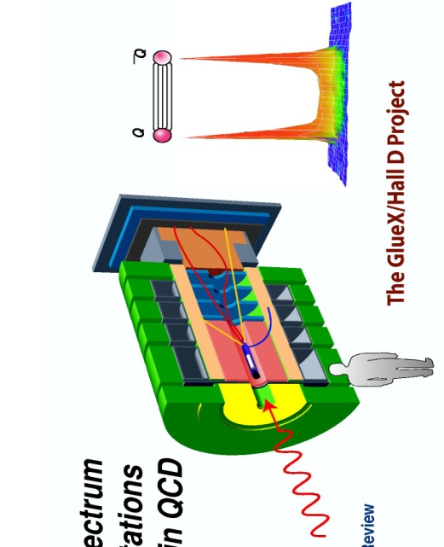
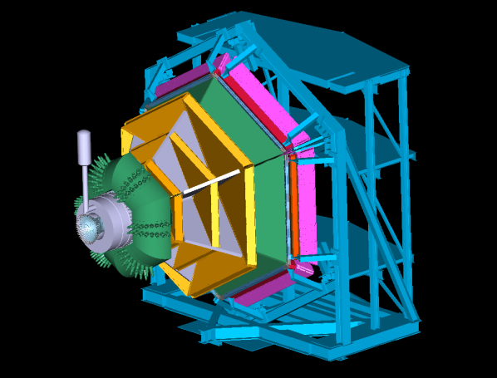
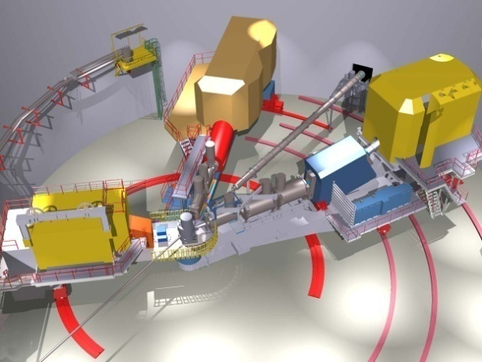

12 GeV Upgrade Physics Instrumentation
GLUEx (Hall D): exploring origin of confinement by studying hybrid mesons
CLAS12 (Hall B): understanding nucleon structure via generalized parton distributions
SHMS (Hall C): precision determination of
valence quark properties in nucleons and nuclei
Hall A: short range correlations, form factors, hypernuclear physics, & future new experiments
Notes:
Note BSM not included in project

Slide 13
A Sampling of Meson Physics Under Study at JLab (now and @ 12 GeV)
Meson spectroscopy – the search for hybrid mesons
Nucleon spectroscopy via meson decay channels
  Now – mainly π, ω, η, 2π, ….;
  tagged virtual photons & heavier meson decay channels @ 12 GeV
Meson form factors
  F_{π}, F_{K}
Mesons as probes of strongly interacting matter:
  Color transparency,
  c c, mesons in medium, …..
Hypernuclear physics
Symmetry tests in nuclear physics (w/ mesons, ….)
And, as time permits, I will add
Other physics motivating the 12 GeV Upgrade

Slide 14
A Sampling of Meson Physics Under Study at JLab (now and @ 12 GeV)
Meson spectroscopy – the search for hybrid mesons
Nucleon spectroscopy via meson decay channels
  Now – mainly π, ω, η, 2π, ….;
  tagged virtual photons & heavier meson decay channels @ 12 GeV
Meson form factors
  F_{π}, F_{K}
Mesons as probes of strongly interacting matter:
  Color transparency,
  c c, mesons in medium, …..
Hypernuclear physics
Symmetry tests in nuclear physics (w/ mesons, ….)
And, as time permits, I will add
Other physics motivating the 12 GeV Upgrade

Slide 15

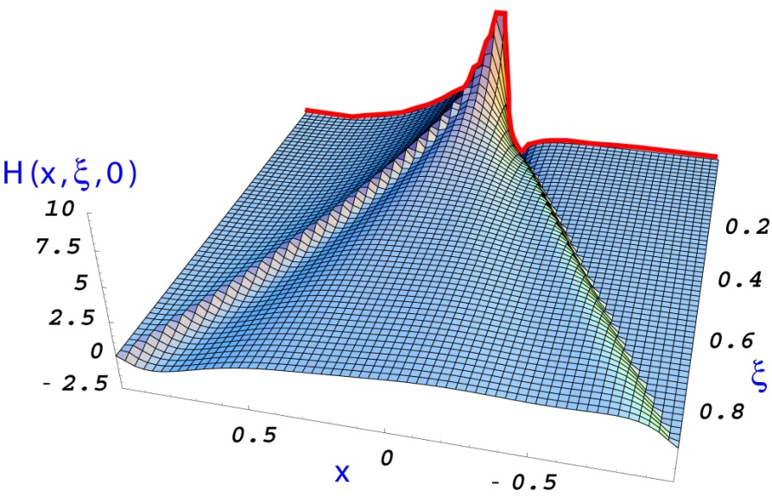
The Science Motivating the 12 GeV Upgrade
The experimental study of the confinement of quarks – one of the outstanding questions of the 21st century physics (Hybrid Meson Program)
Dramatic improvements in our knowledge of the fundamental quark-gluon structure of the nuclear building blocks (GPDs and Valence PDFs)
Further exploration of the limits of our understanding of nuclei in terms of nucleons and the N-N force
Precision experiments with sensitivity to TeV scale physics beyond the Standard Model
And other science we can’t foresee

Slide 16

Gluonic Excitations and the Origin of Confinement
Theoretical studies of QCD suggest that confinement is due to the formation of “Flux tubes” arising from the self-interaction of the glue, leading to a linear potential (and therefore a constant force)
From G. Bali
linear potential
Experimentally, we want to “pluck” the flux tube
(wiggle the hot dog?) and see how it responds

Slide 17
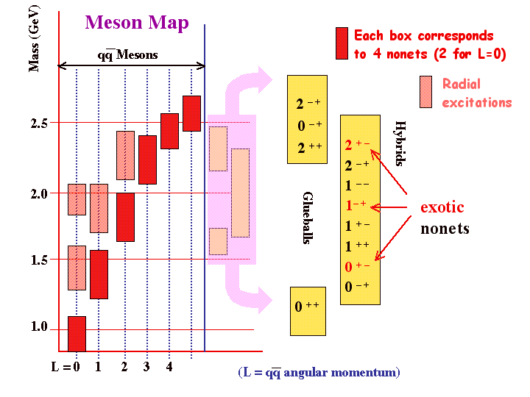
Glueballs and Hybrid Mesons
QCD predicts a rich spectrum of as yet to be discovered gluonic excitations - whose experimental verification is crucial for our understanding of QCD in the confinement regime.
_{Colin Morningstar:}
Gluonic Excitations workshop, 2003 (Jlab)

Slide 18
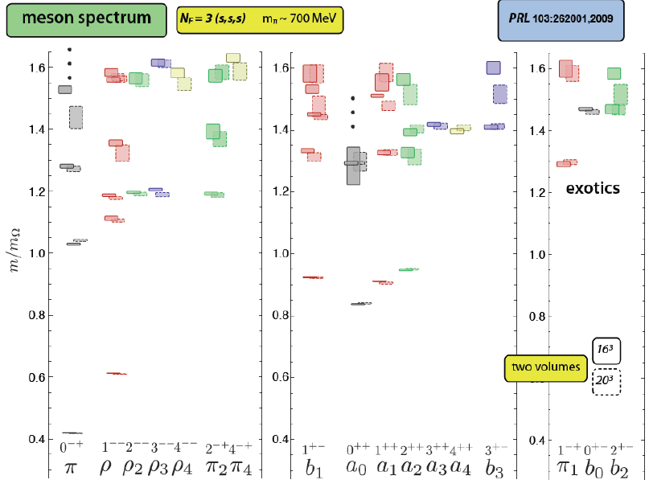
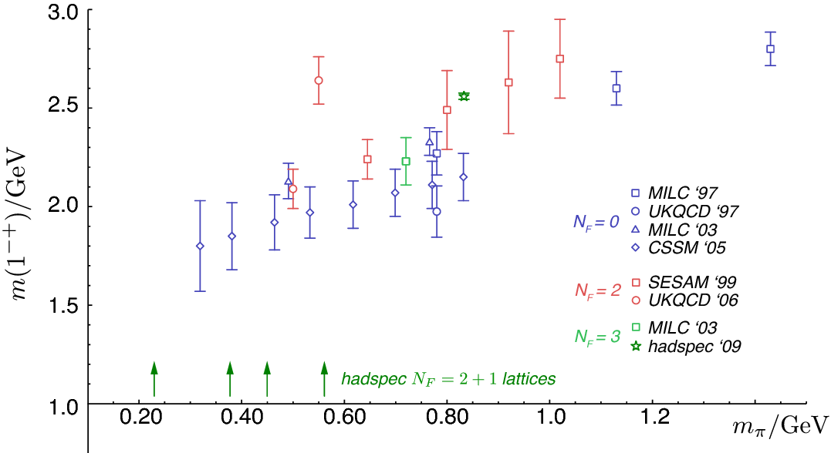
LQCD Developing Firm Predictions
Major challenge for lattice calculations: the excited spectrum with quantum numbers of states identified.
Spectrum of iso-vector mesons composed of strange quark and antiquark, in units of M_{Ω}
Mass of 1⁻⁺, the lightest expected exotic: ground-breaking advance in precision, laying groundwork for calculations for GlueX
Dudek, Edwards, Peardon, Richards, Thomas, PRL103, 262001 (2009)

Slide 19
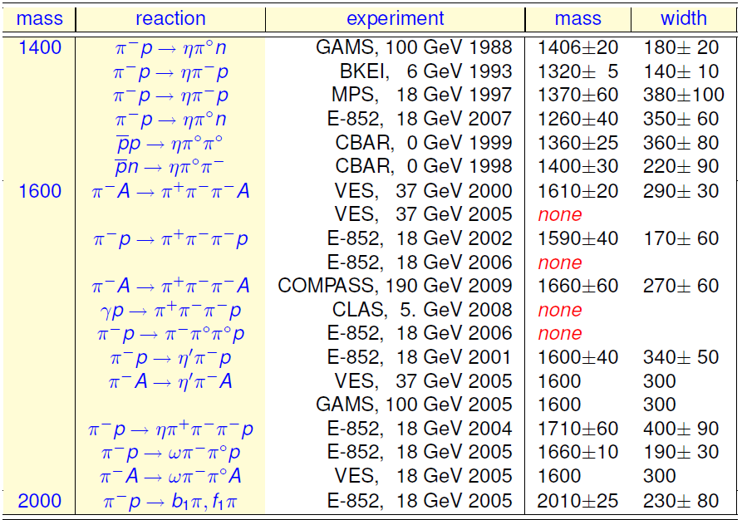
Experimental Evidence for Exotic Hybrids 1⁻⁺

Slide 20
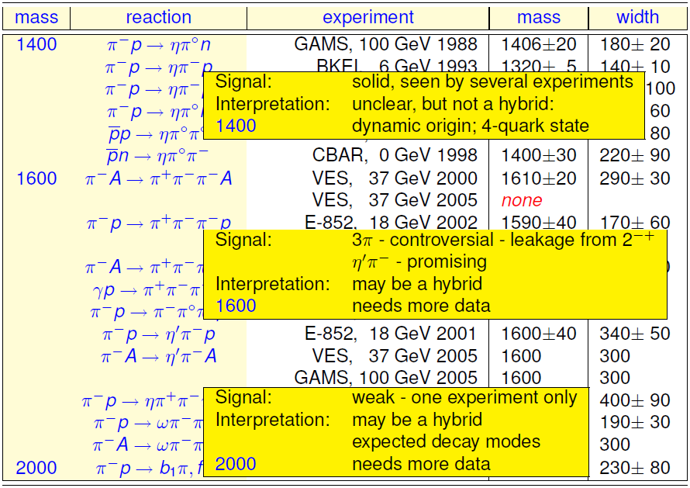
Experimental Evidence for Exotic Hybrids 1⁻⁺

Slide 21
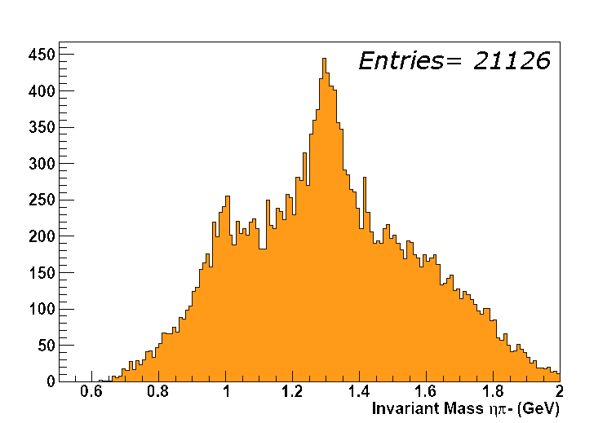
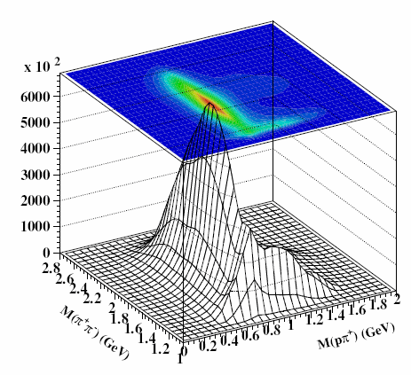
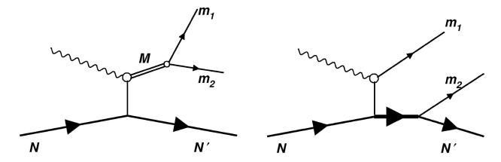
Multiple Searches in Progress at JLab Today
Multiple Experiments have studied meson photoproduction using CLAS:
Huge amount of data “in the can”,
analysis in progress (Weygand, Burkert talks)
γp→π⁺π⁺ηp
a₂(1320)
a₀(980)
A novel additional experiment (eg6) studied coherent photoproduction on ⁴He to provide a complementary approach:
search for exotics in πη, πη’ final states
recoiling nucleus detected in Radial TPC
Coherent Production on ⁴He
Eliminate s-channel resonance background
γp → pπ⁺π⁻
Simpler PWA: S=I=0 target acts as spin and parity filter for final state mesons
Notes:
Ridurre ad una slide

Slide 22
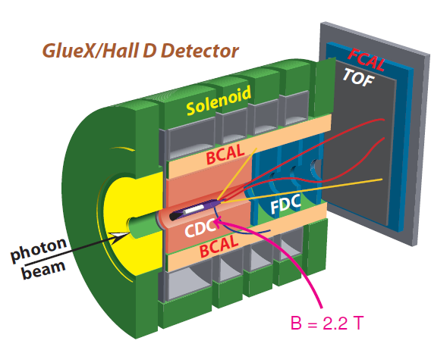
GlueX Experiment: a Major Part of the 12 GeV Upgrade, is Being Built from the Start for the Hybrid Meson search
Key Features Include:
Tagged, linearly polarized photons
Extremely high data rates
Hermetic detector with excellent particle ID
Planning from the start for analysis and interpretation
Physics to begin in 2015:
The goal is to identify J^{PC} unambiguously and map out the predicted hybrid nonets to provide important information on the character of glue

Slide 23
A Sampling of Meson Physics Under Study at JLab (now and @ 12 GeV)
Meson spectroscopy – the search for hybrid mesons
Nucleon spectroscopy via meson decay channels
  Now – mainly π, ω, η, 2π, ….;
  tagged virtual photons & heavier meson decay channels @ 12 GeV
Meson form factors
  F_{π}, F_{K}
Mesons as probes of strongly interacting matter:
  Color transparency,
  c c, mesons in medium, …..
Hypernuclear physics
Symmetry tests in nuclear physics (w/ mesons, ….)
And, as time permits, I will add
Other physics motivating the 12 GeV Upgrade

Slide 24
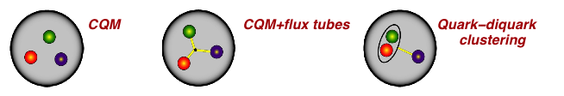
Why do we study excited baryons?
The N* spectrum is a direct reflection of the underlying degrees of freedom of the nucleon.
  Resonance transition amplitudes probe the relevant degrees of freedom at varying distance scales and can reveal the short distance nature
  Many states predicted in most accepted quark model with SU(6) symmetry have not been observed in elastic πN scattering
  Electromagnetic probe and other decay channels may be more sensitive to undiscovered states
Two main components of the experimental N* program
  The search for new states (and confirmation of already “discovered” states) in an unbiased way
  Study of transition form factors of prominent resonances to reveal their structure at different distance scales
Nucleon-meson
system

Slide 25
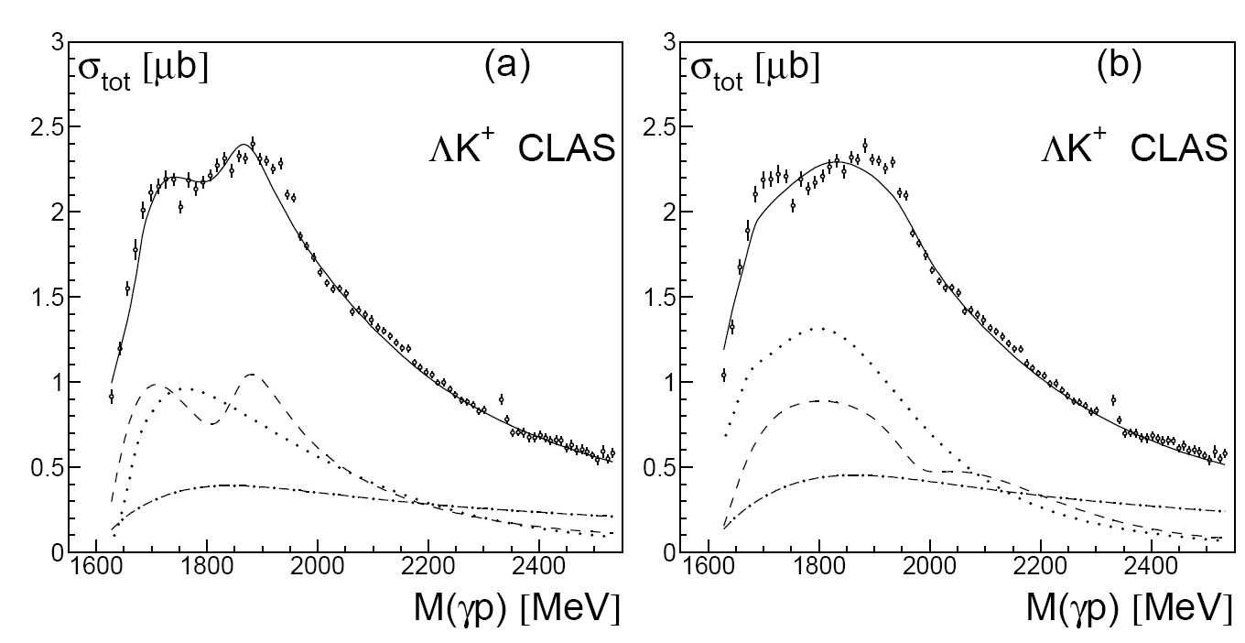
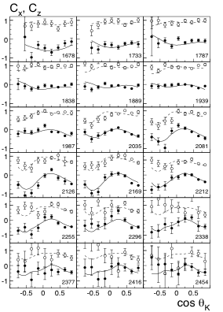
Example from the present program w/ CLAS: Polarization transfer γp K⁺Λ
R. Bradford et al., Phys.Rev.C75:035205,2007
R. Bradford et al., Phys.Rev.C73:035202,2006
Fit: BG Model - A.K. Nikonov et al., Phys.Lett.B662:245-251, 2008.
D₁₃, P₁₁, P₁₃ ?
CLAS
Predicted
in CQM
Strong preference for P₁₃ state in BG analysis.
Existence of N(1900)P₁₃ would be evidence against q(qq) model with tightly bound (qq) diquark.
CLAS
➪ Double polarization measurements can directly discriminate between J=1/2 and J=3/2 states, and clarify the status of the state.
Notes:
A large number of cross section data on k-Lambda and K-Sigma have been published and are being used by various groups for phenomenological analyses. This shows the integrated cross section from CLAS used in a fit by the Bonn-Gatchina group. This group finds significant contributions from a P13(1900) 2* state in the PDG. The strongest constraints however come from the CLAS polarization transfer data using a circularly polarized photon beam, and measuring the Lambda recoil polarization. The graph shows the BG fit to the CLAS data giving a much better fit than the D13 hypothesis.

Slide 26
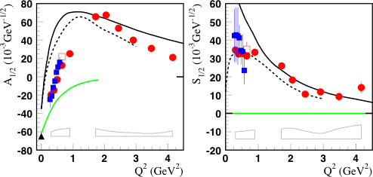
and an example of the additional insights obtained through the use of (e,e’x) to extract the Nucleon’s Transition Form Factors
Nπ
Nππ
Nπ, Nππ
LCQM
Q³G
First sign change of a nucleon transition amplitude, seen in both Nπ and Nππ electro-production analysis.
Consistent with radial excitation of the nucleon in LCQM.
Excludes hybrid baryon assignment for the Roper
I. Aznauryan et al., PRC78:045209,2008
Notes:
For the first time transition amplitudes for the Roper resonance have been extracted for the Roper resonance. The transverse amplitude becomes positive and large, at Q^2=2GeV2 exceeding the value at the photon point. This behavior has been observed both in single pion and 2-pion production. The transverse amplitude becomes positive and large, at Q2=2 exceeding the value at the photon point. The sign change has been observed for both channels. The longitudinal amplitude drops smoothly with Q2. Both amplitudes are qualitatively consistent with LC quark models. However, meson contributions maybe required at low Q2 to explain behavior quantitatively.

Slide 27
Search for S=0 states in single meson production on protons & neutrons
✔ - published, ✔ - acquired, ✔ - in progress, ✔ - planned
 | σ | Σ | T | P | E | F | G | H | T_{x} | T_{z} | L_{x} | L_{z} | O_{x} | O_{z} | C_{x} | C_{z}
pπ⁰ | ✔ | ✓ | ✓ |  | ✓ | ✓ | ✓ | ✓
nπ⁺ | ✔ | ✓ | ✓ |  | ✓ | ✓ | ✓ | ✓
pη | ✔ | ✓ | ✓ |  | ✓ | ✓ | ✓ | ✓
pη’ | ✔ | ✓ | ✓ |  | ✓ | ✓ | ✓ | ✓
pω | ✔ | ✓ | ✓ |  | ✓ | ✓ | ✓ | ✓
K⁺Λ | ✔ | ✓ | ✓ | ✔ | ✓ | ✓ | ✓ | ✓ | ✓ | ✓ | ✓ | ✓ | ✓ | ✓ | ✔ | ✔
K⁺Σ⁰ | ✔ | ✓ | ✓ | ✔ | ✓ | ✓ | ✓ | ✓ | ✓ | ✓ | ✓ | ✓ | ✓ | ✓ | ✔ | ✔
K^{0*}Σ⁺ | ✔ | ✓ |  |  |  |  |  |  |  |  | ✓ | ✓
pπ⁻ | ✔ | ✓ | ✓ |  | ✓ | ✓ | ✓ | ✓
pρ⁻ | ✓ | ✓ | ✓ |  | ✓ | ✓ | ✓ | ✓
K⁻Σ⁺ | ✓ | ✓ | ✓ |  | ✓ | ✓ | ✓ | ✓
K⁰Λ | ✓ | ✓ | ✓ | ✓ | ✓ | ✓ | ✓ | ✓ | ✓ | ✓ | ✓ | ✓ | ✓ | ✓ | ✓ | ✓
K⁰Σ⁰ | ✓ | ✓ | ✓ | ✓ | ✓ | ✓ | ✓ | ✓ | ✓ | ✓ | ✓ | ✓ | ✓ | ✓ | ✓ | ✓
K^{0*}Σ⁰ | ✓ | ✓
Proton targets
Neutron targets
The combination of measurements on proton and neutron targets provides an unprecedented set of data in the search for new baryon states.

Slide 28
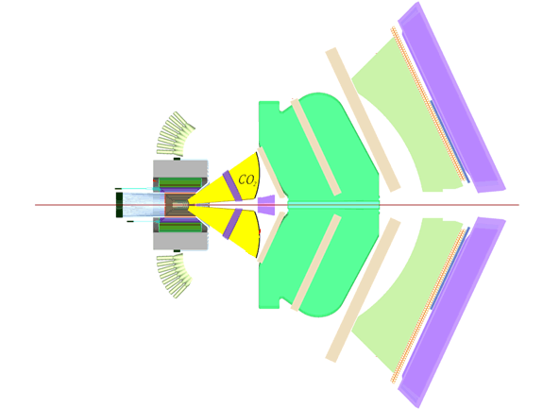
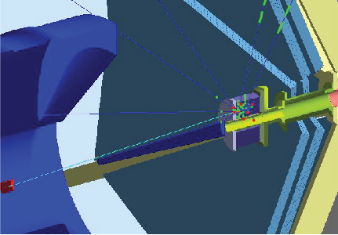
N* Program Continued @ 12 GeV:
A Forward Photon Tagger for CLAS12
Forward Tagger Features:
Incident electron beam, scattered electrons detected between 2º and 5º
Hadronic final state is detected in CLAS12
Effective photon flux for 10³⁵ electron beam luminosity of 5x10⁷ g/s
Compatible with the standard CLAS12 equipment
Drift Chambers
Forward
Electromagnetic Calorimeter
High-Threshold Cerenkov Counter
Central Detector
Forward Tagger
Torus Magnet
Forward Time of Flight
Preshower Calorimeter

Slide 29
A Sampling of Meson Physics Under Study at JLab (now and @ 12 GeV)
Meson spectroscopy – the search for hybrid mesons
Nucleon spectroscopy via meson decay channels
  Now – mainly π, ω, η, 2π, ….;
  tagged virtual photons & heavier meson decay channels @ 12 GeV
Meson form factors
  F_{π}, F_{K}
Mesons as probes of strongly interacting matter:
  Color transparency,
  c c, mesons in medium, …..
Hypernuclear physics
Symmetry tests in nuclear physics (w/ mesons, ….)
And, as time permits, I will add
Other physics motivating the 12 GeV Upgrade

Slide 30
Charged Pion Electromagnetic Form Factor
E01-004, Spokespersons: Henk Blok (VUA), Garth Huber (Regina), Dave Mack (JLab)
Where does the dynamics of the q-q interaction make a transition from
the strong (confinement) to the perturbative (QED-like) QCD regime?
Initial F_{π}(Q²) from
πe elastic scattering
Notes:
It will occur earliest in the simplest systems
→ the pion form factor F_{π}(Q²) provides our best chance to
determine the relevant distance scale experimentally

Slide 31
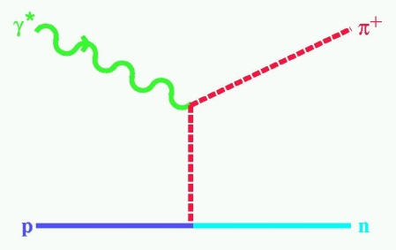
Charged Pion Electromagnetic Form Factor
E01-004, Spokespersons: Henk Blok (VUA), Garth Huber (Regina), Dave Mack (JLab)
Where does the dynamics of the q-q interaction make a transition from
the strong (confinement) to the perturbative (QED-like) QCD regime?
To extend F_{π}(Q²) :
At low Q² (< 0.3 (GeV/c)²): use p + e
scattering → R_{rms} = 0.66 fm
At higher Q²: use ¹H(e,e’p⁺)n,
measure σ_{L}
“Extrapolate” σ_{L} to t = +m_{π}² using a realistic pion electroproduction (Regge-type) model to extract F_{π}
t = (p_{π}-q)² < 0
F_{π}(Q²) Today
Notes:
It will occur earliest in the simplest systems
→ the pion form factor F_{π}(Q²) provides our best chance to
determine the relevant distance scale experimentally

Slide 32
Charged Pion Form Factor – 12 GeV
E12-06-101, Spokespersons: Garth (JLab) Huber (Regina), Dave Gaskell
Further extend F_{π}(Q²)
w/ 12 GeV
Measure F_{π} up to 6 (GeV/c)² to probe onset of pQCD
π⁺/π⁻ measurements to test t-channel dominance of σ_{L}
Q² = 0.30 (GeV/c)² close to pion pole to compare to π+e elastic
F_{π}(Q²) 12 GeV Plans

Slide 33
A Sampling of Meson Physics Under Study at JLab (now and @ 12 GeV)
Meson spectroscopy – the search for hybrid mesons
Nucleon spectroscopy via meson decay channels
  Now – mainly π, ω, η, 2π, ….;
  tagged virtual photons & heavier meson decay channels @ 12 GeV
Meson form factors
  F_{π}, F_{K}
Mesons as probes of strongly interacting matter:
  Color transparency
  c c, mesons in medium, …..
Hypernuclear physics
Symmetry tests in nuclear physics (w/ mesons, ….)
And, as time permits, I will add
Other physics motivating the 12 GeV Upgrade

Slide 34
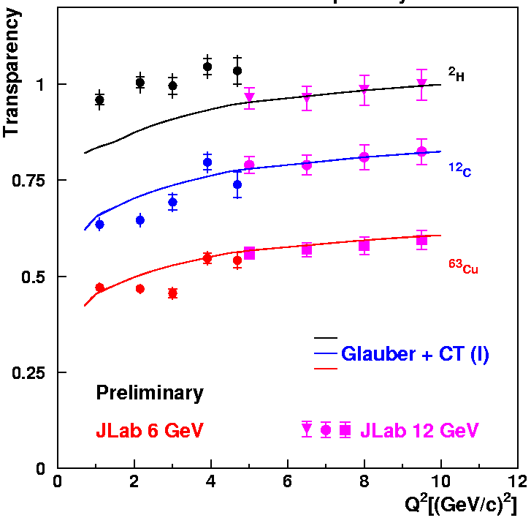
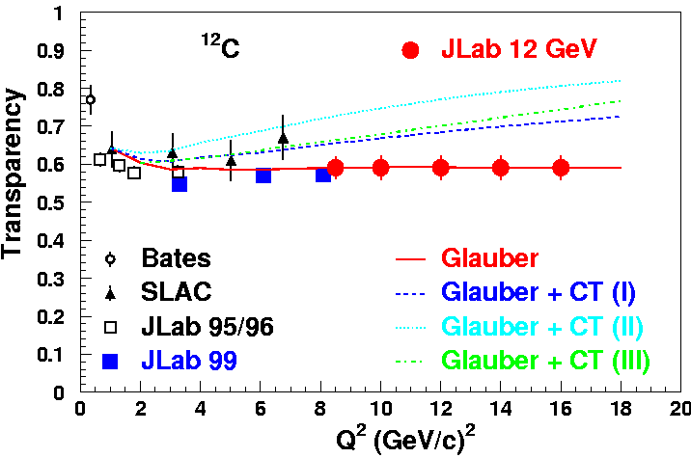
Pion/Proton Transparency Now and at 12 GeV
A(e,e’p) at 12 GeV
(projected results)
A(e,e’π⁺) at 12 GeV (projected results)
(e,e’p)
E12-06-107
Steve Wood’s Talk

Slide 35
A Sampling of Meson Physics Under Study at JLab (now and @ 12 GeV)
Meson spectroscopy – the search for hybrid mesons
Nucleon spectroscopy via meson decay channels
  Now – mainly π, ω, η, 2π, ….;
  tagged virtual photons & heavier meson decay channels @ 12 GeV
Meson form factors
  F_{π}, F_{K}
Mesons as probes of strongly interacting matter:
  Color transparency,
  c c, mesons in medium, …..
Hypernuclear physics
Symmetry tests in nuclear physics (w/ mesons, ….)
And, as time permits, I will add
Other physics motivating the 12 GeV Upgrade

Slide 36
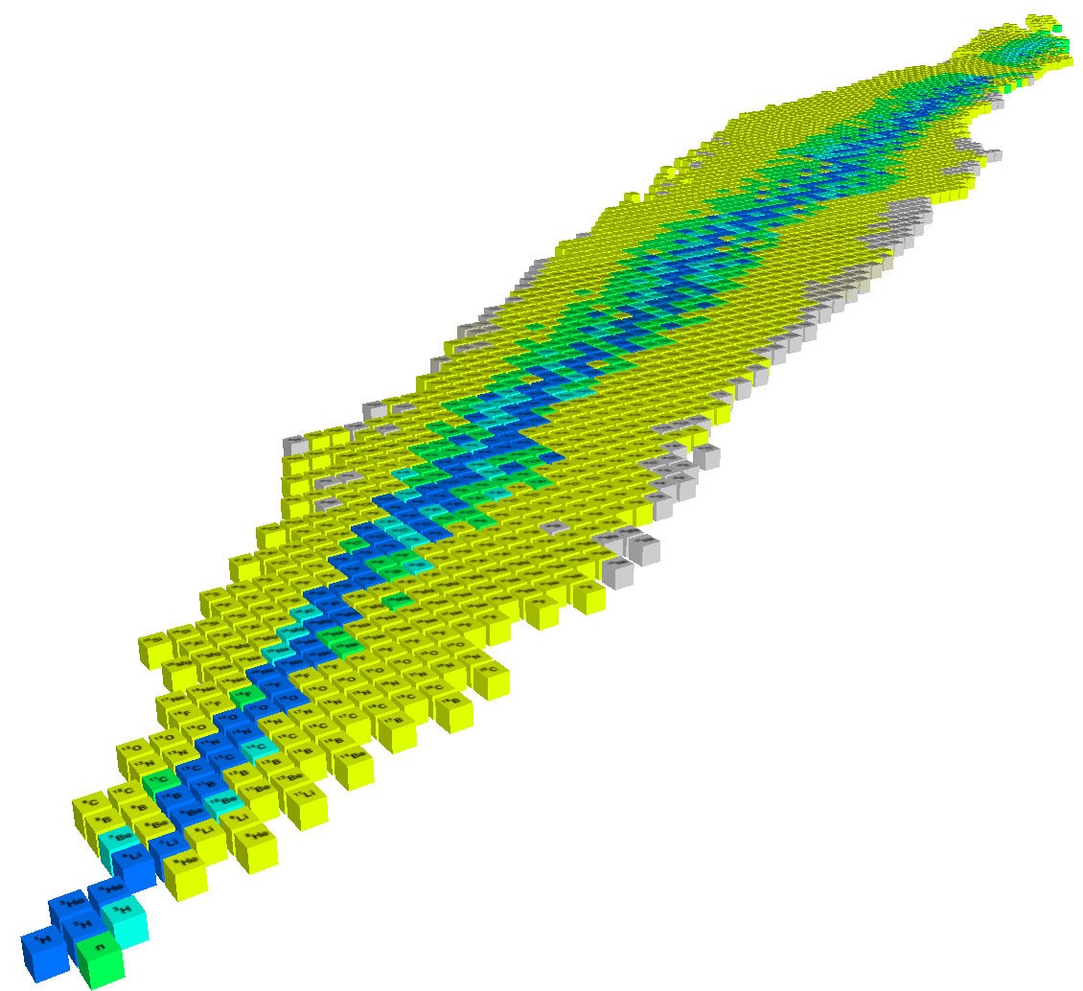
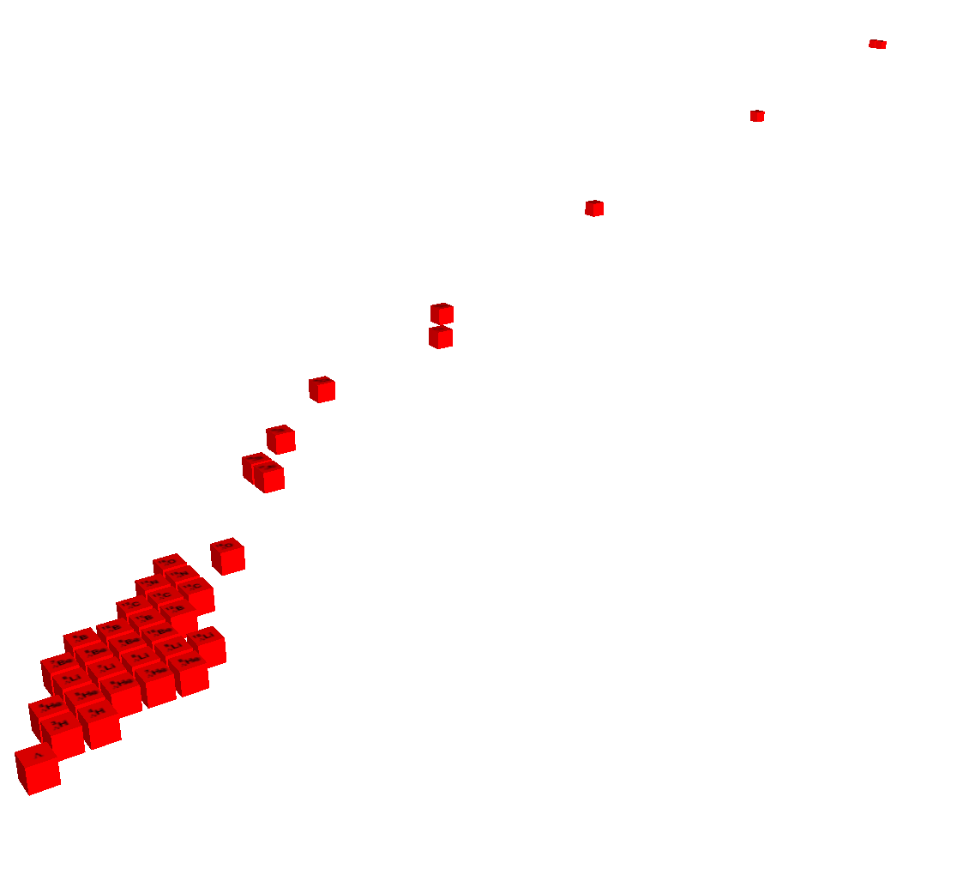


World of matter made of u, d, s quarks
Strangeness
Z
-2
Λ, Σ Hypernuclei
N
-1
0
３-dimensional nuclear chart
H. Tamura

Slide 37
An example of what we learn from Hypernuclei
A Highlight of JLab E01-011 (HKS)
The First reliable observation of ⁷_{Λ}He
A Test of Charge Symmetry Breaking
Begin with a theoretical description of these nuclei without CSB

Slide 38
An example of what we learn from Hypernuclei
A Highlight of JLab E01-011 (HKS)
The First reliable observation of ⁷_{Λ}He
A Test of Charge Symmetry Breaking
Begin with a theoretical description of these nuclei without CSB
A Naïve calculation of the CSB effect, which explains ⁴_{Λ}H –⁴_{Λ}He and available s, p-shell hypernuclear data, predicts opposite shifts for A=7 ,T=1 iso-triplet Λ Hypernuclei.

Slide 39
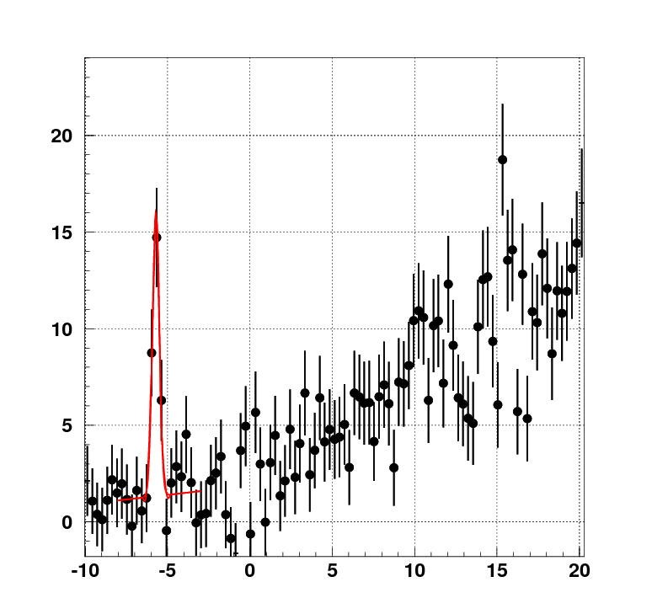
An example of what we learn from Hypernuclei
A Highlight of JLab E01-011 (HKS)
-6.73±0.02 ±0.2 MeV
from α Λ n n
The First reliable observation of ⁷_{Λ}He
A Test of Charge Symmetry Breaking
Compare with new measurements of ⁷_{Λ}He
Measured shift has the opposite sign to
the predicted shift!
-B_{Λ} (MeV)
Begin with a theoretical description of these nuclei without CSB
A Naïve calculation of the CSB effect, which explains ⁴_{Λ}H –⁴_{Λ}He and available s, p-shell hypernuclear data, predicts opposite shifts for A=7 ,T=1 iso-triplet Λ Hypernuclei.

Slide 40
An example of what we learn from Hypernuclei
A Highlight of JLab E01-011 (HKS)
-6.73±0.02 ±0.2 MeV
from α Λ n n
The First reliable observation of ⁷_{Λ}He
A Test of Charge Symmetry Breaking
Naïve theory does not explain the
experimental result.
-B_{Λ} (MeV)
Begin with a theoretical description of these nuclei without CSB
A Naïve calculation of the CSB effect, which explains ⁴_{Λ}H –⁴_{Λ}He and available s, p-shell hypernuclear data, predicts opposite shifts for A=7 ,T=1 iso-triplet Λ Hypernuclei.

Slide 41
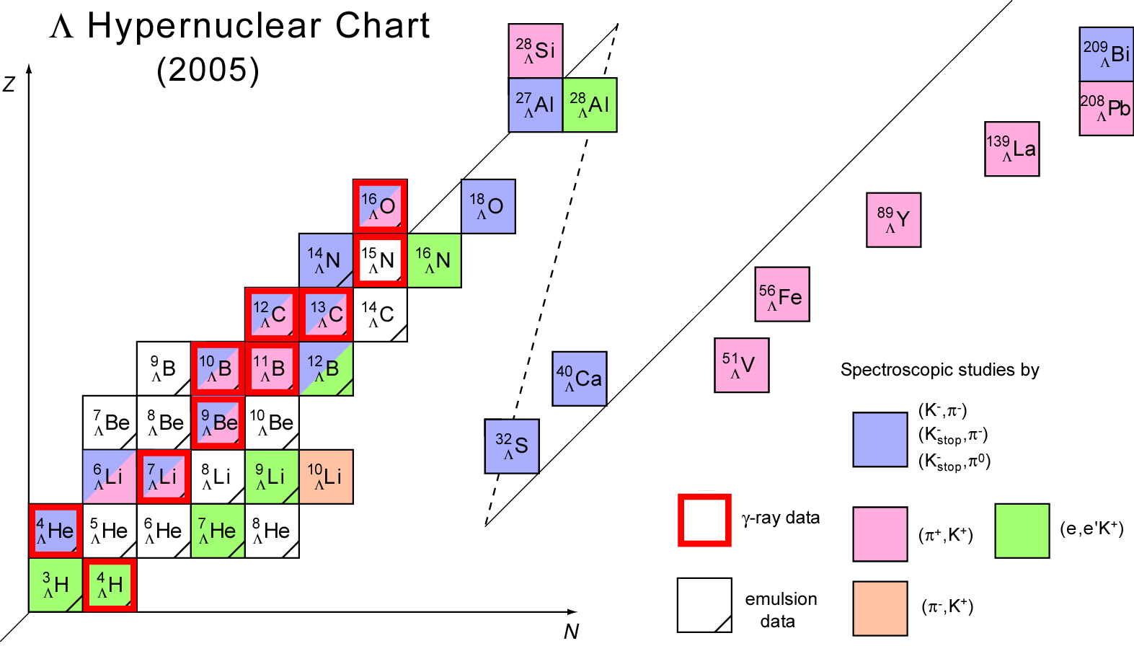
Present Status of
Λ Hypernuclear Spectroscopy
(2006)
Tremendous Progress, but More Nuclei and Higher Precision are Needed
To Fully Understand the Λ−N/N-N Force Differences ⇒ JLab and JPARC Programs
JLab electro-production complementary
to hadro-production, e.g, as planned for
JPARC:
Production throughout the nuclear volume
rather than surface peaked
Emphasizes states with differing J^{PC}
Better resolution for states that cannot be
studied by γ decay branch
Updated from: O. Hashimoto and H. Tamura, Prog. Part. Nucl. Phys. 57 (2006) 564.

Slide 42
A Sampling of Meson Physics Under Study at JLab (now and @ 12 GeV)
Meson spectroscopy – the search for hybrid mesons
Nucleon spectroscopy via meson decay channels
  Now – mainly π, ω, η, 2π, ….;
  tagged virtual photons & heavier meson decay channels @ 12 GeV
Meson form factors
  F_{π}, F_{K}
Mesons as probes of strongly interacting matter:
  Color transparency,
  c c, mesons in medium, …..
Hypernuclear physics
Symmetry tests in nuclear physics (w/ mesons, ….)
And, as time permits, I will add
Other physics motivating the 12 GeV Upgrade

Slide 43
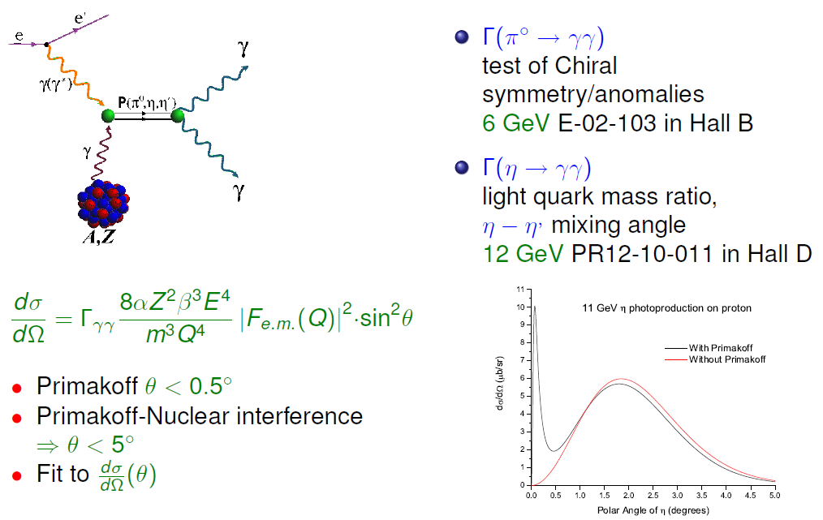
π⁰,η, η′→ γγ coupling in the Primakoff reaction

Slide 44
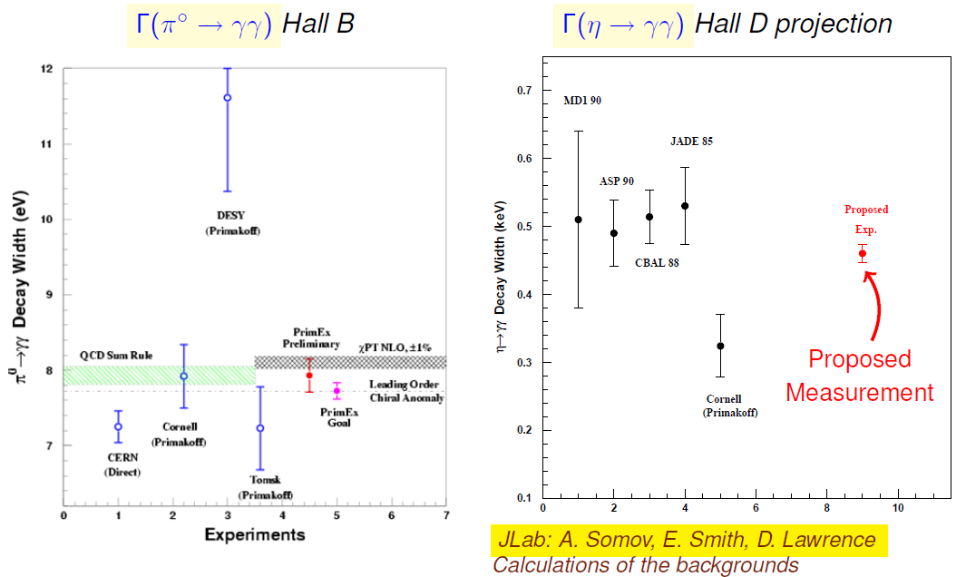
π⁰,η, η′→ γγ coupling in the Primakoff reaction
Γ(π⁰→γγ) = 7.82eV±2.2%±2.1%
Projected uncertainty for PrimEx II

Slide 45
π⁰,η, η′→ γγ coupling in the Primakoff reaction
@ 12 GeV
Experiments

Slide 46
A Sampling of Meson Physics Under Study at JLab (now and @ 12 GeV)
Meson spectroscopy – the search for hybrid mesons
Nucleon spectroscopy via meson decay channels
  Now – mainly π, ω, η, 2π, ….;
  tagged virtual photons & heavier meson decay channels @ 12 GeV
Meson form factors
  F_{π}, F_{K}
Mesons as probes of strongly interacting matter:
  Color transparency,
  c c, mesons in medium, …..
Hypernuclear physics
Symmetry tests in nuclear physics (w/ mesons, ….)
And, as time permits, I will add
Other physics motivating the 12 GeV Upgrade

Slide 47
The Science Motivating the 12 GeV Upgrade
The experimental study of the confinement of quarks – one of the outstanding questions of the 21st century physics (Hybrid Meson Program)
Dramatic improvements in our knowledge of the fundamental quark-gluon structure of the nuclear building blocks (GPDs and Valence PDFs)
Further exploration of the limits of our understanding of nuclei in terms of nucleons and the N-N force
Precision experiments with sensitivity to TeV scale physics beyond the Standard Model
And other science we can’t foresee

Slide 48



Understanding Nucleon Structure: Form Factors
PDFs, and Generalized Parton Distributions (GPDs)
Elastic Scattering & Form Factors:
Transverse charge & current densities in coordinate space
DIS & Structure
Functions:
Quark longitudinal
& helicity distributions
in momentum space
DES & GPDs:
Correlated quark distributions
In transverse coordinate
and longitudinal momentum
space

Slide 49
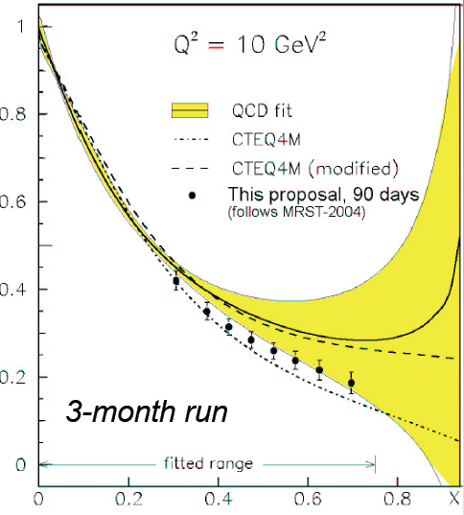
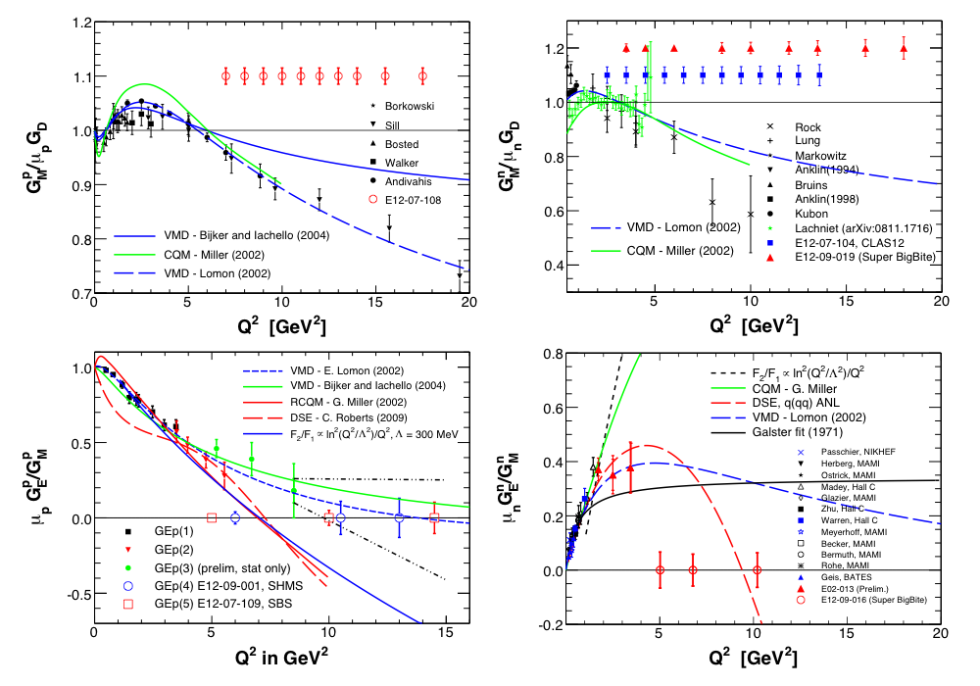
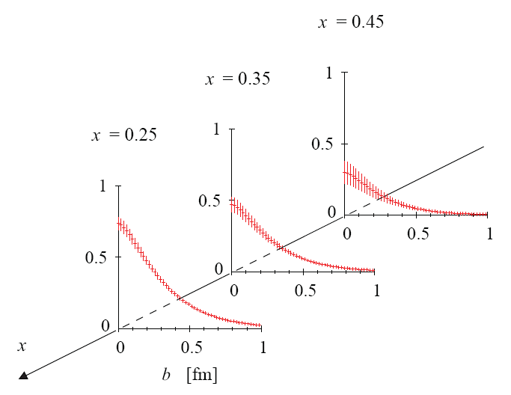
Understanding Nucleon Structure: Form Factors
PDFs, and Generalized Parton Distributions (GPDs)
First Coherent body
of Data on GPDs in
Valence Regime
Double Q² Range of
Form Factor Knowledge
Extend Knowledge
to x→1
Elastic Scattering & Form Factors:
Transverse charge & current densities in coordinate space
DIS & Structure
Functions:
Quark longitudinal
& helicity distributions
in momentum space
DES & GPDs:
Correlated quark distributions
In transverse coordinate
and longitudinal momentum
space

Slide 50
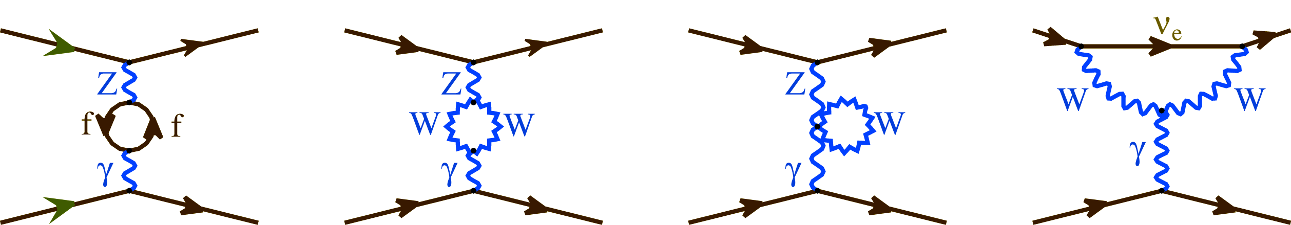
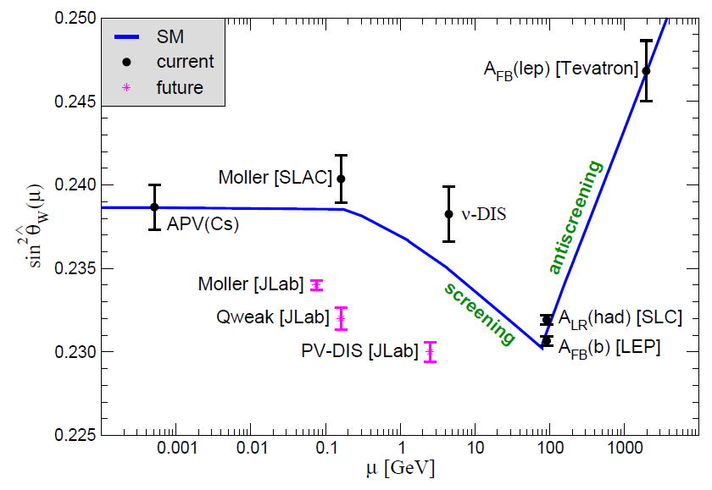
Electroweak Physics
Q_{W}^{e}
modified
Proposed MOLLER Experiment
δ(sin²θ_{W}) ~ 0.0003
sin²θ_{W} runs with Q²
Accuracy comparable to the
LEP Measurement!
Semileptonic processes have
theoretical uncertainties
E158 established running,
probing vector boson loops
JLab measurement would
have impact on
discrepancy between
leptonic and hadronic Z-pole
measurements

Slide 51
Formal Science Program for the 12 GeV Upgrade is Developing Nicely Through the PAC Review Process
The PAC-Approved Science Program includes:
The Hadron spectra as probes of QCD
(GluEx and heavy baryon and meson spectroscopy: 1 approved)
The transverse structure of the hadrons
(Elastic and transition Form Factors: 9 approved, 1 CA)
The longitudinal structure of the hadrons
(Unpolarized and polarized parton distribution functions:
5 approved, 3 CA)
The 3D structure of the hadrons
(Generalized Parton Distributions and Transverse Momentum Distributions: 11 approved, 2 CA)
Hadrons and cold nuclear matter
(Medium modification of the nucleons, quark hadronization, N-N correlations, hypernuclear spectroscopy, few-body experiments:
6 approved, 4 CA)
Low-energy tests of the Standard Model and Fundamental Symmetries
(Møller, PVDIS, PRIMEX, …..: 3 approved, 3 CA)
Plenty of time (and room) for more excellent physics. The
next PAC accepting 12 GeV proposals will be in 2011 – Join us

Slide 52
12 GeV UPGRADE SCHEDULE
Now ~2 years into a 5½ year
Construction Schedule
CD-3 (1 year ago) = formal
Construction start
Accelerator Commissioning Begins: ~10/2013
First Beam to an Experimental Hall: ~10/2014
Full Operation
6/2015

Slide 53
Summary
An exciting science program investigating the nature of quark confinement and other aspects of “strong” QCD is at the heart of the present (“6 GeV”) JLab program, and motivates the Upgrade of CEBAF from 6 to 12 GeV and the addition of major experimental equipment
Meson Physics is an essential component of that program
The combination of advances driven by theoretical insights and tools (the formulation of the GPDs, TMDs, LQCD….) and the capabilities of high luminosity, high energy cw electron beams and modern experimental apparatus provides confidence that this effort will yield important new advances for our field
Join us!

Slide 54
And, in Conclusion, Please Join Me in Expressing our Thanks to the Organizers for their Hospitality and a Delightful and Informative Conference in Kraków
Chairman: Carlo Guaraldo, INFN-LNF Frascati
Chairman: Hartumt Machner, FZ Jülich
Chairman: Stanislaw Kistryn, Jagiellonian University
Catalina Curceanu, INFN-LNF Frascati
Andrzei Magiera, Jagiellonian University
Hans Ströher, FZ Jülich
Antoni Szczurek, IFJ-PAN Kraków
Scientific
Secretary: Aleksandra Wrońska, Jagiellonian University

Slide 56
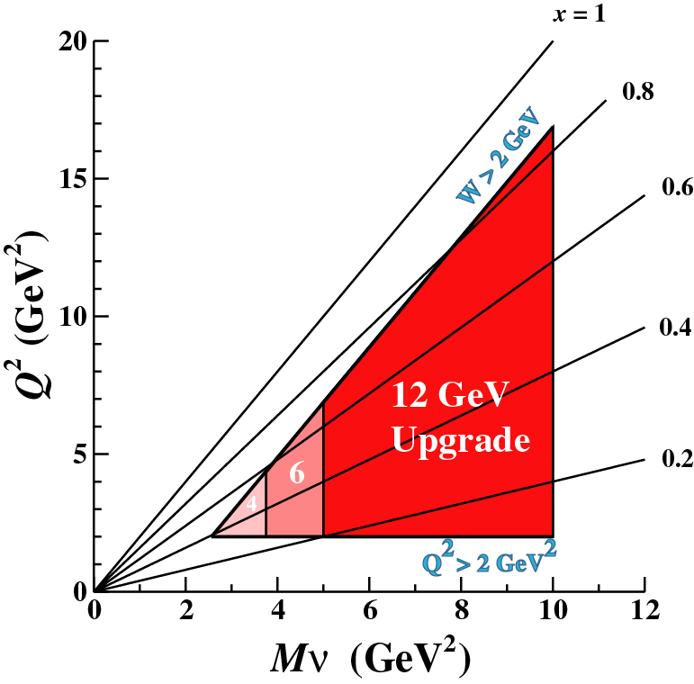
The 12 GeV Upgrade Provides Substantially Enhanced Access to the DIS Regime

Slide 57
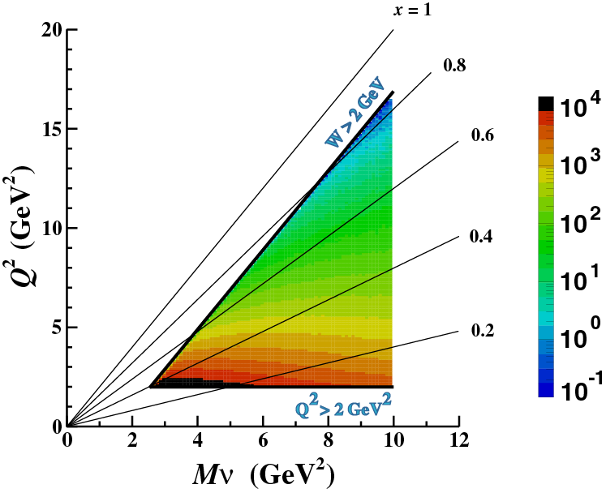
with enough luminosity to reach the high-Q², high-x region!
The 12 GeV Upgrade Provides Substantially Enhanced Access to the DIS Regime
Counts/hour/
(100 MeV)² (100 MeV²) for L=10³⁵ cm⁻² sec⁻¹

Slide 58
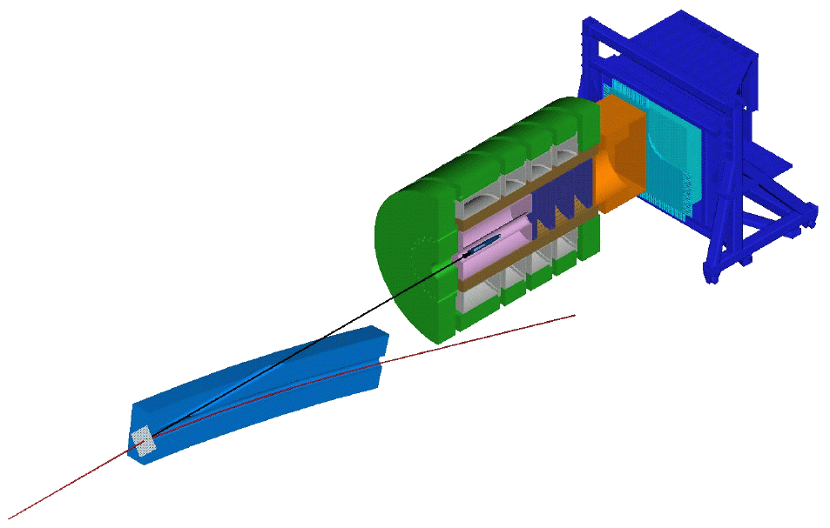
Hall D GlueX Detector
Barrel
Calorimeter
Lead Glass
Detector
LASS/MEGA
Solenoid
Coherent Bremsstrahlung
Photon Beam
Time of
Flight
Note that tagger is
80 m upstream of
detector
Tracking
Cerenkov
Counter
Target
Electron beam from CEBAF

Slide 59

Hall B - CLAS12
LTCC
FTOF 1
FTOF 2
DC R1, R2, R3
Central
Detector
PCAL
EC
Solenoid 5T
Forward
Detector
CTOF
SVT
Forward
carriage
HTCC
TORUS

Slide 60

Hall C: SHMS and HMS

Slide 61
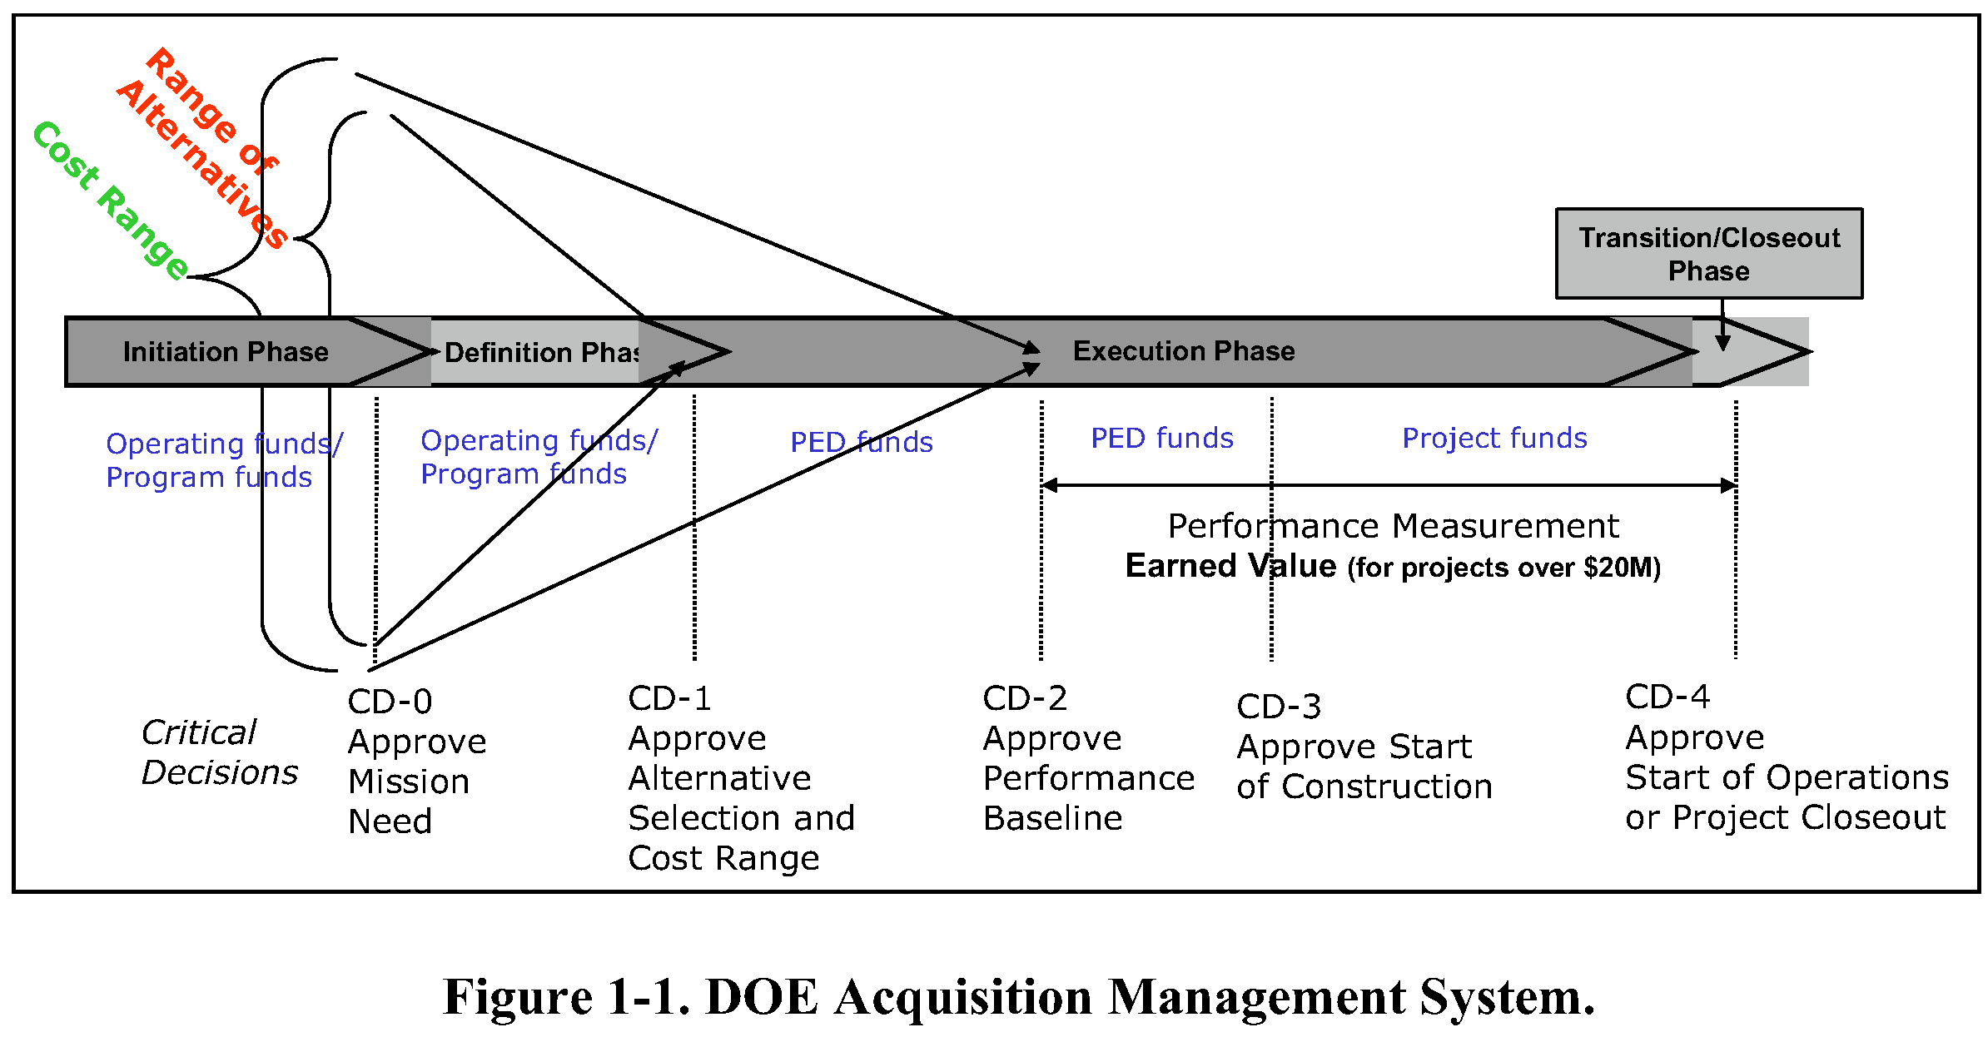
DOE GENERIC PROJECT TIMELINE
graphic from DOE 413.3 Manual
Start of Construction
We are here
(A & B)
MAR 2004
FEB 2006
NOV 2007
SEP 2008
DEC 2014
12 GeV Upgrade – Approval dates
JUN 2015
Notes:
Almost half-way between CD1 and CD2

Slide 62
Below from Claus at Lehman (2009)

Slide 63
Backups

Slide 64
High-level Parameters
Now
Upgrade
ACCELERATOR:
Beam energy 6 GeV
Voltage of each linac 0.6 GV
Number of recirculations 5
Beam power (total program) 1 MW
Beam current (hybrid mesons) -
Emittance 1 nm-rad
Energy spread 0.01%
CRYOPLANT 4.5 kW
EXPERIMENTAL HALLS 3
12 GeV
1.1 GV
5 ½
1 MW
5 µA
7 nm-rad
0.02%
9 kW
4

Slide 65
SCOPE OF 12 GeV UPGRADE
Routinely provide beam polarization of ~85% now, same in 12 GeV era

Slide 66
Beam Transport: Arc Dipoles
Simple Solution:
Add Return iron to convert original ‘C’ Magnet design to ‘H’ Magnet geometry
Arc Dipoles: Linearity of B/I Curve is restored
“C→H” magnet

Slide 67
The Importance of Data at High-x Was Revealed Elegantly by the Recent A₁^{n} Results
A₁^{n}
A₁^{p}
Precision A₁^{n}, A₁^{p} at high-x: the clean valence quark region
Test our understanding of the valence quark picture:
(pQCD, valence quark, di-quark and quark soliton models)
Crucial input for pQCD fits to the Parton Distribution Functions
Δd/d stays negative, disagrees with pQCD model

Slide 68
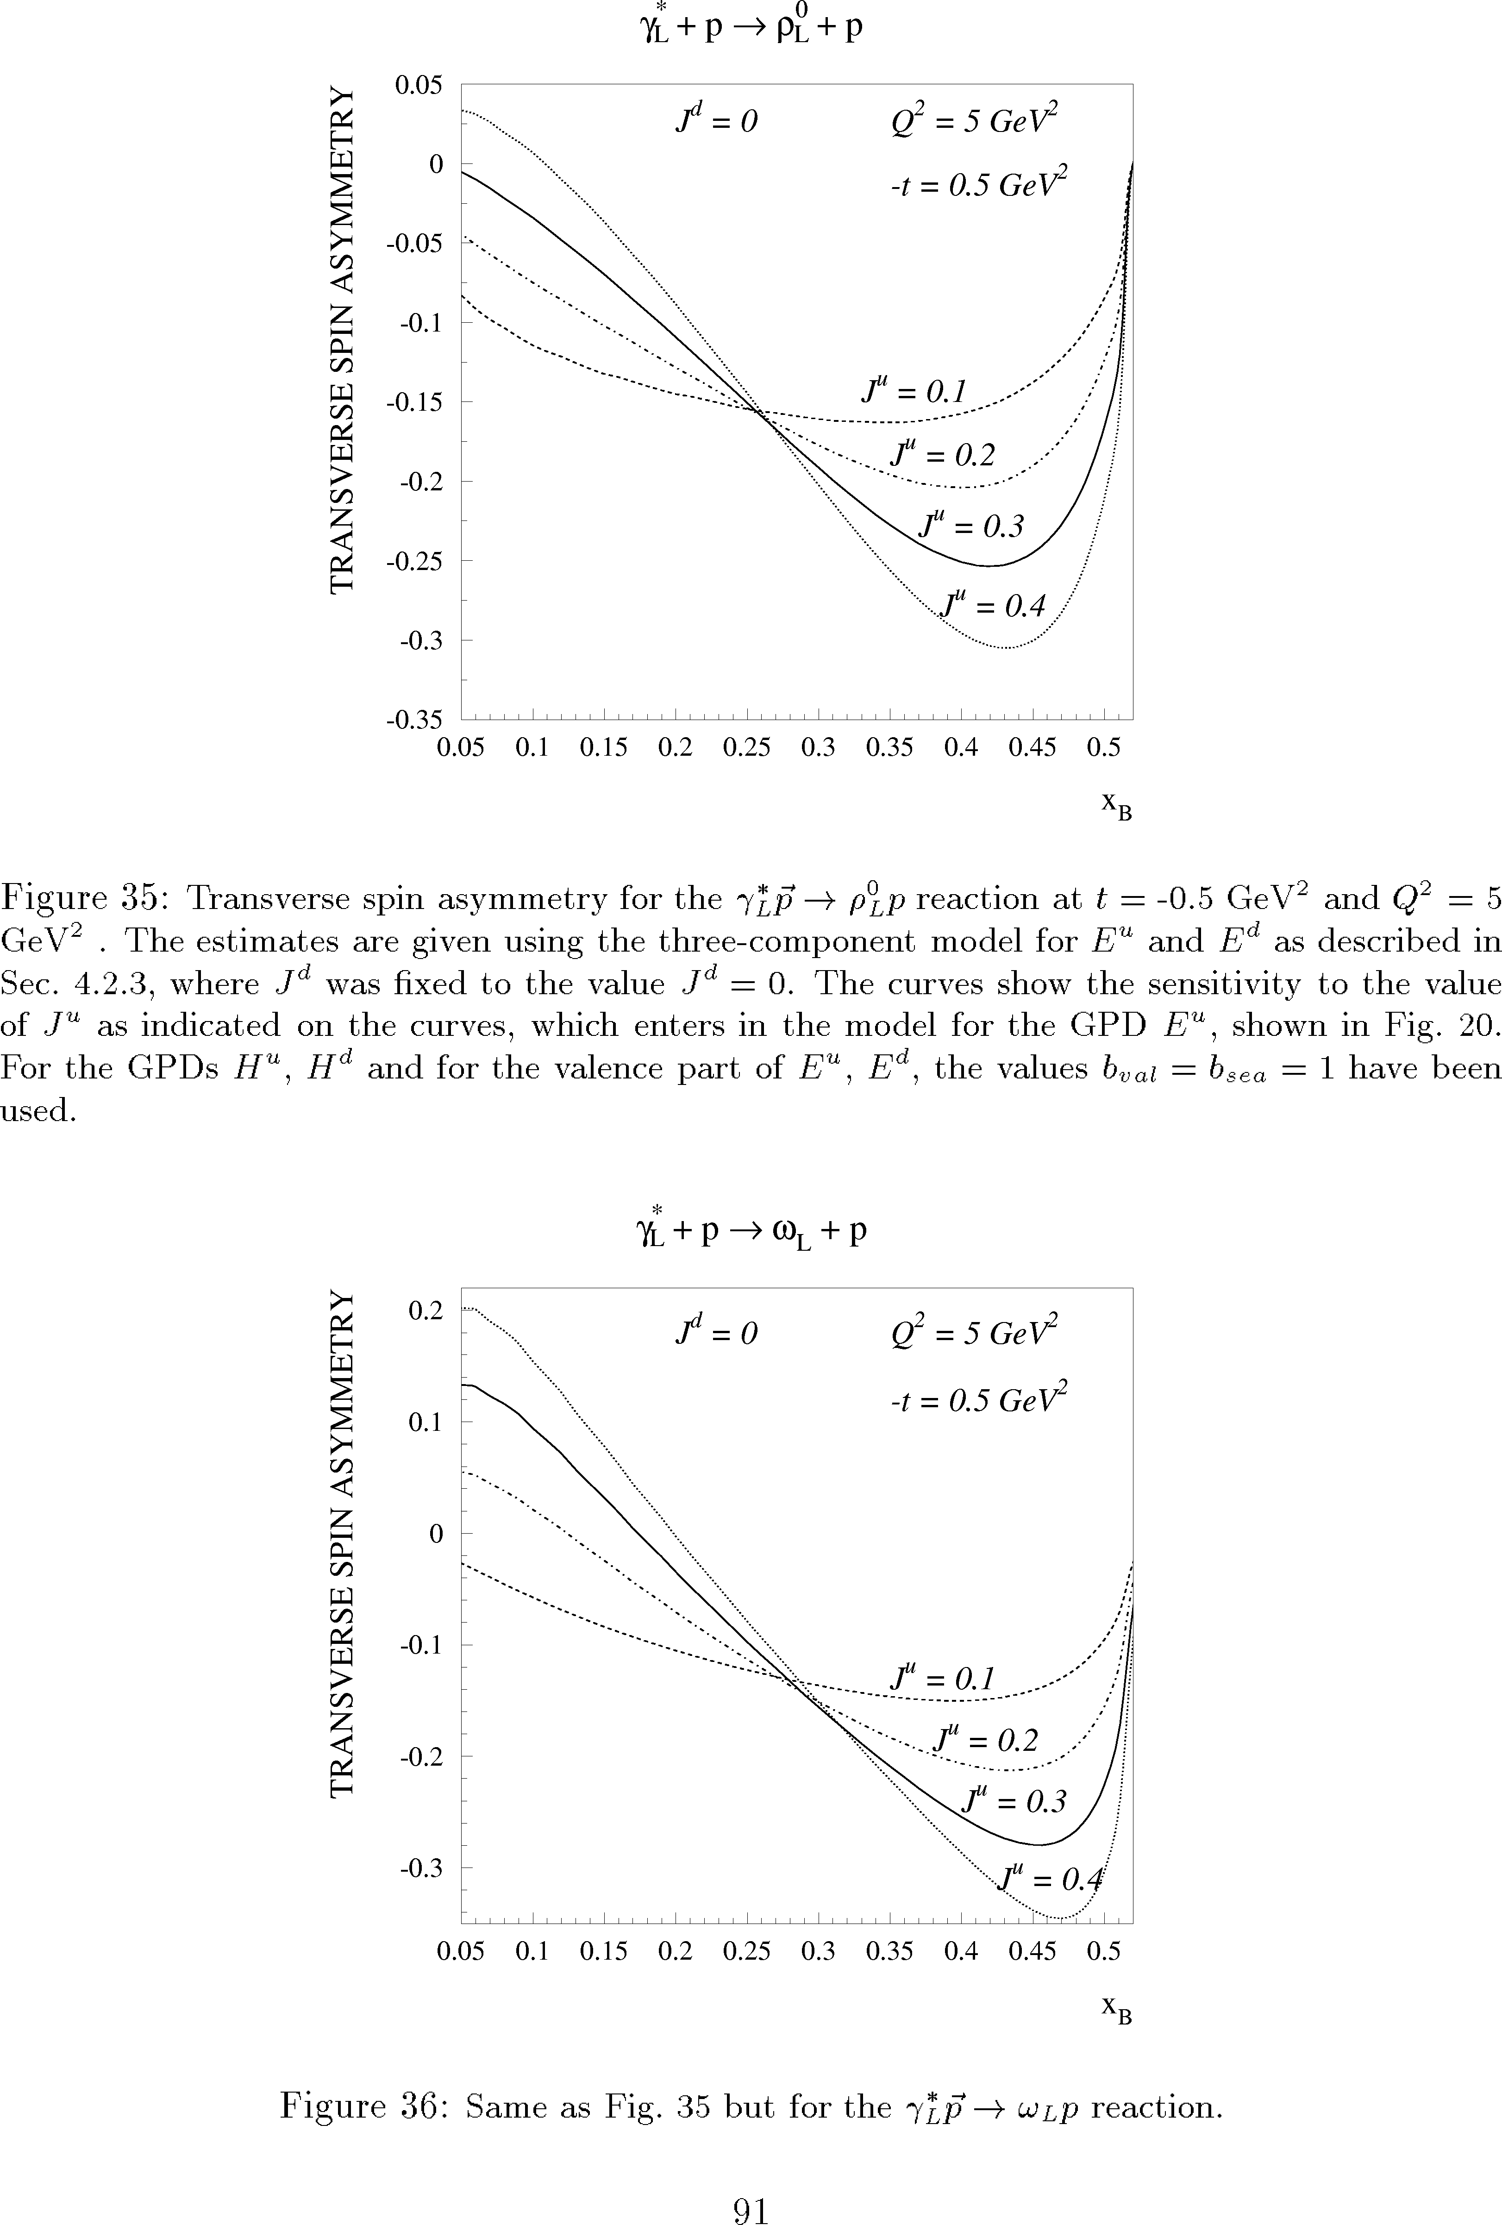
Exclusive ρ⁰ with transverse target
2Δ (Im(AB*))/π
Α_{UT} = −
T
A ~ (2H^{u} +H^{d})
|Α|²(1−ξ²) − |Β|²(ξ²+t/4m²) - Re(ΑΒ∗)2ξ²
ρ⁰
B ~ (2E^{u} + E^{d})
A_{UT}
Q² = 5GeV²
ρ⁰
Asymmetry depends
linearly on the GPD E,
which enters
Ji’s sum rule.
L=10³⁵cm⁻²s⁻¹
2000hrs
K. Goeke, M.V. Polyakov,
M. Vanderhaeghen, 2001
σ_{L} dominance
ΔQ² =1
-t = 0.5GeV²
Δt = 0.2
x_{B}

Slide 69
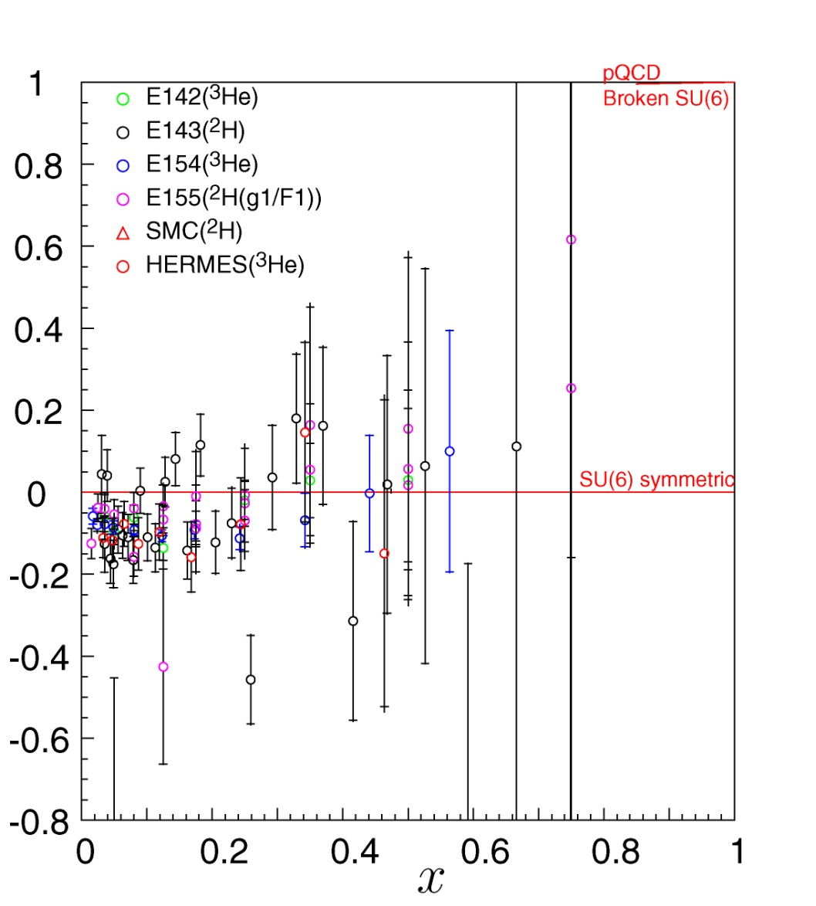
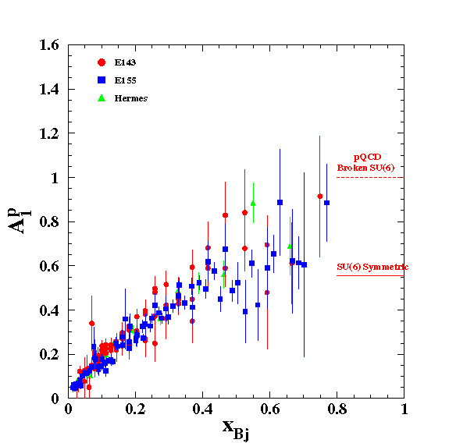
Similar Problem with Spin Dependence as x → 1
Neutron A₁^{n}
Proton A₁^{p}
Neutron

Slide 70
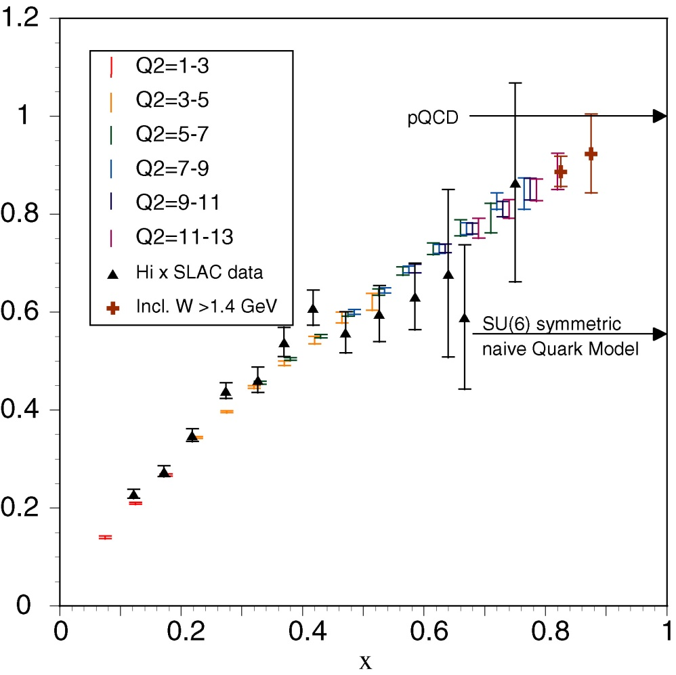
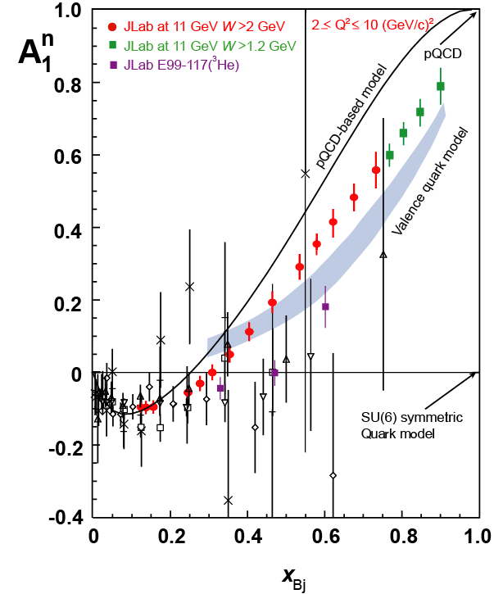
12 GeV : Unambiguous Spin Structure as x → 1
A₁^{p} at 11 GeV
A₁^{n} at 11 GeV

Slide 71
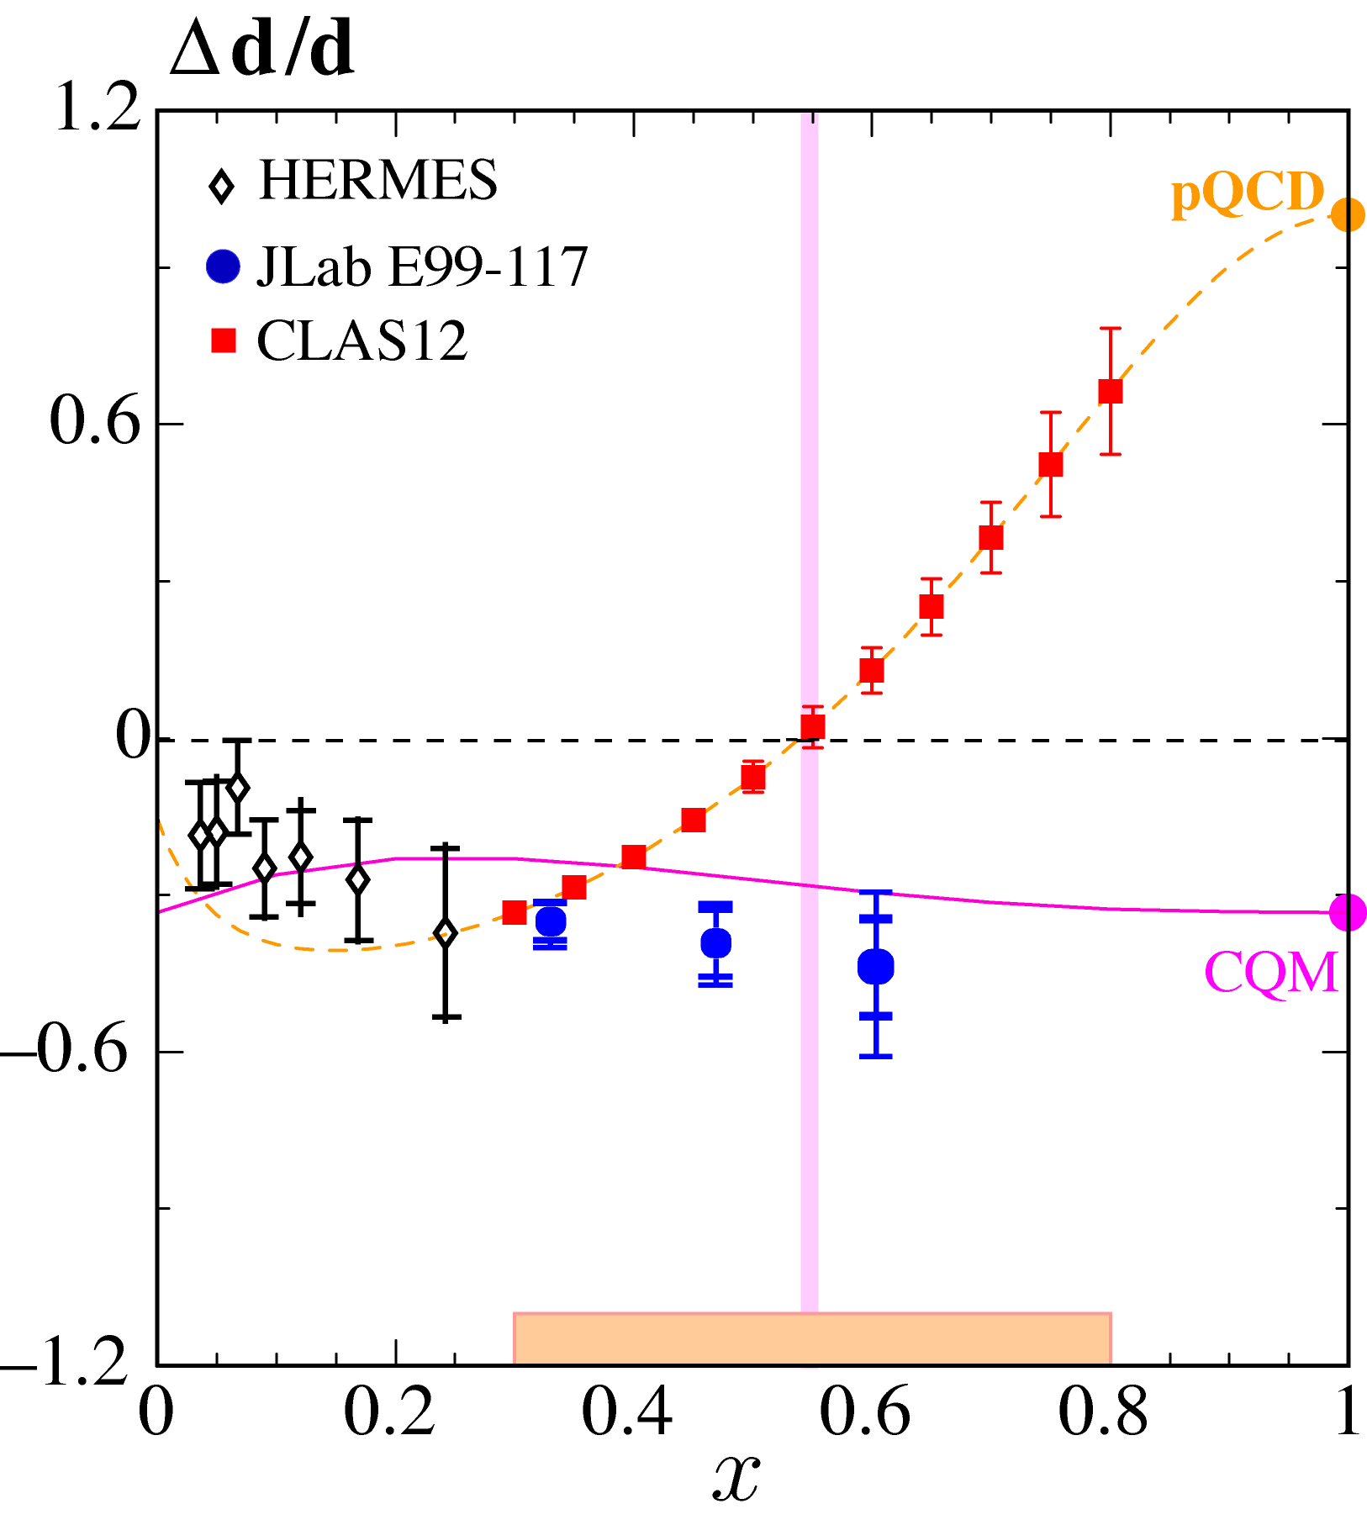

Valence Quark Structure and Parton Distributions
Access to valence quark region through DIS at large x will be augmented with a SIDIS program
Boer-Mulders asymmetry for pions as function of Q² and p_{T}

Slide 72



Many Other Experiments Can be Modeled in Detail Based on Experience with CEBAF @ 6 GeV
Pion Elastic Form Factor
Deuteron Photodisintegration
Parity Violation Experiments
,etc…………

Slide 73



Form Factors – Constraints on the GPDs
E12-07-109 (Hall A)
E12-07-104 (Hall B)
E12-06-101 (Hall C)

Slide 74
Science Motivating a Next Generation Collider
How do quarks and gluons provide the binding and spin of the nucleons?
What is the quark-gluon structure of mesons?
How do quarks and gluons evolve into hadrons?
How does energy convert to mass?
How does nuclear binding originate from quarks and gluons?
How do gluons behave in nuclei?
……..

Slide 76
12 GeV - $310M Total Project Cost
Start Construction
Oct 2008
Nov 2009 Profile
ARRA
Advance Funding
$65M included
CD-4A
Dec 2014
CD-4B
June 2015

Slide 77
Defining the 12 GeV Science Program in Detail
PACs 30, 32, 34, and 35 have approved a total of 34 proposals for 12 GeV science and conditionally approved 13 more. There are also a number of Letters of Intent that have been encouraged
The scientific prioritization of the approved expeirments began at PAC35, and will continue at PAC36 (this August) and future PACs
Additional new proposals will continue to be accepted at future PACs; your participation is encouraged
~1-2 years before the start of physics, hall-by-hall, there will be a PAC review of the Hall “commissioning year” of startup physics

Slide 78




The 12 GeV Upgrade Physics Instrumentation Technical Performance Requirements
Hall D | Hall B | Hall C | Hall A
excellent hermeticity | luminosity 10³⁵ | energy reach | installation space
polarized photons | hermeticity | precision
E_{γ}∼8.5−9 GeV | 11 GeV beamline
10⁸ photons/s | target flexibility
good momentum/angle resolution |  | excellent momentum resolution
high multiplicity reconstruction |  | luminosity up to 10³⁸
particle ID
Notes:
Don’t dwell on this too long, they can read it quickly

Slide 80

Understanding Nucleon Structure: Form Factors
PDFs, and Generalized Parton Distributions (GPDs)
12 GeV will access
the regime (x > 0.3),
where valence quarks dominate
DIS & Structure
Functions:
Quark longitudinal
& helicity distributions
in momentum space

Slide 81

Projected precision in extraction of GPD H at x = ξ
Projected results
Spatial Image

Slide 82
Understanding Nucleon Structure: Form Factors
PDFs, and Generalized Parton Distributions (GPDs)
Elastic Scattering & Form Factors:
Transverse charge & current densities in coordinate space

Slide 83


Form Factors – Constraints on the GPDs
Today

Slide 84
Form Factors – Constraints on the GPDs
After 12 GeV

Slide 85

After 35 years:
Miserable Lack of Knowledge of Valence d-Quarks
pQCD
di-quark
correlations

Slide 86


12 GeV : Unambiguous Flavor Structure x → 1
Hall C 11 GeV with HMS
³H/³He DIS
Hall B 11 GeV with CLAS12
²H w/ recoil detection
Initial experiment with recoil detection technique
(BONUS radial TPC) was highly successful

Slide 87
Understanding Nucleon Structure: Form Factors
PDFs, and Generalized Parton Distributions (GPDs)
Elastic Scattering & Form Factors:
Transverse charge & current densities in coordinate space
DIS & Structure
Functions:
Quark longitudinal
& helicity distributions
in momentum space
This program:
Drove spectrometer requirements
for CLAS12 & the SHMS
Sets beam power goal
DES & GPDs:
Correlated quark distributions
In transverse coordinate
and longitudinal momentum
space

Slide 88
Developing a Unified Description of Hadron Structure via the Recently Devised Generalized Parton Distributions
Transverse
momentum
of partons
Quark angular momentum
Quark spin distributions
GPDs
Form factors
(transverse Quark distributions
Pion distribution amplitudes
Pion cloud
Quark longitudinal momentum distributions

Slide 89

Deeply Virtual Exclusive Processes -
Kinematics Coverage of the 12 GeV Upgrade
overlap with other
experiments
unique to JLab
High x_{B} only reachable
with high luminosity
Upgraded JLab has
complementary
& unique capabilities
Notes:
Emphasize complementarity of CLAS and Hall A approaches/information/experimental technique
Identify what will be done after upgrade

Slide 90

Projected Path: the Extraction of GPDs
Use polarization!
Subset of projected results
σ⁺ − σ⁻
σ⁺ + σ⁻
Δσ
2σ
A =
=
e p epγ
Δσ_{LU} ~ sinφIm{F₁H + ...}dφ
Kinematically suppressed
H(ξ,t)
ξ = x_{B}/(2-x_{B})

Slide 92
12 GeV Science Categories
The Hadron spectra as probes of QCD
(GluEx and heavy baryon and meson spectroscopy)
The transverse structure of the hadrons
(Elastic and transition Form Factors)
The longitudinal structure of the hadrons
(Unpolarized and polarized parton distribution functions)
The 3D structure of the hadrons
(Generalized Parton Distributions and Transverse Momentum Distributions)
Hadrons and cold nuclear matter
(Medium modification of the nucleons, quark hadronization, N-N correlations,
hypernuclear spectroscopy, few-body experiments)
Low-energy tests of the Standard Model and Fundamental Symmetries
(Møller, PVDIS, PRIMEX, …..)

Slide 93
Table Key
Column | Color/Symbol | Meaning | Notes
Rating | Blank | TBD by PAC
Days Awarded | Black (Blue) | PAC Approved Proposal Request | To be confirmed or adjusted by PAC at Rating
Spokesperson(s) | Name in italics | Corresponding Spokesperson

Slide 94
The Hadron spectra as probes of QCD
(GluEx and heavy baryon and meson spectroscopy)
12 GeV Proposal # | TITLE | SPOKES-PERSON(S) | HALL | Rating | DAYS
12-06-102 | Mapping the Spectrum of Light Quark Mesons and Gluonic Excitations with Linearly Polarized Photons | C. Meyer G. Lolos | D |  | (120)

Slide 95
The transverse structure of the hadrons
(Elastic and transition Form Factors)
12 GeV Proposal # | TITLE | SPOKES-PERSON(S) | HALL | Rating | DAYS
12-06-101 | Measurement of the Charged Pion Form Factor to High Q² | G. Huber, D. Gaskell | C | A | 52
12-07-104 | Measurement of the Neutron Magnetic Form Factor at High Q² Using the Ratio Method on Deuterium | G. Gilfoyle, W. Brooks, K. Hafidi J. Lachinet, M. Vineyard L. Weinstein | B | A- | 30
12-07-108 | Precision Measurement of the Proton Elastic Cross Section at High Q² | B. Moffit, J. Arrington, S. Gilad, B. Wojtsekhowski | A | A- | 24
12-07-109 | Large Acceptance Proton Form Factor Ratio Measurements at 13 and 15 (GeV/c)² Using Recoil Polarization Method | L. Pentchev, E. Cisbani, M. Khandaker C. Perdrisat, V. Punjabi, B. Wojtsekhowski | A | A- | 45

Slide 96
The transverse structure of the hadrons (cont.)
(Elastic and transition Form Factors)
12 GeV Proposal # | TITLE | SPOKES-PERSON(S) | HALL | Rating | DAYS
12-09-003 | Nucleon Resonance Studies with CLAS | R. Gothe, V. Burkert, P. Cole, K. Joo, V. Mokeev, P. Stoler | B | B+ | 40
12-09-006 | The Neutron Electric Form Factor at Q² up to 7 GeV/c)² from the Reaction ²H(e,e’n)¹H via Recoil Polarimetry | A. Semenov B. Anderson, J. Arrington, S. Kowalski, R. Madey, B. Plaster | C |  | (66)
12-09-016 | A Measurement of the Neutron Electromagnetic Form Factor Ratio G_{E}^{n}/G_{M}^{n} at High Q² | B. Wojtsekhowski, G. Cates, S. Riordan | A | A- | 50
12-09-019 | Precision Measurement of the Neutron Magnetic Form Factor up to Q² = 18 (GeV/c)² by the Ratio Method | B. Wojtsekhowski, R. Gilman, B. Quinn | A | B+ | 25

Slide 97
The transverse structure of the hadrons (cont.)
(Elastic and transition Form Factors)
12 GeV Proposal # | TITLE | SPOKES-PERSON(S) | HALL | Rating | DAYS
 | Conditionally Approved Experiments
12-09-001 | G_{E}^{p}/G_{M}^{p} with an 11 GeV Electron Beam | E. Brash, M. Jones, C. Perdrisat, V. Punjabi | C |  | (94)

Slide 98
The longitudinal structure of the hadrons
(Unpolarized and polarized parton distribution functions)
12 GeV Proposal # | TITLE | SPOKES-PERSON(S) | HALL | Rating | DAYS
12-06-104 | Measurement of the Ratio R = σ_{L}/σ_{T} in Semi-Inclusive DIS | R. Ent, P. Bosted, H. Mkrtchyan | C |  | (40)
12-06-109 | The Longitudinal Spin Structure of the Nucleon | S. Kuhn, D. Crabb, A. Deur, V. Dharmawardane, T. Forest, K. Griffioen, M. Holtrop, Y. Prok | B |  | (80)
12-06-121 | A Path to “Color Polarizabilities” in the Neutron: A Precision Measurement of the Neutron g₂ and d₂ at High Q² in Hall C | B. Sawatzky, T. Averett, W. Korsch, Z.E. Meziani | C |  | (29)
12-06-122 | Measurement of the Neutron Asymmetry A₁^{n} in the Valence Quark Region using 8.8 and 6.6 GeV Beam Energies and BigBite spectrometer in Hall A | B. Wojtsekhowski, G. Cates, N. Liyanage, Z.E. Meziani, G. Rosner, X. Zheng | A |  | (23)

Slide 99
The longitudinal structure of the hadrons (cont.)
(Unpolarized and polarized parton distribution functions)
12 GeV Proposal # | TITLE | SPOKES-PERSON(S) | HALL | Rating | DAYS
12-10-002 | Precision measurements of the F₂ structure function at large x in the resonance region and beyond | S. Malace C. Keppel I. Niculescu | C |  | (13)

Slide 100
The longitudinal structure of the hadrons (cont.)
(Unpolarized and polarized parton distribution functions)
12 GeV Proposal # | TITLE | SPOKES-PERSON(S) | HALL | Rating | DAYS
 | Conditionally approved experiments
12-06-110 | Measurement of the Neutron Spin Asymmetry A₁^{n} in the Valence Quark Region Using an 11 GeV Beam in Hall C | X. Zheng, A. Camsonne, G. Cates, J.P. Chen, Z.E. Meziani | C |  | (53)
12-06-113 | The Structure of the Free Neutron at Large x-Bjorken | S. Bueltmann, M.E. Christy, H. Fenker, K. Griffioen, C. Keppel, S. Kuhn, W. Melnitchouk, V. Tvaskis | B |  | (40)
12-06-118 | Measurement of the F₂^{n}/F₂^{p}, d/u Ratios and A=3 EMC Effect in DIS off the Tritium and Helium Mirror Nuclei | G. Petratos, J. Gomez, R. Holt, R. Ransome | A |  | (31)

Slide 101
The 3D structure of the hadrons
(Generalized Parton Distributions and Transverse Momentum Distributions)
12 GeV Proposal # | TITLE | SPOKES-PERSON(S) | HALL | Rating | DAYS
12-06-108 | Hard Exclusive Electroproduction of π⁰ and η with CLAS12 | P. Stoler, K. Joo, V. Kubarovsky, M. Ungaro, C. Weiss | B |  | (120)
12-06-112 | Probing the Proton's Quark Dynamics in Semi-Inclusive Pion Production at 11 GeV | H. Avakian, K. Joo, Z.E. Meziani, B. Seitz | B |  | (60)
12-06-114 | Measurement of Electron-Helicity Dependent Cross Sections of Deeply Virtual Compton Scattering with CEBAF at 12 GeV | C. Hyde, B. Michel, C Munoz-Camacho, J. Roche | A |  | (100)
12-06-119 | Deeply Virtual Compton Scattering with CLAS at 11 GeV | F. Sabatie, A. Biselli, H. Egiyan, D. Ireland, L. Elouadhriri, M. Holtrop, W. Kim | B |  | (200)

Slide 102
The 3D structure of the hadrons (cont.)
(Generalized Parton Distributions and Transverse Momentum Distributions)
12 GeV Proposal # | TITLE | SPOKES-PERSON(S) | HALL | Rating | DAYS
12-07-105 | Scaling Study of the L-T Separated Pion Electro-production Cross-Section at 11 GeV | T. Horn, G. Huber | C |  | (42)
12-07-107 | Studies of Spin-Orbit Correlations with Longitudinally Polarized Target | H. Avakian, P. Bosted, K. Griffioen, K. Hafidi, P. Rossi | B |  | (103)
12-09-007 | Studies of Partonic Distributions using Semi-Inclusive Production of Kaons | K. Hafidi, H. Avakian, F. Benmokhtar, A. El Alaoui, M. Mirazita | B |  | (159)
12-09-008 | Studies of the Boer-Mulders Asymmetry in Kaon Electroproduction with Hydrogen and Deuterium Targets | H. Avakian, M. Contalbrigo, K. Joo, Z-E. Meziani, B. Seitz | B |  | (56)

Slide 103
The 3D structure of the hadrons (cont.)
(Generalized Parton Distributions and Transverse Momentum Distributions)
12 GeV Proposal # | TITLE | SPOKES-PERSON(S) | HALL | Rating | DAYS
12-09-009 | Studies of Spin-Orbit Correlations in Kaon Electroproduction in DIS with Polarized Hydrogen and Deuterium Targets | H. Avakian, E. Cisbani, K. Griffioen, K. Hafidi, P. Rossi | B |  | (103)
12-09-011 | Studies of the L-T Separated Kaon Electroproduction Cross Section from 5-11 GeV | T. Horn, G. Huber, P. Markowitz | C |  | (38)
12-10-006 | An update to PR12-09-014: Target Single Spin Asymmetry in Semi-Inclusive Deep-Inelastic Electro Pion Production on a Transversely Polarized 3He Target at 8.8 and 11 GeV | H. Gao J-P. Chen X. Jiang J-C Peng X. Qian | A |  | (90)

Slide 104
The 3D structure of the hadrons (cont.)
(Generalized Parton Distributions and Transverse Momentum Distributions)
12 GeV Proposal # | TITLE | SPOKES-PERSON(S) | HALL | Rating | DAYS
 | Conditionally approved experiments
12-09-017 | Transverse Momentum Dependence of Semi-Inclusive Pion Production | R. Ent, P. Bosted, H. Mkrtchyan | C |  | (32)
12-09-018 | Measurement of the Semi-Inclusive π and K Electro-production in the DIS Regime from a Transversely Polarized ³He Target with the SBS & BB Spectrometers in Hall A | B. Wojtsekhowski, G. Cates, E. Cisbani, G. Franklin | A |  | (64)

Slide 105
Hadrons and cold nuclear matter
(Medium modification of the nucleons, quark hadronization, N-N correlations, hypernuclear spectroscopy, few-body experiments)
12 GeV Proposal # | TITLE | SPOKES-PERSON(S) | HALL | Rating | DAYS
12-06-105 | Inclusive Scattering from Nuclei at x > 1 in the quasi-elastic and deep-inelastic regimes | D. Day, J. Arrington | C |  | (32)
12-06-106 | Study of Color Transparency in Exclusive Vector Meson Electroproduction off Nuclei | K. Hafidi, L. El Fassi, M. Holtrop, B. Mustapha, | B |  | (40)
12-06-117 | Quark Propagation and Hadron Formation | W. Brooks, G. Gilfoyle, H. Hakobyan, K. Hafidi, K. Hicks, M. Holtrop, K. Joo, G. Niculescu, I. Niculescu, L. Weinstein, M. Wood | B |  | (60)

Slide 106
Hadrons and cold nuclear matter (cont.)
(Medium modification of the nucleons, quark hadronization, N-N correlations, hypernuclear spectroscopy, few-body experiments)
12 GeV Proposal # | TITLE | SPOKES-PERSON(S) | HALL | Rating | DAYS
12-10-001a | Study of light hypernuclei by pionic decay at JLab | L. Tang, F. Garabaldi J. LeRose A. Margaryan S. Nakamura J. Reinhold L. Yuan | A |  | (5)
12-10-003 | Deuteron Electro-Disintegration at very high missing Momentum | W. Boeglin M. Jones | C |  | (21)
12-10-008 | Detailed studies of the nuclear dependence of F₂ in the light nuclei | A. Daniel, J. Arrington, D. Gaskell | C |  | 23

Slide 107
Hadrons and cold nuclear matter (cont.)
(Medium modification of the nucleons, quark hadronization, N-N correlations, hypernuclear spectroscopy, few-body experiments)
12 GeV Proposal # | TITLE | SPOKES-PERSON(S) | HALL | Rating | DAYS
 | Conditionally approved experiments
12-06-107 | The Search for Color Transparency at 12 GeV | D. Dutta, R. Ent | C |  | (26)
12-07-101 | Hadronization in Nuclei by Deep Inelastic Electron Scattering | B. Norum, J-P. Chen, H. Lu, K. Wang | C |  | (15)
12-07-106 | The A-Dependence of J/Ψ Photoproduction near Threshold | E. Chudakov, P. Bosted, J. Dunne | C |  | (23)
12-10-001b | Study of light hypernuclei by pionic decay at JLab | L. Tang, F. Garabaldi J. LeRose A. Margaryan S. Nakamura J. Reinhold L. Yuan | A |  | (42)

Slide 108
Low-energy tests of the Standard Model and Fundamental Symmetries
(Møller, PVDIS, PRIMEX, …..)
12 GeV Proposal #, L. | TITLE | SPOKES-PERSON(S) | HALL | Rating | DAYS
12-09-005 | An Ultra-Precise Measurement of the Weak Mixing Angle using Moeller Scattering | K. Kumar | A |  | (253)
12-10-007 | Precision Measurement of Parity-violation in Deep Inelastic Scattering Over a Broad Kinematic Range | P. Souder | A |  | (339)
12-10-011 | A Precision Measurement of the eta Radiative Decay Width via the Primakoff Effect | A. Gasparian, L. Gan | D |  | (88)

Slide 109
Low-energy tests of the Standard Model and Fundamental Symmetries
(Møller, PVDIS, PRIMEX, …..)
12 GeV Proposal # | TITLE | SPOKES-PERSON(S) | HALL | Rating | DAYS
 | Conditionally approved experiments
12-07-102 | Precision Measurement of the Parity-Violating Asymmetry in DIS off Deuterium Using baseline 12-GeV Equipment in Hall C | P. Reimer, K. Paschke, X. Zheng | C |  | (36)
12-09-002 | Precise Measurement of π⁺/π⁻ Ratios in Semi-Inclusive Deep Inelastic Scattering: Charge Symmetry Violating Quark Distributions | K. Hafidi, D. Dutta, D. Gaskell | C |  | (17)
12-10-009 | Search for new Vector Boson A’ Decaying to e⁺e⁻ | B. Wojtsekhowski, N. Toro P. Schuster R. Essig | A |  | (33)

