Slide 1
Recent results from LEPS and prospects of LEPS II at SPring-8
M. Niiyama (Kyoto Univ.)
Contents
Introduction to SPring-8/LEPS I
κ-meson search in K(890)Σ⁺ production
Physics motivation at LEPS II
Status of LEPS II project
Summary

Slide 2

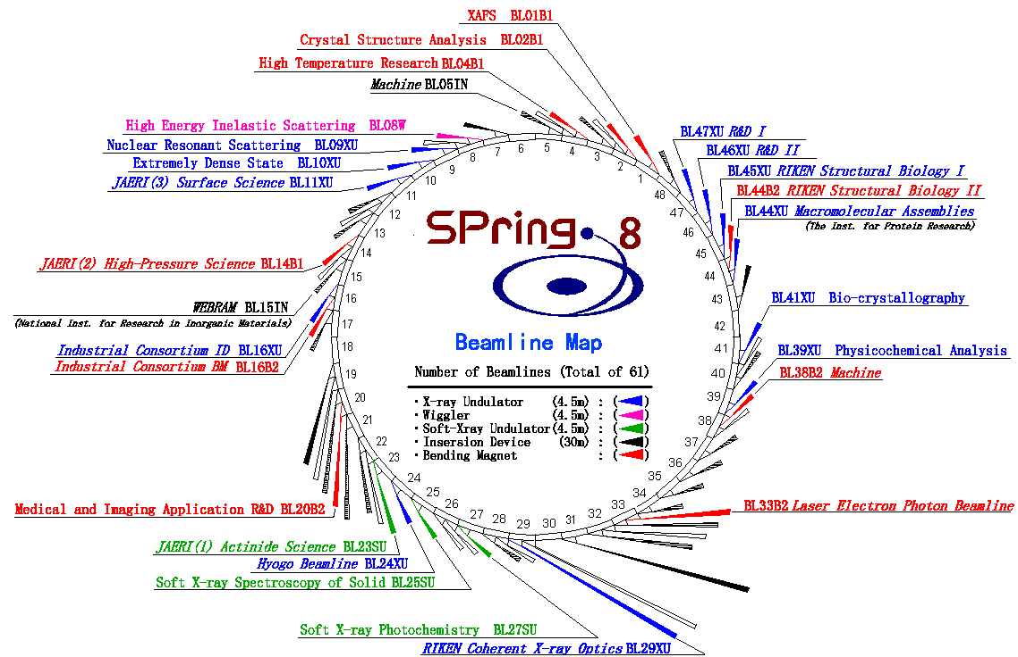
Super Photon Ring 8 GeV (SPring-8)
J-Parc

Slide 3
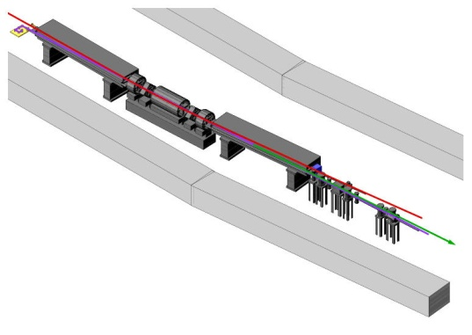
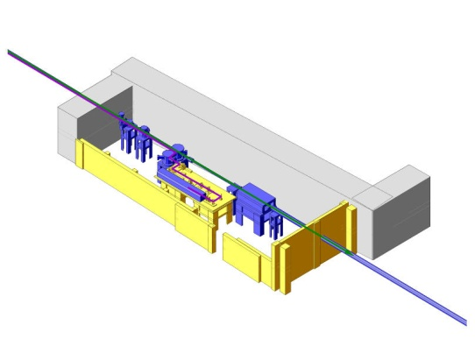
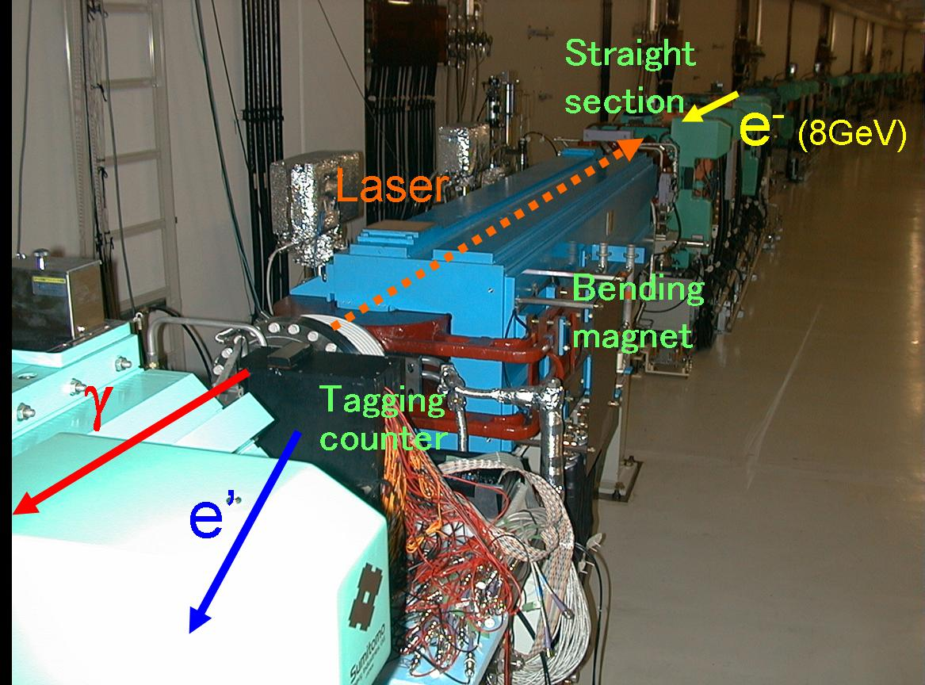
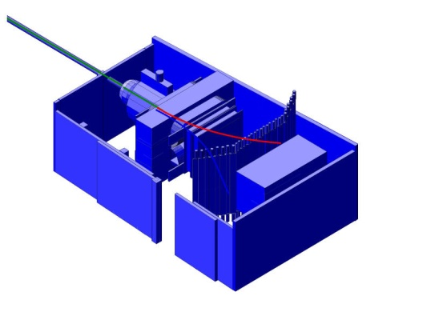
Schematic View of LEPS I Facility
8 GeV electron
Backward-Compton scattering
Collision
Recoil electron
Tagging counter
36m
70m
a) SPring-8 SR
Laser light
b) Laser hutch
Compton γ-ray
c) Experimental hutch

Slide 4
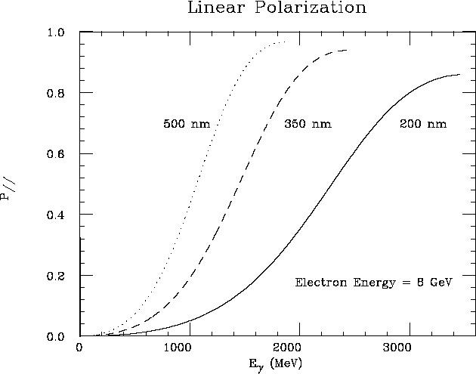
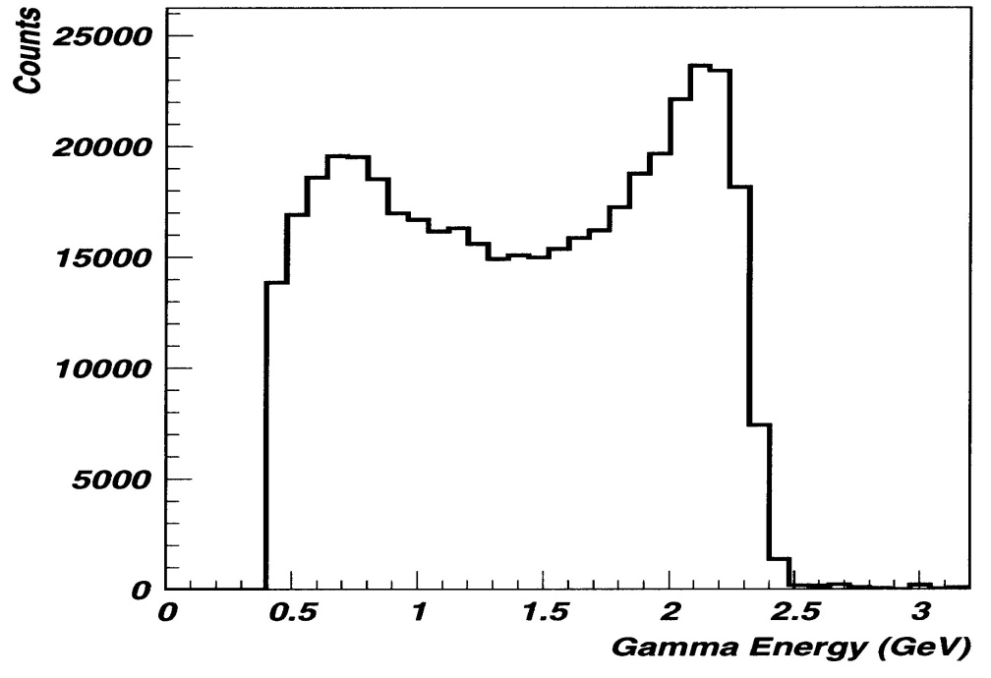
Backward-Compton Scattered Photon
8 GeV electrons in SPring-8
  + 351nm Ar laser (3.5eV） 8W➔ ~ 2.4 GeV photon
  + 266nm Solid+BBO (4.6eV） 1W➔ +3.0 GeV photon
Laser Power ~6 W (351nm) ➔ Photon Flux ~1 Mcps (2.4 GeV)
Eγ measured by tagging a recoil electron ➔ Eγ>1.5 GeV, ΔEγ ~10 MeV
Laser linear polarization 95-100% ⇒ Highly polarized γ beam
PWO measurement
Linear Polarization of γ beam
tagged
photon energy [GeV]
photon energy [MeV]

Slide 5
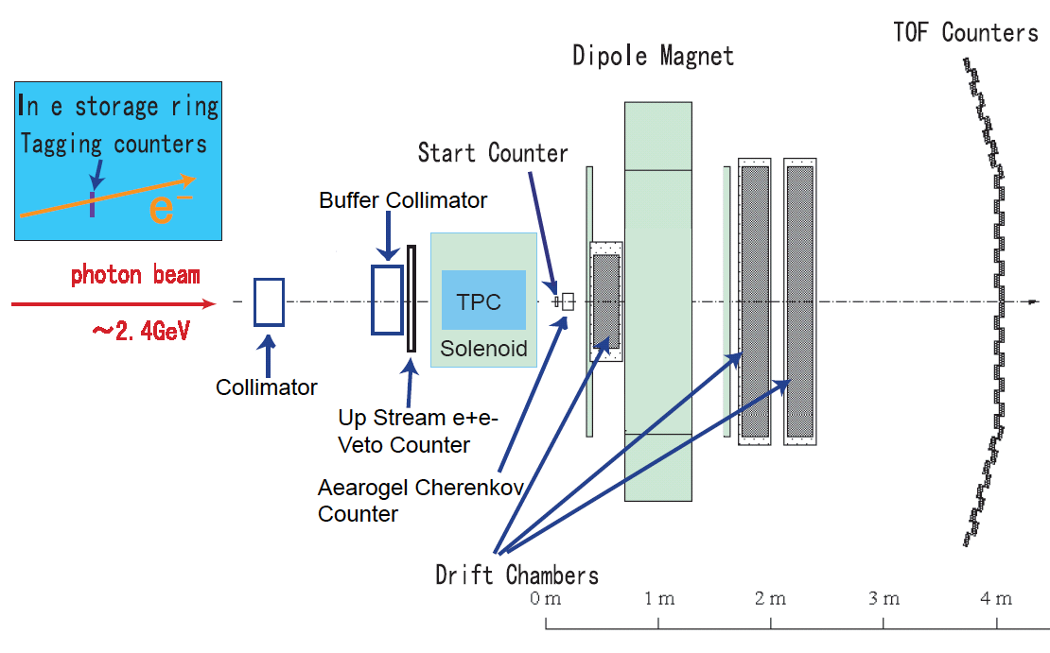
Setup of LEPS I
1.5

Slide 6
κ meson search in K(890)Σ⁺ photoproduction

Slide 7
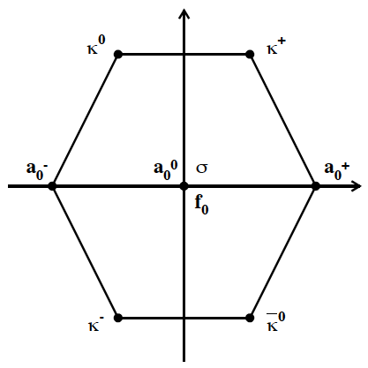
scalar meson
Particle Data Group
  the identification of the scalar mesons is
  “a long-standing puzzle”.
  a₀(980), f₀(980)
    are firmly established
    interpretation as exotic 4-quark states is in question.
  σ(600)
    Mass:600〜1200 MeV, Γ: 600〜1000 MeV
  κ(800): Needs confirmation.
    Mass:676 ±40 MeV, Γ: 548 ±24MeV

Slide 8
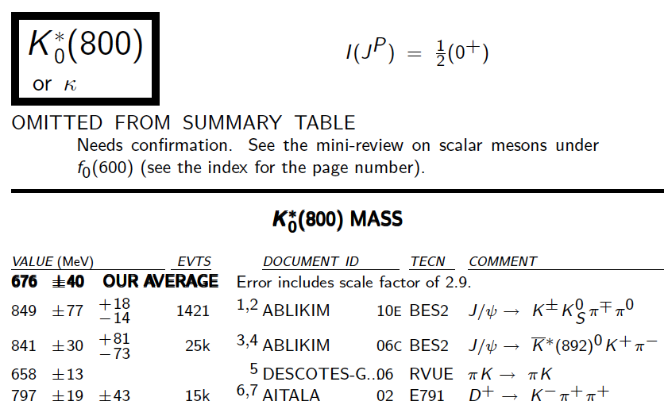

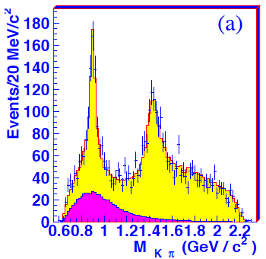
PDG (2010)
BES, PLB693
Additional evidence is needed to establish κ.

Slide 9
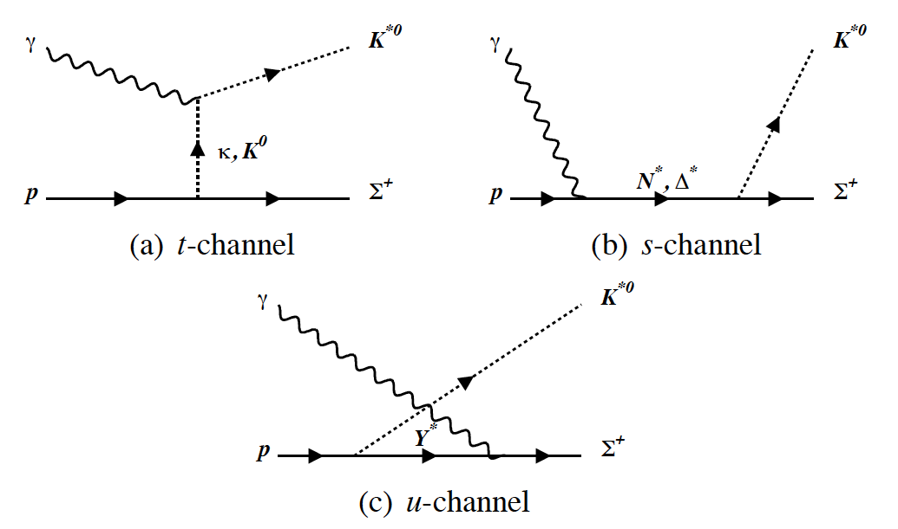
Born terms of K(890)Σ⁺ photoproduction
K* exchange is suppressed.

Slide 10
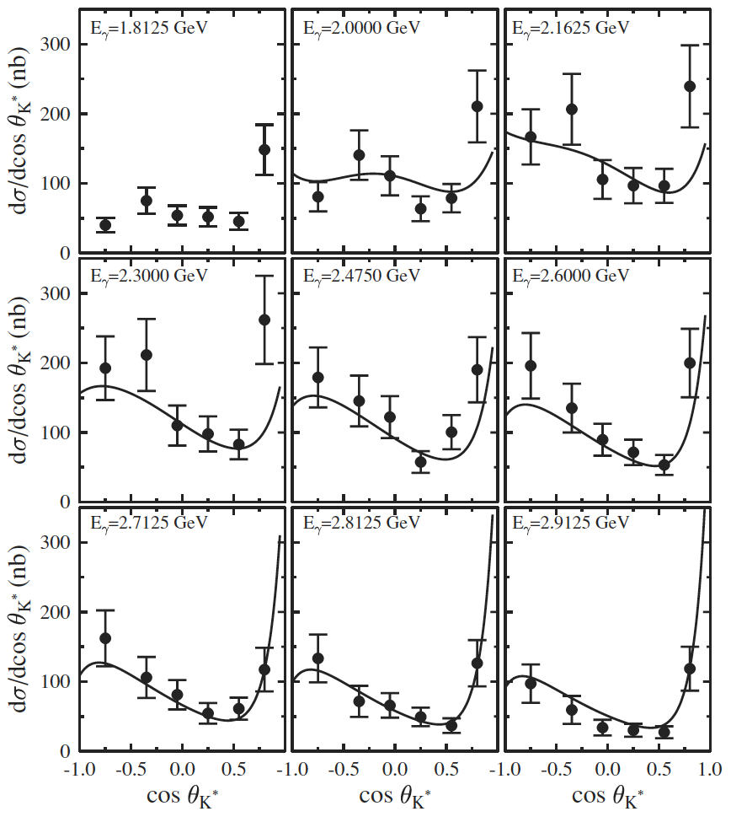
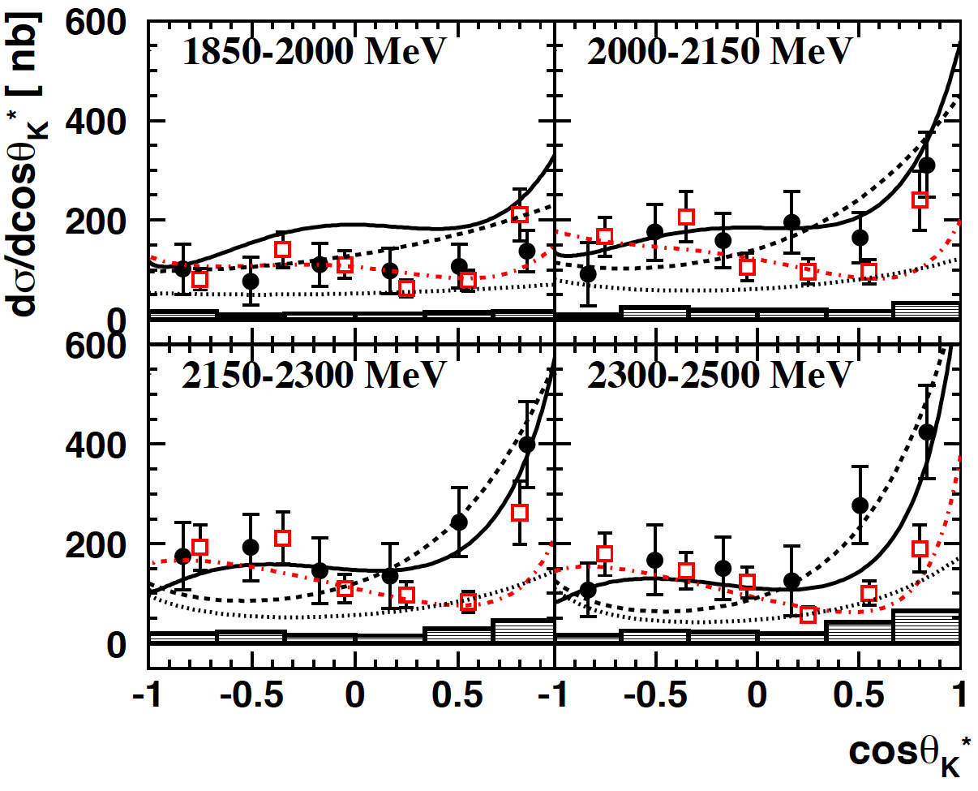
K(890)Σ⁺ photoproduction
t-channel: forward region
polarization measurement is needed
CBELSA/TAPS
Eur. Phys. J. A 35, 333
CLAS, PRC75(042201)

Slide 11
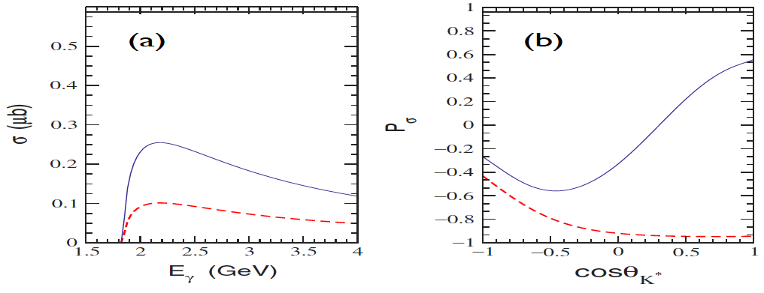
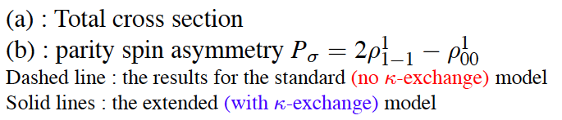
Theoretical model

Slide 12
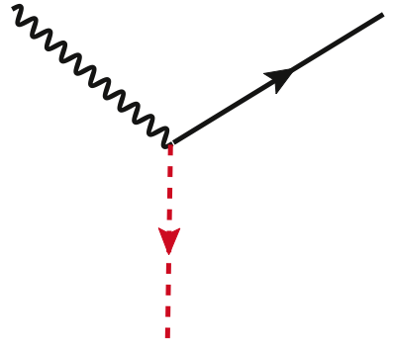
Hyperon production with K*(892)
γp→K(890)Σ⁺
Parity filter with linearly polarized photon
K
γ
E
K*
π
unatural parity ex.
P= -(-1)^{J}
pseudo-scalar: kaons

Slide 13
Hyperon production with K*(892)
γp→K(890)Σ⁺
Parity filter with linearly polarized photon
γ
K
E
K*
π
natural parity ex.
P=(-1)^{J}
scalar: kappa

Slide 14
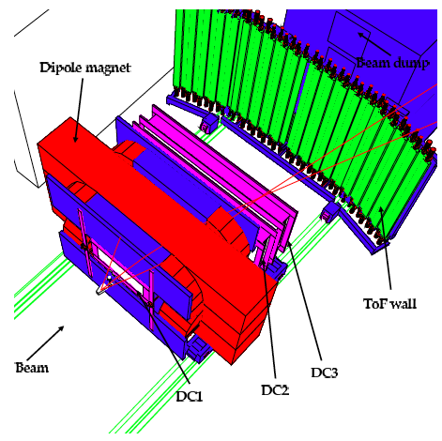
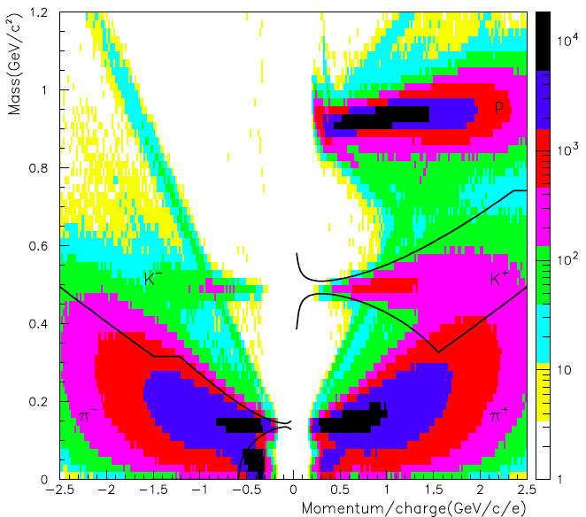
LEPS sectromenter and K/π selection

Slide 15
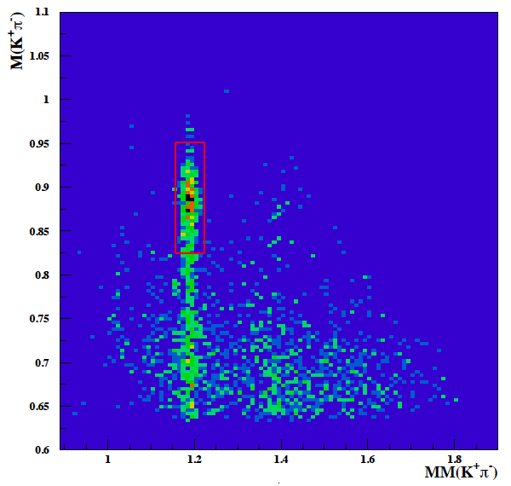
IM(K⁺π⁻) vs MM(γ,K⁺π⁻)

Slide 16
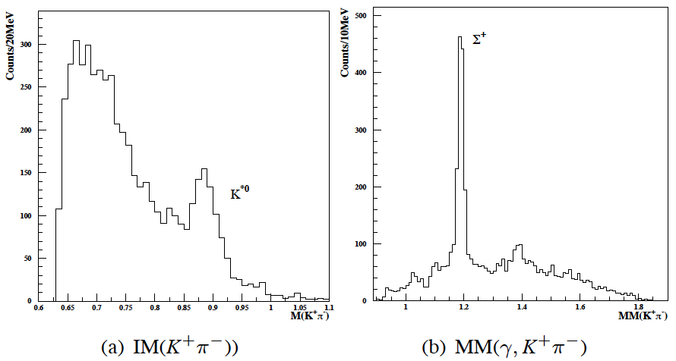
Projected spectra

Slide 17
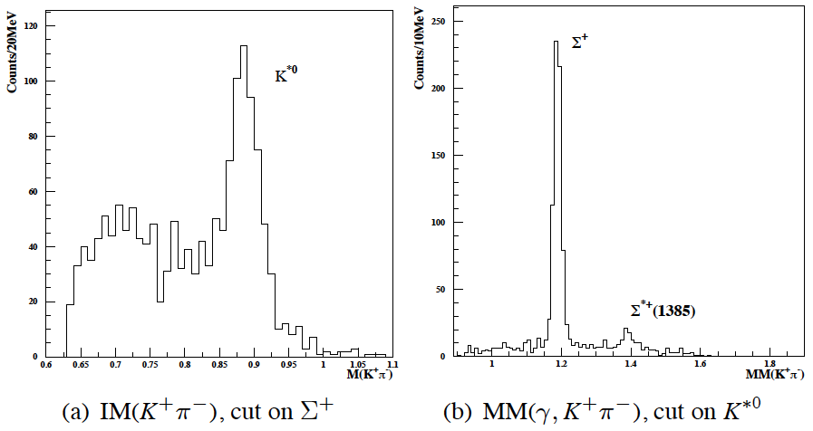
IM and MM with K^{*0}/Σ⁺ cut

Slide 18
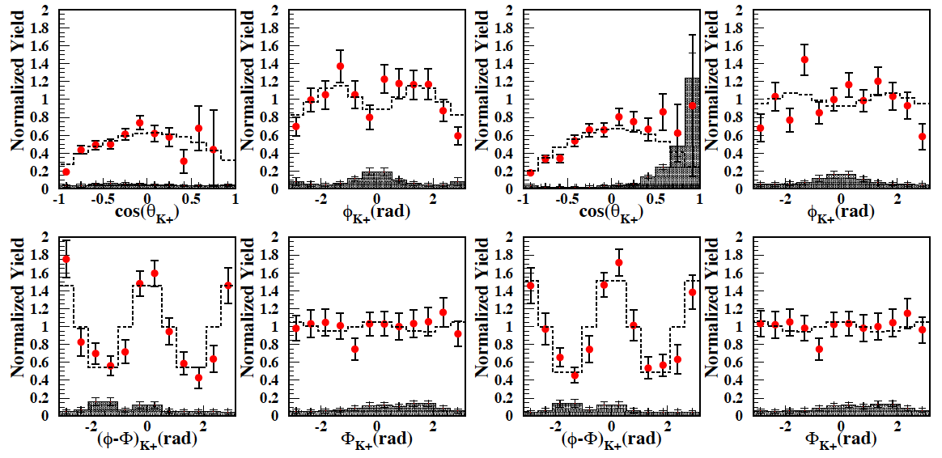

Decay angular distribution

Slide 19
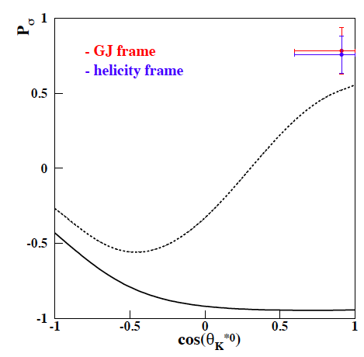
Parity spin asymmetry
κ-exchange
is dominant.
S.H.Hwang et al, PRL,108:092001,2012

Slide 20
LEPS II project

Slide 21
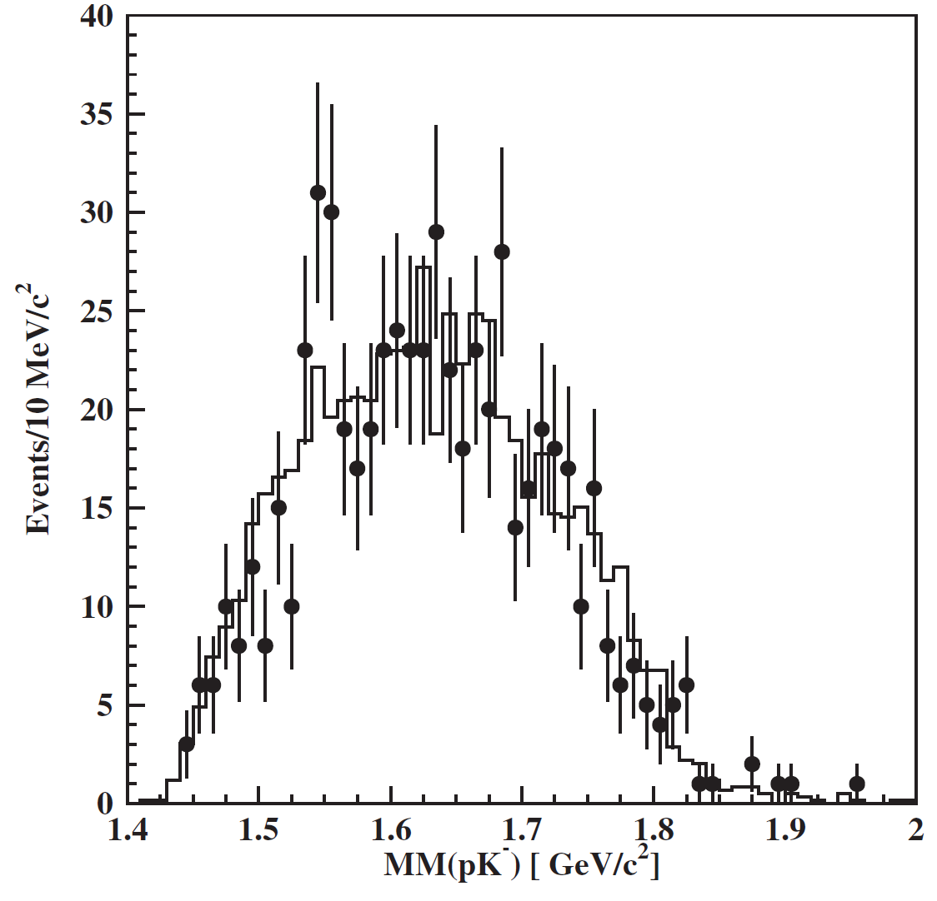

Physics motivation for LEPS II
Pentaquark Θ⁺ LEPS vs CLAS
Strong angular dependence of production rate?
LEPS
forward
angle
CLAS
large angle
Result of 3 times more data will be shown in August,
at FewBody workshop in Fukuoka, Japan.
PRC 79, 025210 (2009)
PRL 96, 212001(2006)

Slide 22
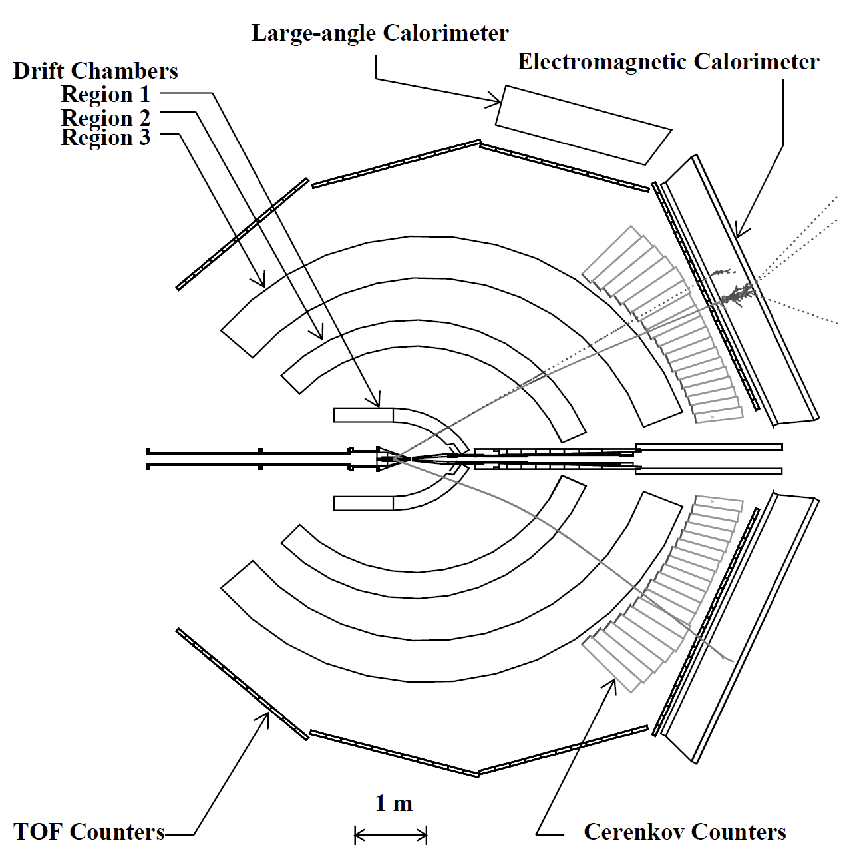
Physics motivation for LEPS II
Θ⁺ LEPS vs CLAS
Strong angular dependence of production rate?
LEPS
forward
angle
CLAS
large angle
SVTX
DC1
TOF
AC(n=1.03)
After reconfirmation of Θ⁺ peak with x3 statistics data
→ Angular dependence of production cross section.
4π detector LEPS II.
Photons
Target
Dipole Magnet
0.7Tesla
Start Counter
DC2
DC3
PRC 79, 025210 (2009)
PRL 96, 212001(2006)

Slide 23
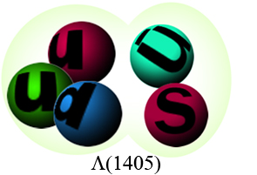
Physics motivation for LEPS II
Λ(1405) J^{P}=1/2-
Structure of P-wave baryons
1/2⁻
N(1535)
3/2⁻
Λ(1520)
N(1520)
3/2⁻
η+Ν (1485)
K+N (1430)
30 MeV
1/2⁻
Λ(1405)

Slide 24
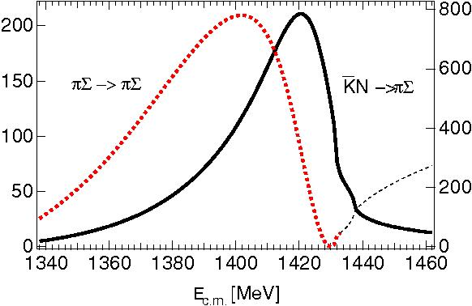
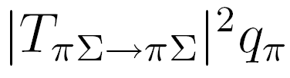
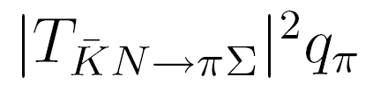
Two pole structure of Λ(1405)
D. Jido, et al. NPA725(2003)
Reconfirm by photoproduction.
M.Niiyama. PRC78
V.K. Magas, E. Oset and A. Ramos, PRL 95

Slide 25
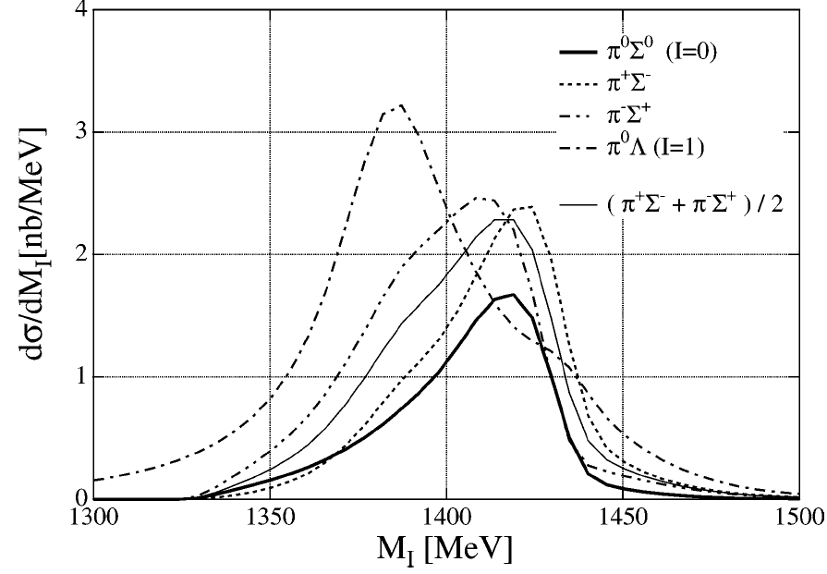
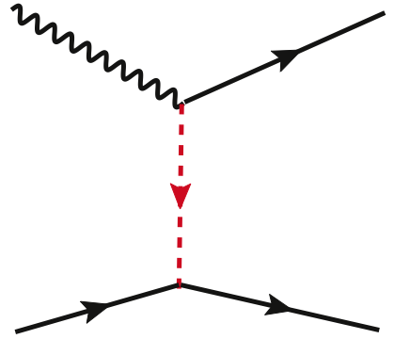
Size of hyperon resonances
K*(890) Y* photoproduction with linearly polarized photon
γ
K
E
K*
π
High luminosity photon beam with Eγ>2.4 GeV.
Detect K*⁺→ K⁰s π⁺ → πππ
Λ(1405) → Σ⁰π⁰ → Λγ γγ
Σ(1385) → Λπ⁰
Large acceptance charged / photon detector
T.Hyodo et. al,
PLB593
K-
p
Λ(1405)
Σ(1385)

Slide 26
Physics motivation for LEPS II
K*(890) Y* photoproduction with linearly polarized photon
γ
Comparison of transition
form factor Λ(1405)/Σ(1385)
may reveal broad molecular
structure of Λ(1405)
K*(890)
K⁻
p
Transition
form factor
Λ(1405)
Σ(1385)

Slide 27
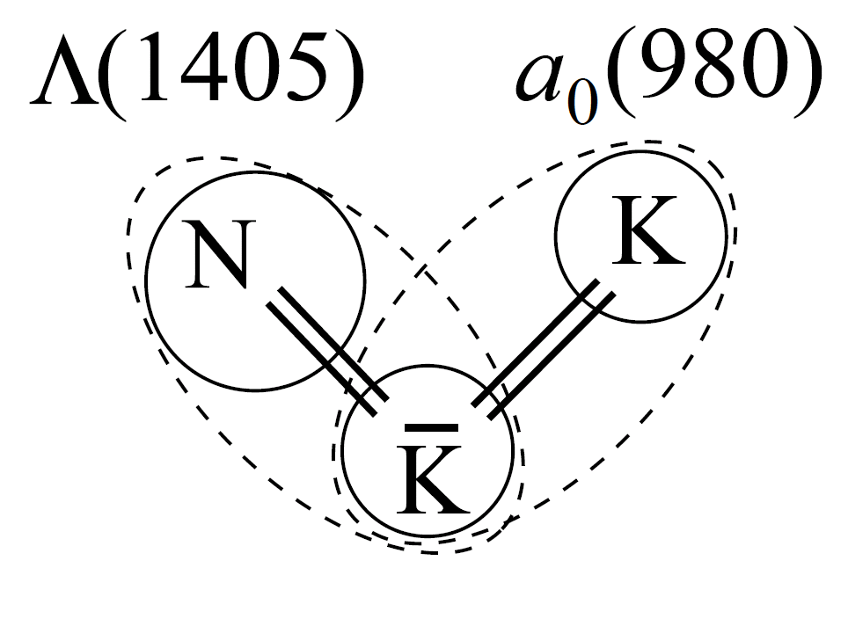
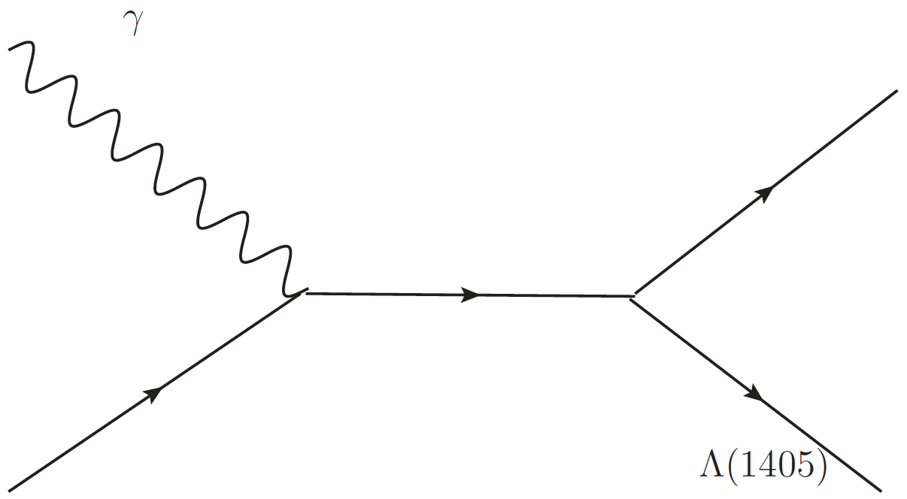
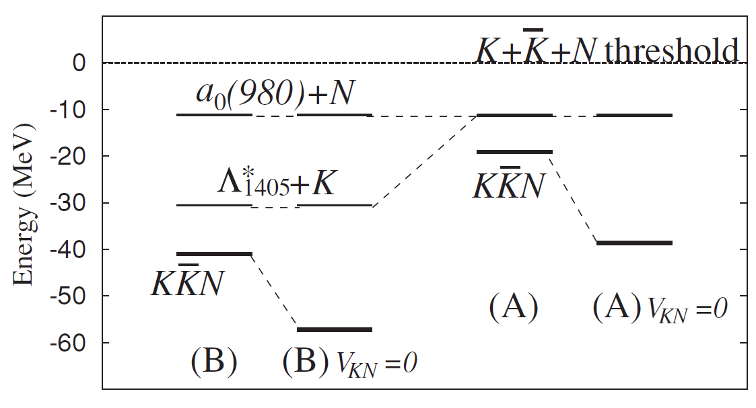
KK^{bar}P molecule
γ p →N*→K⁺ Λ(1405)
γ
K
N*
p
Λ(1405)
γ p →N*→a₀(980) p
γ
a₀(980)
N*
Jido and Enyo (PRC78)
p
p

Slide 28
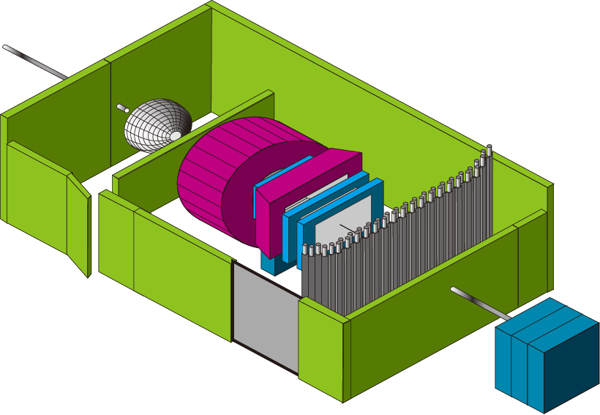
Schematic view of the LEPS2 facility
Backward Compton Scattering
10 times high intensity：
Multi laser injection
&Laser beam shaping
(future possibility: Re-injection of
X-ray from undulator)
8 GeV electron
SR ring
Recoil electron
(Tagging)
30m long line
Laser
LEP
(GeV γ -ray)
Laser room
Inside SR bldg
Best emittance e beam
pencil photon beam
Outside SR bldg
Experimental bldg
Beam dump
Large 4π spectrometer

Slide 29



High Beam Intensity
LEP intensity ≥ 10⁷ cps for E_{γ}<2.4 GeV beam (355 nm)
≥ 10⁶ cps for E_{γ}<2.9 GeV beam (266 nm)
4-laser injection [x4]
Higher power CW lasers.
355 nm (for 2.4 GeV) 8 W→16 W, 266 nm (for 2.9 GeV) 1 W→2 W [x2]
Laser beam shaping with cylindrical expander [x2]
UV lasers
(355/266 nm)
400 um
laser
10 um
prism
expander
Electron beam is horizontally wide.
⇒ BCS efficiency will be increased
by elliptical laser beam.
AR-coated mirror
w/ stepping motor
Need large aperture of the laser injection line
→ construct new BL chambers

Slide 30
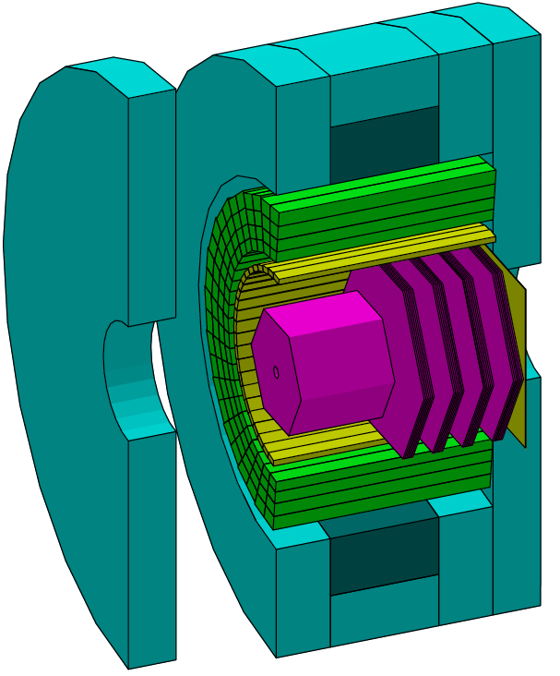
LEPS II detector R&D
2.22 m
B=1 T
γ counter
RPC
Δp/p 〜 1%
for θ >7 deg
TOP
Good K/π/p
separation < 2.7 GeV/c
γ
TPC
DC

Slide 31
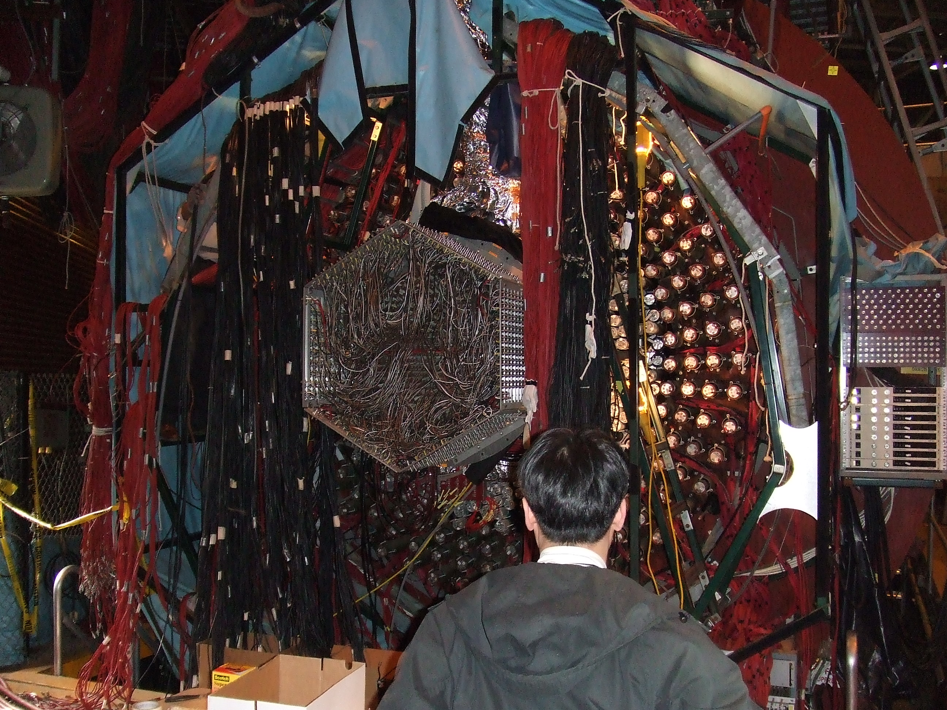
2006. 03
BNL E949
(K⁺ → π⁺ νν_{bar})

Slide 32
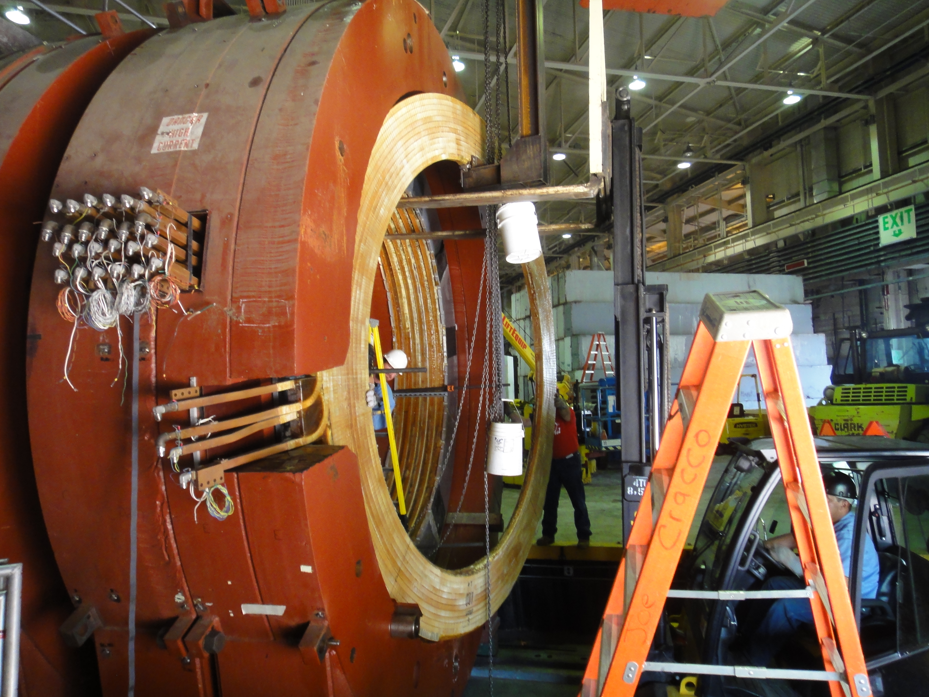
2011. 08

Slide 33
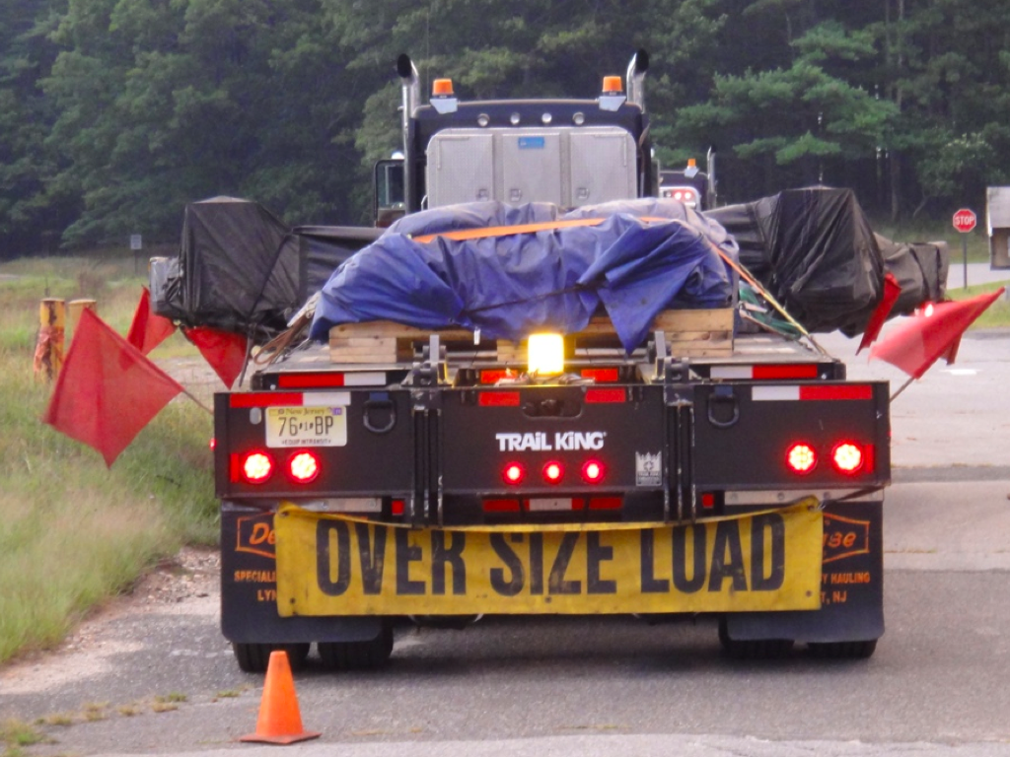
2011. 09

Slide 34
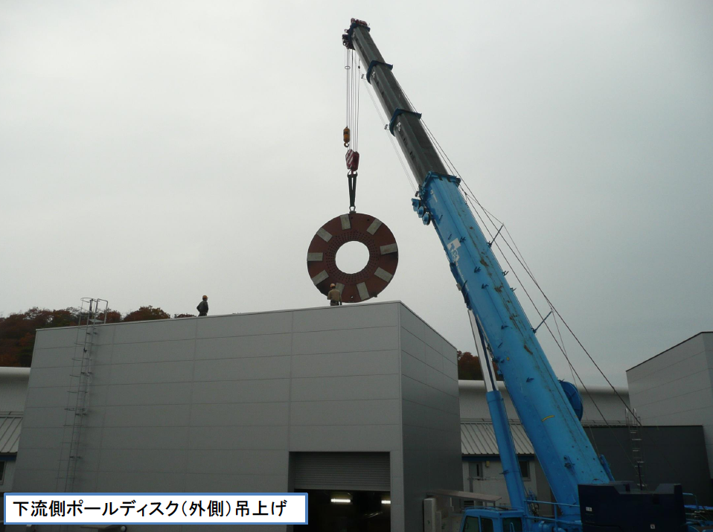
2011.11 SP8

Slide 35
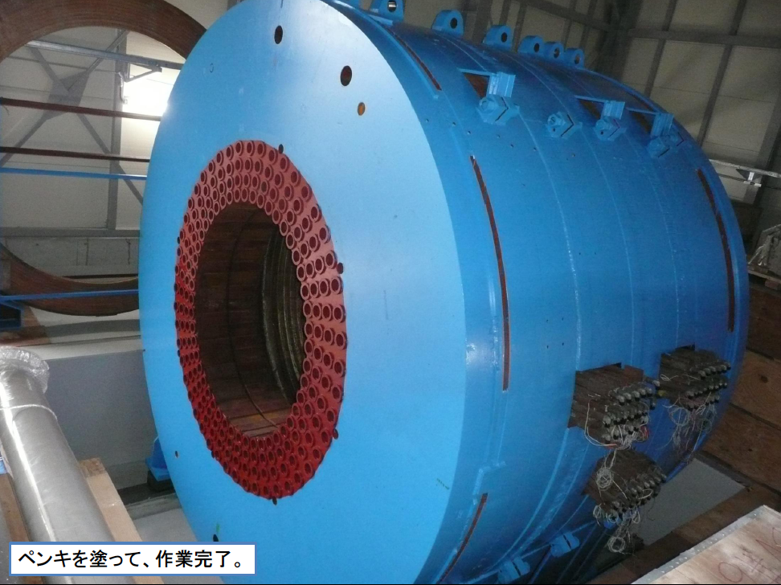
2011.12 SP8

Slide 36
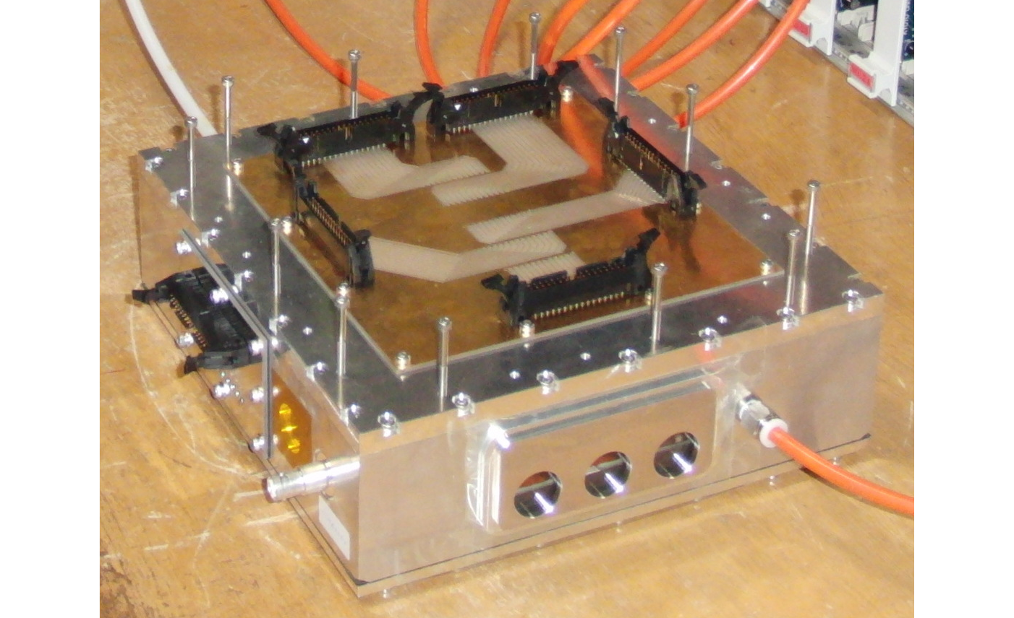
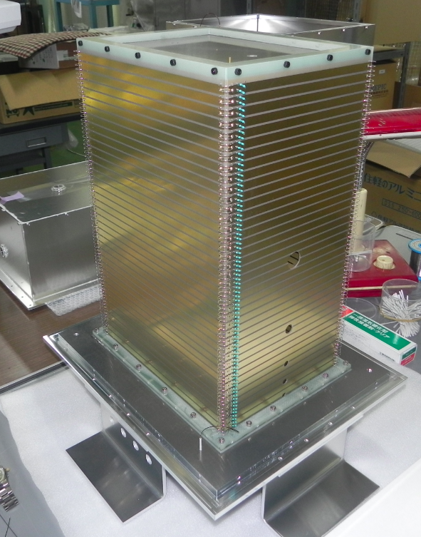
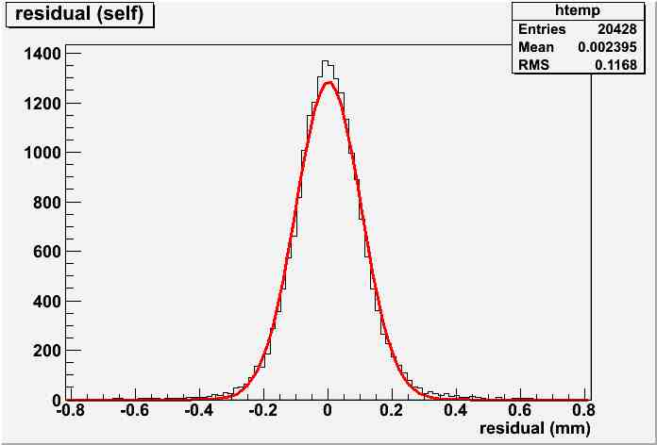
Detector development
Time projection chamber
prototype 1
prototype 2
Volume (50 mm × 50 mm × 20 mm)
Volume (118 mm × 250 mm × 412.6 mm)
~ 20 mm
P10
Ne-CH₄
~ 400 mm
P10
residual

Slide 37
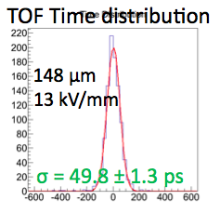
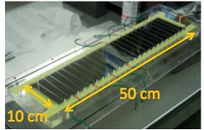
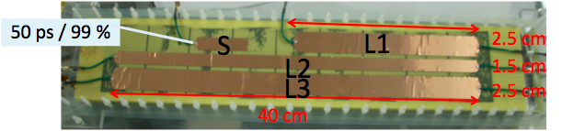
Detector development
Resistive plate chamber
60 ps / 99 %

Slide 38
Summary
LEPS
  Highly polarized photon beam up to 3 GeV.
  K*Σ⁺ photoproduction with evidence for κ meson exchange. (PRL108, 092001,2012)
  The results of Θ⁺ search will be shown at FB20 workshop in August.
LEPS II
  x10 luminosity.
  4π detector with solenoid which cover from very forward to backward.
  Photon and charged particle detection simultaneously.
  First beam in this autumn.
  Physics data taking start from 2014.

Slide 40
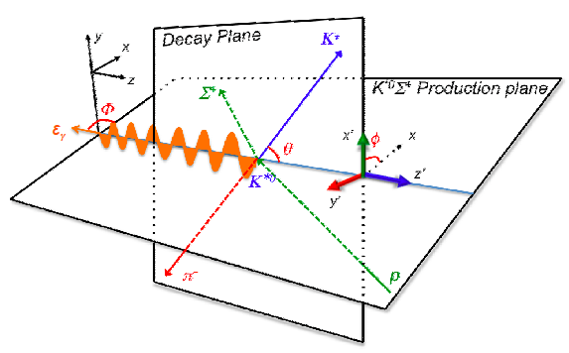
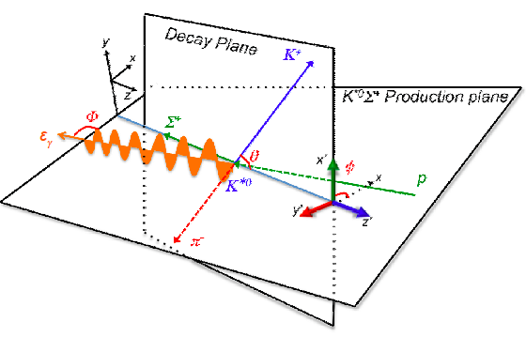



Slide 41



Slide 42

Good beam emittance
Beam size @ target (RMS): x ~2cm, y~1cm

Slide 43
LEPS2 roadmap

Slide 44

Solenoid tracking system
TOF
TOP
・PID
sideway: TOF (Δt =50 psec)
forward: TOP (quarts Cerenkov)

Slide 45
Solenoid tracking system

Slide 46

Physics motivation for LEPS II
u-channel meson production
Recoilless meson production in nucleus.
γ
ω,φ,η,η’
p
p
Detection of scattered and decay particles
  4π acceptance forward to backward
Detection of charged particles and photons

Slide 47

2010.10.11

Slide 48

2010.11.10

Slide 49

2010.12.10

Slide 50

2011.1.31

Slide 51


Slide 52


Slide 53

Aug, 2010, at BNL AGS
E949 (K+rare decay)

Slide 54

Opened the downstream endplate. (Jan. 14)

Slide 55

A part of RS and BV is removed (Feb.16).

Slide 56


