Slide 1
Recent Results of Light Hadron Spectroscopy at BESIII
Yutie LIANG
(On behalf of the BESIII Collaboration)
Justus-Liebig-Universität, Gieβen, Germany
MESON 2012, 31st May – 5th June, Krakow, Poland

Slide 2
Outline
Introduction to BESIII/BEPCII
Latest results on hadron spectroscopy
Summary
pp mass threshold enhancement
Isospin violated decay η(1405) →f₀(980)π⁰
Precision measurement of Br(J/ψ→ π⁺π⁻π⁰) and Br(ψ’→ π⁺π⁻π⁰)
Confirmation of X(1835) and observation of two new structures
X(1870) in J/ψ → ωX, X→a₀(980)π
N* baryon in ψ’ → ppπ⁰, ψ’ → ppη
Yanping’s talk

Slide 3
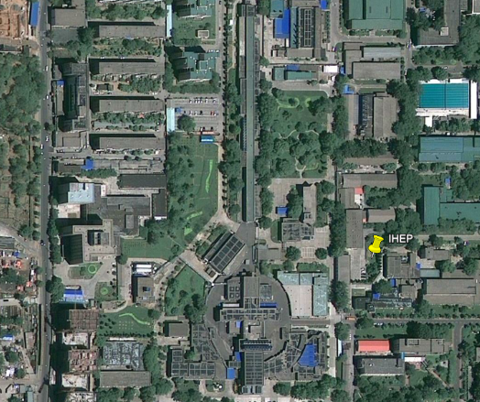
The BESIII/BEPCII Project
BEPCII: e+e- collider (τ-charm region)
: 2.0-4.6 GeV
First collisions: March 2008
Luminosity: ~6.9×10³² cm⁻²s⁻¹@3770
(~11×CESRc and ~62×BEPC)
BESIII:
Momentum resolution:
σ_{p}/p = 0.58% at 1GeV/c
Photons: σ_{E}/E = 2.5% at 1GeV
TOF: 80ps(barrel), 100ps(endcap)
MUC: 9 layers RPC for barrel, 8 for
endcap

Slide 4
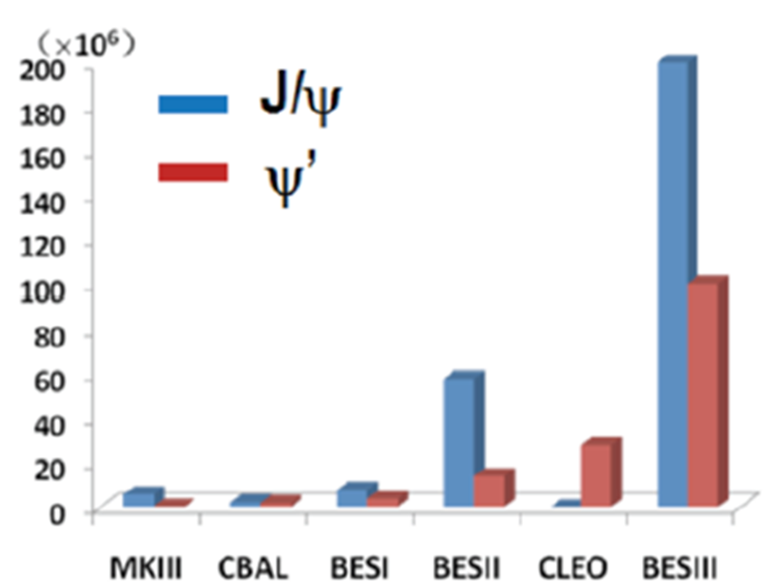
Introduction to the BESIII experiment
BESIII Data
Physics at BESIII
R_{had} and precision tests of Standard Model
Light hadron spectroscopy
Charm and charmonium physics
τ physics
Improve the measurement precision
of CKM matrix elements
Search for new physics / new particles
BESIII collected by the end of 2011
J/ψ: 225 Million
Ψ’ : 106 Million
ψ(3770) : 2.9fb⁻¹
ψ(4010) : 0.5fb⁻¹
More data is coming.

Slide 5
Light Hadron Spectroscopy (u, d, s)
Multi-quarks states, glueballs and hybrids have been
searched experimentally for a long time, but none
have been established unambiguously.
In the past several years, a lot of unexpected
experimental evidence for hadron states cannot (easily)
be explained by the conventional quark model.
Search for more non-conventional hadrons
BESIII’s advantages:
Gluon rich
Clean environment
J^{PC} filter, and isospin filter

Slide 6
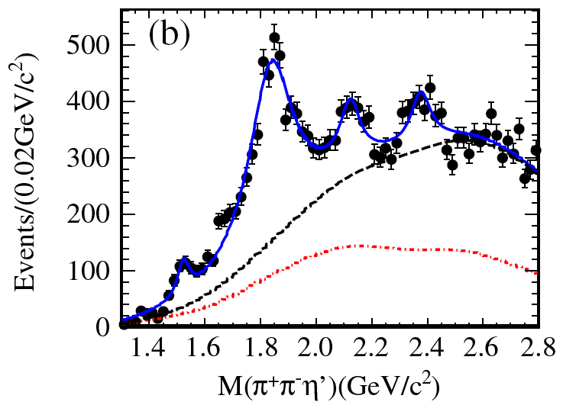
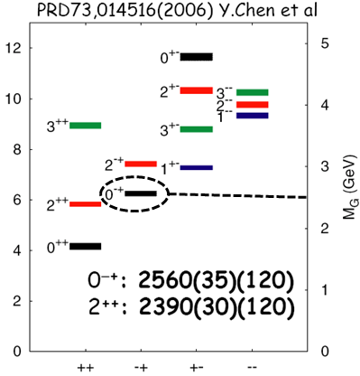
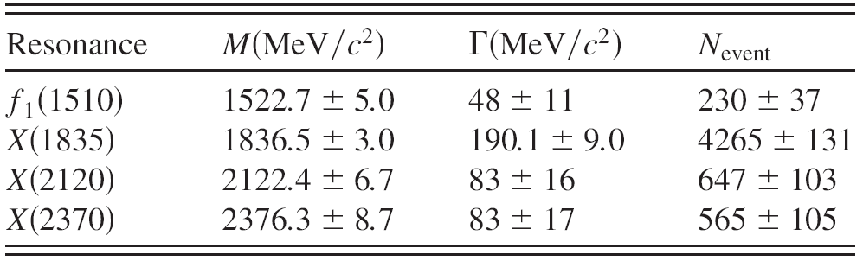
X(1835) and two new structures in J/ψ→γπ⁺π⁻η’
X(1835)
f1(1510)
C.L.
5.7 σ
>20 σ
7.2 σ
6.4 σ
PRL 106, 072002 (2011)
Details shown in Yanping’s talk

Slide 7
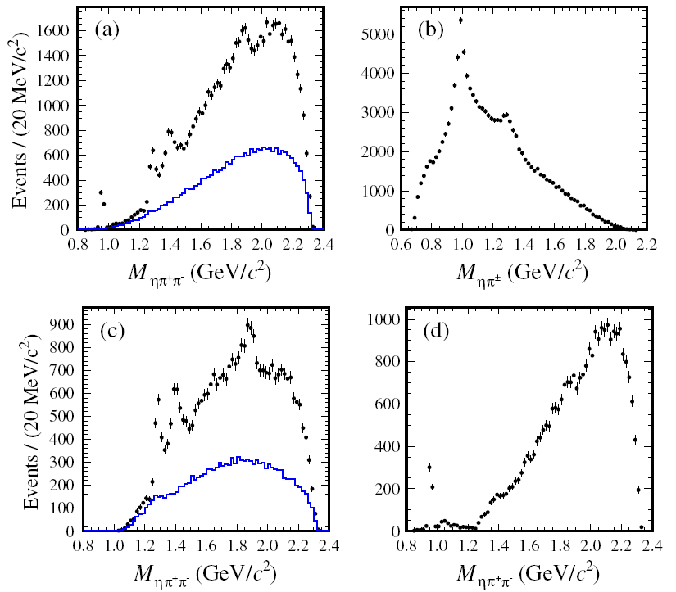
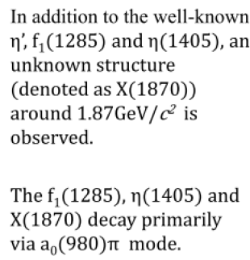
X(1870) in J/ψ → ωπ⁺π⁻η
a₀(980)
PRL 107, 182001 (2011)

Slide 8

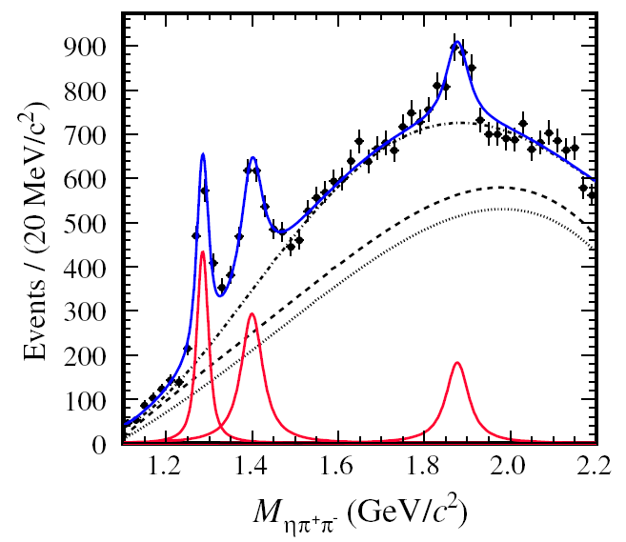
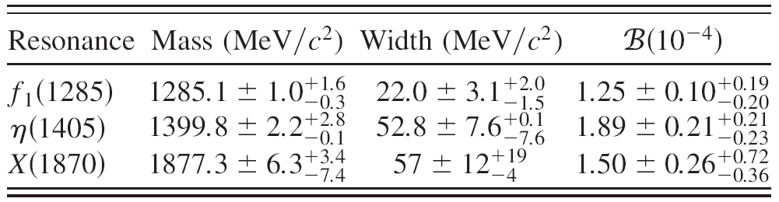
X(1870) in J/ψ → ωX, X→a₀(980)π
f1(1285)
η(1405)
X(1870) : 7.2σ
0⁻⁺ (?)
Is it X(1835) ?
Need PWA!
PRL 107, 182001 (2011)

Slide 9
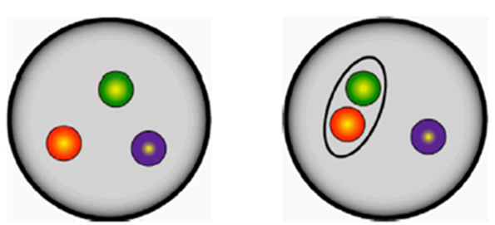
N* Program at BESIII
“Missing” baryon resonance problem: Quark models predict many more baryon resonances than have been observed.
Possible explanations:
Theoretically: Reduce the number of degree of freedom. (Quark-diquark)
Experimentally: If the missing N*s have small couplings to πN & γN, they would not have been discovered by experiments using photons or pions.
9

Slide 10


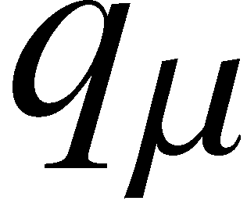
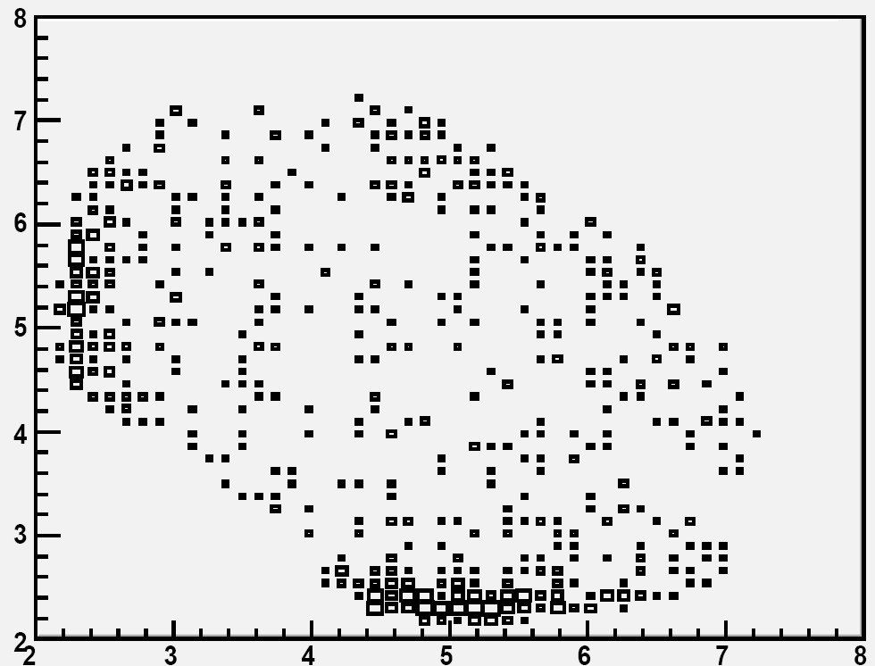
Comparison of BESIII with πN, γN at N* Study
N* knowledge primarily from πN, γN.
At BESIII
e⁺
γ*
γ
ψ (I = 0)
N
N
N*
e⁻
M²pη
1: Pure Isospin 1/2
2: Study by many decay channels,
such as π⁰N, ηN, η’N, ωN…
3: N* and N*, twice of the statistics
4: Large statistics for charmonium
states
10
M²pη

Slide 11
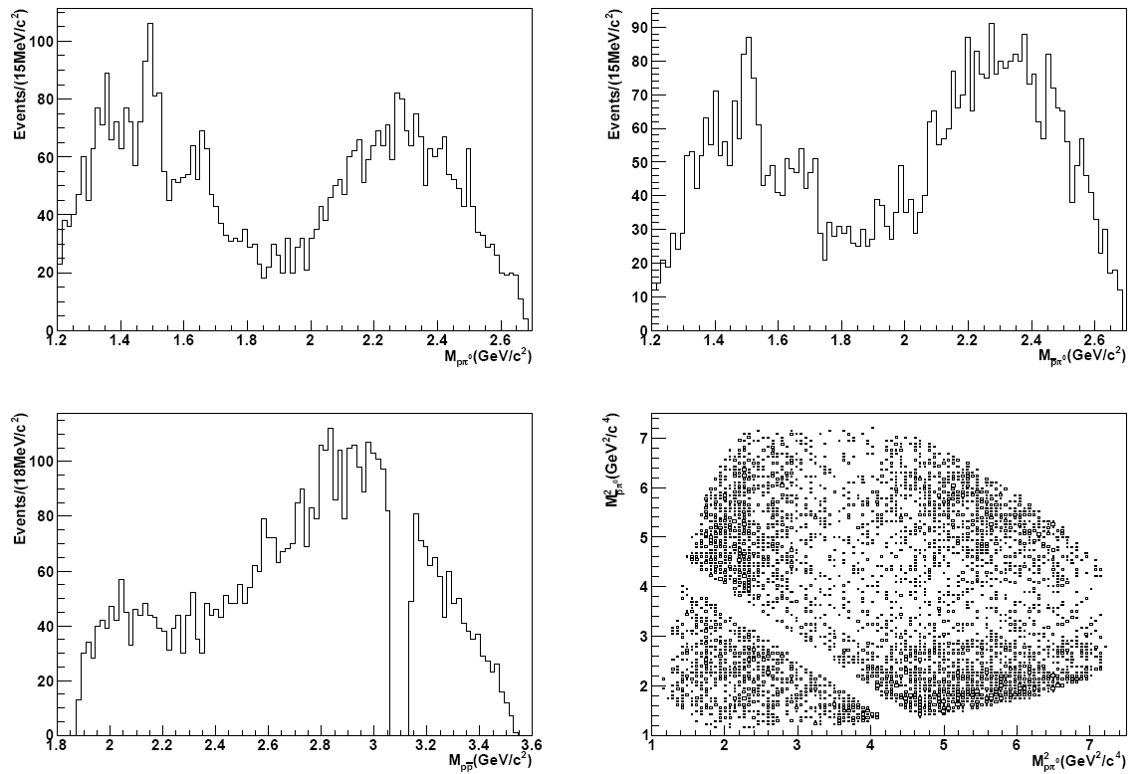



N* study at BESIII -- ψ’ → ppπ⁰
Preliminary
?
11

Slide 12
Partial wave analysis of ψ’ → ppπ⁰
A full PWA performed.
Construct amplitude A_{i}
Construct differential cross section
Construct log likelihood function
Maximize log likelihood function
Covariant tensor amplitude (S. Dulat and B. S. Zou, Eur. Phys. J A 26:125, 2005)
N* resonances up to 2200 MeV/c² with a spin up to 5/2 in the PDG considered.
(19 N* resonances)
12

Slide 13
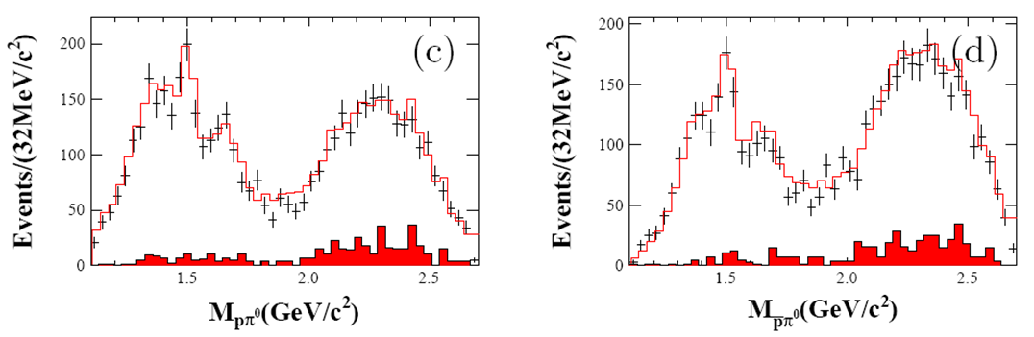
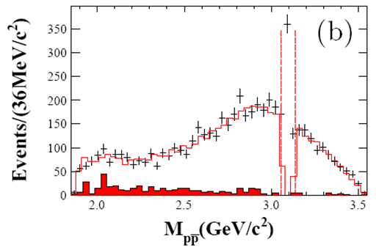
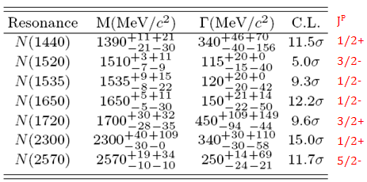
N* study at BESIII -- ψ’ → ppπ⁰
Preliminary
Preliminary

Slide 14
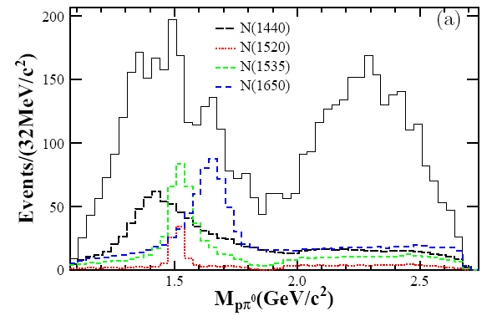
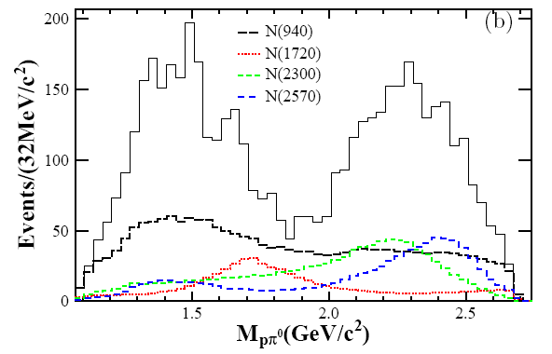
N* study at BESIII -- ψ’ → ppπ⁰
Preliminary
N(940) and 7 N* intermediate resonances significant.
No pp resonance needed.
The products of the production and decay branching fractions for each N* intermediate resonance are determined.

Slide 15
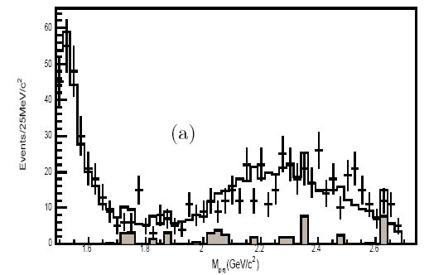
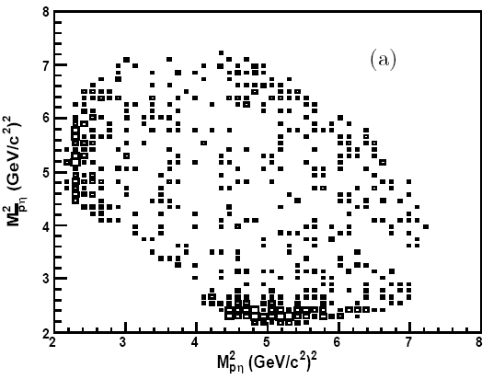
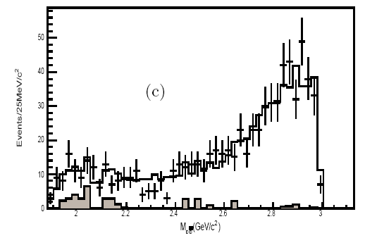
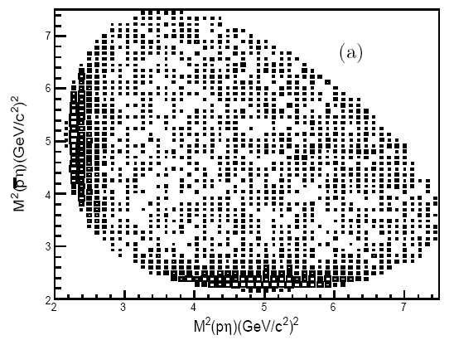
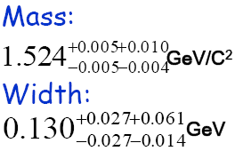

N* study at BESIII -- ψ’ → ppη
Data
A full PWA is performed.
Data & MC
Two components:
1. N(1535) ½-
2. PHSP
M_pη(GeV/c²)
Preliminary
MC
Data & MC
M_pbar η(GeV/c²)

Slide 16
Summary and Prospects
A lot of results have been obtained with the huge data samples at BESIII
X(1835) and two new structures in J/ ψ→γππη’ decays
New structure X(1870) in J/ψ → ωππη.
J^{PC}, is it X(1835)? (Need PWA)
N* baryon study in ψ’ → ppπ⁰, ψ’ → ppη
We expect rich physics results in the coming years from BESIII.

Slide 17
Thank you!

Slide 18
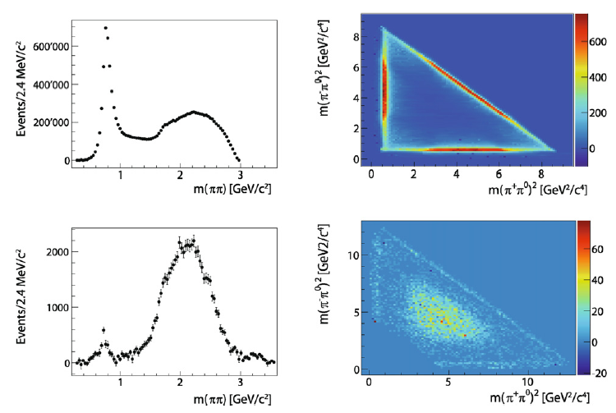
Measurement of Br(J/ψ and ψ’ → π⁺π⁻π⁰)
J/ψ → π⁺π⁻π⁰
ψ’ → π⁺π⁻π⁰
World average:
Br(J/ψ→ π⁺π⁻π⁰) =
Br(ψ’→ π⁺π⁻π⁰) =
Physics Letters B 710 (2012) 594-599

Slide 19
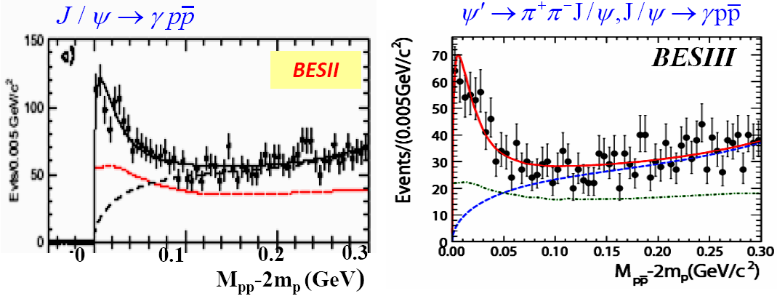
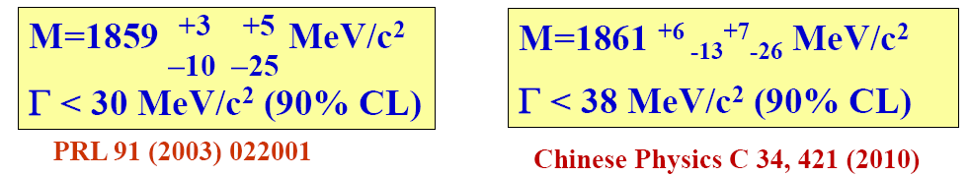
pp mass threshold enhancement in J/ψ→γpp

Slide 20
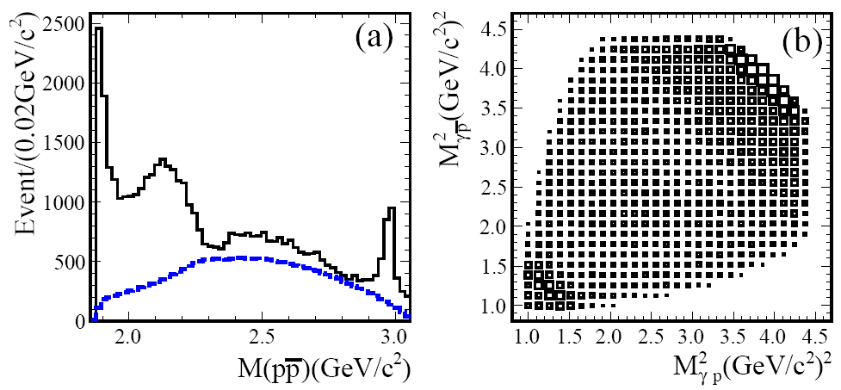
PWA on the pp mass threshold structure
X( pp )
η_{c}
Partial Wave Analysis (PWA):
Concentrate on dealing with the pp mass threshold structure,
especially to determine the J^{PC}
Covariant tensor amplitude (S. Dulat and B. S. Zou, Eur. Phys. J A 26:125, 2005)
Include the Jülich-FSI effect (A. Sibirtsev et al. Phys. Rev. D 71:054010, 2005).
PRL 108, 112003 (2012)

Slide 21
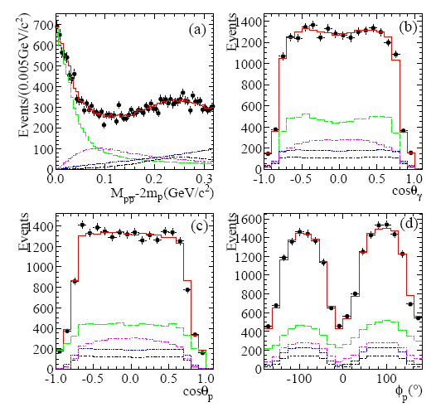
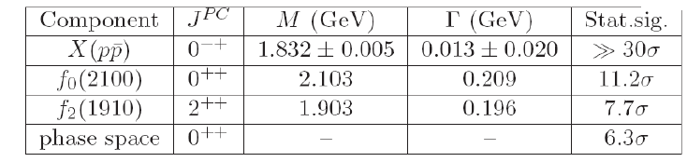

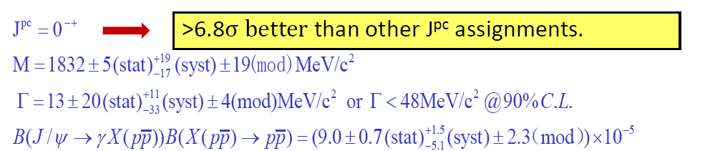
PWA results and projections
The fit with a BW and S-wave FSI factor can well describe pp mass threshold structure .
It is much better than that without FSI, Δ2lnL = 51 ➔ 7.1 σ
PRL 108, 112003 (2012)

Slide 22
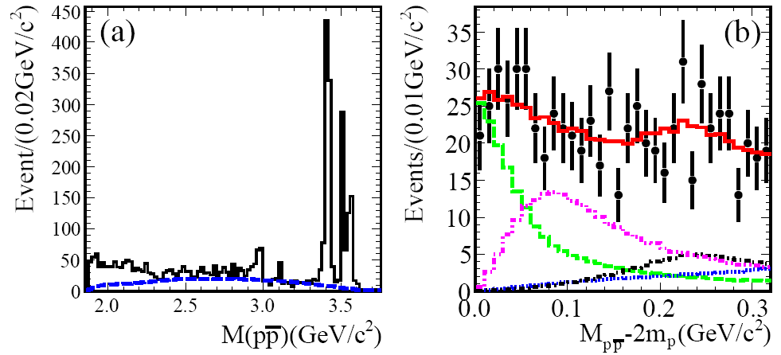
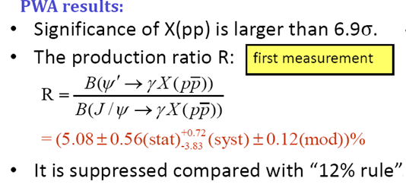
pp mass threshold enhancement in ψ’→γpp
Obviously different line shape from that in J/ ψ decays
PRL 108, 112003 (2012)

Slide 23
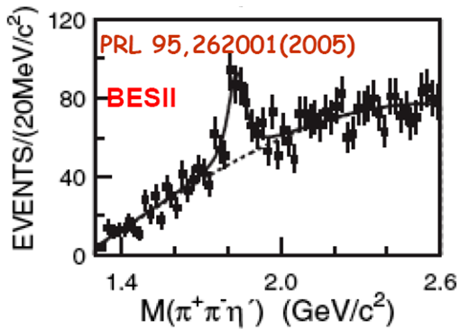
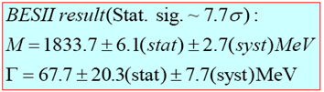
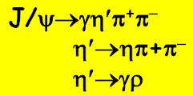
X(1835) and two new structures in J/ψ→γπ⁺π⁻η’
PRL 106, 072002 (2011)
BESIII
f1(1510)

Slide 24
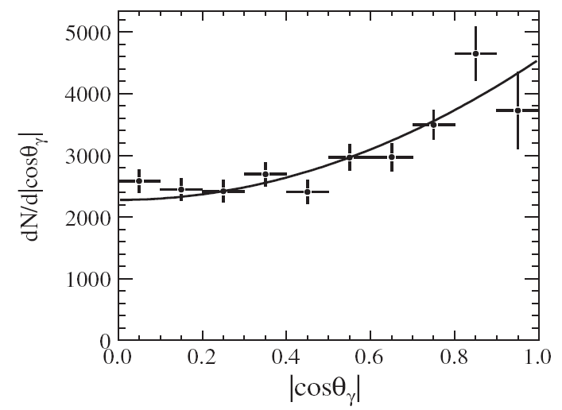


X(1835) and two new structures in J/ψ→γπ⁺π⁻η’
C.L.
5.7 σ
>20 σ
7.2 σ
6.4 σ
PRL 106, 072002 (2011)

Slide 25
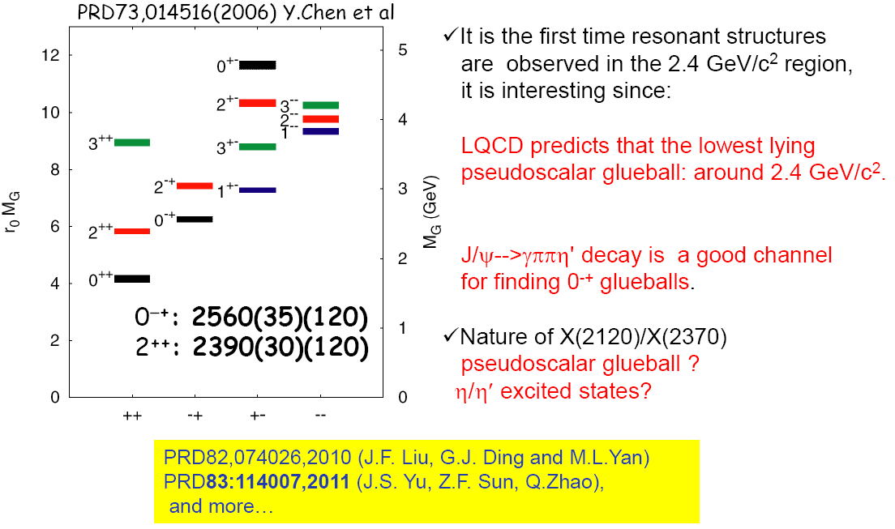
What’s the nature of the new structures?

Slide 26
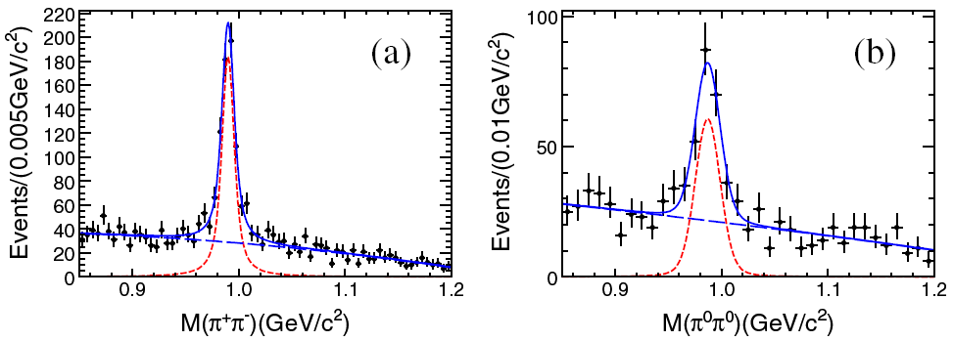
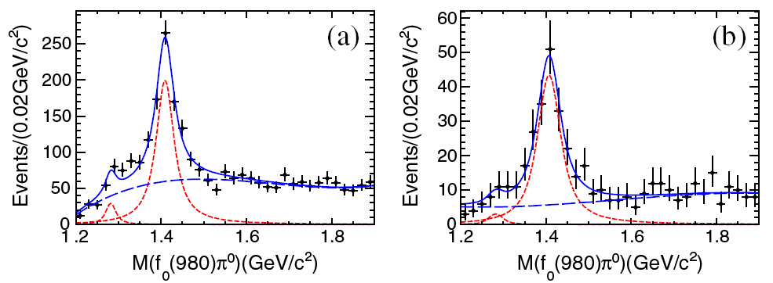
η(1405) in J/ψ → γf₀(980)π⁰, f₀(980)→ππ
f₀(980)
f₀(980)
J/ψ→γπ⁰π⁰π⁰
J/ψ→γπ⁰π⁺π⁻
First observation of
η(1405) → f₀(980) π⁰
(isospin violated)
and J/ψ→γf0(980)π⁰
η(1405): >10σ
f₀(980)→π⁺π⁻
η(1405): >10σ
f₀(980)→π⁰π⁰
Helicity analysis indicates the peak at 1400 MeV is from η(1405), not f₁(1420).
PRL 108, 182001 (2012)

Slide 27
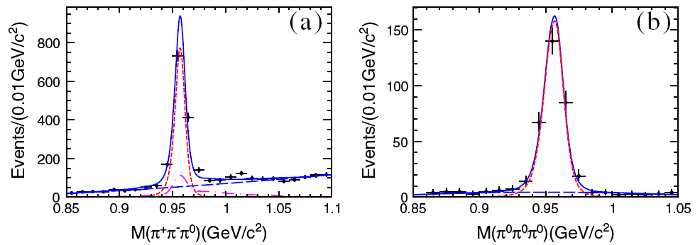
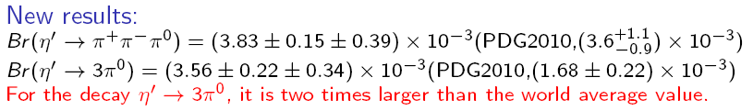
New results on η’→3π in J/ψ→γπππ
PRL 108, 182001 (2012)

Slide 28
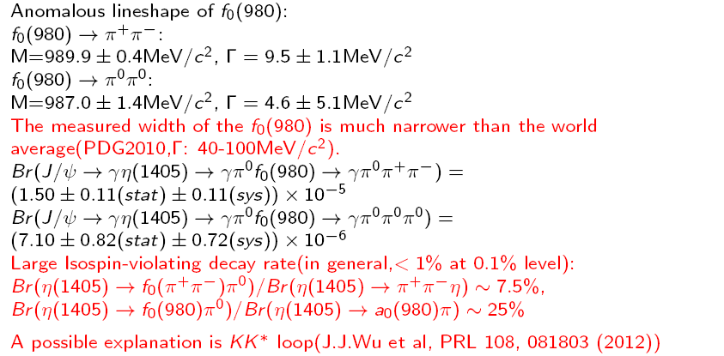

Slide 29
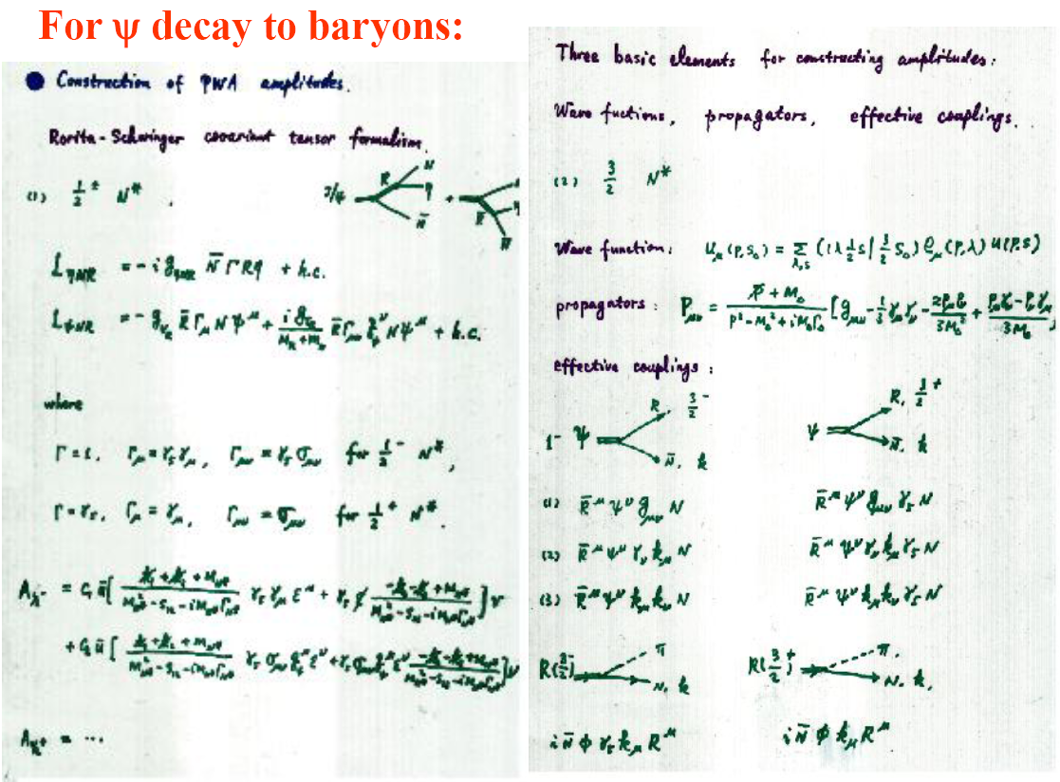

Slide 30
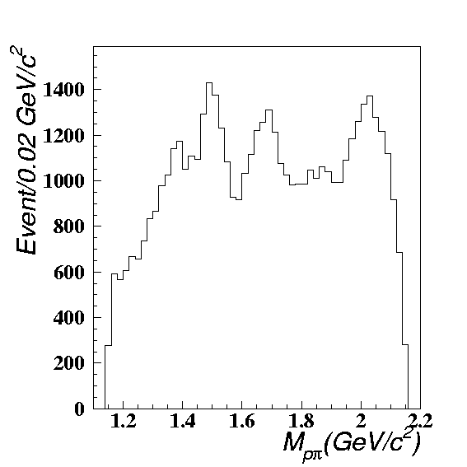
Previous result of BESII on N* Physics
Observation of N(2050)
N*(1520)
N*(1535)
N*(1650)
N*(1675)
N*(1680)
N*(1440)?
Pure Isospin 1/2
e⁺
Ψ
?
γ*
e⁻
J^{P} of N(2050): 1/2⁺ or 3/2⁺
PRL 97, 062001 (2006)

Slide 31
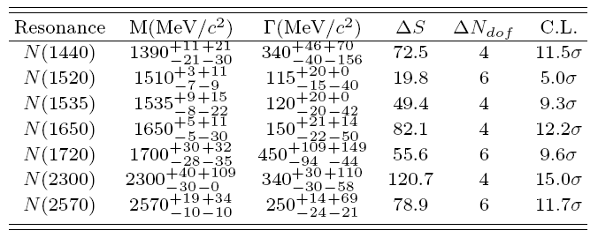
N* study at BESIII -- ψ’ → ppπ⁰
Preliminary
Preliminary
PWA results are checked carefully from different aspects:
1: J^{P} check.
2: Additional states.
3: I/O check.
4: Background level
5: BW formula
J^{P}
1/2+
3/2-
1/2-
1/2-
3/2+
1/2+
5/2-

