Slide 1
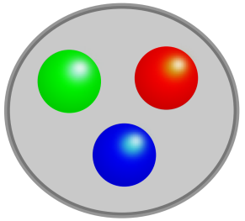
Chiral condensate in nuclear matter beyond linear density using chiral Ward identity
S.Goda (Kyoto Univ.)
D.Jido（YITP）
12th International Workshop on
Meson Production, Properties and Interaction

Slide 2
Contents
1.Introduction
・Partial Restoration of Chiral Sym.
2.Methods
・Chiral Ward identity
・In-medium chiral perturbation theory
3.Analysis and Results
4.Summary

Slide 3


Partial restoration of chiral symmetry
Partial restoration of chiral symmetry
: Reduction of
Hadron properties change!
It is important to derive the reduction of from hadron properties’ change.
Several in-medium low energy theorems are derived by using model-
independent current algebra analysis.
D. Jido, T. Hatsuda and T. Kunihiro, Phys. Lett. B 670 (2008) 109
In-medium Glashow-Weinberg relation
In-medium Gell-Mann-Oakes-Renner relation
In-medium Weinberg-Tomozawa relation
In-medium decay constant is related to isovector scattering length.
These theorems suggest that in-medium pionic observables is related to in-medium chiral condensate.
Notes:
線形密度まではいけてると書きなおすほうが良い？精密化！部分的回復はどこでみれるか？

Slide 4
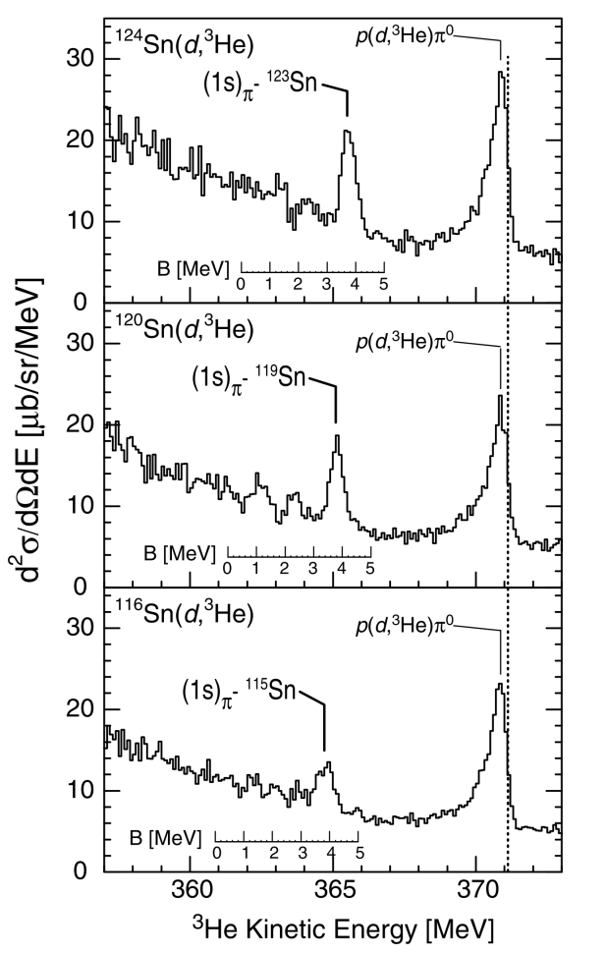
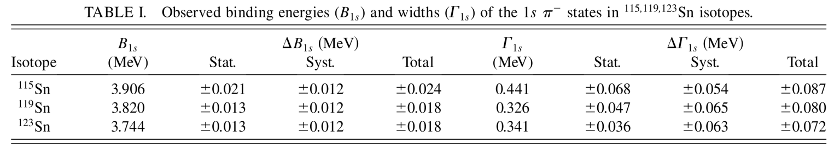
Partial restoration of chiral symmetry
Partial restoration of chiral symmetry
: Reduction of
Change of Hadron properties
This phenomenon is observed by deeply bound pionic atom.
This peak shows 1s state of pionic atom.
Binding energy and width of 1s state are determined to deduce isovector scattering length b1.
K. Suzuki et al., Phys. Rev. Lett. 92, 072302 (2004)
In-medium chiral condensate is reduced
in linear density approximation.
We want to know quantitatively
beyond linear density.
Sn(d,3He) reaction

Slide 5
Preceding Study(theory)
Linear density approximation
(model independent)
E. G. Drukarev and E. M. Levin, Prog. Part. Nucl. Phys. 27, 77 (1991)
πN sigma term : πN scattering amplitude in soft limit
Hellmann-Feynman theorem ＋ Hadronic EFT
R. Brockmann, W. Weise, Phys. Lett. B 367 (1996) 40.
N. Kaiser, P. de Homont and W. Weise, Phys. Rev. C77 (2008) 025204.
In-medium condensate is given by .
But, it is necessary to differentiate energy density wrt quark mass!

Slide 6
Motivation in this study
Partial restoration of chiral symmetry in nuclear matter beyond linear density approximation!
Our work in this talk
We analyze the density dependence of in nuclear matter beyond linear density using reliable hadronic EFT.
We show that interactions between pions and nucleons, such as pion-exchange are important to , and then can be calculated by nuclear many-body theory.

Slide 7
Chiral Ward Identity
D. Jido, T. Hatsuda and T. Kunihiro, Phys. Lett. B 670 (2008) 109
We consider following current Green fn. in 2 flavor.
：Axial current
：Pseudo-scalar current
：Nuclear matter ground state
PCAC
soft limit
This is satisfied in any state because we use only current algebras.
We calculate density dependence of chiral condensate
by using Chiral Ward identity and some hadronic theory.

Slide 8
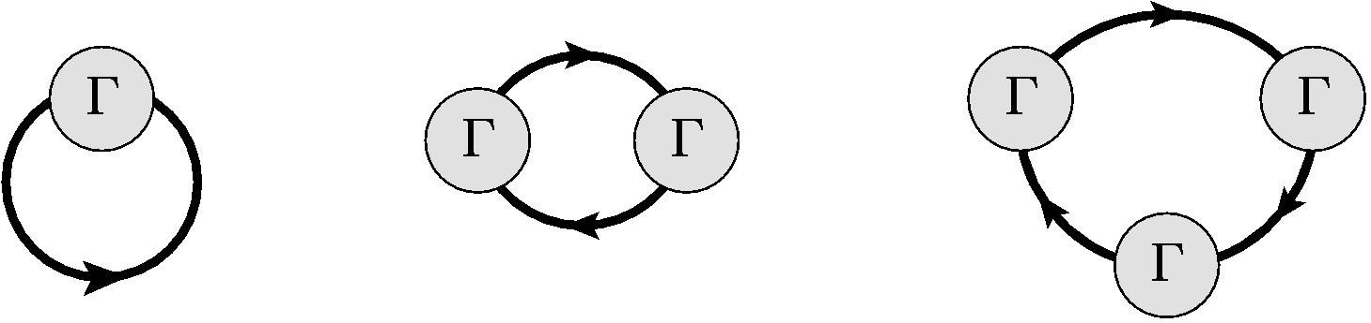
In-medium Chiral Perturbation Theory
Considering chiral effective πN Lagrangian(up to nucleon bilinear term) and ground state Fermi seas of nucleons at asymptotic time as vacuum
Nucleon field is integrated out in the Generating functional.
J. A. Oller, Phys. Rev. C 65 (2002) 025204
U. G. Meissner, J. A. Oller and A. Wirzba, Annals Phys. 297 (2002) 27
Chiral Effective Theory for in-medium pions and nuclear matter
Generating functional is characterized by
Double Expansion of Fermi sea insertion and chiral orders.
Fermi momentum of nuclear Fermi sea
A(bilinear πN chiral interaction) is subject to a chiral expansion.
Thick line : Fermi sea effect from nuclear Fermi gas

Slide 9
Power Counting Rule of in-medium CHPT
π momentum and mass are counted as O(p).
Nuclear Fermi momentum is counted as O(p).
We can perform order counting for density corrections systematically.
In-vacuum interaction is fixed by pion-nucleon dynamics.
New parameters characterizing nuclear matter is not necessary.
: chiral power of an arbitrary diagram
: the number of loops
: the number of pion propagators
: chiral dimension of π vertex
: Power of in-medium vertex
n : the number of Fermi sea insertion

Slide 10
Classification of density corrections
Chiral Ward identity
We calculate these Green fns , by in-medium CHPT.
BUT…
Axial current is coupled to pion with derivative interaction
due to chiral sym. breaking.
By taking soft limit, vanishes.
We consider only .
Notes:
かいらる極限ではAP
有限クォーク質量の場合はPPから計算できる
PCACからどちらのessentially equivalent

Slide 11
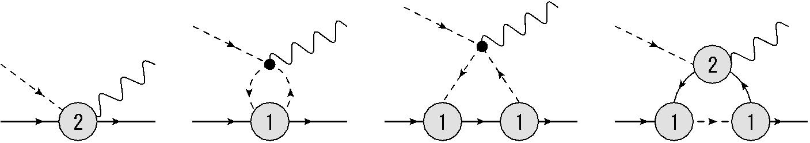
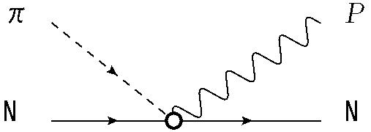
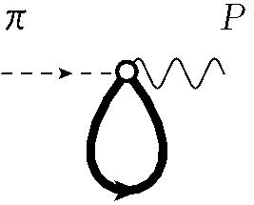
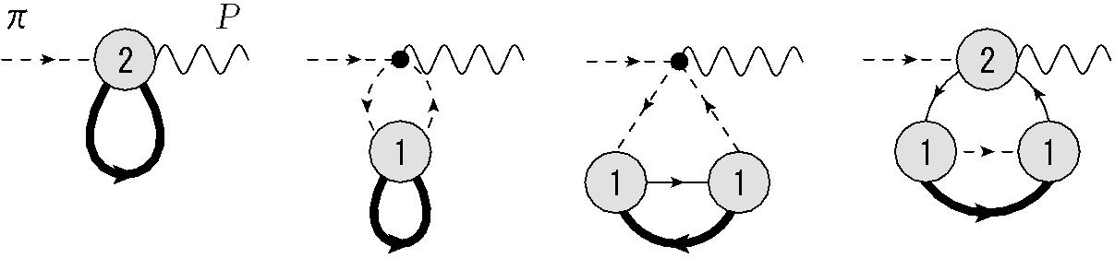
Classification of density corrections
Renormalization and physical coupling
Ex. Density corrections to πN sigma term which is pi-N amplitude in soft limit
Physical coupling
=
And then we consider density corrections
=
They have different chiral order in chiral counting,
but the same density order.
We take observed value as coupling in chiral Lagrangian and focus on density order.
Notes:
This is the meaning that parameters are fixed in vacuum.

Slide 12
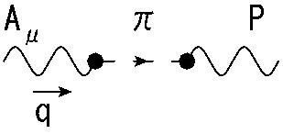
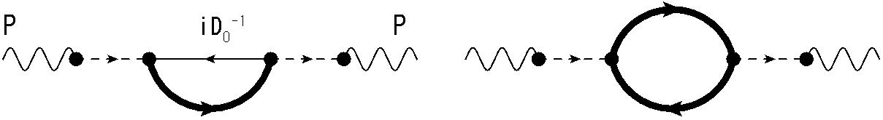
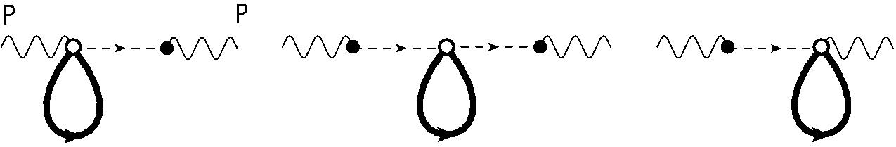
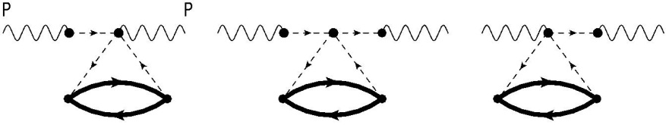
Classification of density corrections
We can classify the corrections which contribute in symmetric nuclear matter based on Density Order Counting.
In-vacuum (ν＝2)
In-vacuum condensate
ν＝4(not leading)
All diagrams vanish
in soft limit.
Leading order O(ρ)
Fermi sea effect to πN sigma term
Linear density approximation!
NLO O(ρ^{4/3})
Density correction
to through pion loop

Slide 13
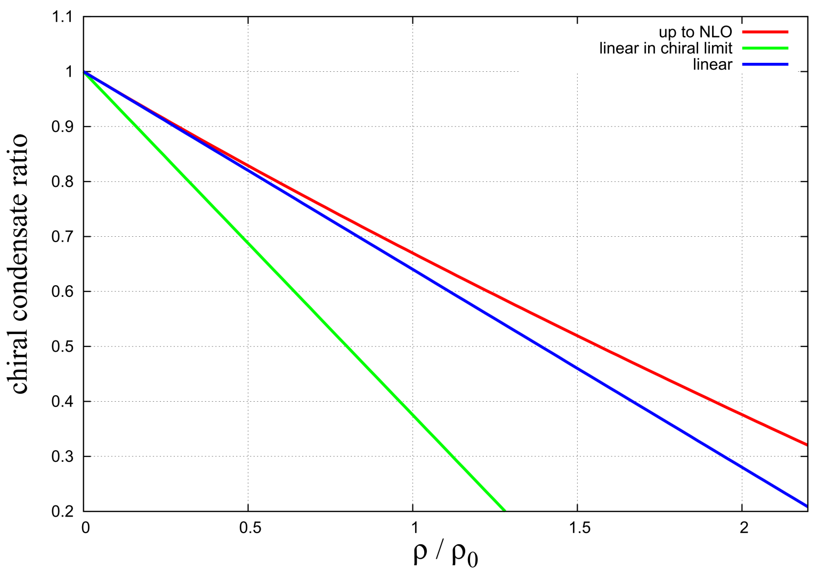
Density dependence of chiral condensate
in symmetric nuclear matter up to NLO
O(ρ)
in chiral limit
O(ρ)
off chiral limit
up to NLO
off chiral limit
Input off chiral limit
NLO
Off chiral limit
NLO effect is small around normal nuclear density.
Up to NLO, Linear density approx. is good.

Slide 14
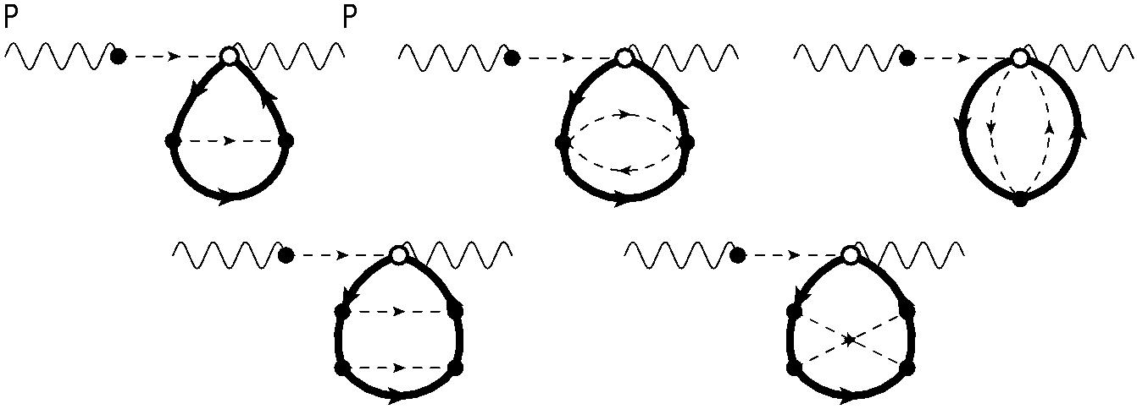
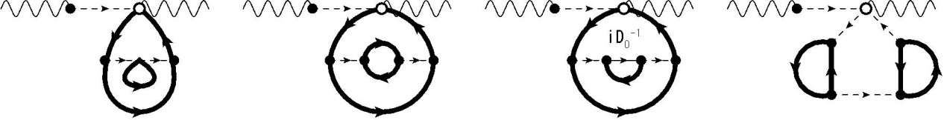
Higher order corrections beyond NLO
They come from the density corrections to πN sigma term
due to interaction between pions and nucleons.
Density corrections to 1,2 pions-exchange in Fermi gas
Density corrections to
by interactions between nucleons through pions-exchange
In higher corrections, we need nucleon contact-term couplings for renormalization.
In other words, we need not only πN dynamics, but also NN dynamics information.
We can include Δ(1232) particle in this theory.
Notes:
短距離相関のカップリングがくりこみに必要であり、それを利用すれば短距離相関の寄与もいれられる
それはNNの核力を記述するEFTから決められる
デルタやかくしの短距離相関にも言及

Slide 15
Summary
We evaluate by using chiral Ward identity and in-medium chiral perturbation theory.
We classify density corrections of the condensate based on density order counting. This suggests that interactions between pions and nucleons, such as pion-exchange are important to .
We find that NLO contribution is small and is well approximated by linear density approximation.
is determined by in-vacuum πN dynamics up to NLO, but for NNLO, nucleon correlation should be implemented into the model. This bring us unified treatment of nuclear matter based on χEFT. . These contributions can be calculated by following nuclear many-body techniques.
Outlook
We examine nucleon contact term contribution.
We calculate density corrections to other quantities, such as pion decay constant, beyond linear density.
Thank you for your attention.

Slide 17
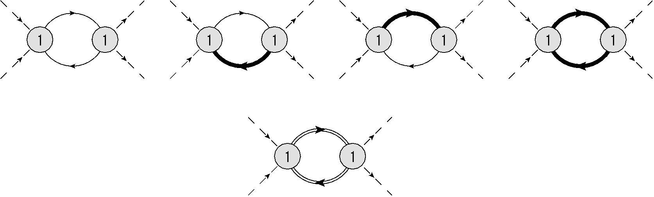
In-medium Chiral Perturbation Theory
Equivalence to conventional many-body theory
For example ππ scattering
Sum
Relativistic Fermi gas propagator
＝
＋
Calculation in this formalism is equivalent to
conventional in-medium calculation!

