Slide 1
Hadron Physics Experiments at J-PARC
- Current Status and Future Prospects
Megumi Naruki (KEK)

Slide 2
Contents
Overview of J-PARC Hadron Facility
  Facility & Physics Programs
Current Status
  beam commissioning
  spectrometer performance
Search for Pentaquark Θ⁺ in Hadronic Reaction
  J-PARC E19 experiment : π–p→K–X
  Future Plan
    other pentaquarks, tetraquarks

Slide 3
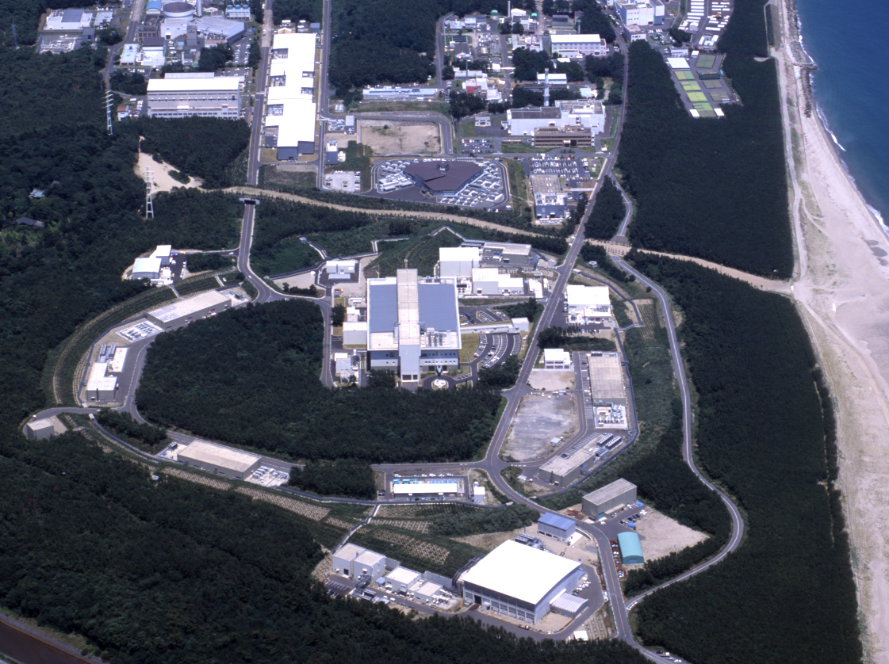
J-PARC bird’s-eye view
neutrino
400MeV
LINAC
3GeV PS (RCS)
ν
Day-I | Day-II
30 GeV 9μA (270kW) | 50 GeV 15μA (750kW)
Materials &Life Science Facility
50GeV PS (MR)
Hadron Experimental Facility
slow extraction section

Slide 4
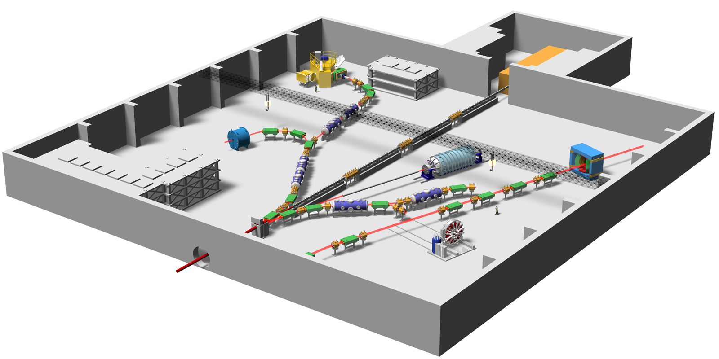
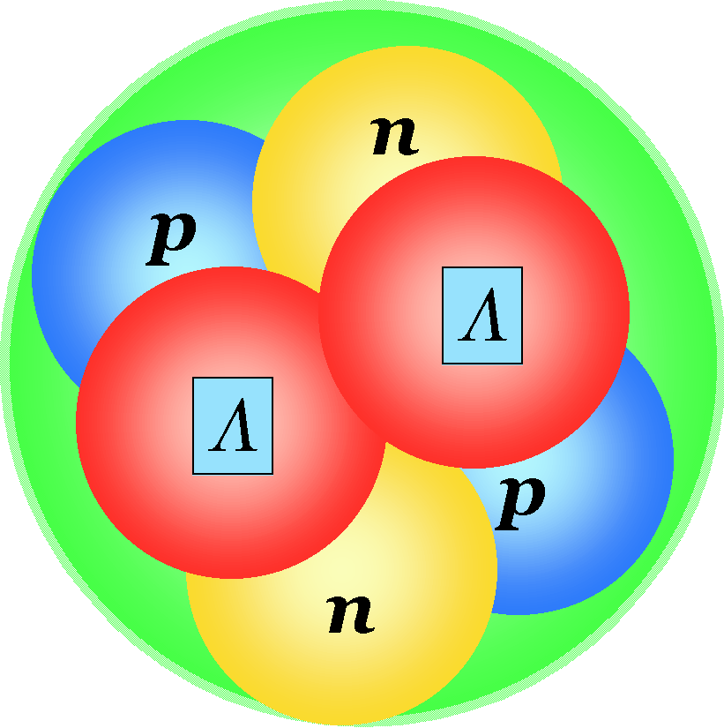
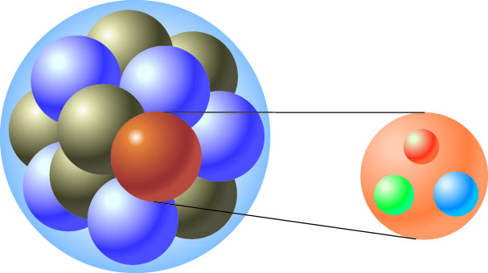
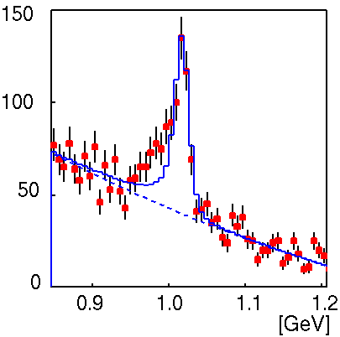
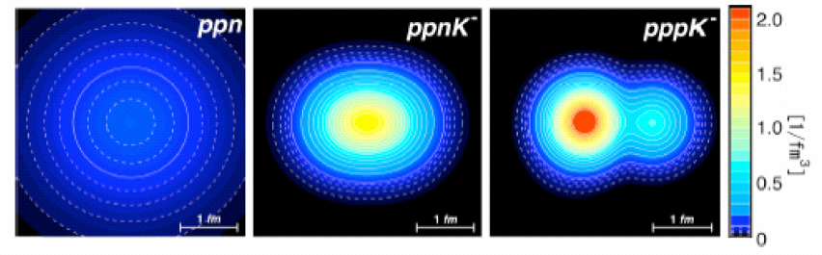
Nuclear & Hadron Physics at J-PARC
Strangeness Physics
Exotic Hadrons
Pentaquark Θ⁺
multi-strangeness
hypernuclei
double-Λ
d
_{Λ}⁶_{Λ}He
SKS
u
s
d
u
Λ,Ξ
K1.8
KL
K1.8BR
K1.1
High momentum
Ｋ⁻ atom
K1.1BR
φ(1020)
φ
nuclei
Ｘ ray
kaonic atom
Origin of Hadron Mass
kaonic nuclei

Slide 5
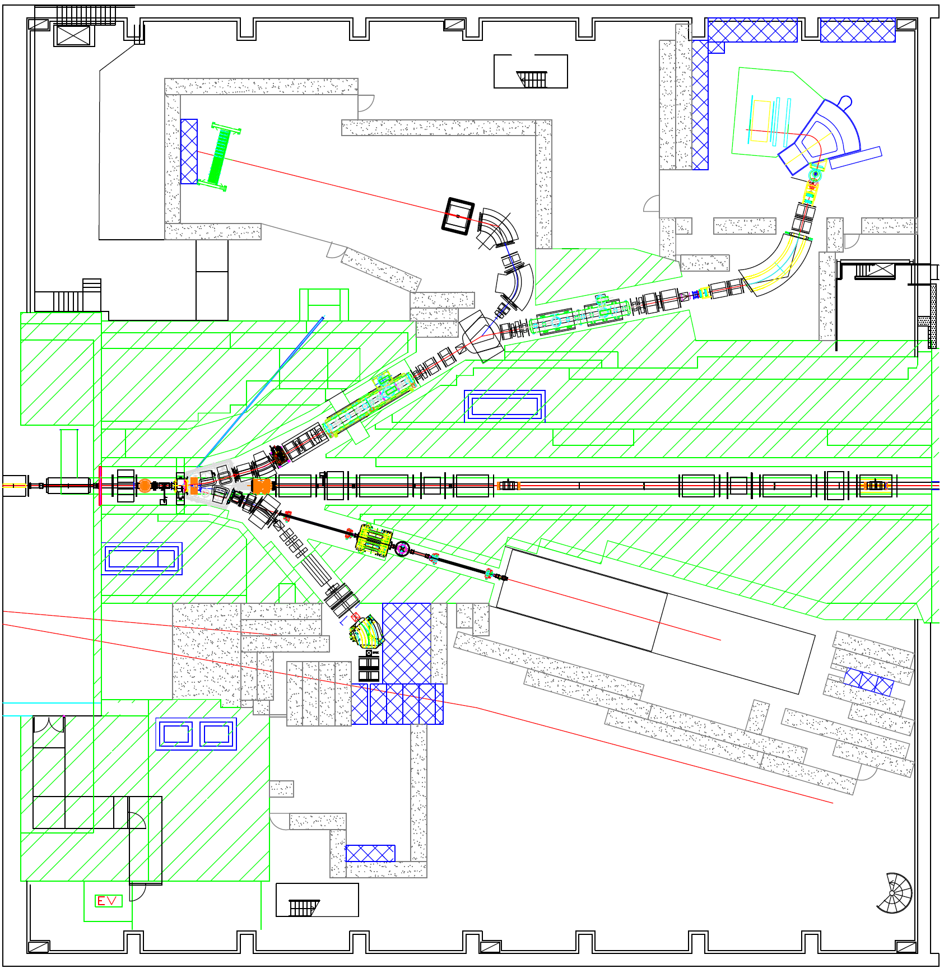
Hadron Experimental Facility
High Intensity Kaon Beams
K1.8BR
p_{max} = 1.1 GeV/c
I_{K}~10⁶ ppp
Large Exp. Area
K1.8
Production Target
Loss of 30%
p_{max} = 2.0 GeV/c
I_{K}~10⁶ ppp
Double-stage
Electrostatic Separators
proton
KL
K1.1BR
primary proton
p_{max} = 51 GeV/c
I_{p}~10^{9~12} ppp
p_{max} = 0.8 GeV/c
I_{K}~10⁶ ppp
high momentum

Slide 6
----J-PARC PAC Approval summary after the 6th meeting --­
 | Spokespersons | Affiliation | Title of the experiment | Approval status | Slow line priority |  | Beamline
 |  |  |  |  | Day1? | Priority
E15 | M.Iwasaki, T.Nagae | RIKEN, KEK | A Search for deeply-bound kaonic nuclear states by in-flight 3He(K⁻, n) reaction | Stage 2 | Day1 |  | K1.8BR
E17 | R.Hayano, H.Outa | U. Tokyo, RIKEN | Precision spectroscopy of Kaonic 3He 3d->2p X-rays | Stage 2 | Day1 |  | K1.8BR
E31 | H. Noumi | Osaka U. | Spectroscopic study of hyperon resonances below KN threshold via the (K -,n) reaction on Deuteron | Stage1 |  |  | K1.8BR
E03 | K.Tanida | Kyoto U | Measurement of X rays from Ξ⁻ Atom | Stage 2 |  |  | K1.8
E05 | T.Nagae | KEK | Spectroscopic Study of Ξ-Hypernucleus, 12 ΞBe, via the 12C(K⁻, K⁺) Reaction | Stage 2 | Day1 | 1 | K1.8
E07 | K.Imai, K.Nakazawa, H.Tamura | Kyoto U., Gifu U., Tohoku U. | Systematic Study of Double Strangeness System with an Emulsion-counter Hybrid Method | Stage 2 |  |  | K1.8
E08 | A.Krutenkova | ITEP | Pion double charge exchange on oxygen at J-PARC | Stage 1 |  |  | K1.8
E10 | A. Sakaguchi, T. Fukuda | Osaka U | Production of Neutron-Rich Lambda-Hypernuclei with the Double Charge-Exchange Reaction (Revised from Initial P10) | Stage 2 |  |  | K1.8
E13 | T.Tamura | Tohoku U. | Gamma-ray spectroscopy of light hypernuclei | Stage 2 | Day1 | 2 | K1.8
E18 | H.Bhang, H.Outa, H.Park | SNU, RIKEN, KRISS | Coincidence Measurement of the Weak Decay of 12 _{Λ}C and the three-body weak interaction process | Stage 1 |  |  | K1.8
E19 | M.Naruki | RIKEN | High-resolution Search for Θ⁺ Pentaquark in π ⁻p → K⁻X Reactions | Stage 2 | Day1 |  | K1.8
E22 | S. Ajimura, A.Sakaguchi | Osaka U | Exclusive Study on the Lambda-N Weak Interaction in A=4 Lambda-Hypernuclei (Revised from Initial P10) | Stage 1 |  |  | K1.8
E27 | T. Nagae | Kyoto U. | Search for a nuclear Kbar bound state K-pp in the d(π⁺,K⁺) reaction | Stage 1 |  |  | K1.8
E14 | T.Yamanaka | Osaka University | Proposal for KL -> π⁰ ν ν-bar Experiment at J-PARC | Stage 2 |  |  | KL
E06 | J.Imazato | KEK | Measurement of T-violating Transverse Muon Polarization in K⁺ -> π⁰ µ + ν Decays | Stage 1 |  |  | K1.1BR
E16 | S.Yokkaichi | RIKEN | Electron pair spectrometer at the J-PARC 50-GeV PS to explore the chiral symmetry in QCD | Stage 1 |  |  | High pt

Slide 7
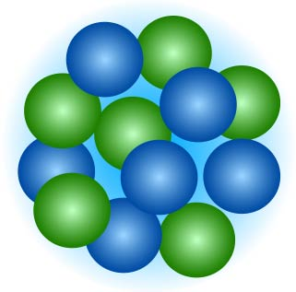
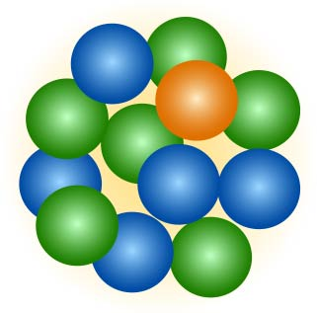
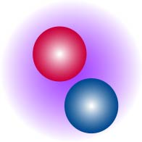
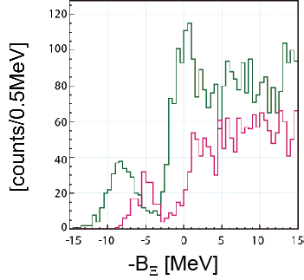
Double-Strangeness Hypernuclei
J-PARC E05 Experiment
high intensity kaon beam (K1.8) + SKS spectrometer
Ξ－（dss)
Expected Spectrum
K－
s
K＋
－
－
u
s
u
nuclei
12C
Ξ-hypernuclei
discovery of Ξ-hypernculei
Ξ-nucleus interaction
  structure of the neutron star
  explore multi-strangeness hadronic systems
green: Ξ-nucleus potential = 20MeV
magenta: Ξ-nucleus potential = 14MeV

Slide 8
T. Hiraiwa, Parallell A1, Friday
A search for deeply bound kaonic nuclear states
by in-flight ³He(K⁻,n) reaction
J-PARC E15 Experiment @ K1.8BR
prediction for nucleon density distribution by AMD
ρ ~ 10ρ₀ :
extremely dense system
  Does the deeply bound state really exists?
A.Dote et al., PRC70 (2004) 044313.
K⁻
³He
K⁻pp
neutron
Missing mass
Spectroscopy
via neutron
Λ
proton
decay
π⁻
Invariant mass
reconstruction
clarify the kaon nucleus interaction quantitatively
proton

Slide 9
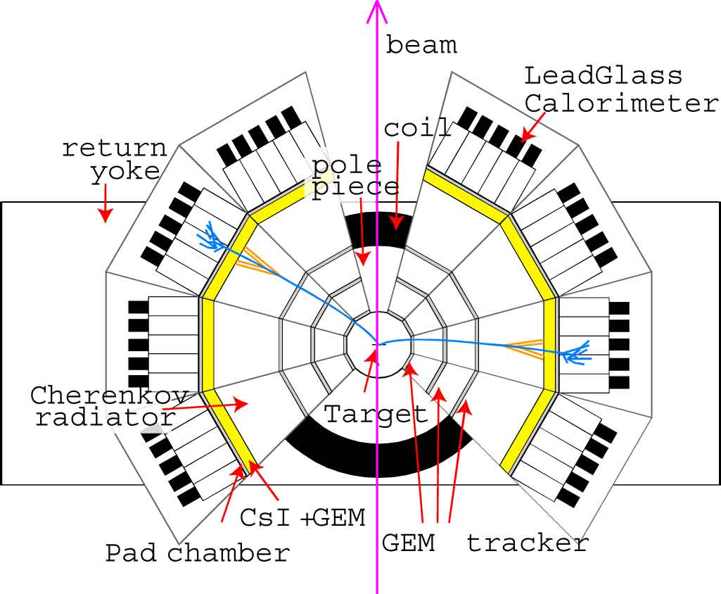
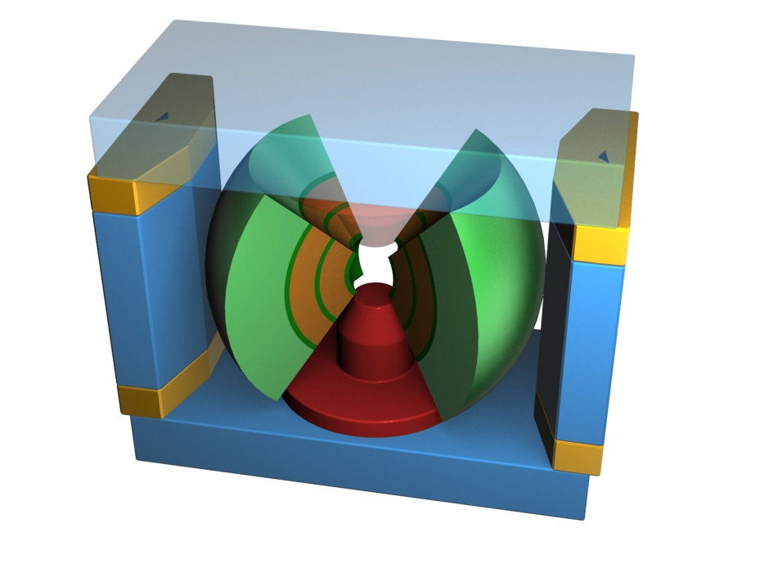
Origin of Hadron Mass - J-PARC E16 -
In Vacuum
In Hot/Dense Matter
spontaneous breaking of chiral symmetry
u
u
d
u
d
u
Current quarks ~ 5 MeV/c²
Hadrons ~ 1000 MeV/c²
Constituent quarks ~ 300 MeV/c²
→ vector meson mass in nuclear matter
e⁻
proton
φ
e⁺
nuclear target(p,C,Pb)
high momentum beamline + E16 Spectrometer

Slide 10
Beam Requests from Stage-2 Experiments
30 GeV, 9μA = 270 kW, 2 x 10¹⁴ protons/3.6s
K1.8 (SKS)
 |  | Beam Power [kW] | Period [days] | Protons on Target
E03 | X rays from Ξ⁻ Atom | 270 | 33 | 1.6 x 10²⁰
E05 | Ξ-Hypernucleus | 270 | 28 | 1.4 x 10²⁰
E07 | Double Strangeness with Emulsion | 56 | 25 | 2.5 x 10¹⁹
E10 | Λ-Hypernuclei | 3.2 | 42 | 2.4 x 10¹⁸
E13 | Gamma-ray spectroscopy of light hypernuclei | 270 | 42 | 2.0 x 10²⁰
E19 | Θ⁺ Pentaquark | 3.2 | 14 | 8.1 x 10¹⁷

Slide 11
Beam Requests from Stage-2 Experiments
30 GeV, 9μA = 270 kW, 2 x 10¹⁴ protons/3.6s
K1.8BR
 |  | Beam Power [kW] | Period [days] | Protons on Target
E17 | Kaonic 3He | 270 | 3.5 | 1.7 x 10¹⁹
E15 | deeply bound kaonic nucleus | 270 | 28 | 1.4 x 10²⁰
KL
 |  | Beam Power [kW] | Period [days] | Protons on Target
E14 | Kaon Rare Decay | 270 | 350 | 1.7 x 10²¹

Slide 12
Milestone
First Beam Extraction 2009/1/27
First Kaon Beam 2009/3
Completion of K1.8 beamline 2009/10
Construction of K1.1BR beamline
high momentum beamline ？
Extension of Hadron Hall ？？

Slide 13
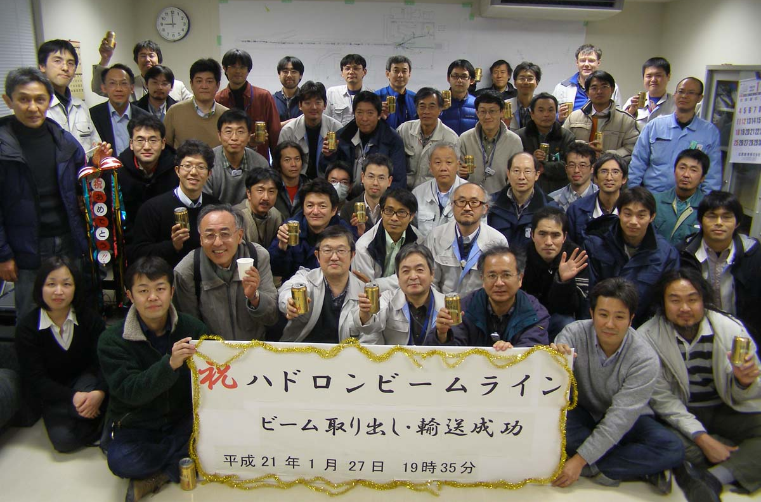
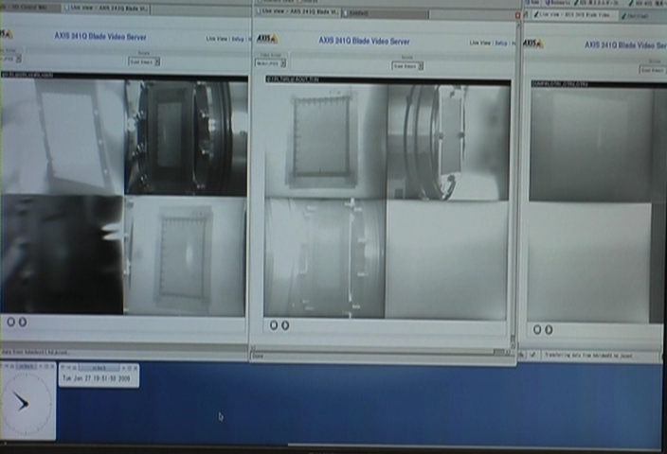
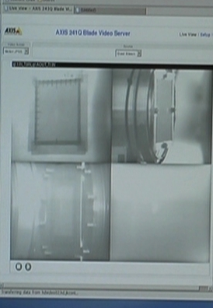
The First Shot 2009/1/27
1 (q01in)
2 (q02in)
5 (q11in)
6 (T0in)
9 (Dump in)
3 (v04in)
4 (V06in)
7 (q1Aout)
8 (T1in)

Slide 14
Milestone
First Beam Extraction 2009/1/27
First Kaon Beam 2009/3
Completion of K1.8 beamline 2009/10
Construction of K1.1BR beamline
high momentum beamline ？
Extension of Hadron Hall ？？

Slide 15
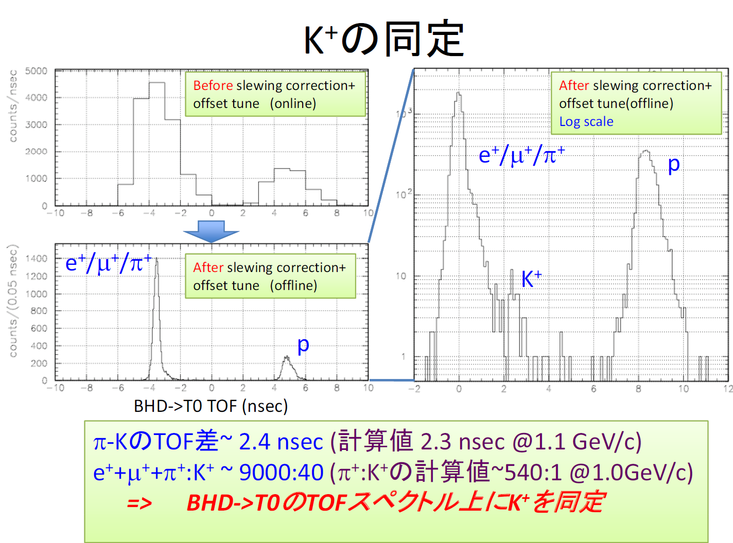
The First Kaon at J-PARC
time difference between π & K ~ 2.4nsec (Expected: 2.3 nsec @ 1.1 Gev/c
e⁺+μ⁺+π⁺:K⁺ ~ 9000:40 (Expected : π⁺:K ⁺ ~ 540:1 @ 1.0 GeV/c)
→ Identify K ⁺ on TOF the spectrum
Beamline Tuning @K1.8BR 2009/2
By T. Suzuki

Slide 16
Milestone
First Beam Extraction 2009/1/27
First Kaon Beam 2009/3
Completion of K1.8 beamline 2009/10
Construction of K1.1BR beamline
high momentum beamline ？
Extension of Hadron Hall ？？

Slide 17
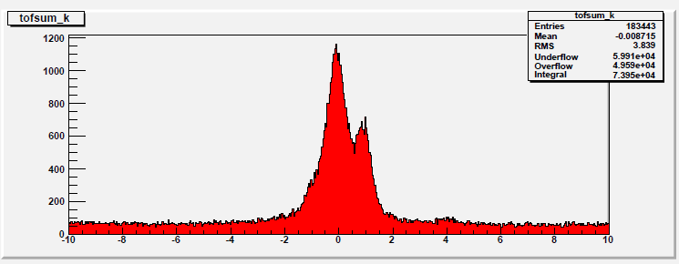
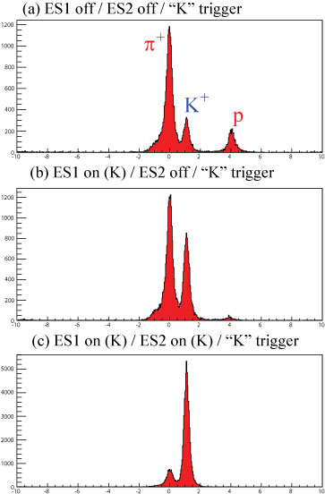
– Purity & Yield at Kaons @ K1.8
TOF of beam particle in “K” trigger
ES1/ES2 OFF
20.5%
π⁻
K⁻
p
ES1 ON
ES2 OFF
38.5%
K- : 7k/2.5E+12 ppp
K+ : 40k/2.5E+12 ppp
consistent with design value
ES1/ES2 ON
83.4%
8% in non-biased trigger
*still rough tuning
K/π will be much more improved

Slide 18
Milestone
First Beam Extraction 2009/1/27
First Kaon Beam 2009/3
Completion of K1.8 beamline 2009/10
Construction of K1.1BR beamline
high momentum beamline ？
Extension of Hadron Hall ？？
now

Slide 19
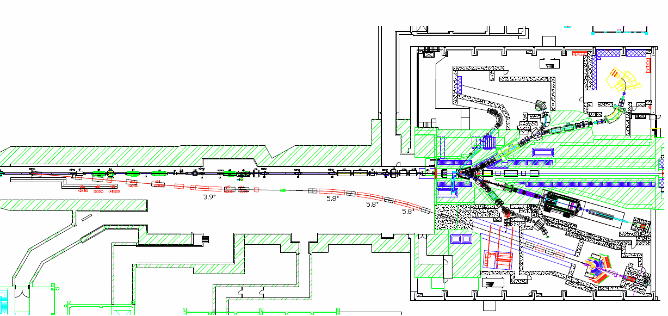
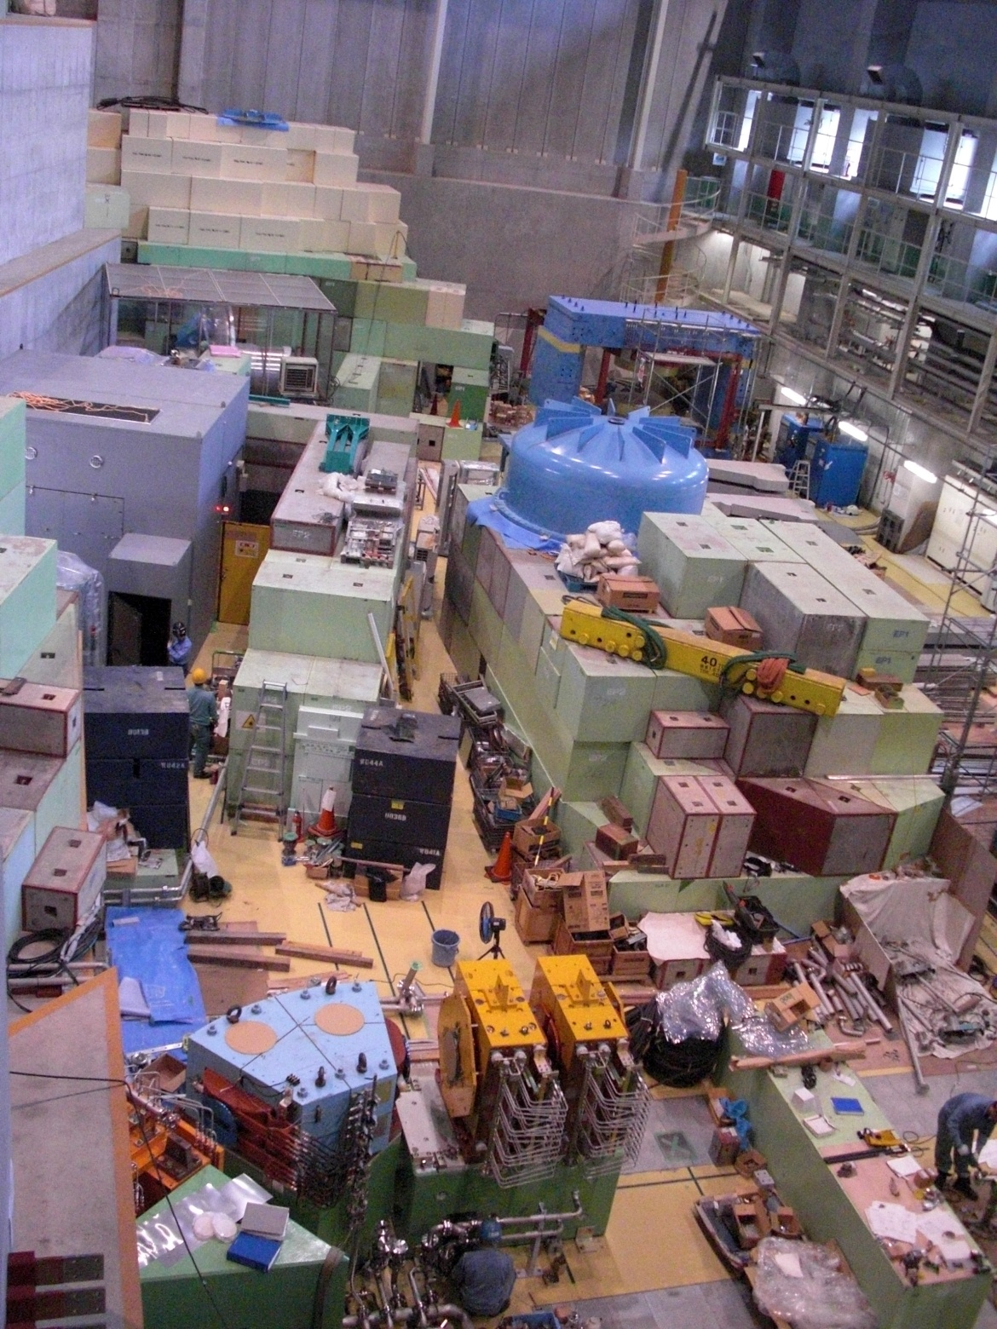
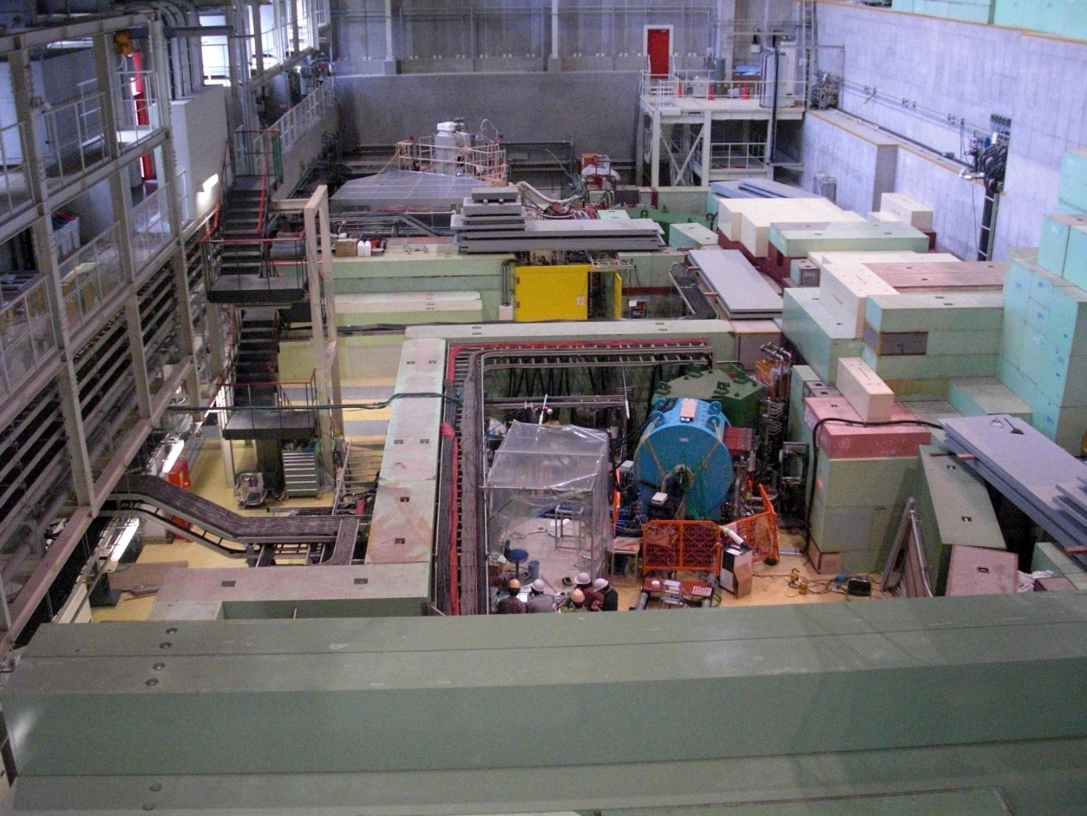
South part
North part
KL
SKS
High Momentum
K1.8BR
K1.1BR

Slide 20
Milestone
First Beam Extraction 2009/1/27
First Kaon Beam 2009/3
Completion of K1.8 beamline 2009/10
Construction of K1.1BR beamline
high momentum beamline ？
Extension of Hadron Hall ？？
now

Slide 21
High Momentum Beamline
SM1: branched by 5°
Vertical Bend
3.9°
5.8°x3
Experimental Area
beam dump

Slide 22
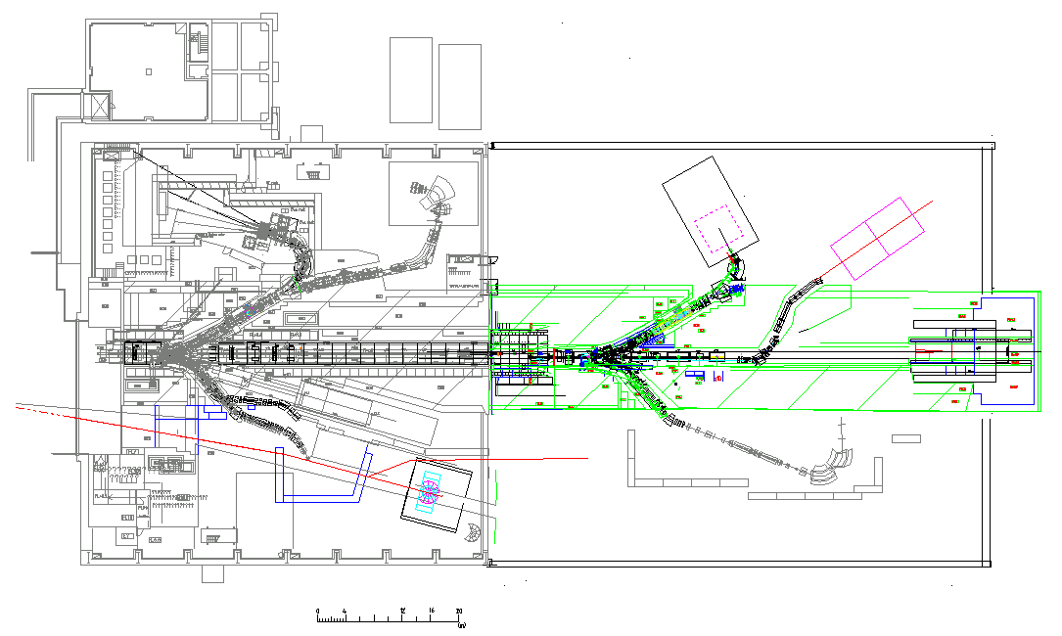
Phase II : Hall Extension

Slide 23
E19 experiment
K1.8BR
K1.8
proton
K1.1BR
KL

Slide 24
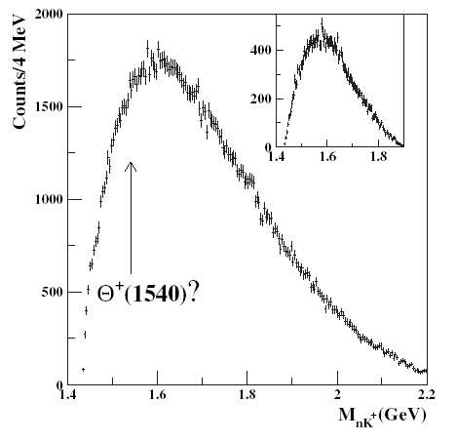
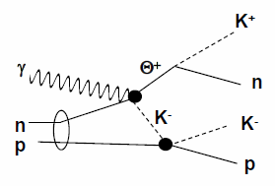
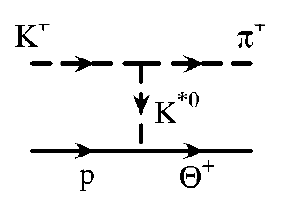
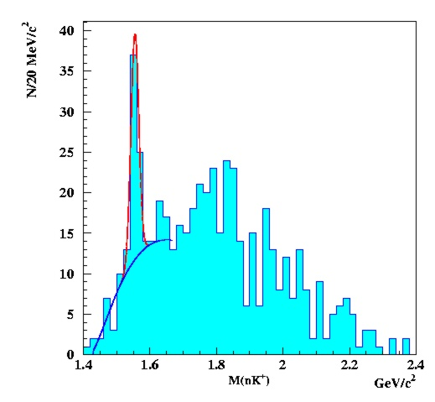
Production Mechanism
PRL 96, 042001 (2006)
CLAS-d | γd → pK⁻K⁺(n) | U.L. ~3nb for γn
LEPS | γC → K⁻K⁺(n) | 4.6σ
consistent with each other: since there is strong angle / energy dependence.
CLAS-p | γp → KºKN | U.L. 0.8nb
E559 | K⁺p → p⁺X | U.L. 3.5 μb/sr
it implies a very small coupling to K*. g_{NK*Θ+} ∼ 0
Θ⁺ production in hadronic reaction
γ
CLAS
PRL 92 032001 (2004)
π⁺
small angle dependence
inverse proportion to energy
π⁻
K⁻
K⁺
proton
n
cf: γ p → π⁺ K⁻ K⁺ (n)
Θ⁺
n

Slide 25
KEK-PS E522 experiment
if exist
Θ⁺ search via π–p→K–X
  K2 beamline + KURAMA
beam momentum : 1.87, 1.92 GeV/c
target : Polyethylene
intensity : 3.3 X 10⁵ π– /spill
beam time : 32 hours for each momentum → ~ 7 X 10⁹ π⁻
Mass resolution : 13.4MeV(FWHM)
p_{π}=1.92 GeV/c
a bump was observed
at M =1530.8MeV/c2
at p_{π}=1.92 GeV/c
but : S/N = 2.5σ
upper limit : dσ/dΩ < 2.9μb/sr
dσ/dΩ = 1.9 μb/sr
→ σ_{tot} = 2.9 μb

Slide 26
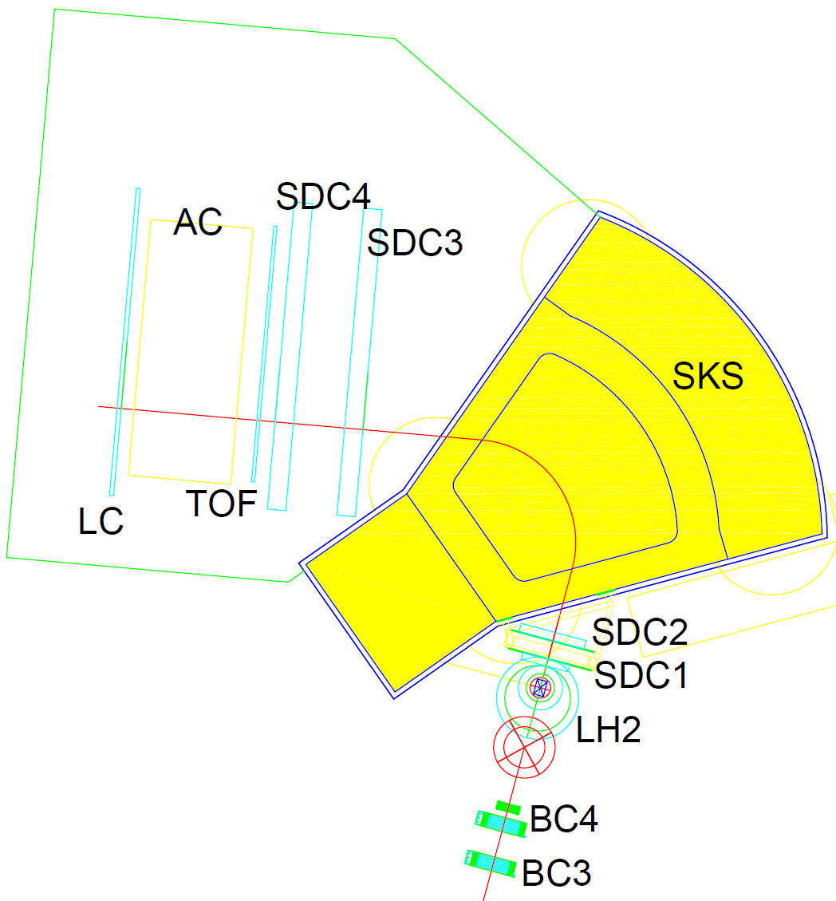
J-PARC E19 experiment
Magnetic Field: 2.4T
Acceptance : 0.1sr
Weight : 300 tons
K1.8 beam line + SKS
2GeV/c π⁻ + p → K⁻ + Θ⁺
target : liquid H₂, reuse E559’s
SKS :
  momentum coverage : 0.7-0.95GeV/c
  angle coverage ≤ 20°
  p_{scattered} up to ~ 1.1 GeV/c
  dp/p ~ 0.2% @ 1GeV/c
(~5 times better than KURAMA)
  ΔM = 2.5MeV FWHM
ideal for Θ⁺ detection
K⁻
2GeV/c π⁻

Slide 27
Expected Missing Mass Spectrum
1.9μb/sr
KEK PS E522
significance : 62σ assuming
Γ < 2MeV
σ = 1.9μb
main contributions come from;
φ : | φn → K⁺K–n | 30.0±8.0 μb
Λ : | Λ(1520)K⁰ → K–K⁰p | 20.8±5.0 μb
phase space : | K–KN | 26 μb
sensitivity
75nb/sr

Slide 28
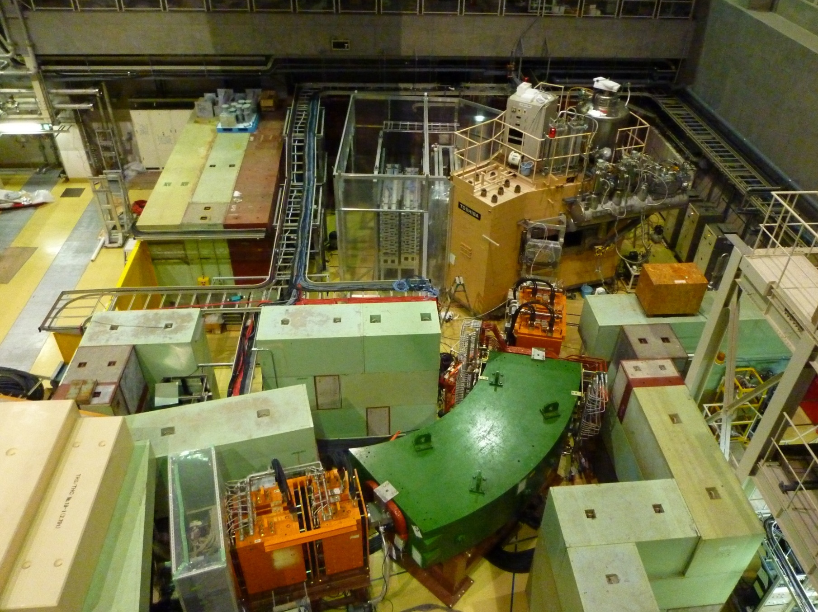
SKS Spectrometer
Q13
Q12
K1.8 Beam Spectrometer
D4
Q10
Q11

Slide 29
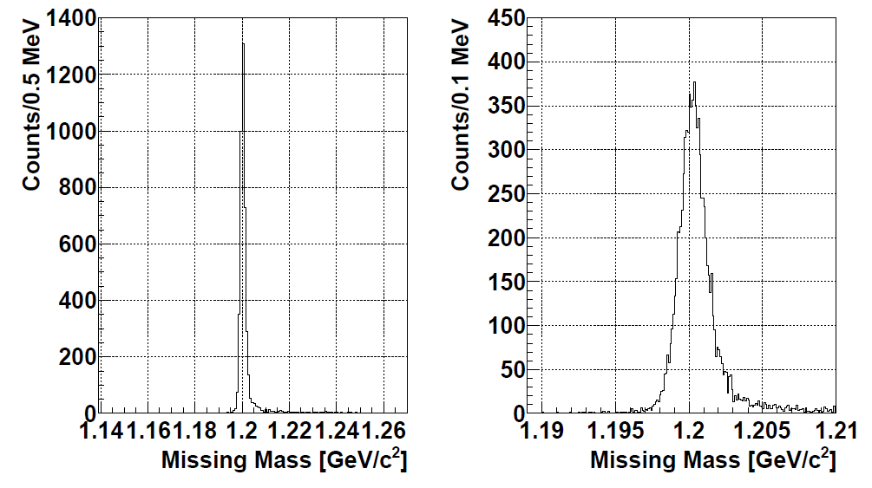
Spectrometer Performance
p(π⁻,K⁺)Σ⁻ @1.25GeV/c
Σ⁻
Target: Liq-H2(0.86 g/cm2 )
(750k/spill x 18hour)
Expected:
Δp/p(Beam) = 3.3x10⁻⁴(FWHM)
Δp/p(SKS) = 4.5x10⁻³(FWHM)
Measured:
ΔM = 1.66±0.05 MeV (FWHM)
Δp_{SKS} ~3.3 MeV/c (FWHM) @ 0.7 GeV/c
ready for E19!
M = 1.201 GeV (1.1974 GeV)
for p(π⁻, K⁻)Θ⁺ @1.92 GeV/c : ΔM ~1.76 MeV

Slide 30
In FUTURE…
other pentaquarks: cascade Ξ₅⁻⁻(1862) , charmed Θ⁰_{c}(3100)
  K⁻n→Ξ⁻⁻K+, p_{th}=2.4GeV
  pp→ppΘ⁰_{c}X, p_{th}=12.3GeV
tetraquark: Q⁺(udss) , Θ⁺ “family”
  Y. KANADA-En’yo et. al. : J^{p}=1⁺ , M=1.4GeV, Γ=20~50MeV, Q⁺→K⁺K⁺π⁻
  Burns et al. : J^{p}=1⁻ , M=1.6GeV, Γ<100MeV
  Karliner & Lipkin : J^{p}=0⁺
    K⁺p→K⁺pQ⁺ X p_{th}=3.7GeV
    K⁺p→ΛQ⁺ X p_{th}=2.8GeV
    K⁺p→Σ⁺Q⁺ p_{th}=3GeV
Notes:
.

Slide 31
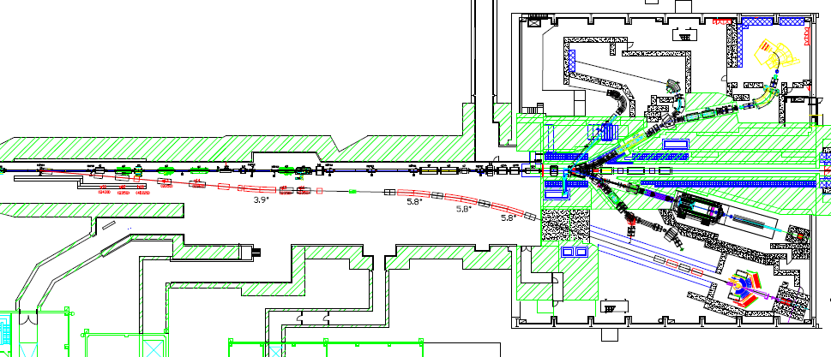
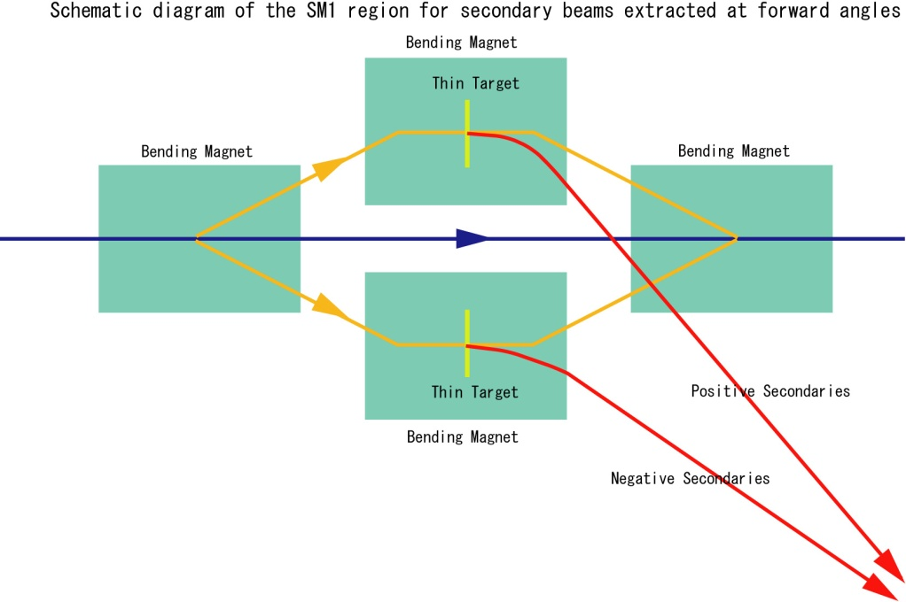
High momentum secondary beams at high-p beam line
SM1: branched by 5°
Vertical Bend
3.9°
5.8°x3
Secondary Beams:
  Use a thin (2% = 15kW loss) target at SM1
  Collect them at forward angles
  Transport them for ~120m

Slide 32
Power upgrade plan of SX
 | Beam intensity |  |  | Spill structure
JFY | Key components | Users operation [kW] | Accelerator study [ kW] | Key components | Duty [%]
2010 | Dynamic bump | 5 | 10 | Feedback system Ripple canceller | 15+α
2011 | SX collimator | 10 | 20 | RQ Power supply | 30
2012 | Ti chambers Local shields | 20 | 30 | Main Power Supplies ? | > 30
2013 |  | 30 | > AGS power
2014 |  | > AGS power

Slide 33
Summary
Current Status
  K and p Yield is consistent with the expectation
  Spectrometer performance is good enough to reach the expected sensitivity.
J-PARC E19 searches for Θ⁺ in π–p→K–Θ⁺ raction
  K1.8 beamline + SKS is ideal for Θ⁺
  significance ~60σ, sensitivity ~75nb/sr
  with mass resolution of 2.5MeV(FWHM)

Slide 34
Bakups

Slide 35
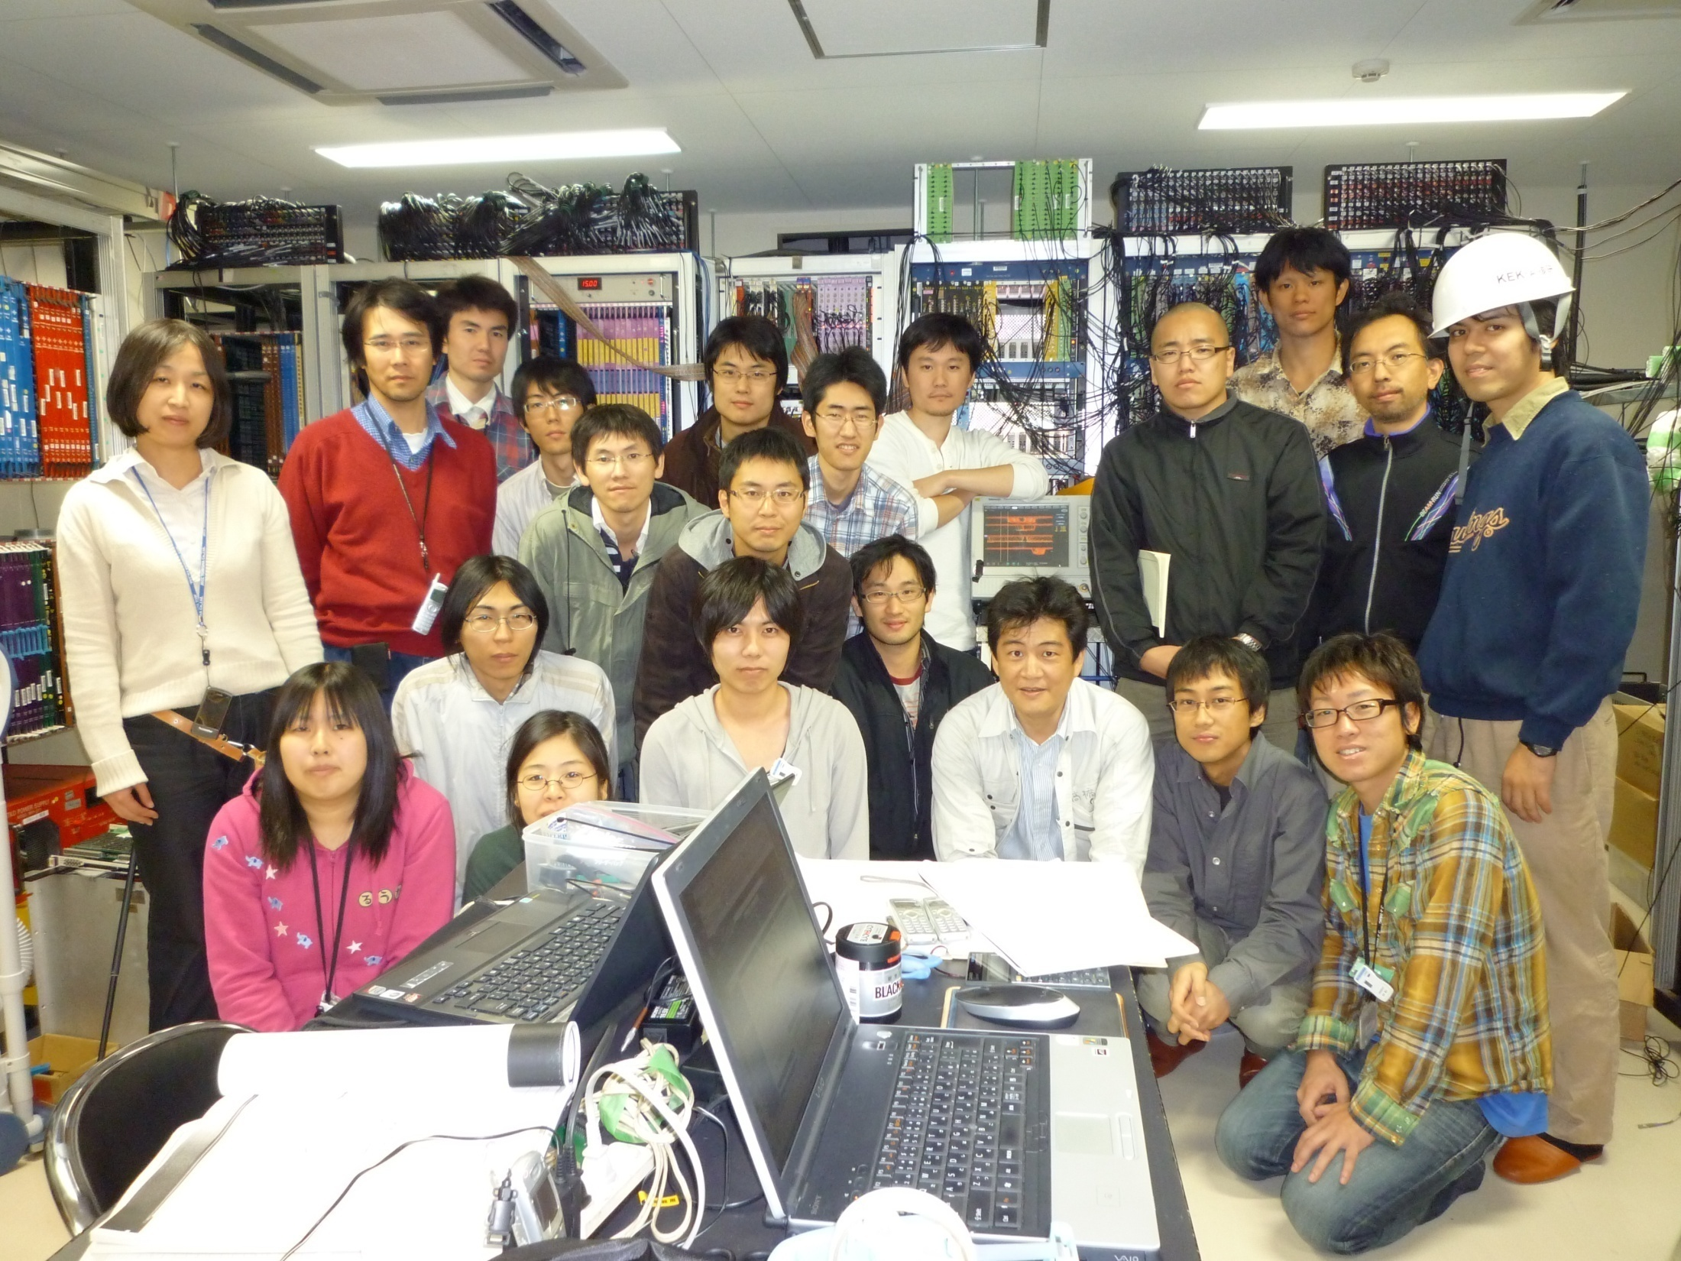

Slide 36
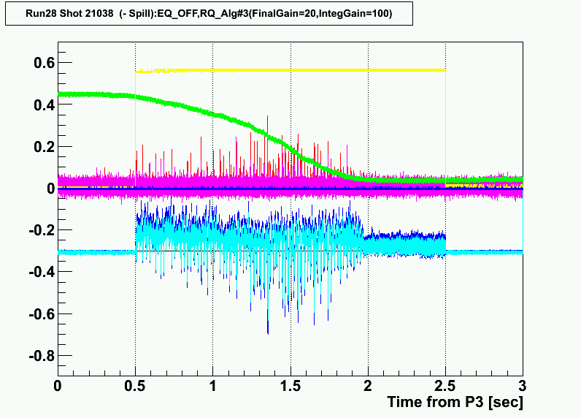
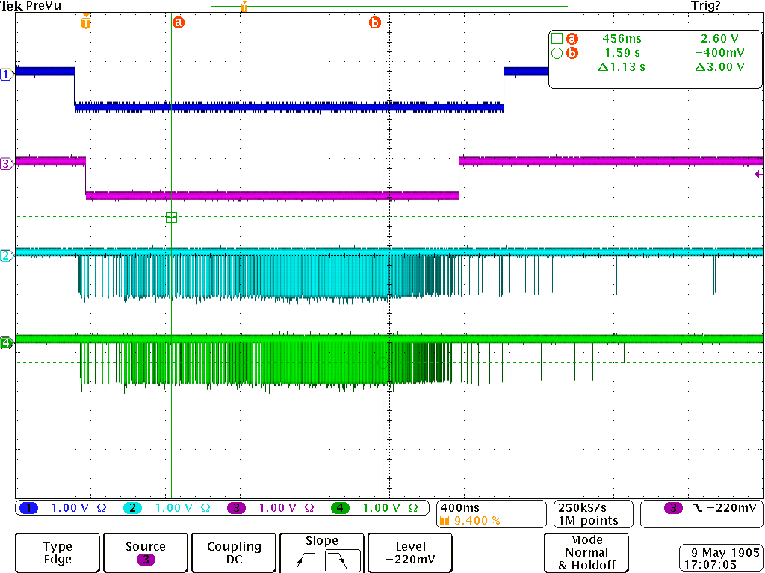
EQ off
RQ Algorithm#3
Main Gain = 20
Int. Gain = 100
Spill Structure
Shot#21025

